Slide 1
Contribution of Rome to Western Civilizations
World History
SOL WHI 6j

Slide 2
Essential Question
How did Roman achievements influence western civilization?

Slide 3
Art/Architecture

Slide 4


Slide 5


Slide 6
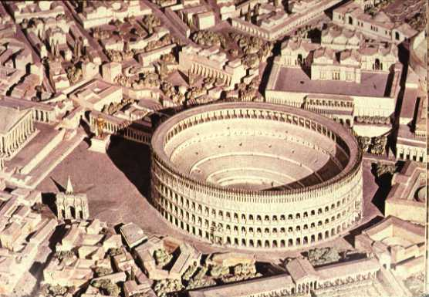

Slide 7
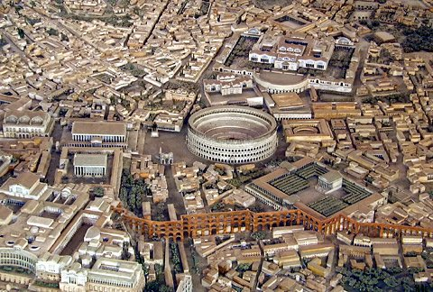

Slide 8
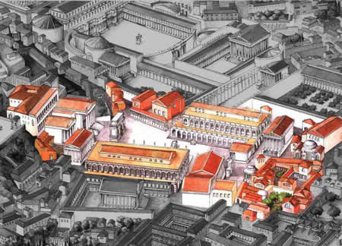

Slide 9
Roman technology

Slide 10
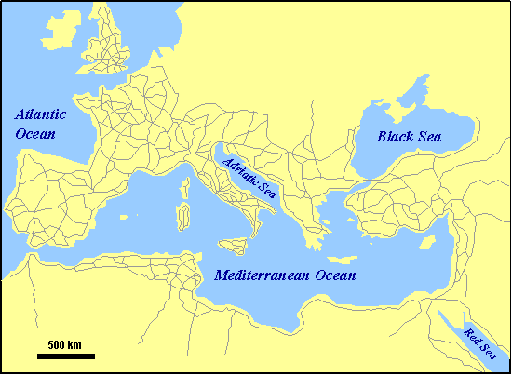

Slide 11


Slide 12
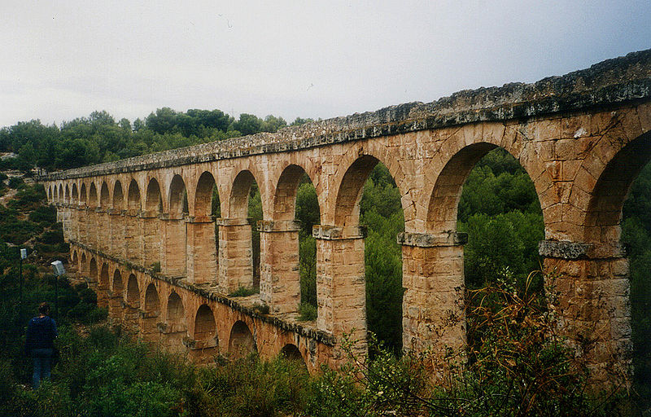

Slide 13


Slide 14
Science and medicine
Ptolemy was a famous Roman scientist who wrote books on optics, mathematics, astronomy, and music.
Roman medicine emphasized public health and public structures such as baths, medical schools, and sanitation networks were common.

Slide 15


Slide 16


Slide 17


Slide 18

Romance Languages

Slide 19
Literature

