Slide 1
Christianity
World History
SOL WHI 6h, i

Slide 2
Essential Questions
How did Christianity become established within the Roman Empire?
What were the essential beliefs of the early Christian faith?
How and why did Christianity spread?
What was the impact of the early church in the late Roman Empire?

Slide 3
Major Beliefs

Slide 4
Jesus
Christianity was founded by Jesus Christ, who was born into a Jewish family in Bethlehem around 4 BCE. Growing up he studied Jewish law and at the age of 30 he began preaching
He recruited 12 close followers called disciples
Some thought he challenged the authority of Rome and Jewish leaders and he was arrested and crucified
According to Christians he rose from the dead several days later and ascended to heaven

Slide 5
Bible

Slide 6
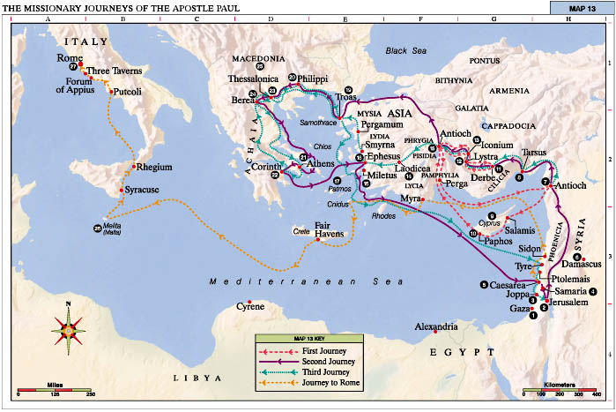

Slide 8
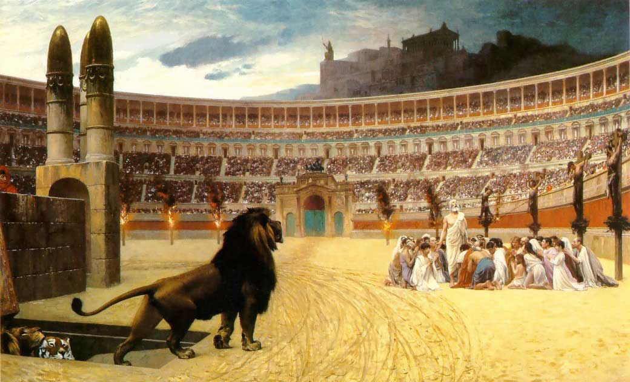

Slide 9
Why did Christianity Spread?

Slide 10
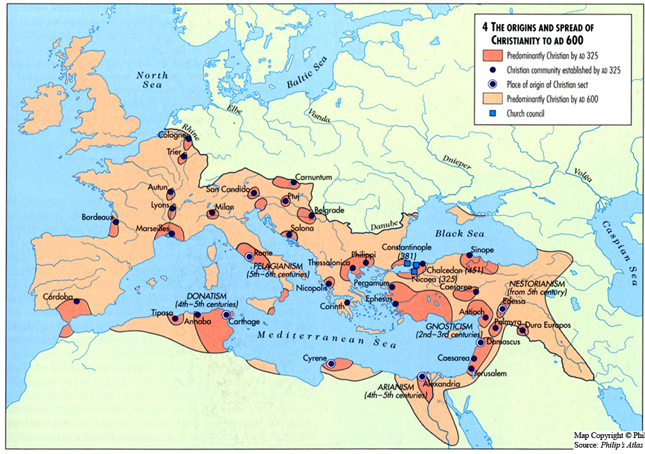

Slide 11
Church Structure

Slide 12
Christianity
The Roman Emperor, Constantine, was the first emperor to convert to Christianity
In 313 CE, he issued the Edict of Milan
The Edict of Milan made Christianity legal
Christianity became the state religion of Rome in 380 CE

Slide 13
Christianity
The Christian church became a source of moral authority and loyalty to the church became more important than loyalty to the emperor
When the Western Roman Empire began to fragment and weaken in the late 5th century the Christian Church, became the unifying force in Western Europe

