Slide 1
Decline and Division of the Roman Empire
SOL WHI 6k

Slide 2
Essential Questions

Slide 3
Decline
The Roman Empire created a widespread civilization and expanded over a period of about 500 years
The Roman Empire had some bad emperors but it had many more good emperors until 200 CE
After 200 CE a series of poor emperors and other problems caused the Western Roman Empire to eventually collapse and cease to exist

Slide 4
Causes for Decline

Slide 5
Causes for Decline

Slide 6
Size

Slide 7
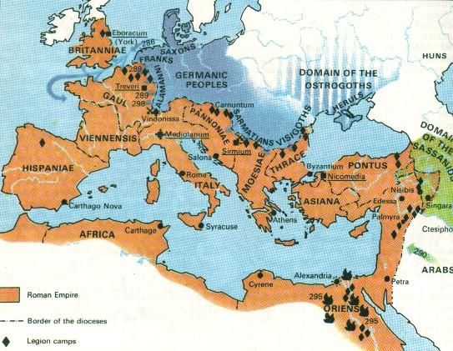

Slide 8
Economy

Slide 9
Political Problems
As the government became more authoritarian and oppressive it lost the support of the people
Growing numbers of corrupt officials undermined loyalty
Civil wars over the succession of emperors weakened the military

Slide 10
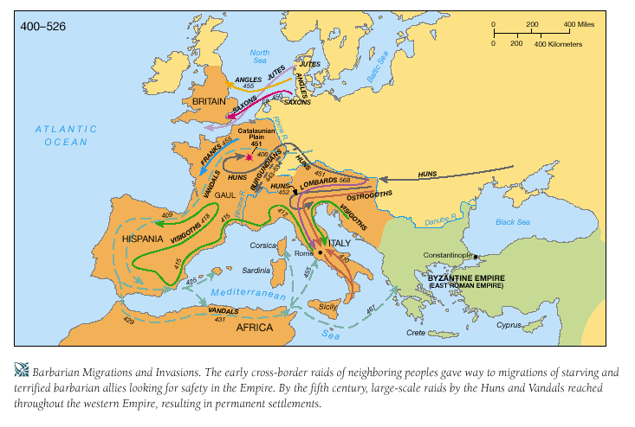

Slide 11
Division
Several strong emperors after 200 CE tried to reverse the decline of Rome
Diocletian (284 – 305) – divided the empire into two parts to make it easier to govern
Constantine (306 – 337) moved the capital of Rome to Constantinople on the Bosporus near the Black Sea

Slide 12
