Slide 1
Roman Empire
World History
SOL WHI 6e, f, g

Slide 2
Essential Questions
Why did the Roman Republic fail to survive challenges by Julius Caesar?
How did military conquests alter economic and social life in Rome?
How did an imperial monarchy come to rule Rome?
What was the Pax Romana?

Slide 3
Decline of the Republic

Slide 5
Decline of the Republic
Rome became crowded and riots between rich and poor increased
Values of the Republic such as simplicity, hard work, and devotion declined
Influx of gold and loot from conquered territories devalued Roman currency and created inflation
Corruption and greed increased

Slide 6
Rise of the Empire
Julius Caesar was a popular general and politician who wanted to reform the Republic and become emperor
First Triumvirate – He formed a political partnership with two other wealthy Romans, Pompey and Crassus
Julius Caesar took his army to Gaul and conquered the territory of modern France. His army was loyal to him rather than the Senate

Slide 7
1st Triumvirate

Slide 8
Rise of the Empire
The Senate, fearing Caesar’s power, ordered him to return to Rome
Caesar ignored the order and seized Rome with his army
Caesar kept the Senate and officials of the Republic but he was named dictator for life
Caesar was assassinated in 44 BCE in the Senate

Slide 9
2nd Triumvirate

Slide 10
Rise of the Empire
After Caesar was assassinated his grand nephew, Octavian, formed the 2nd Triumvirate but eventually there was a civil war
Octavian defeated Marc Antony in the civil war and proclaimed himself Augustus Caesar in 31 BCE

Slide 12
Pax Romana
200 year span from Augustus to Marcus Aurelius is known as the period of the Pax Romana or “Roman Peace”
Roman rule brought peace, prosperity, and unity
Trade increased in the Mediterranean and over the Silk Road

Slide 13
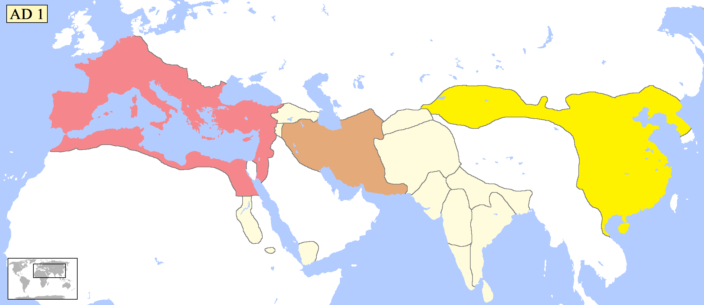

Slide 14
PAX romana

Slide 15
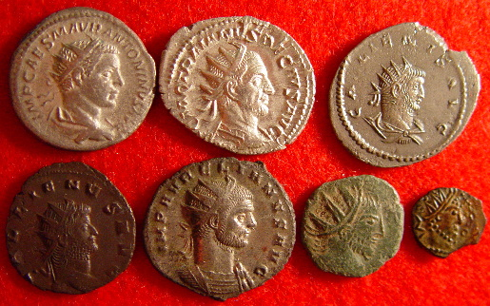

Slide 16
PAX romana

Slide 17
Roman law

