Slide 1
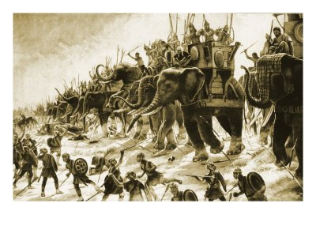
Roman Republic
World History
SOL WHI 6a,b,c,d

Slide 2
Essential Questions
How was geographic location important to social, economic, and political development of Rome?
What was the source of Roman mythology?
What impact did Roman mythology have on later civilizations?
How did the government of Rome become more democratic in its decision making?

Slide 3
Physical Geography

Slide 4
Physical Geography

Slide 5
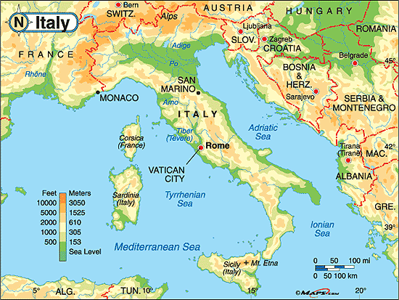

Slide 6
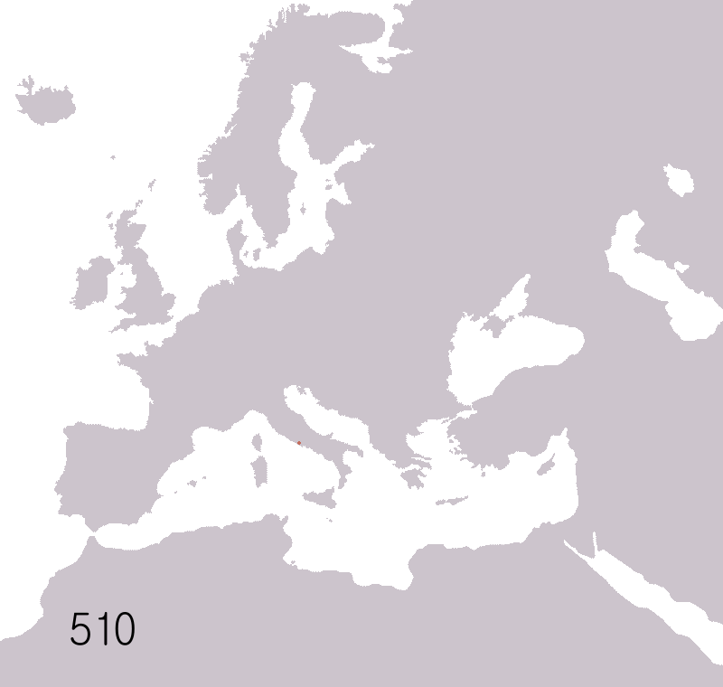

Slide 7
Roman Religion

Slide 8
Roman God | Greek God
Jupiter | Zeus
Juno | Hera
Apollo | Apollo
Minerva | Athena
Venus | Aphrodite

Slide 9
Social Structure

Slide 10
Social Structure

Slide 11
Roman Government

Slide 12
Roman Government
Plebeians gradually acquired more rights
450 BCE, the laws of Rome were inscribed on 12 tablets and set up in the Forum
In time plebeians gained the right to elect their own officials called tribunes who could veto laws
Later, plebeians could be elected to the Senate

Slide 14
Citizenship

Slide 15
Citizenship

Slide 16
Punic Wars
The Roman Republic fought three wars with the Carthaginian Empire between 264 – 146 BCE called the Punic Wars
Rome and Carthage competed for trade in the Mediterranean
In 218 BCE, Hannibal, a Carthaginian general, crossed the Alps with an army and invaded Italy, but he failed to capture Rome

Slide 17
Outcome of Punic Wars
Carthage was defeated and destroyed
The Roman Republic expanded to North Africa and Spain
The Roman Republic changed to an Empire

Slide 18
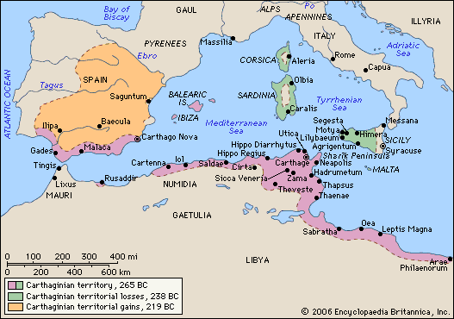

Slide 19
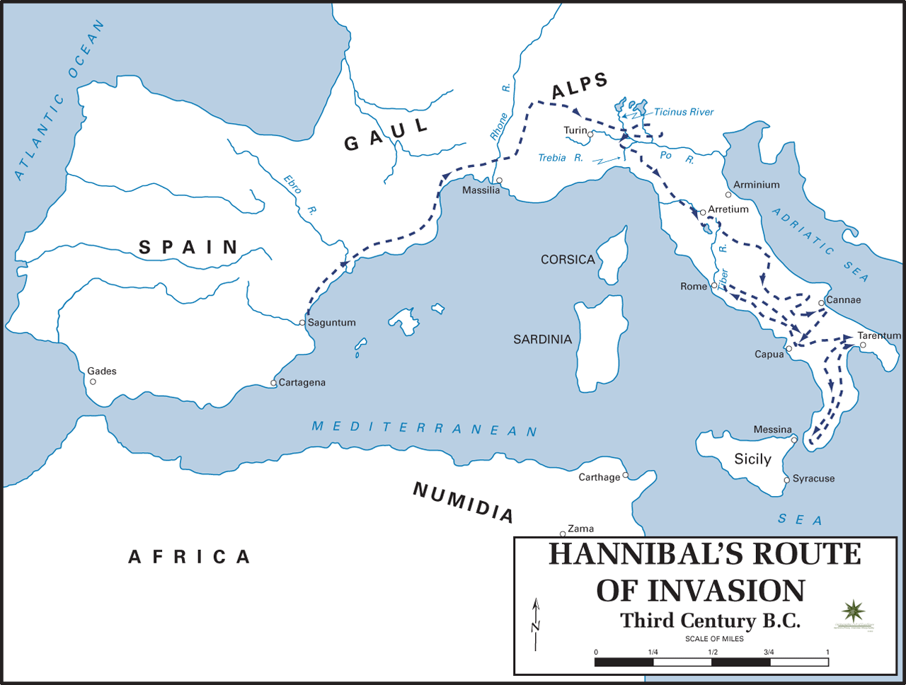

Slide 20
