Slide 1
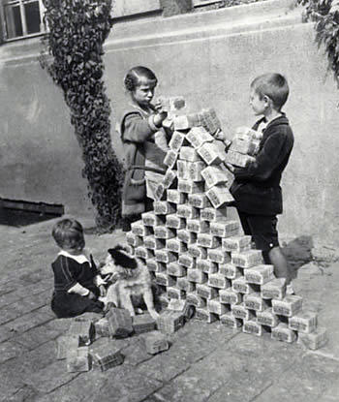
Interwar Years

Slide 2
Worldwide Depression

Slide 3
Worldwide Depression
There was a worldwide depression in the 1930s
Depression weakened Western democracies, making it difficult for them to challenge the threat of totalitarianism
Expansion of production capacities and dominance of the U.S. in the global economy

Slide 4
Impact of World Depression

Slide 5
U.S.S.R. during Interwar Period
Communism became a way of life
Stalin introduced 5 year plans, collectivization of farms, state industrialization, secret police
Collectives = large farms owned and operated by peasants
Great Purge = Intellectuals and anyone who disagreed with Stalin were sent to prison camps called Gulags

Slide 6
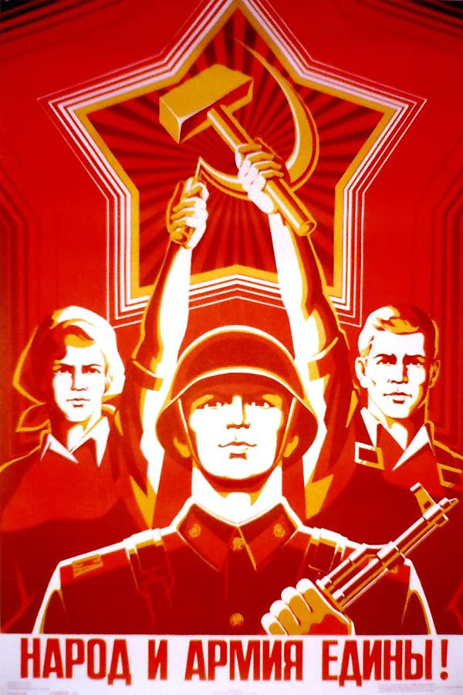
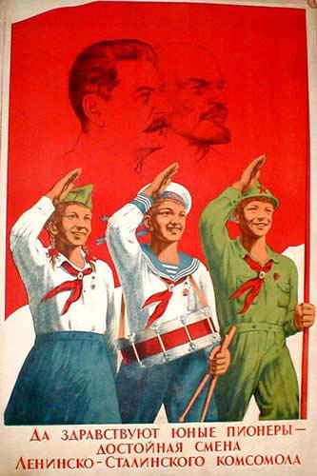
The hammer and sickle became the symbol of the Soviet Union.
Propaganda poster with
Stalin and Lenin.

Slide 7
Germany during Interwar Period

Slide 8
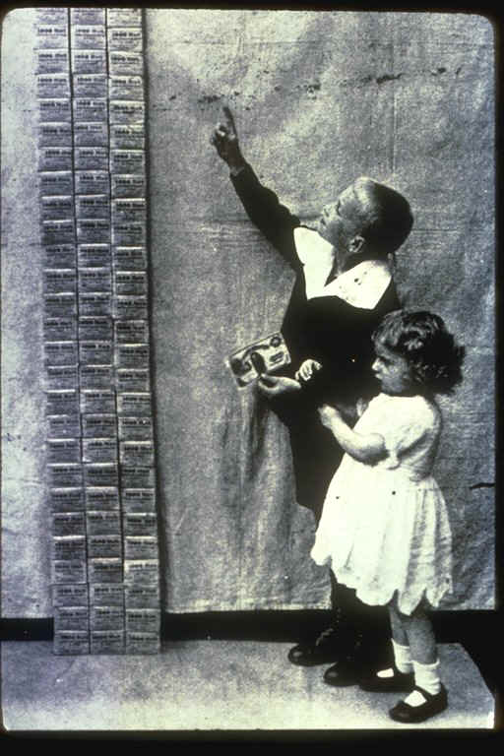
Inflation

Slide 9
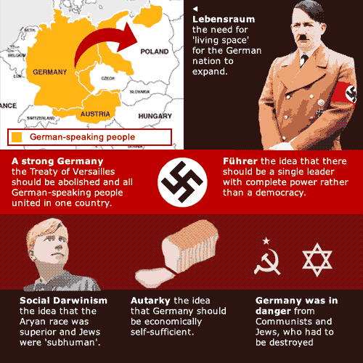
Nazism

Slide 11
Italy during the Interwar Period

Slide 12
Japan during the Interwar Period

Slide 13
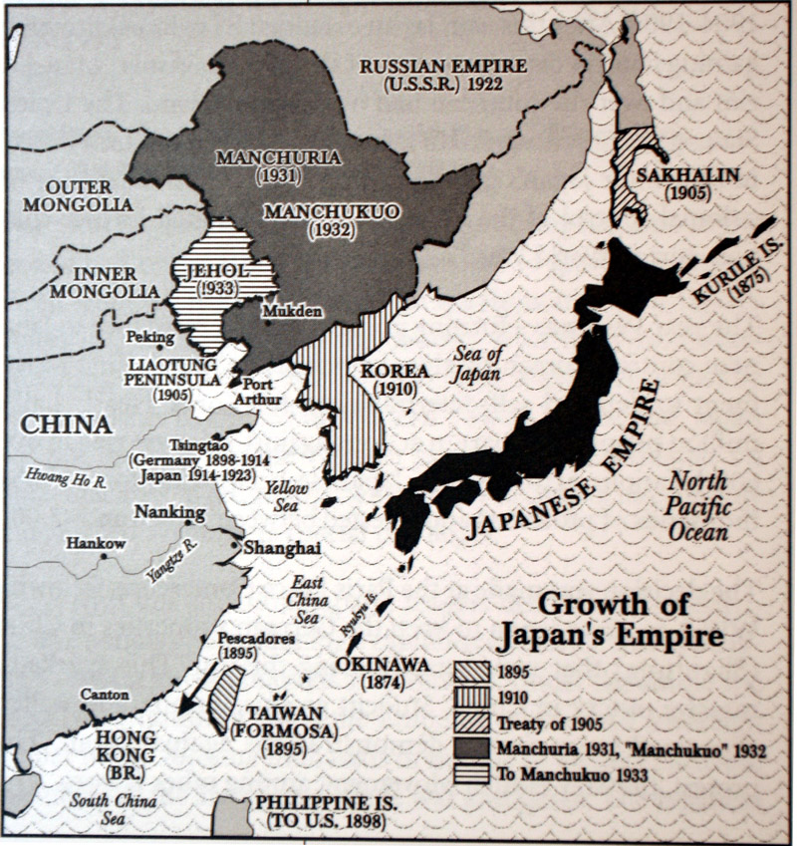

Slide 14
World Leaders

