Slide 1
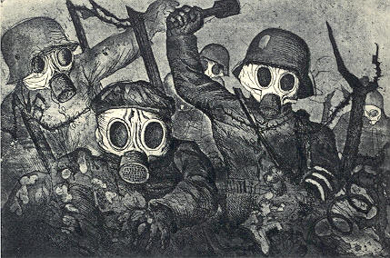
World War I

Slide 2
Causes of World War I
Alliances that divided Europe into competing blocks
Nationalistic feelings
Diplomatic failures
Imperialism
Competition over colonies
Militarism – belief that government should have a strong military and be prepared to use it

Slide 3
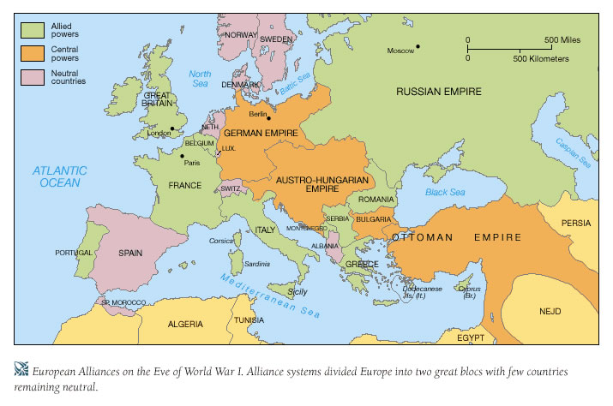

Slide 4
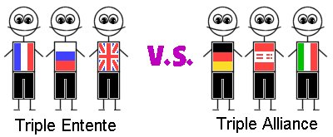
Alliances
Triple Entente
Britain, Russia, France
Triple Alliance
Germany, Austria-Hungary, Italy
Italy changed sides and Ottoman Empire joined

Slide 5
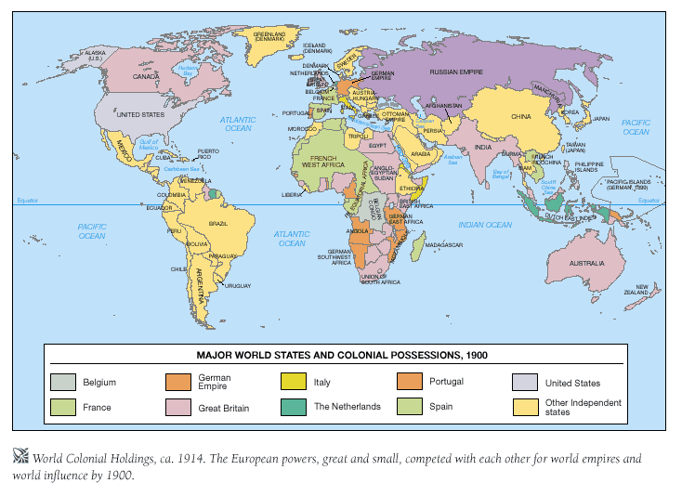

Slide 8
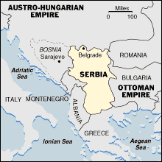
Gavrilo Princip

Slide 9
Trench Warfare
Static trench warfare on the western front
More mobile warfare on the eastern front
Large loss in life
War of attrition

Slide 10
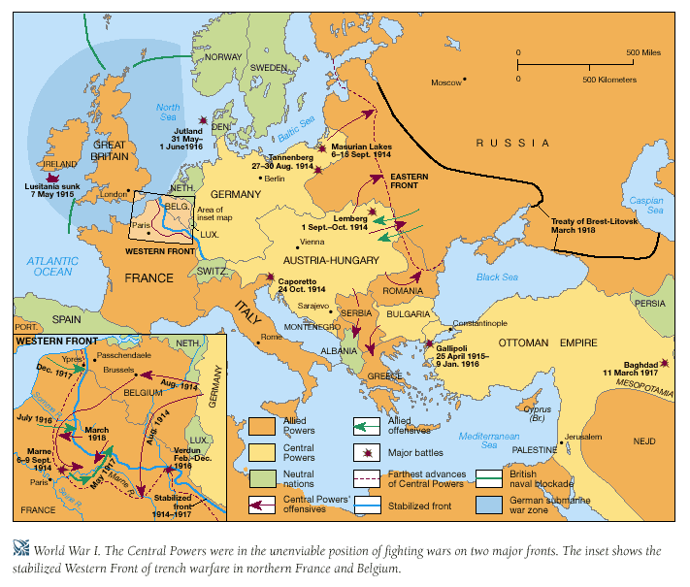

Slide 11
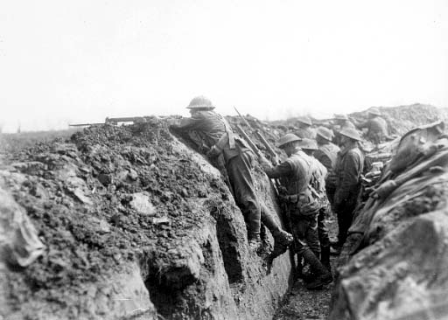
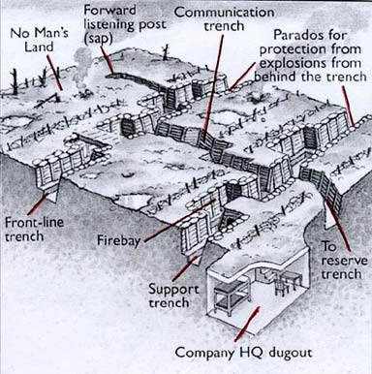
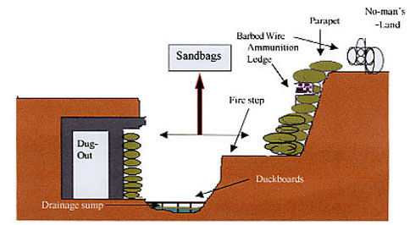

Slide 12
Why did the U.S. Enter the War?
The U.S. was isolationist (it did not want to fight in a European War)
The U.S. entered the war because of German unrestricted submarine warfare
German promises to Mexico to help it regain territory from the U.S. (Zimmerman telegram)

Slide 13
What happened in Russia?
1917 Revolution, communists (bolsheviks) took power and killed the Tsar and his family
Vladimir Lenin became ruler of Russia (Soviet Union)
Lenin’s New Economic Policy
Lenin died in 1924, Joseph Stalin took power
Causes
Russia was defeated in 1905 war with Japan
Peasants were unhappy
Military defeats and high casualties
Incompetence of Tsar Nicholas II

Slide 15
Treaty of Versailles
Germany gave up all colonies
Germany must pay war reparations
Germany lost territory to France
Germany had to dismantle military
Founded League of Nations an international organization to prevent future wars
The U.S. did not join the League of Nations
The league did not have power to enforce its decisions
League was basis for United Nations

Slide 16
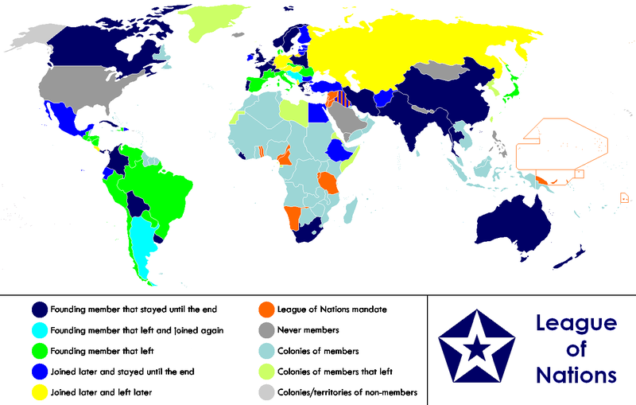

Slide 17
Mandate System
Great Britain and France divided portions of the Ottoman Empire in the Middle East under a mandate system
The mandate system planted seeds for future conflicts in the Middle East
Britain gained the lands that became Transjordan and Palestine
France gained the lands that became Syria and Lebanon

Slide 18
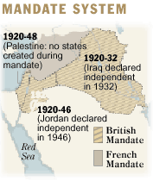
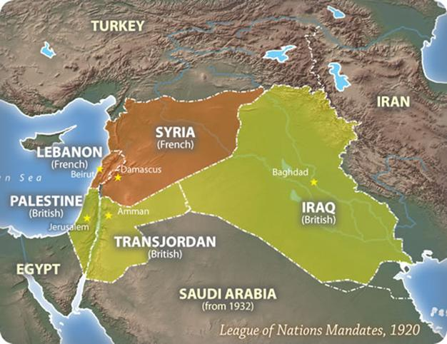

Slide 19
Outcomes of World War I
Colonies’ participation in the war, which increased demands for independence
End of Russian Imperial, Ottoman, German, and Austro-Hungarian empires
Enormous cost of the war in lives, property, and social disruption

Slide 20
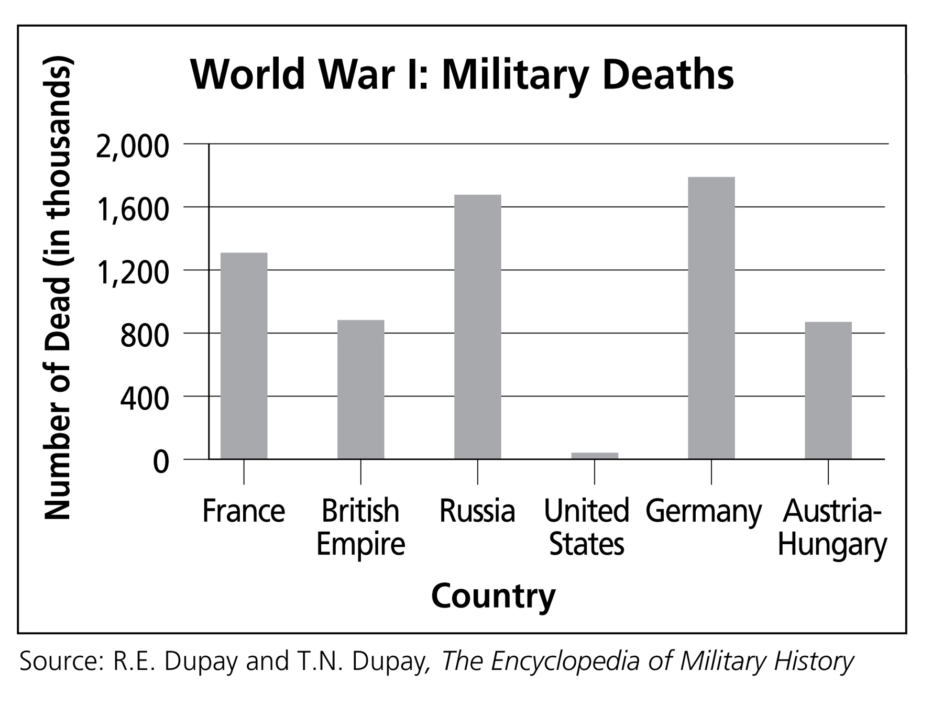

Slide 21
