Slide 1
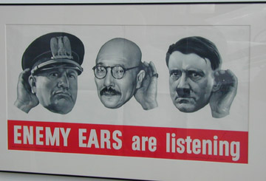
World War II

Slide 2
Economic and Political Causes of WWII

Slide 3
Economic and Political Causes of WWII

Slide 4
Major Events in Europe

Slide 5
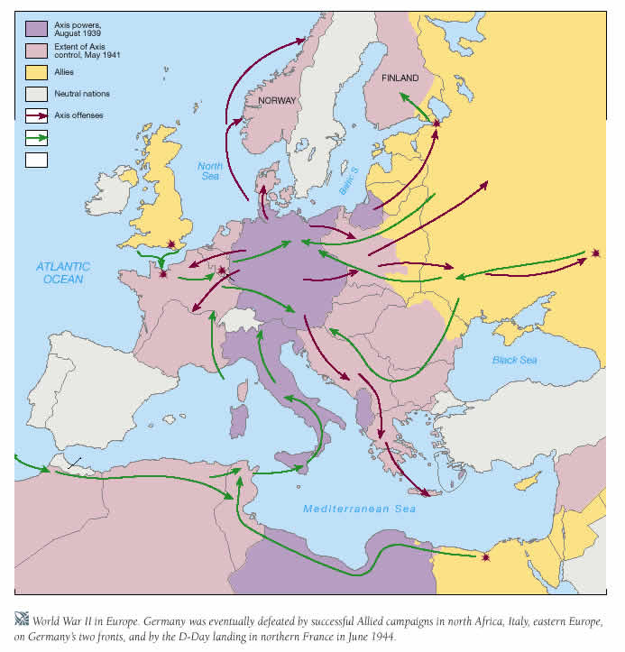
WWII

Slide 6
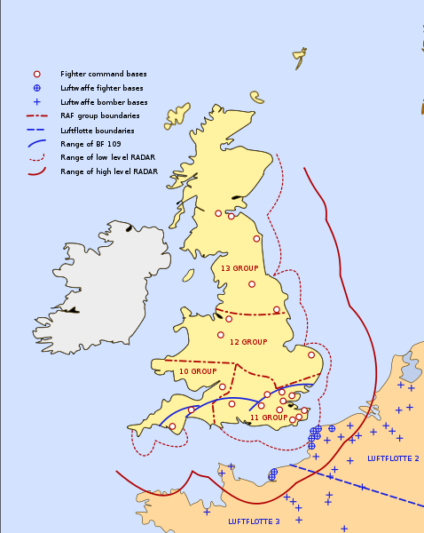
Battle of Britain

Slide 7
Major Events in Europe

Slide 8
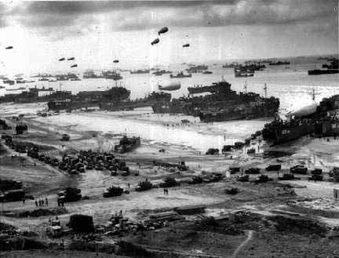
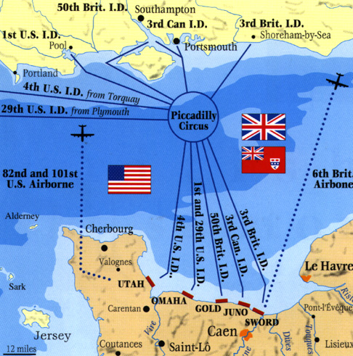
D-Day

Slide 9
Major Events in Asia

Slide 10
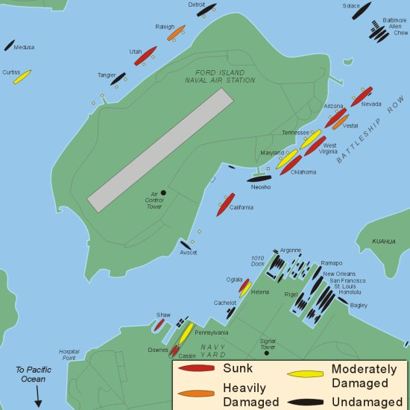
Pearl Harbor
Japan makes a surprise attack on the U.S. naval base at Pearl Harbor, Hawaii
Japan hoped to sink the entire U.S. fleet
The U.S. fleet is destroyed but two aircraft carriers survive

Slide 11
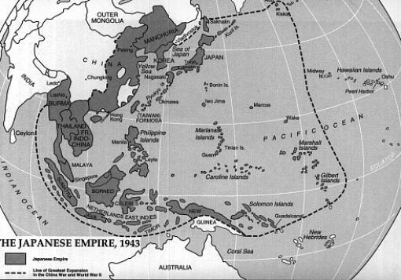
Japanese Empire

Slide 12
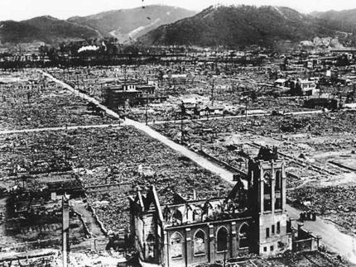
U.S. Drops Atomic Bombs
1945 – U.S. drops two atomic bombs on the Japanese cities of Hiroshima and Nagasaki
Japan surrenders
Japan is occupied by U.S. military

Slide 13
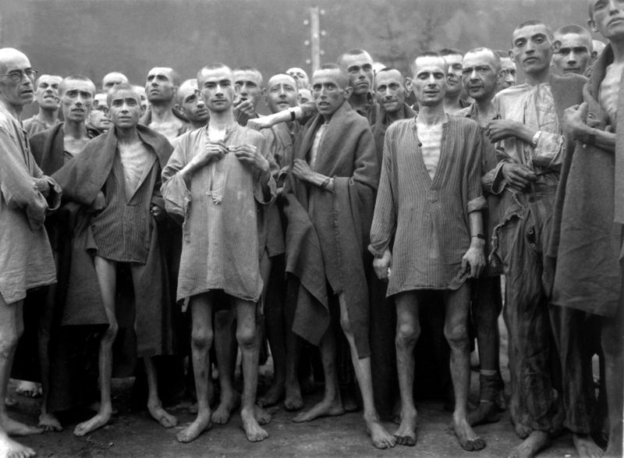
Holocaust
History of anti-Semitism
German defeat in WWI and economic depression blamed on German Jews
Hitler’s belief in the master race
Final solution – extermination camps, gas chambers

Slide 14
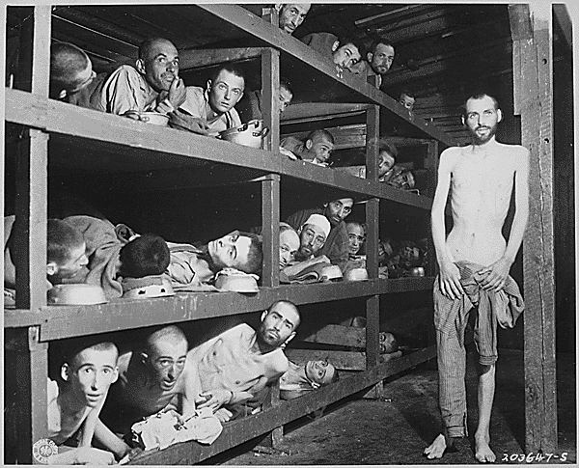
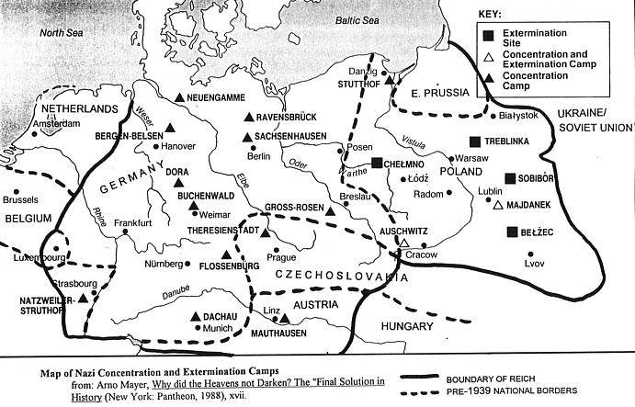
Holocaust

Slide 15
Other Genocides

Slide 16
Leaders

Slide 17
Leaders

Slide 18
Outcomes of WWII

Slide 19
Outcomes of WWII

Slide 20
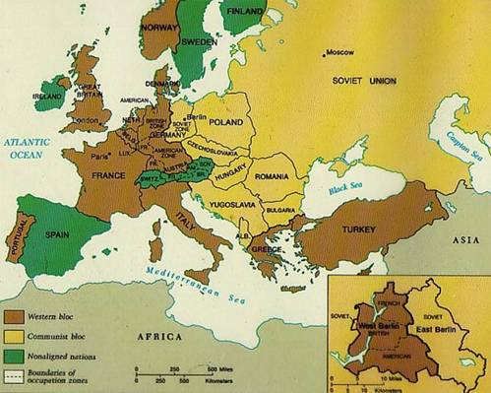
Iron Curtain

Slide 21
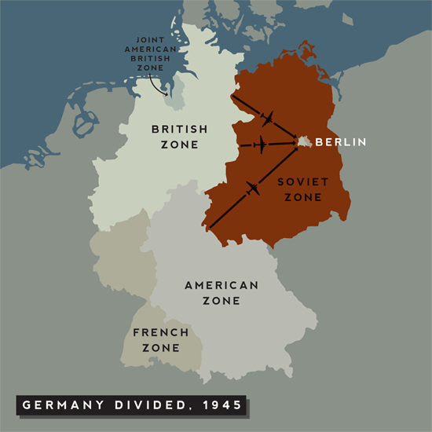
Reconstruction of Germany
Democratic government installed in West Germany and West Berlin
Germany divided among the four Allied powers
Emergence of West Germany as economic power in postwar Europe

Slide 22
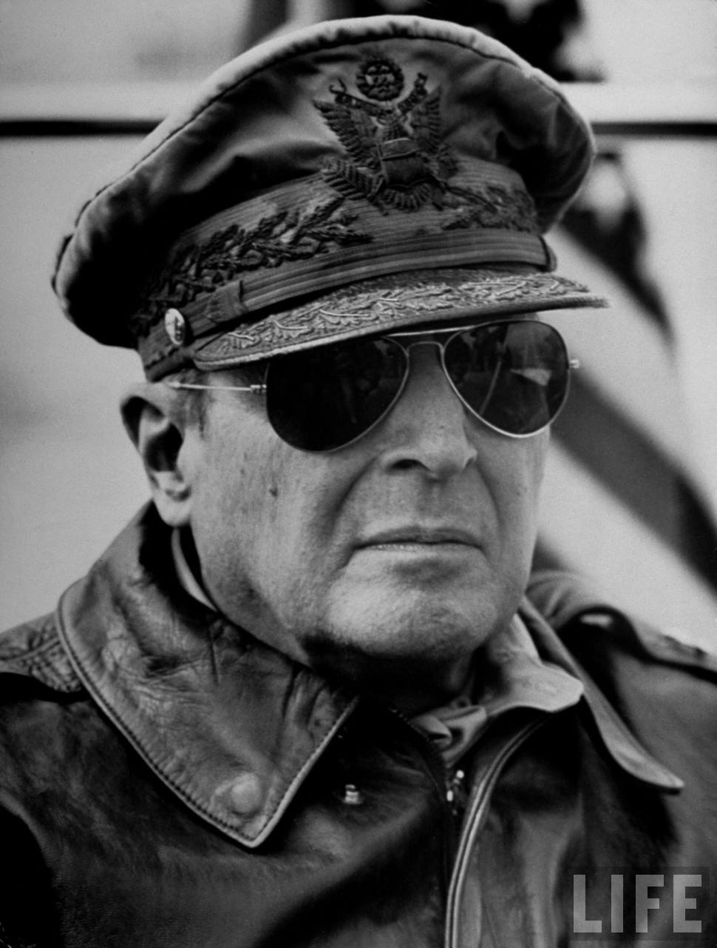
Reconstruction of Japan
U.S. occupation of Japan under MacArthur’s administration
Democracy and economic development
Elimination of Japanese offensive military capabilities; U.S. guarantee of Japan’s security

