Slide 1
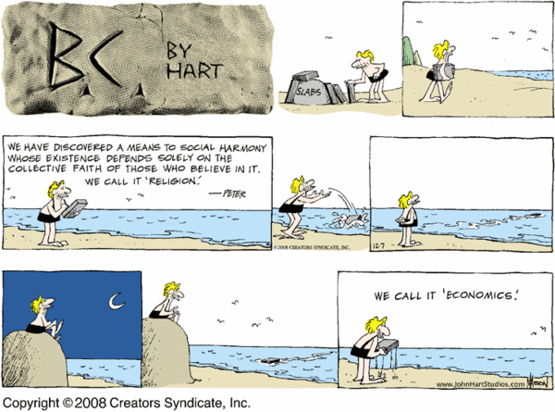

Slide 2
What is the biggest problem in economics and how does it affect the other aspects of the economy?
Fundamentals of Economics

Slide 3
Vocabulary
Adam Smith- Founder of modern day economics (Wealth of Nations 1776)
Scarcity-permanent combination of unlimited wants and limited resources(faced by all).
Shortage-temporary condition of a lack of certain resources
Invisible hand- force that drives the market(interaction between consumer and producer)
Law of Self Interest- motivation for rational economic decisions
Notes:
Play You can’t always get what you want.

Slide 4
SSEF1 The student will explain why limited productive resources and unlimited wants result in scarcity, opportunity costs, and tradeoffs for individuals, businesses, and governments.
a. Define scarcity as a basic condition that exists when unlimited wants exceed limited productive resources.

Slide 5
Explains allocation of
resources
A section of
Economics
Evaluates how economies
make decisions
Fundamentals
Describes interconnectedness
of the economy
Factors of
Production
Adam Smith
Opportunity
Cost
Scarcity
TINSTAAFL

Slide 6
What is economics?
Economics is the study of how individuals, firms, and nations allocate scarce resources
the branch of knowledge concerned with the production, consumption, and transfer of wealth.
Known as the Dismal Science
Notes:
allocate - distribute to use
Dismal science - only hear about it when things are bad.

Slide 7
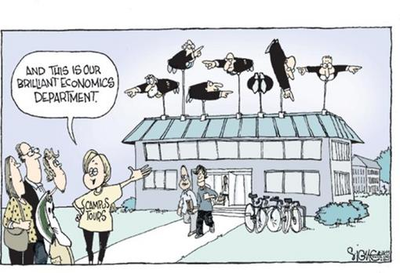

Slide 8
Types of Economists
Much Government
Intervention
Little Government
Intervention
Keynesian
Manipulate
Economy
Through Gov’t
Spending
Austrian School
Free Market but
Human
Behavior
Too difficult to
predict
Marxist
Economy
Totally
Controlled by
Gov’t
Monetarist
Manipulate
Economy
Through Gov’t
Spending
School of
Chicago
Milton Friedman
Free Market

Slide 9
Type of Economist
Microeconomists: Study supply and demand and find out how to maximize production.
Macroeconomists: Study the economy as a whole; interest rates and national productivity
Financial Economists: financial economists study interest rates to see their effect on banking systems.

Slide 10
Type of Economist
International Economists: Study markets international, currency exchange and the effects of tariffs and trade procedures and laws.
Organizational or Industrial Economists: Study the markets of individual industries, studying competitors and making predictions based on the decisions of competitors.
Demographic or Labor Economists: Study trends in salary and determines the need for labor.

Slide 11
Type of Economist
Public Finance Economists: Study of government involvement in the economy, such as taxation, deficits or surpluses in budget, or policies concerning welfare.
Econometricians: Study of mathematics is in all branches of economics. Economist use models using methods like calculus, regression analysis, and game theory.

Slide 12
Why?
Why do I come here everyday?
Why do your parents go to work?
If you have a job, why do you go there?
Does that make me or your parents or you selfish?
Notes:
self - interest

Slide 13
Founder of Economics
Adam Smith
founder of modern economics.
wrote Wealth of Nations
It is not from the benevolence of the butcher, the brewer, or the baker that we expect our dinner, but from their regard to their own interest. Adam Smith

Slide 14
Smith cont..
Key points/Concepts:
the economy is guided by an invisible hand
people are motivated by self interest
Profits and self interest are motives for improved efficiency, growth, and freedom.
Laissez Faire- no gov’t intervention in economy

Slide 15
Smith’s Economic Concepts
Voluntary exchange
Free Trade
Application
More
Norberg video

Slide 16
What is the biggest problem in Economics?
Bucket List

Slide 17
What if
What if you were asked to create a wishlist of everything you wanted, how long would the list be? How long will it take to write it?
What if everybody in the world, all 7 Billion, made a wish list. Would there be enough of each item to fill all of the lists?
How is it determined who gets what? Why?

Slide 18
Scarcity
The basic problem in economics is scarcity.
Scarcity is a combination of unlimited wants and limited resources(faced by all).
Scarcity means people do not and cannot have enough income, time, or other resources to satisfy their every desire.
Notes:
Time, energy, cash, resources, etc.

Slide 19
Scarcity versus Shortage
Scarcity is an inevitability and all things are scarce. It is a permanent effect and always exist.
Time and money will always be scarce.
Shortages are only temporary and usually caused by a disaster, hurricane or flood.
There may be a shortage of safe water after a flood.

Slide 20


Which is more valuable? Why?
Silver
Vanilla

Slide 21
Which is more valuable? Why?
Silver
$247.04 per pound
Vanilla
@$300 per pound

Slide 22
Wants versus Needs
Choices are often divided into wants versus needs.
Needs are necessities people require to survive. Wants are basically everything else. The job of a consumer is to make a distinction between the two. The job of a seller is to make a want a need so they advertise.

Slide 23
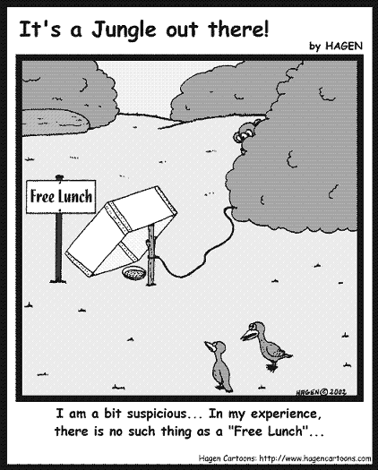
TINSTAAFL
There is no such thing as a free lunch.
Everything costs(not always money). The cost is often passed on to someone else.
Notes:
23
Play Ain’t no rest for the wicked.

Slide 24
What motivates your and others?
An incentive is simply something that motivates.
What are some incentives?

Slide 25
What motivates your and others?
Incentives can be
Financial
Moral
Social
Legal

Slide 26
Assignment
Complete worksheet B on page 2.

