Slide 1
Vocabulary
Factors of Production- resources used in economics
Capital- factor of production used to create more items(money, machines, tools, etc)
Allocate- to distribute, to divide
Consumer Good-goods for consumption
Capital Good-good used to make other goods
Notes:
Play Money by Pink Floyd

Slide 2
Vending Machine Dilemma
What is the thought process when someone buys something at a benefit?

Slide 3
The thoughts
Vending Machine- The marginal benefit of your dollar is greater than the marginal cost of the candy bar.
You-The marginal benefit of the candy bar is greater than the marginal cost of the my dollar.

Slide 4
What do we learn?
In non-fraudulent, rational, voluntary exchanges/transactions, both will have more marginal benefit than cost.
Both sides benefit (and sometimes say “Thank you”.
Same works in employment.

Slide 5
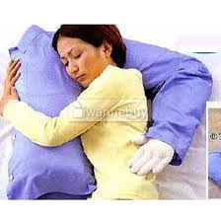

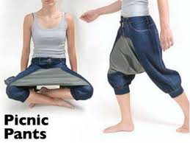



What is used to make these incredible products?

Slide 6
What do we need to produce products?
Factors of Production(aka Productive Resources)-resources required to produce the things

Slide 7
Factors of Production
Land-natural resources such as land, minerals, lumber, etc. Location of land may determine value
Human Resources- 1)Labor- work that people do 2)Human Capital- skills and talents people have
Physical Capital- all the property people use to make other goods and services - things that work(except people), examples are money and machines.

Slide 8
Factors(cont…)
Entrepreneurship- the way the other 3 factors are used and organized or the ability of individuals to start new businesses (payment is profit), to introduce new products and techniques, and to improve management techniques. Examples are Henry Ford’s assembly line or opening a Starbucks

Slide 9
Why do people become Entrepreneurs? What is their effect?
Entrepreneurs take risks because of potential profits. They also create jobs, innovate, and improve society.

Slide 10
A way to remember Factors of Production
CELL
Capital
Entrepreneurship
Land - natural resources
Labor - human resources

Slide 11
It’s in the use.
Note- Goods can be capital or consumer, it’s all in how it is used.
A wrench in your hand vs. a wrench in the hands of a trained mechanic.
A guitar in your hands vs. a guitar in the hands of a trained musician.

Slide 12




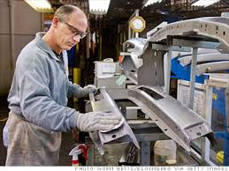

Name that Factor

Slide 13
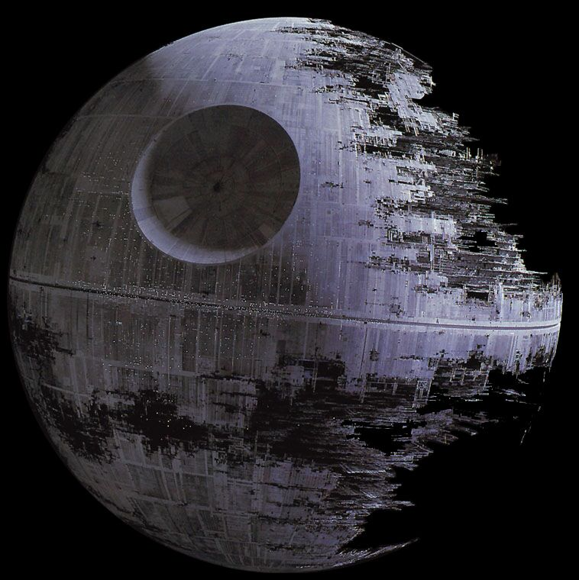
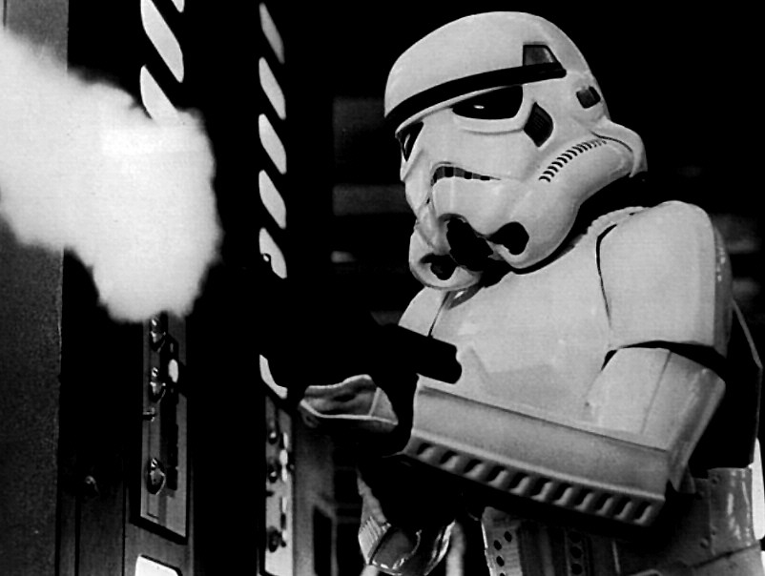


Factors of Production Star Wars

Slide 14
You the Capital.
Human Capital are the skills, talents, abilities, and knowledge that you possess and can use.
The more capital you possess, the more you are worth in the labor market!!

Slide 15
Why it matters?
Using Resources Wisely
Specialization is doing what you do best and is using the factors of production(esp. labor) in tasks they can do more efficiently than others.
Promoting more efficiency and production
Division of Labor takes place when work is arranged so that individuals workers do fewer task than before but these tasks are more specialized.

Slide 16
The Next Step
If FOP are used wisely, then individual, business, and national productivity.
Productivity is a quantitative measure of the relationship between input and output.
Productivity = Total output / total input

Slide 17
Productivity
Example- In one day 5 employees produce 25 widgets. The productivity is 25/5=5
Suppose you add FOP(Labor). 6 Employees would produce 33 widgets. The productivity is 33/6=5.5.
The goal is to increase productivity.
How? Add/modify FOP.

Slide 18
If we make or have stuff????
If scarcity is inevitable, how are resources allocated?
Who gets what?

Slide 19
Allocating the Resources
How is allocation of the following determined?
Gold medal at the Olympics
Parking spots on graduation day
Beach front property
Positions in North Korean Government
Toys in a day care(with little supervision)

Slide 20
Allocating Resources
Resources are allocated the following ways:
Price
Majority Rule
Contests
Force
Sharing
Lottery
Authority
First Come- First Serve
Personal Characteristics

