Slide 1
Vocabulary
Opportunity Cost-the value of the next best alternative
Specialization-the ability to perform a task more efficiently than others
Notes:
Play Two Princes

Slide 2
Cost
Cost is an amount that has to be paid or given up in order to get something.
Cost can be:
Monetary
Effort
Time
Resources
All expenses are costs, but not all costs are expenses.

Slide 3
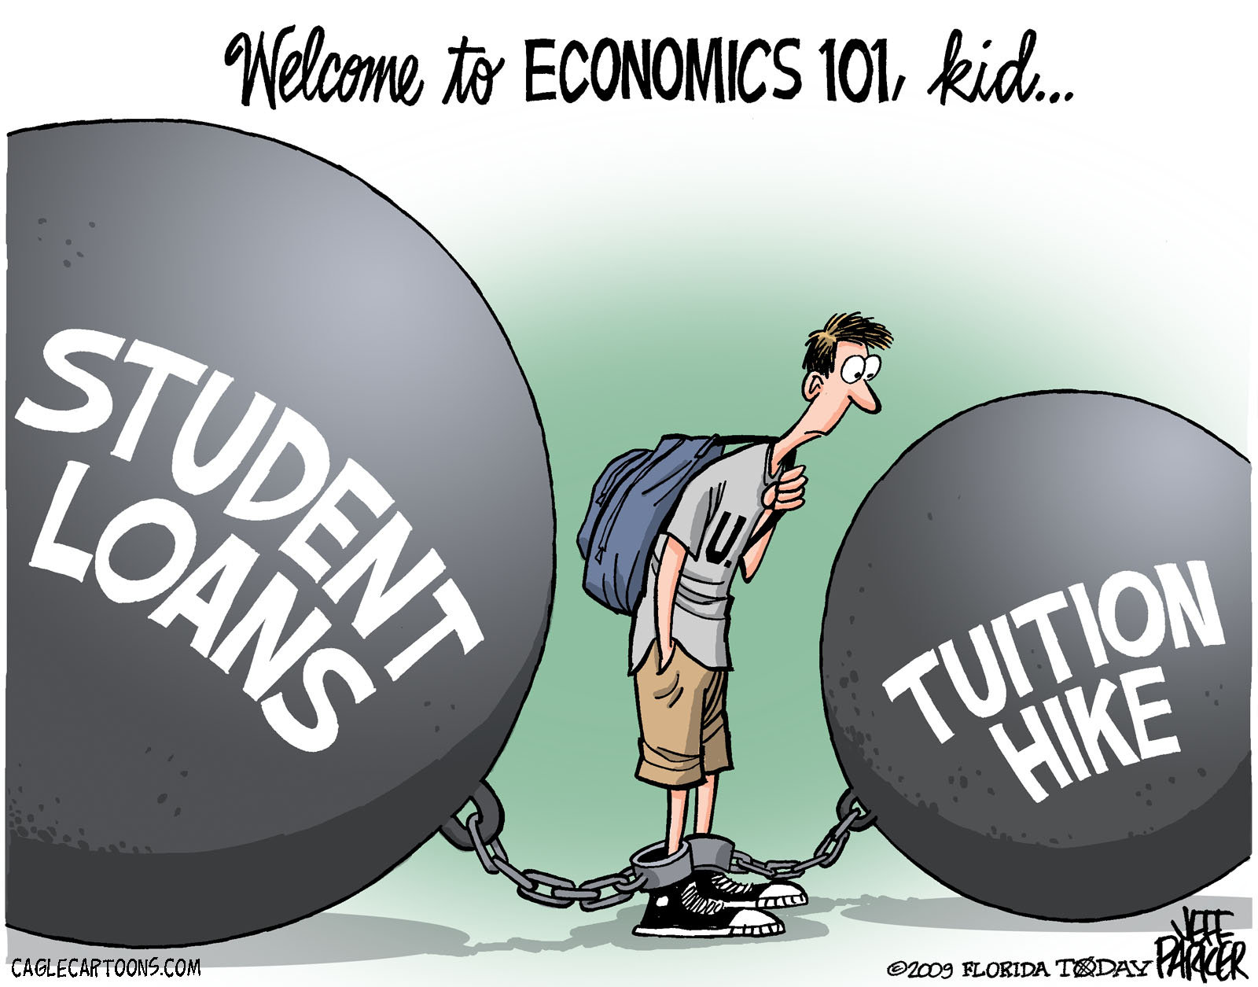

Slide 4
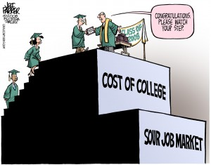
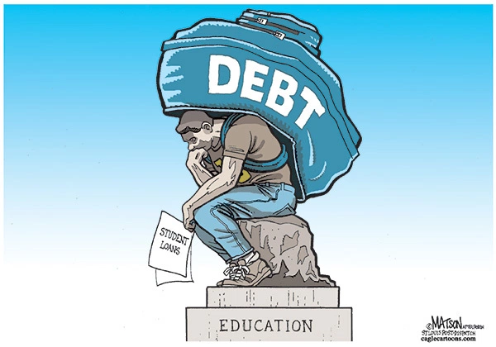
What is the view of college?

Slide 5
Scary thoughts
What is the total student loan debt?
How many people have a student loan?
What is the percentage of student loan delinquency?
What percent of 2015 Bachelor’s graduates had student debt?
What was the average debt?
https://www.forbes.com/sites/zackfriedman/2017/02/21/student-loan-debt-statistics-2017/#309f84475dab https://www.usatoday.com/story/money/personalfinance/2017/04/28/average-student-loan-debt-every-state/100893668/

Slide 6
Scary Questions
What is the total student loan debt?
$1.48 Trillion
How many people have a student loan?
44,000,000
What is the percentage of student loan delinquency?
11.2%

Slide 7
Scary Questions
What percent of 2015 Bachelor’s graduates had student debt?
68%
What was the average debt?
$31,000

Slide 8
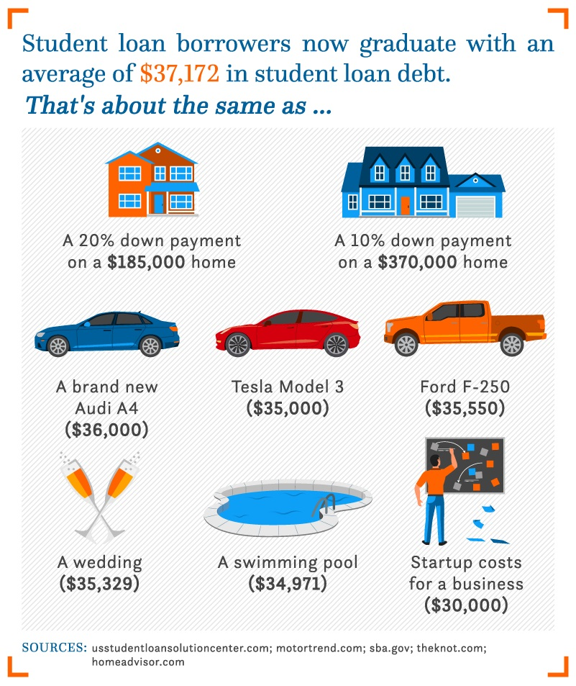

Slide 9
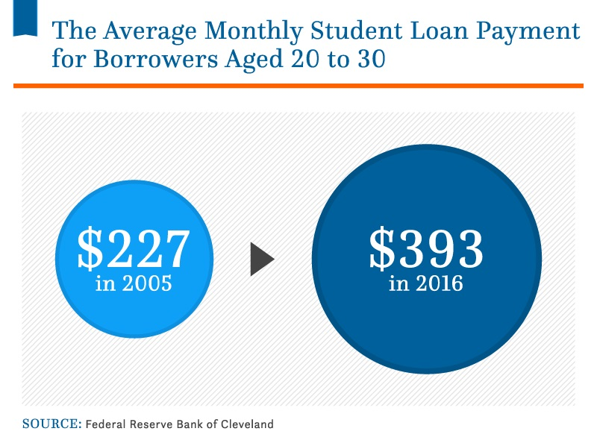

Slide 10
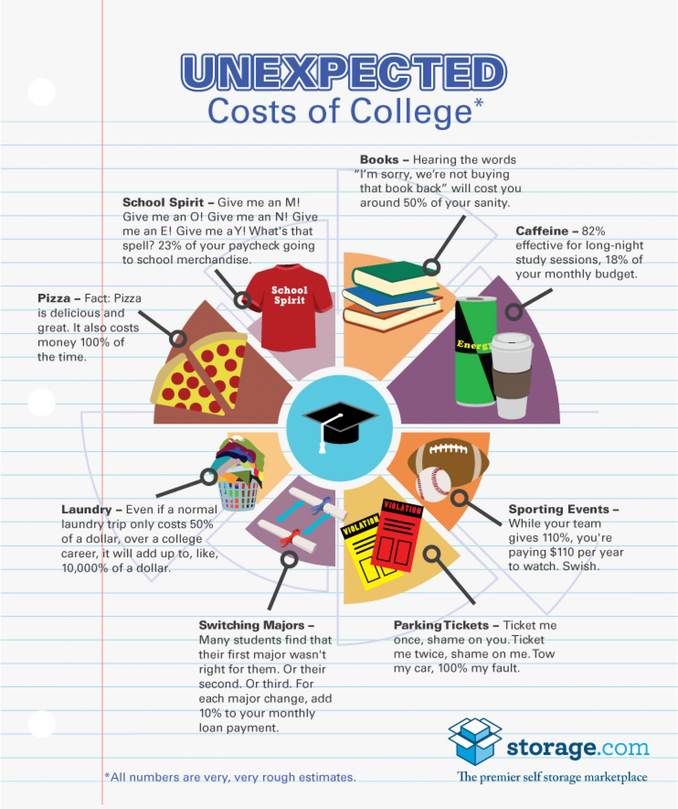

Slide 11
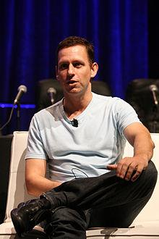
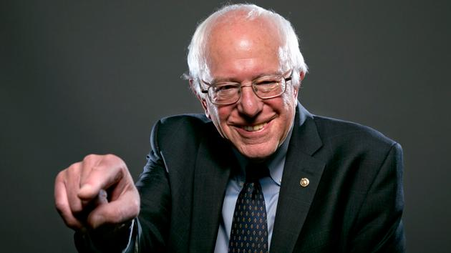
How do these guys differ on how you allocate your next 4-5 years?
He has paid 80 teenagers $100,000 to quit or forgo college. He calls college “stifling”.
Article
He is running for President and says the choice is “college or prison”.

Slide 12
Average 4 year college costs
4 years in state tuition= $39,508
4 years out of state tuition= $97,690
4 years private=$135,010

Slide 13
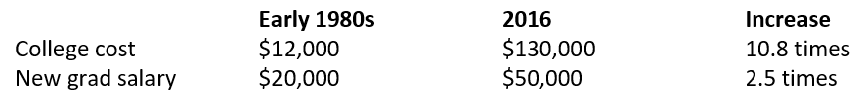
More Scary Stuff
Student Debt Map

Slide 14
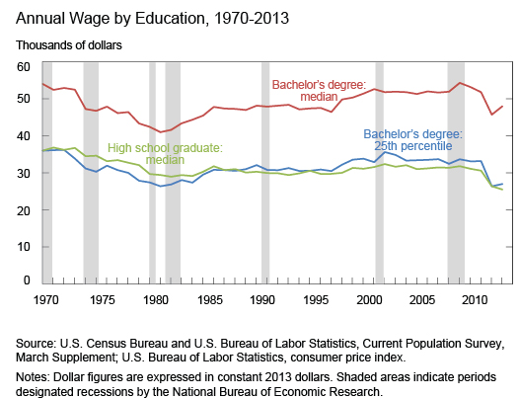
The Chart
This means the bottom 25% of college graduates are no better off than high school graduates.
Richest College/Non

Slide 15
Finally
Most of the time, it doesn’t matter where you graduate from.
To an employer, most of the time it doesn’t matter how long it takes to graduate. It does matter in terms of cost.
The degree you obtain DOES MATTER.
What does a college degree really mean?

Slide 16
What do you gain by going to college?

Slide 17
Mapping your future

Slide 18
What do you gain by not going to college?

Slide 19
Opp. Cost of Public vs Private
Public
Private

Slide 20
Tradeoff
An alternative choice.
Item you trade for another.
Example- You pick a truck instead of a car for your vehicle. Your tradeoff is the car.
Give another example.

Slide 21
Opportunity Cost
Opportunity Cost is the value of the next best alternative. The value is not always money; it may be time, experience, etc
OC is the value what you give up.
OC is forgoing the benefits of the next best alternative.
Cost of the lost opportunity.
It is the road not traveled.
Value/benefit can be
Time, money, experience, quality, etc
Notes:
21

Slide 22
Tradeoff and Opportunity Cost Implications
The more aware you are of tradeoffs and opportunity cost, the better a consumer you will be.
Tradeoffs and opportunity costs are not just money decisions but any type of decision.
One big example is time. Since time is a scarce resource, choices, tradeoffs, and opportunities exist.
Notes:
22

Slide 23
Implications
Individuals, companies, groups, and nations all deal with opportunity cost. The better you understand OC, the better the choices you can make.
Example- How and where the government spends its money?

Slide 24
Opportunity Cost
Example 1-You have a date and $40 to spend. You can either go to a movie, go eat dinner at Chili’s, or watch TV at your house. You decide to eat dinner at Chili’s. The next choice would be to go to a movie. The opportunity cost is to go to a movie.
Example 2- You are planning the prom. You can hire a DJ for $1000, a live band for $1,200, or use a prerecorded CD with sound system for $500. Which would you choose and what is the opportunity cost?
Notes:
24

Slide 25
Opportunity Cost
Example 3- Joe’s House of Grub can purchase 100 lbs of pork, 150 lbs of chicken, or 10 lbs of unicorn. Joe buys the pork. His second choice would be chicken and his last was unicorn. What is the opportunity cost of the decision?
Notes:
25

Slide 26
Example 4- Why would a student choose not to study for an exam even though she knows from past experience that she performs better on exams when she has spent time studying?
Example 5- Why would a poor family in a developing country choose to send a 10 year-old to work in a factory rather than to school, even though they know that being able to read and write would offer the child better options for the future?

Slide 27
Example – You have just started your 2nd semester of college and must choose a major. You can choose between Psychology, Engineering, and Business Administration ? What do you choose and what is the opportunity cost?
Video
https://www.youtube.com/watch?v=NwOYLV-L7pc

Slide 28
Dostoevsky on education
"to sacrifice, for example, five or six years of (your) ebulliently youthful life to hard, difficult studies, to learning, in order to increase tenfold (your) strength to serve the very truth and the very deed that (you) loved and set out to accomplish" The Brothers Karamazov

