Slide 1
Problem
Michalyn is in the process of opening a shirt company. Due to scarcity, she can only produce so many. she can choose between two designs, one with grape jelly and the other with strawberry jelly. If she choose only strawberry jelly, she can make 40, but if she choose only grape jelly, she can produce 50. Or she can have 25 strawberry jelly and 35 grape jelly. What is the opportunity cost of choosing only grape jelly instead of all strawberry jelly? opposite?

Slide 2
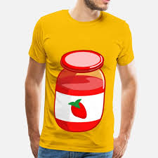


Slide 3
grape jelly
strawberry jelly
0

Slide 4
Production Possibility
Graphically Illustrating Opportunity Cost

Slide 5
Vocabulary
Production Possibility Frontier/Curve- illustration of opportunity cost
Notes:
Play Possiblitiy

Slide 6
Production Possibilities Curve/Frontier
An illustration of tradeoffs and opportunity cost can be seen in production possibilities.
Production possibilities are all the combinations of good and services that can be produced from a fixed amount of resources in a given time period.

Slide 7
Production Possibilities(cont…)
There are 2 assumptions 1)All items are working efficiently and 2)Availability of resources and level of technology remains the same( ceteris paribus-all things remaining equal).
Individuals, businesses, and nations may use this.

Slide 8
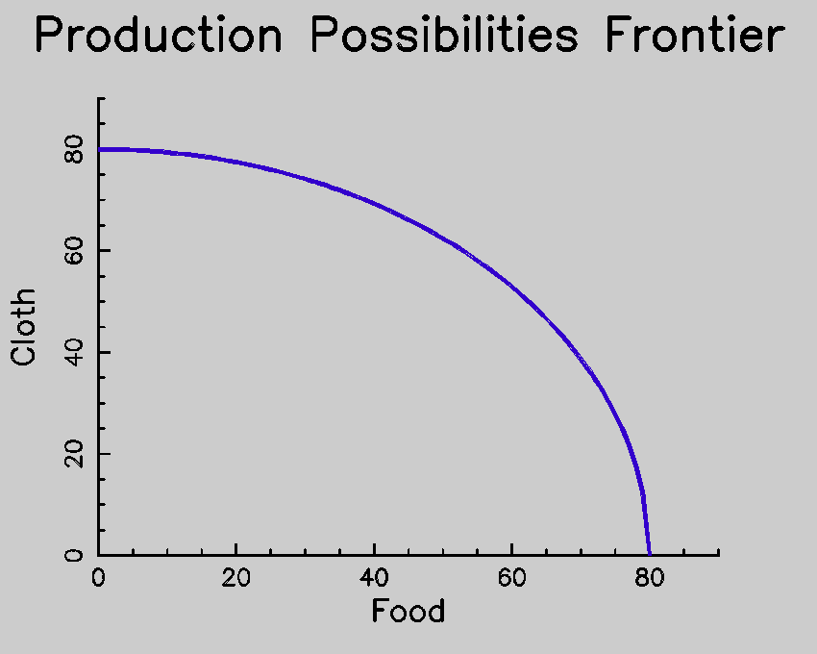
Production Possibilities
All points on the curve meet the 2 assumptions.
All points inside, represent inefficiency.
All points outside are impossible with the assumptions.
Impossible
Inefficiency

Slide 9
Shifting the Curve
Under what circumstances will the curve shift to the right(increase)?
New forms of technology, better efficiency and productivity, more resources(FoP)
Under what circumstances will the curve shift to the left(decrease)?
Fewer resources(maybe a shortage), natural disaster, ineffeciency

Slide 10
Calculating Opportunity Cost
While using numbers, OC is the amount you are giving up or losing.
What is OC from point C to B?
 | Widgets | Greebes
A | 20 | 0
B | 12 | 9
C | 5 | 15
D | 0 | 18
What is the OC from point A to B? B to C? C to A?

Slide 11
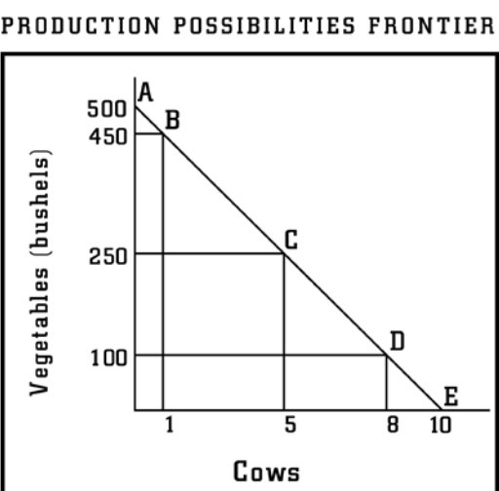
1)What would be produced at point A? B? C? D? E?
2)What would be the issue if you produced 200 Veg. and 10 Cows?
3)Starting a point C, what would happen if there was a “Vegan” fad? “Carnivore” fad?

Slide 12
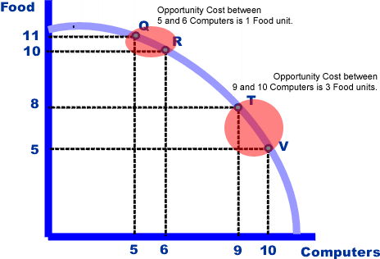
What is the opportunity cost of the following?
Q to V R to Q
T to R V to Q

Slide 13
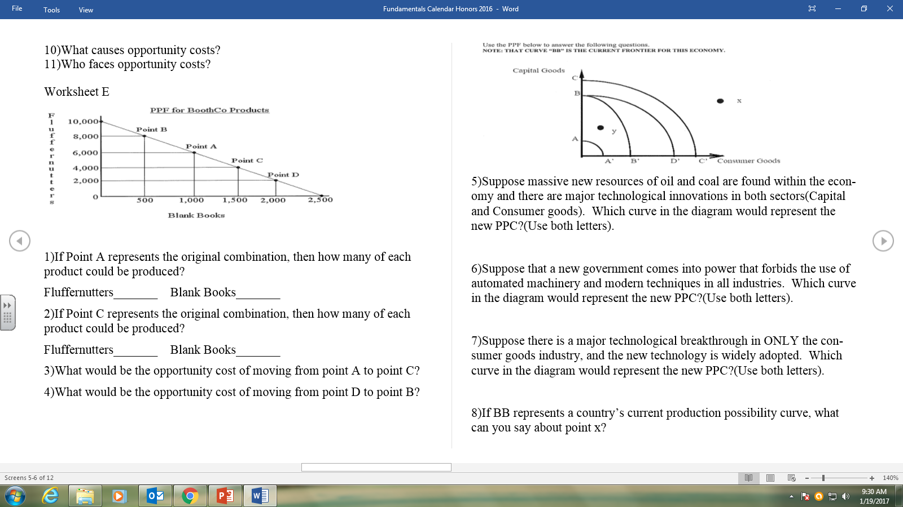
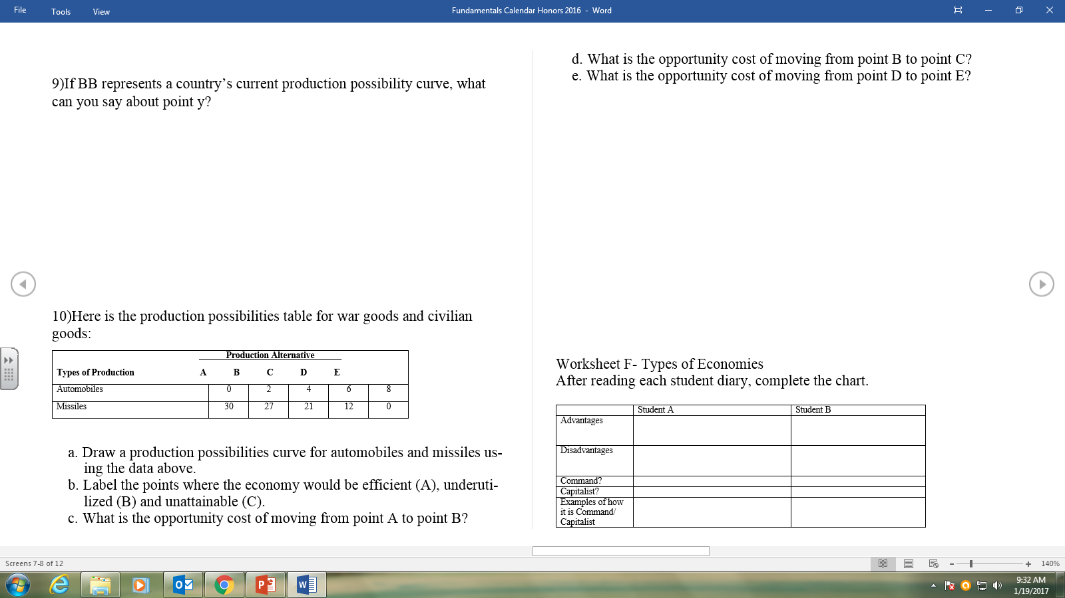

Slide 14
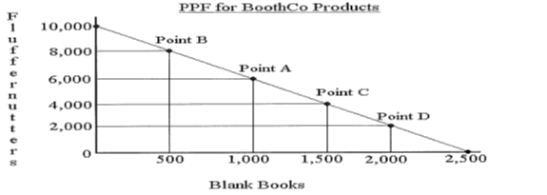

Slide 15
