Slide 1
Vocabulary
Market Economy-economy in which consumers and producers make decisions and control FoP
Command Economy-economy in which government make decisions and control FoP
Consumer – one who buys goods and services
Producer- those who create goods and services

Slide 2
All economies face three basic choices, questions that must be answered for an economy to work well.
What do you think these questions are?
3 Basic Questions Economies Ask

Slide 3
WHAT and HOW much to produce?
What goods and services will be produced and in what quantity.
Example- The number and types of restaurants in Hiram.

Slide 4
2. HOW to produce?
How to produce includes how to best use the FOP(specialization, division of labor, etc.).
Example- How the restaurants in Hiram are run and operated.

Slide 5
3. Who will consume the products?
Which demographic or group are you producing for? Pay attention to advertisements on internet sites. How do search engines make money?
Example-Restaurants market to different groups and demographics.

Slide 6
Relate
How do the questions relate to opportunity cost?
the PPC?
Video

Slide 7
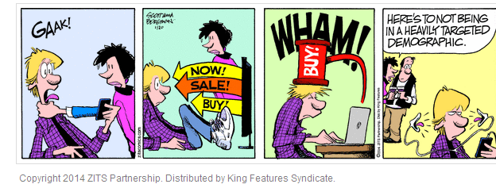
Which question is being asked in the comic?

Slide 8
Types of Economies/Economic Systems
Economic systems are usually separate from government. Economic systems are how a nation/group distributes resources and trades goods and services.
Factors determine how to categorize an economy(transactions of a large group of people).
  Who owns FoP?
  How 3 Questions are answered.
  Incentives/Profit
  Role of Consumer Sovereignty

Slide 9
Type of Economy | Command | Market/ Capitalism | Mixed | Traditional
How Q’s answered? | By Gov’t | Consumers/ Producers | Both | Past
Competition | None/Only Gov’t | Extensive/ Encouraged | Some | None
Gov’t Regulations | Extensive | Few | Some | Little/None

Slide 10
Type of Economy | Command | Market | Mixed | Traditional
Consumer Sovereignty/Rule | None | Extensive | Some | None
Profit Motive? | None | Extensive | Some | None/ To Preserve Culture
Who owns FOP/ Private Property? | Gov’t | Individuals | Both | Community

Slide 11
Pondering.
Which system better serves it members?
Which system is there more opportunity?

Slide 12
Shoe Production in Communist Poland
A shoe factory in Poland was given a mandate to produce the most shoes, based on weight. What happened?
The government noticed this and changed the mandate to produce the most shoes based on sheer numbers. What happened?

Slide 13
Shoe Production in Communist Poland
A shoe factory in Poland was given a mandate to produce the most shoes, based on weight. What happened?
  The factory produced only large shoes causing a shortage of smaller shoes.
The government noticed this and changed the mandate to produce the most shoes based on sheer numbers. What happened?
  The factory produced only small shoes causing a shortage of large shoes

Slide 14
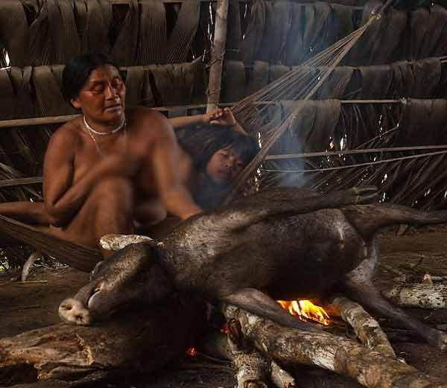
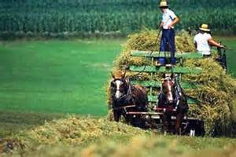
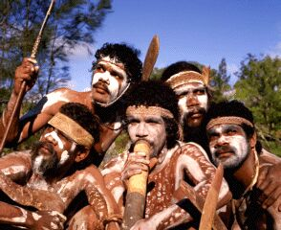

Slide 15
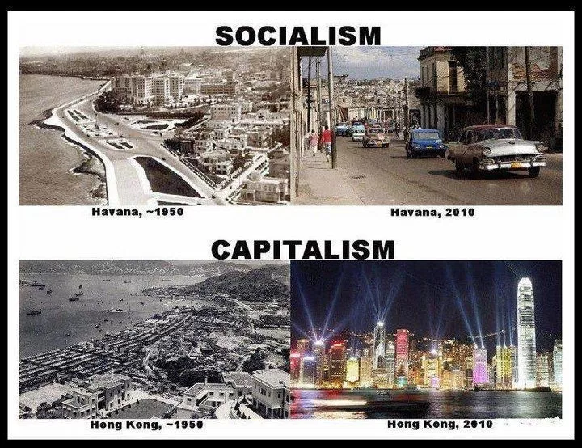
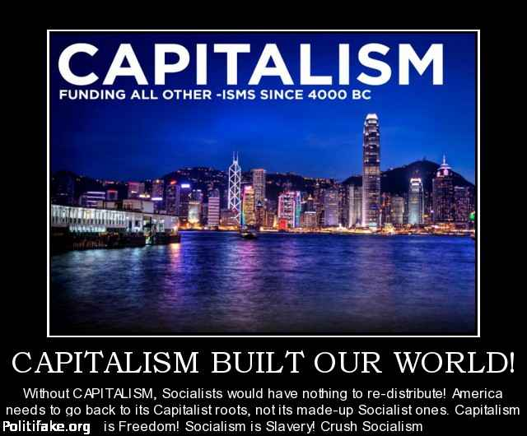

Slide 16
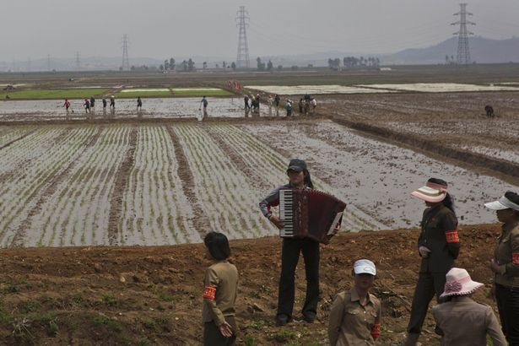
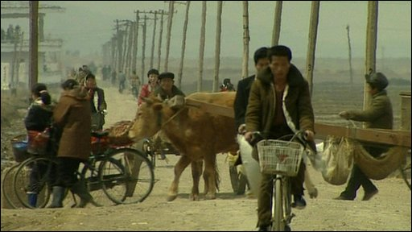
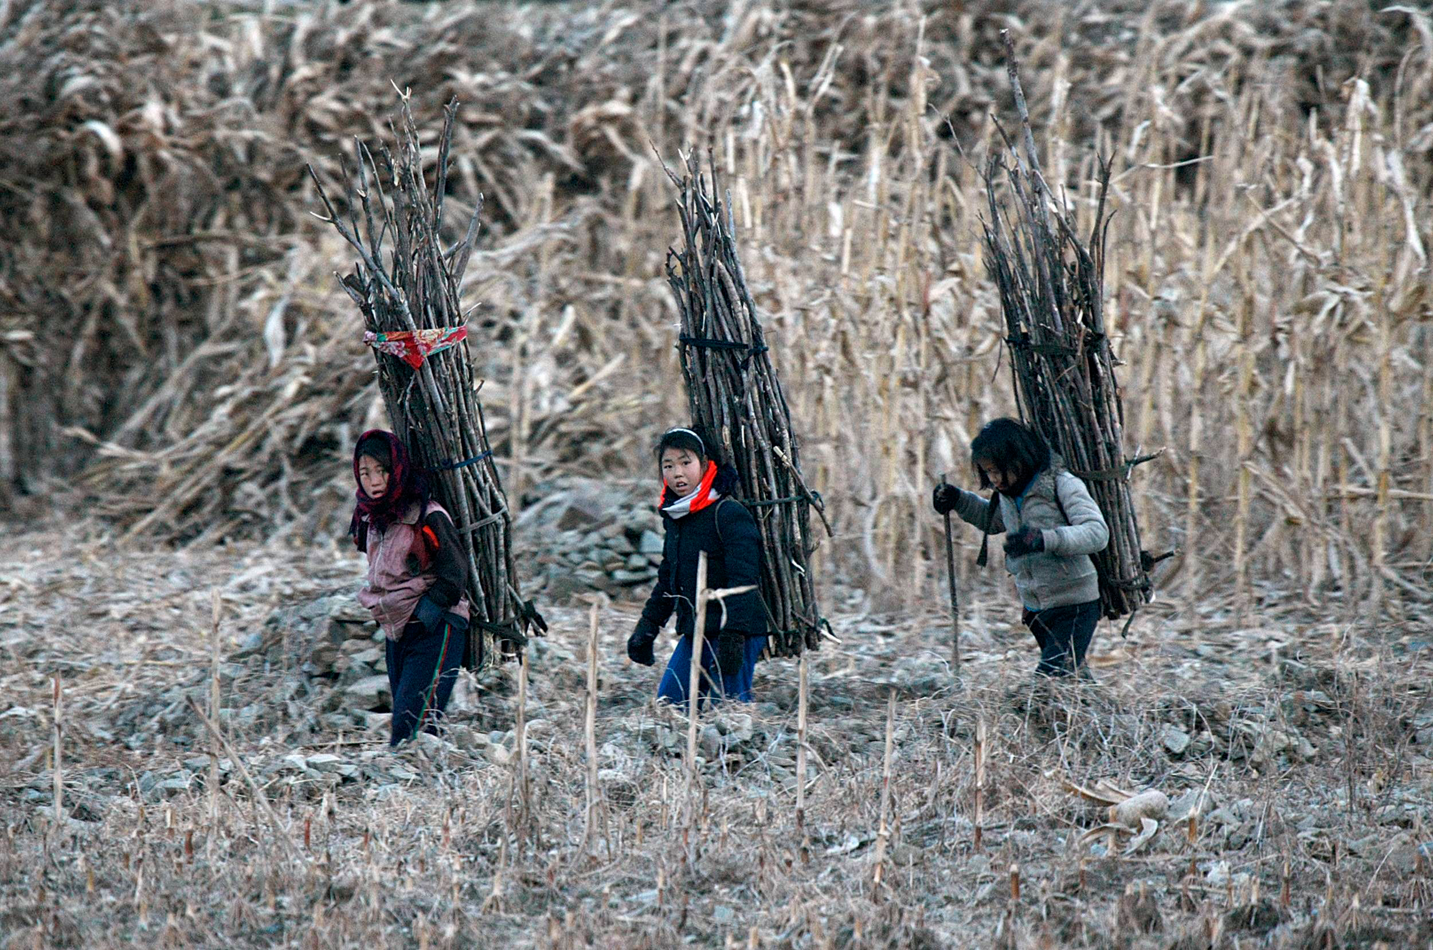
North Korea

Slide 17
The Man
Milton Friedman compares communism and capitalism
https://www.youtube.com/watch?v=lgh6wivCerE
Changing China’s Economy
https://www.npr.org/sections/money/2018/02/07/583999476/episode-337-the-secret-document-that-transformed-china
Changing America History
Pilgrims shifted from communal farms to individual ones

Slide 18
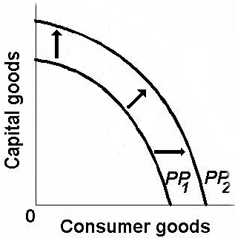
Review
1)What would cause a shift from PP1 to PP2?
A)Natural Disaster
B)Workers Strike
C)New Technology
D)Power outage

Slide 19
Changing China’s Economy
https://www.npr.org/sections/money/2018/02/07/583999476/episode-337-the-secret-document-that-transformed-china
1)How well did centrally planned farming work?
2)What principle of Adam Smith did the Chinese farmers discover and institute?
3)Why was this dangerous?
4)How did this idea change the work of the farmers and the harvests? Why?

