Slide 1
Vocabulary
Regulation- government mandates/rules regarding production and consumption
Entrepreneurship- ability to start business or using factors of production
Liability- Negative, Responsibility

Slide 2
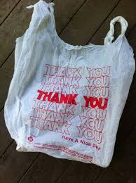
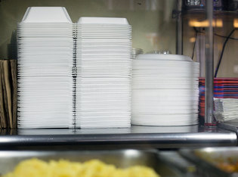
Where can’t you use these now?
Why can’t Chuck?
Ridiculous Regulations
Florists

Slide 3
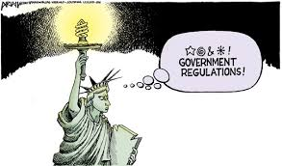
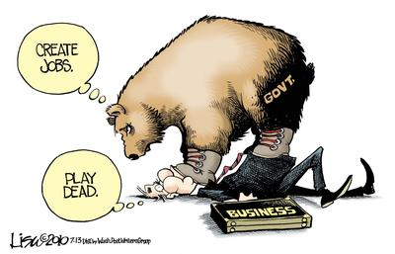
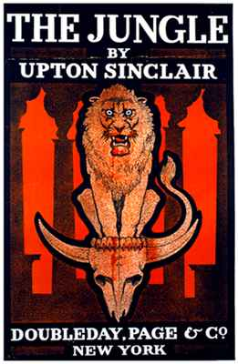
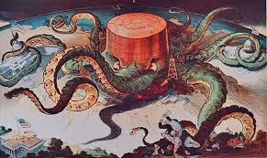

Slide 4
Recent News
Trump administration wants to freeze gas-mileage standards, reversing Obama

Slide 5
Government’s role in economy is often a political matter. (Remember the recent election???)
Government should be like an umpire, making sure rules are followed but not altering the game.
NYC Ride Apps

Slide 6
Reasonable Government Roles in the Economy
Provide public goods
  Protection, roads, infrastructure, items private firms don’t provide
Redistribute income
  Provide for those who can’t provide for themselves
Protect property rights and enforce contracts
Resolve market failures
  Situation where market is out of balance

Slide 7
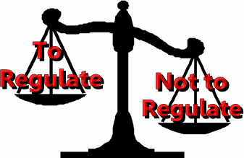
Regulation vs Deregulation

Slide 8
Regulation vs Deregulation
 | Intent | Possible Side Effects
Regulation | Protect Workers, Producers and Consumers | Could raise costs for consumers and producers; Could slow innovation and the economy
Deregulation | Reduce role of government in area of economy/ allow “market” to work | Could lead to unbalanced playing field and unfair business practices

Slide 9
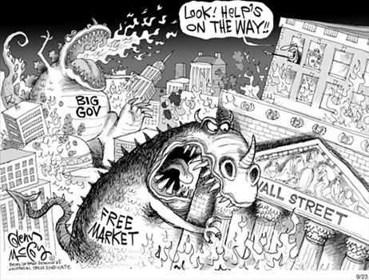
Which is better?

Slide 10
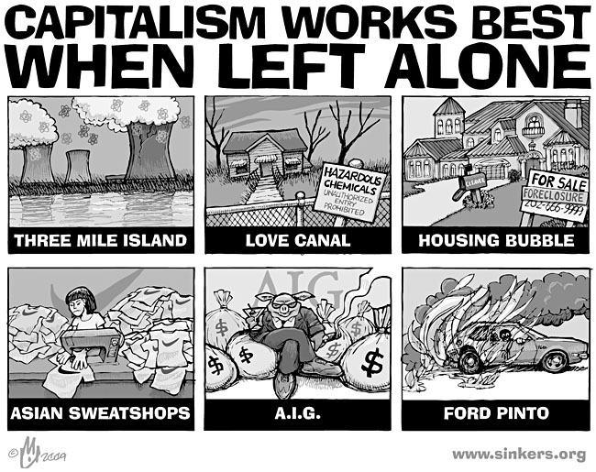
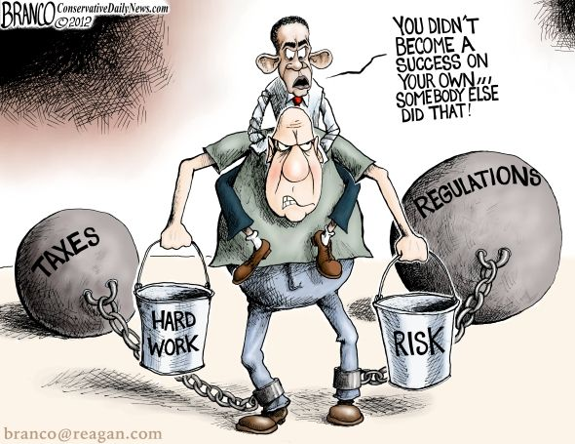
Which do you agree with?

