Slide 1
Startup
1)The federal government requires all legal mechanics to pass a mandatory online test. What is this an example of?
  A)Government deregulation
  B)Monetarists attempt to manipulate the economy
  C)Government regulation
  D)Keynesian actions on employment

Slide 2
2)What could be a possible negative consequence of regulation?
  A)safer products for consumers
  B)increased costs for businesses
  C)increased protection for businesses
  D)decreased number of worker injuries

Slide 3
Vocabulary
Public Good-nonexcludable and nonrivalrous goods or services
Market Failure-situation in which the market is out of balance
Productivity-act of producing more items with less
Marginal Cost- Cost of additional unit
Marginal Benefit-Benefit of additional unit
Notes:
Play Sittin on the dock of the Bay/Firework

Slide 4
Market Failures
Market failures are flaws in the market system. In some cases, the government must step in to “fix” the issue. In other cases, producers and consumers bear additional costs. The overall market system does have some flaws. These flaws are called market failures. There are different categories for these.
Types

Slide 5
Instability
Price system’s ability to adapt to change is generally considered a benefit but this flexibility is also unstable
System reacts to many things that could cause a drastic change
Ex. severe weather, work protests etc. Hurricane Katrina, Epi pens

Slide 6
The Fireworks Show
On July 4, the city of Hiram set off a large fireworks show. However, this was a market failure in the following ways:
People not from Hiram could see it.
The city forced citizens to pay taxes to fund it.
Hiram didn’t pay to clean up air pollution.

Slide 7
Why are public restrooms often more unclean?
How do you solve the education problem?
Why doesn’t Coke build roads without being paid for it?
What is the greatest restaurant concept of all time?
Why are rhinos almost hunted to extinction?

Slide 8
Tragedy of the Commons
Overfishing
Extinction of Black Rhinos
Dirty Public Bathrooms
Bunny Game

Slide 9
Public Goods
Any good or service that is consumed by all members of a group and none can be excluded, the goal is to produce more positive externalities than negative.
If government did not force people to pay for these goods and services through taxes than those who benefit from them won't pay

Slide 10
Examples
Public Schools(solution to education gap)
Roads
Parks
Levees
Rivers(GA)
Rhinos

Slide 11
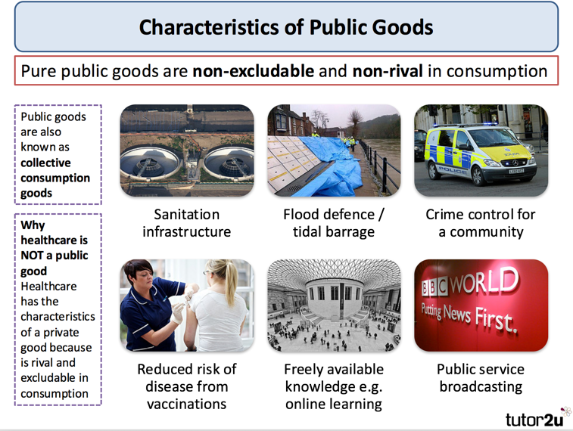
Why don’t private companies make public goods?
Private companies don’t make public goods because they can’t make a profit off of them.

Slide 12
Free Rider Problem
A free rider is someone or group who consumes more of a good than they pay for.
  Someone who gets something for nothing(public).
  Example- Riding public transit for free.
  Obtaining police protection without paying taxes.
Forced Rider is someone who pays for something but doesn’t use it.
  Paying taxes for something you don’t use.

Slide 13
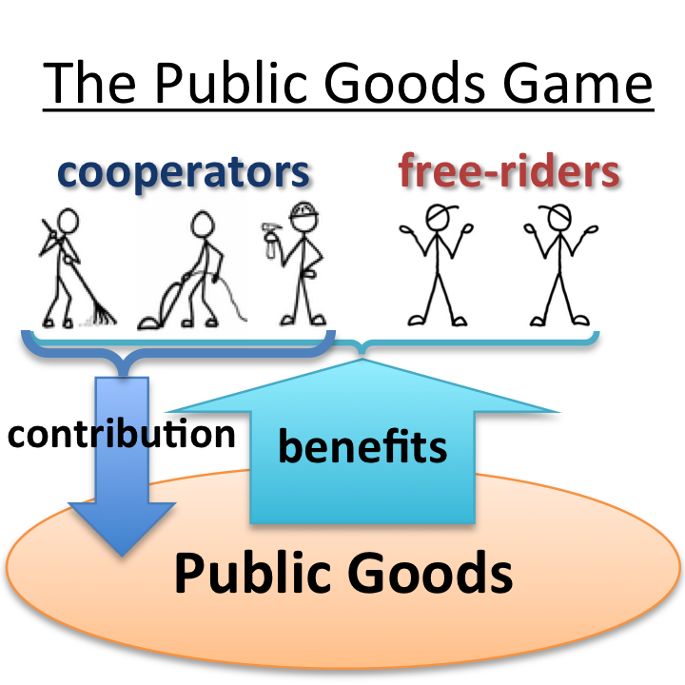

Slide 14
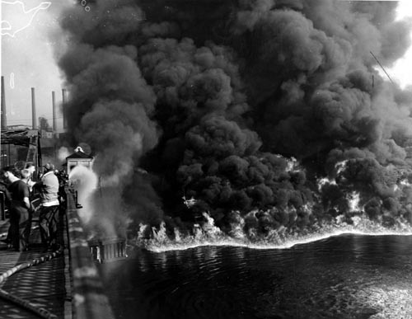
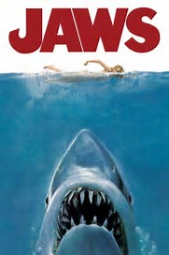
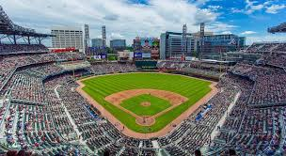

What do these have in common?

Slide 15
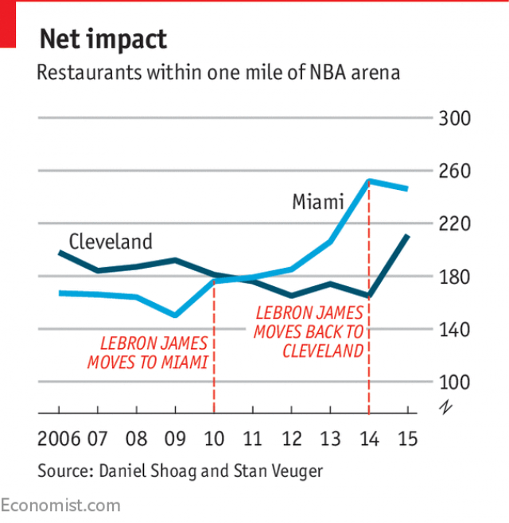
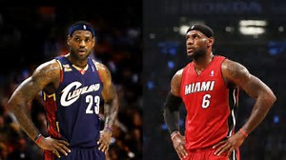
https://www.economist.com/blogs/gametheory/2017/06/sports-economics-0

Slide 16
Externalities
One limitation of the price system is that it does not take into account all of the costs and benefits of production
The production of goods has side effects for those not directly involved with the production or consumption goods these are called Externalities
Governments may unwilling or willing play a role.(EX. California and Kyoto Treaty)

Slide 17
Externalities
A cost or benefit arising from a private activity (e.g. production or consumption) that falls on others.
Externalities are symptoms not causes of market incompleteness or poorly defined property rights.
Externalities can be positive or negative
Negative Examples- pollution, increased traffic
Positive Examples- increased business due to someone else’s decision

Slide 18
Unassigned Cost/Benefit is the Problem
Flint, Michigan
Example 1: An upstream factory pollutes the water. Downstream a town uses the river for drinking water.
Since the factory is not charged for dumping polluted water in the river and since it does not use the polluted water, it does not worry about the costs it is creating.

