Slide 1
Vocabulary
Incentive- something done for motivation
Trade- mutually beneficial exchange between individuals, businesses, or governments
Globalization- expansion of economic and social ties between countries(“shrinking the world”)

Slide 2
How much do you participate in international trade?
Clothes?
Car?
Phone?

Slide 3
Quick Check
How American are your clothes?
other belongings?

Slide 4
Why do you trade?
Why do you buy orange juice when you can simply make your own?
1)Plant tree and wait
2)Harvest oranges
3)Squeeze juice into bottle
Wikihow

Slide 5
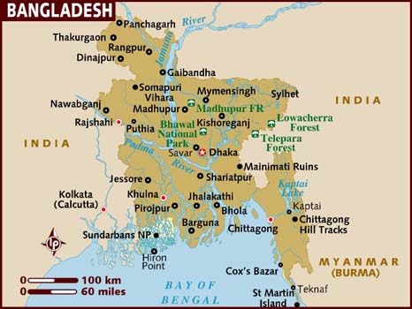
Which country is the # 2 producer of ready made clothing?
@$25,000,000,000 per year

Slide 6
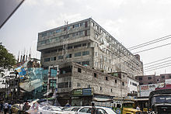
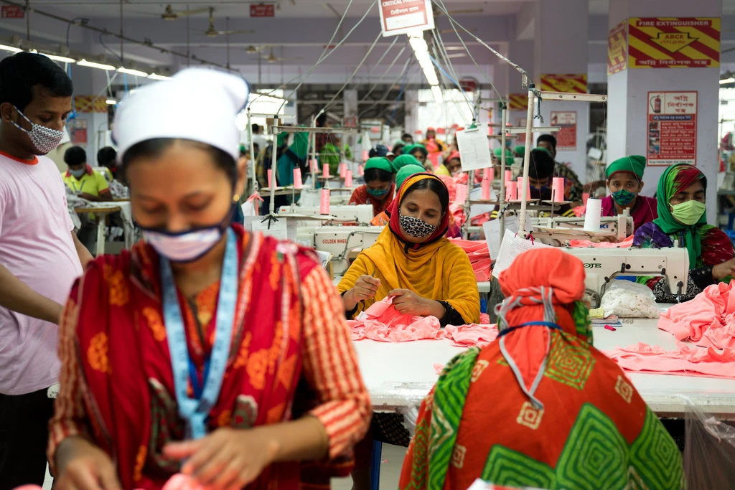
Brands made here- Benetton, Bonmarché, the Children's Place, El Corte Inglés, Joe Fresh, Monsoon Accessorize, Mango, Matalan, Primark, and Walmart.

Slide 7
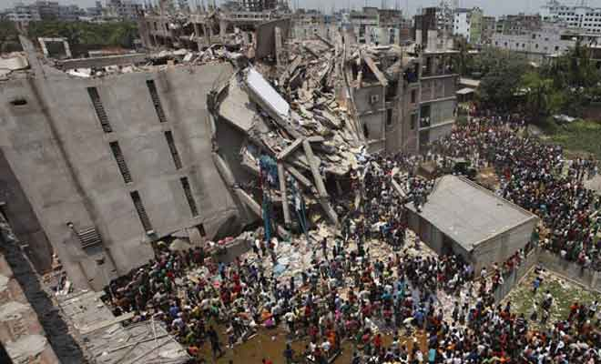
What does this image have to do with problems of free trade?
Deaths 1,135
Injuries 2,500
https://www.youtube.com/watch?v=3gBFAi0dTCw

Slide 8
Who wins? Who loses?
Invisible Winners
1)Consumers in US (cheaper prices)
2)High skilled workers in US
3)Importers in US
4)Transportation workers
Visible Losers
1)Low skilled workers in US
?)Bangladeshi Worker

Slide 9
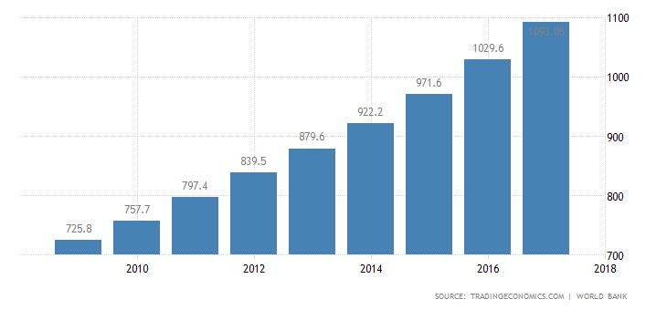
2 Sides
Garment workers minimum wage- $.32 an hour
$68 per month
@4 million workers

Slide 10
Results
1)More safety standards in Bangladesh
Supported by clothing companies
Not always followed
2)41 arrested as a result(last floors built without permit)

Slide 11
https://www.reuters.com/article/us-bangladesh-labour-fashion/six-years-after-bangladeshs-rana-plaza-disaster-fashion-brands-urged-to-pay-more-idUSKCN1S01BI
As competing garment factories are pushed lower on price by global clothing brands, profit margins are squeezed and this leads to workers’ wages being cut or paid late, restricted break times, and rising production targets, said the report by HRW.
This also leaves factories that had made safety improvements unable to compete or forced to push costs onto their workers by cutting wages, according to HRW, which urged brands to be more transparent and create fairer contracts with factory owners.

Slide 12
https://www.nytimes.com/2018/04/24/style/survivors-of-rana-plaza-disaster.html
“Eighty-three percent of our foreign currency comes from the garment sector,” said Siddiqur Rahman, president of the Bangladesh Garment Manufacturers & Exporters Association in an interview this week in his grand, air-conditioned office at the organization’s headquarters in Dhaka. “Fifty million people depend on it, and our economy is dependent on it.” He added that the government would like to double output in the next five years.

Slide 13
Generalization
No nation will engage in trade with another nation unless it will gain by that trade, both, must overall benefit from the trade.

Slide 14
FYI
Companies and individuals complete international trade, nations and other organizations create the rules for the trade.

Slide 15
Why do nations trade?
It increases the availability of goods
Some nations are better at producing goods than others
Raises living standards
Nations can focus on what to produce
Video

Slide 16
Gains from Trade
  Many people are skeptical about importing goods that a country could produce for itself.
  When countries sell goods to one another, there are benefits and costs, however the benefits should be greater.
  Trade and income distribution
    International trade might hurt some groups within nations, but help others.

Slide 17
Trade Philosophy | Free/ Unrestricted | Restricted/ Protectionism
Definition | Trade with no barriers | Trade with barriers
How | Eliminate barriers through laws | Raise barriers through laws

Slide 18
Trade Philosophy | Free/ Unrestricted | Restricted/ Protectionism
Why | 1)Promotes democracy and free trade 2)Better world relations 3) More competition means cheaper $ 4) More competition means better quality | 1)Stop unfair trade practice 2)Unfair advantages 3)Protect domestic industries 4)National Security(lower dependency) 5)To influence a country 6)Save native cultures

Slide 19
Trade Philosophy | Free/ Unrestricted | Restricted/ Protectionism
Intended Result | More competition More international cooperation | Protect domestic industries
Unintended Result | Improve global living standards More peace | Less global cooperation Protects some at expense of others

Slide 20
Read more: Catch-Up Effect Definition | Investopedia https://www.investopedia.com/terms/c/catch-up-effect.asp#ixzz5D24hTKnj
According to a longitudinal study by economist Jeffrey Sachs and Andrew Warner, national economic policies on free trade and openness play a role in the catch-up effect's manifesting. Studying 111 countries from 1970 to 1989, the researchers found that industrialized nations had a growth rate of 2.3%/per year/per capita, while developing countries with open trade policies had a rate of 4.5%, and developing countries with more protectionist and closed economy policies had a growth rate of only 2%
What does that imply about free vs restricted trade?

Slide 21
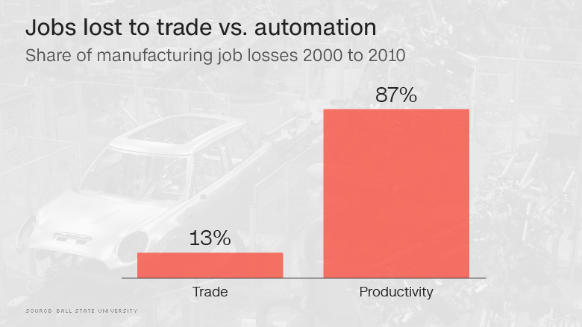
Job Loss Fallacy

Slide 22
What does the following mean?
“When trade crosses borders, then armies won’t.”

Slide 23
How did Malcolm McLean and Keith Tantlinger change the world?

Slide 24
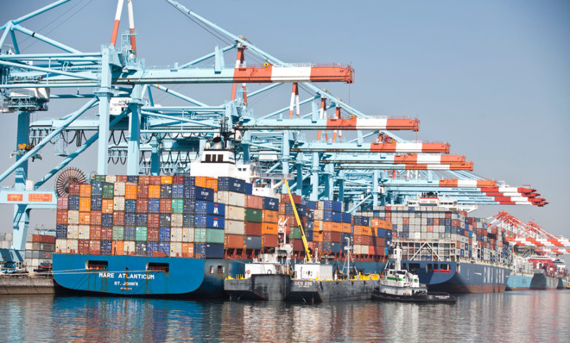
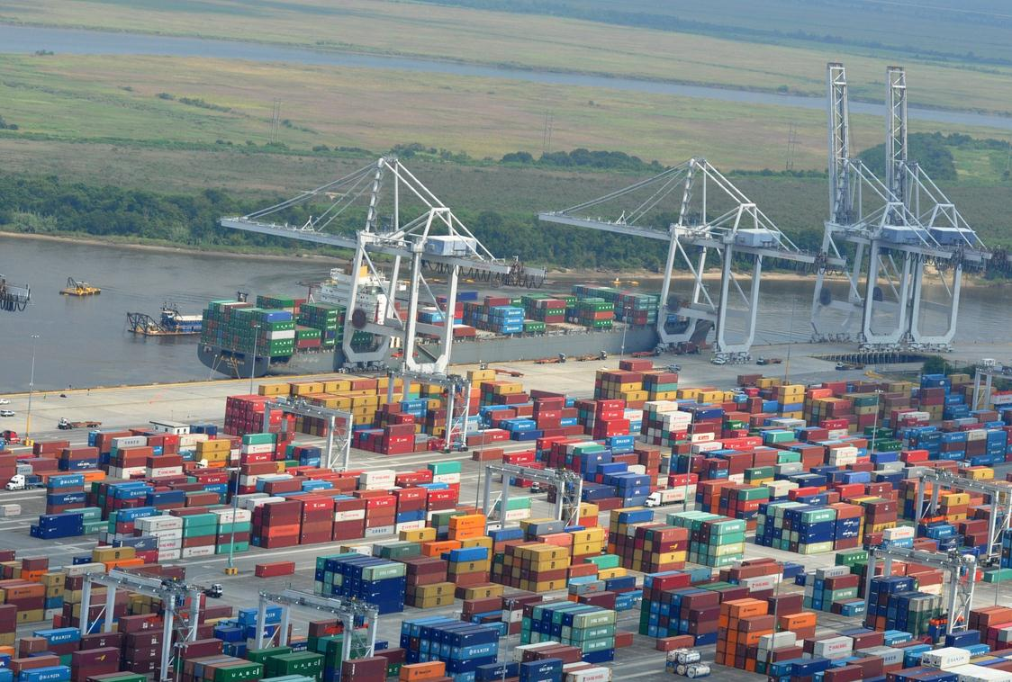
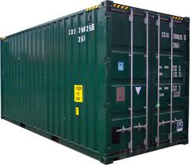
How did Malcolm McLean and Keith Tantlinger change the world?

Slide 25
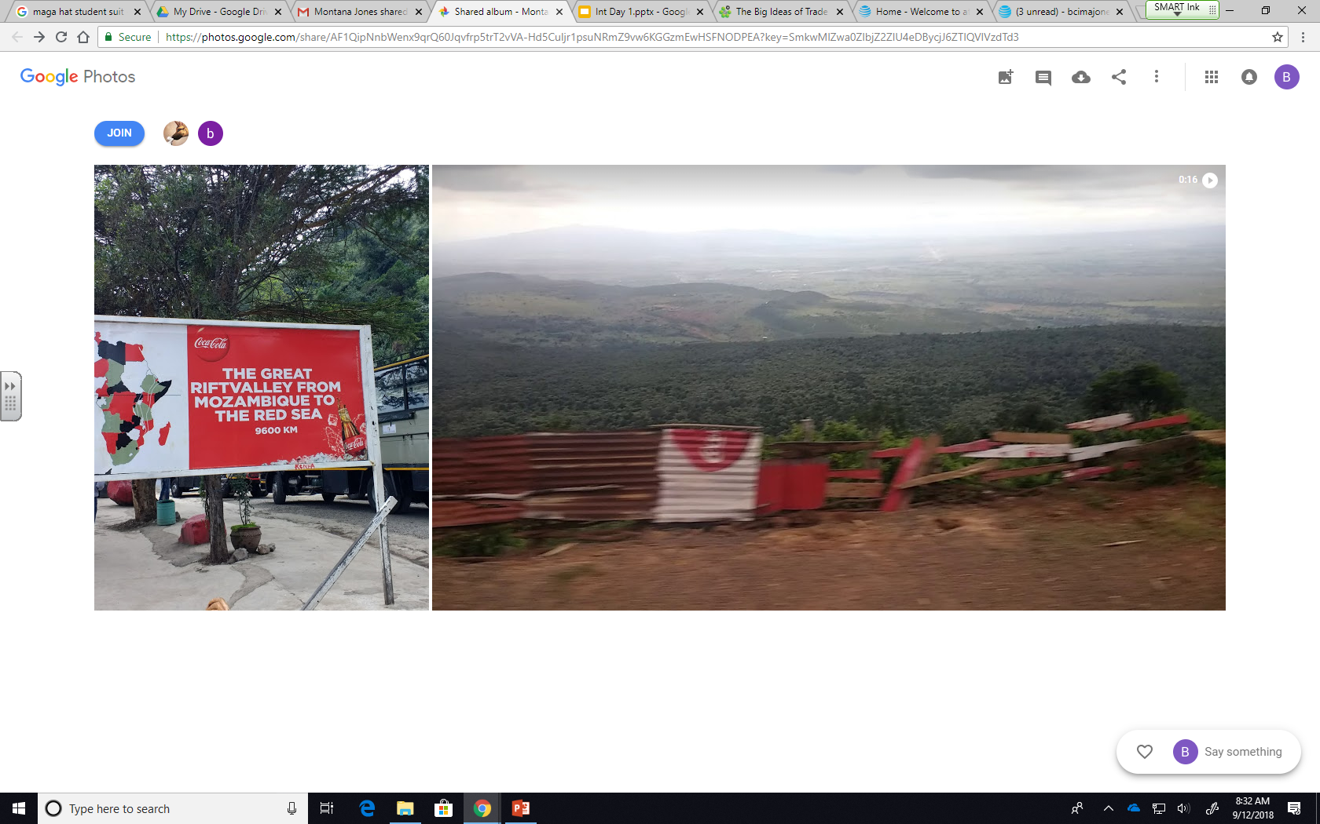
Globalization- Where is this?

Slide 26
What is unusual about the sign?

Slide 27
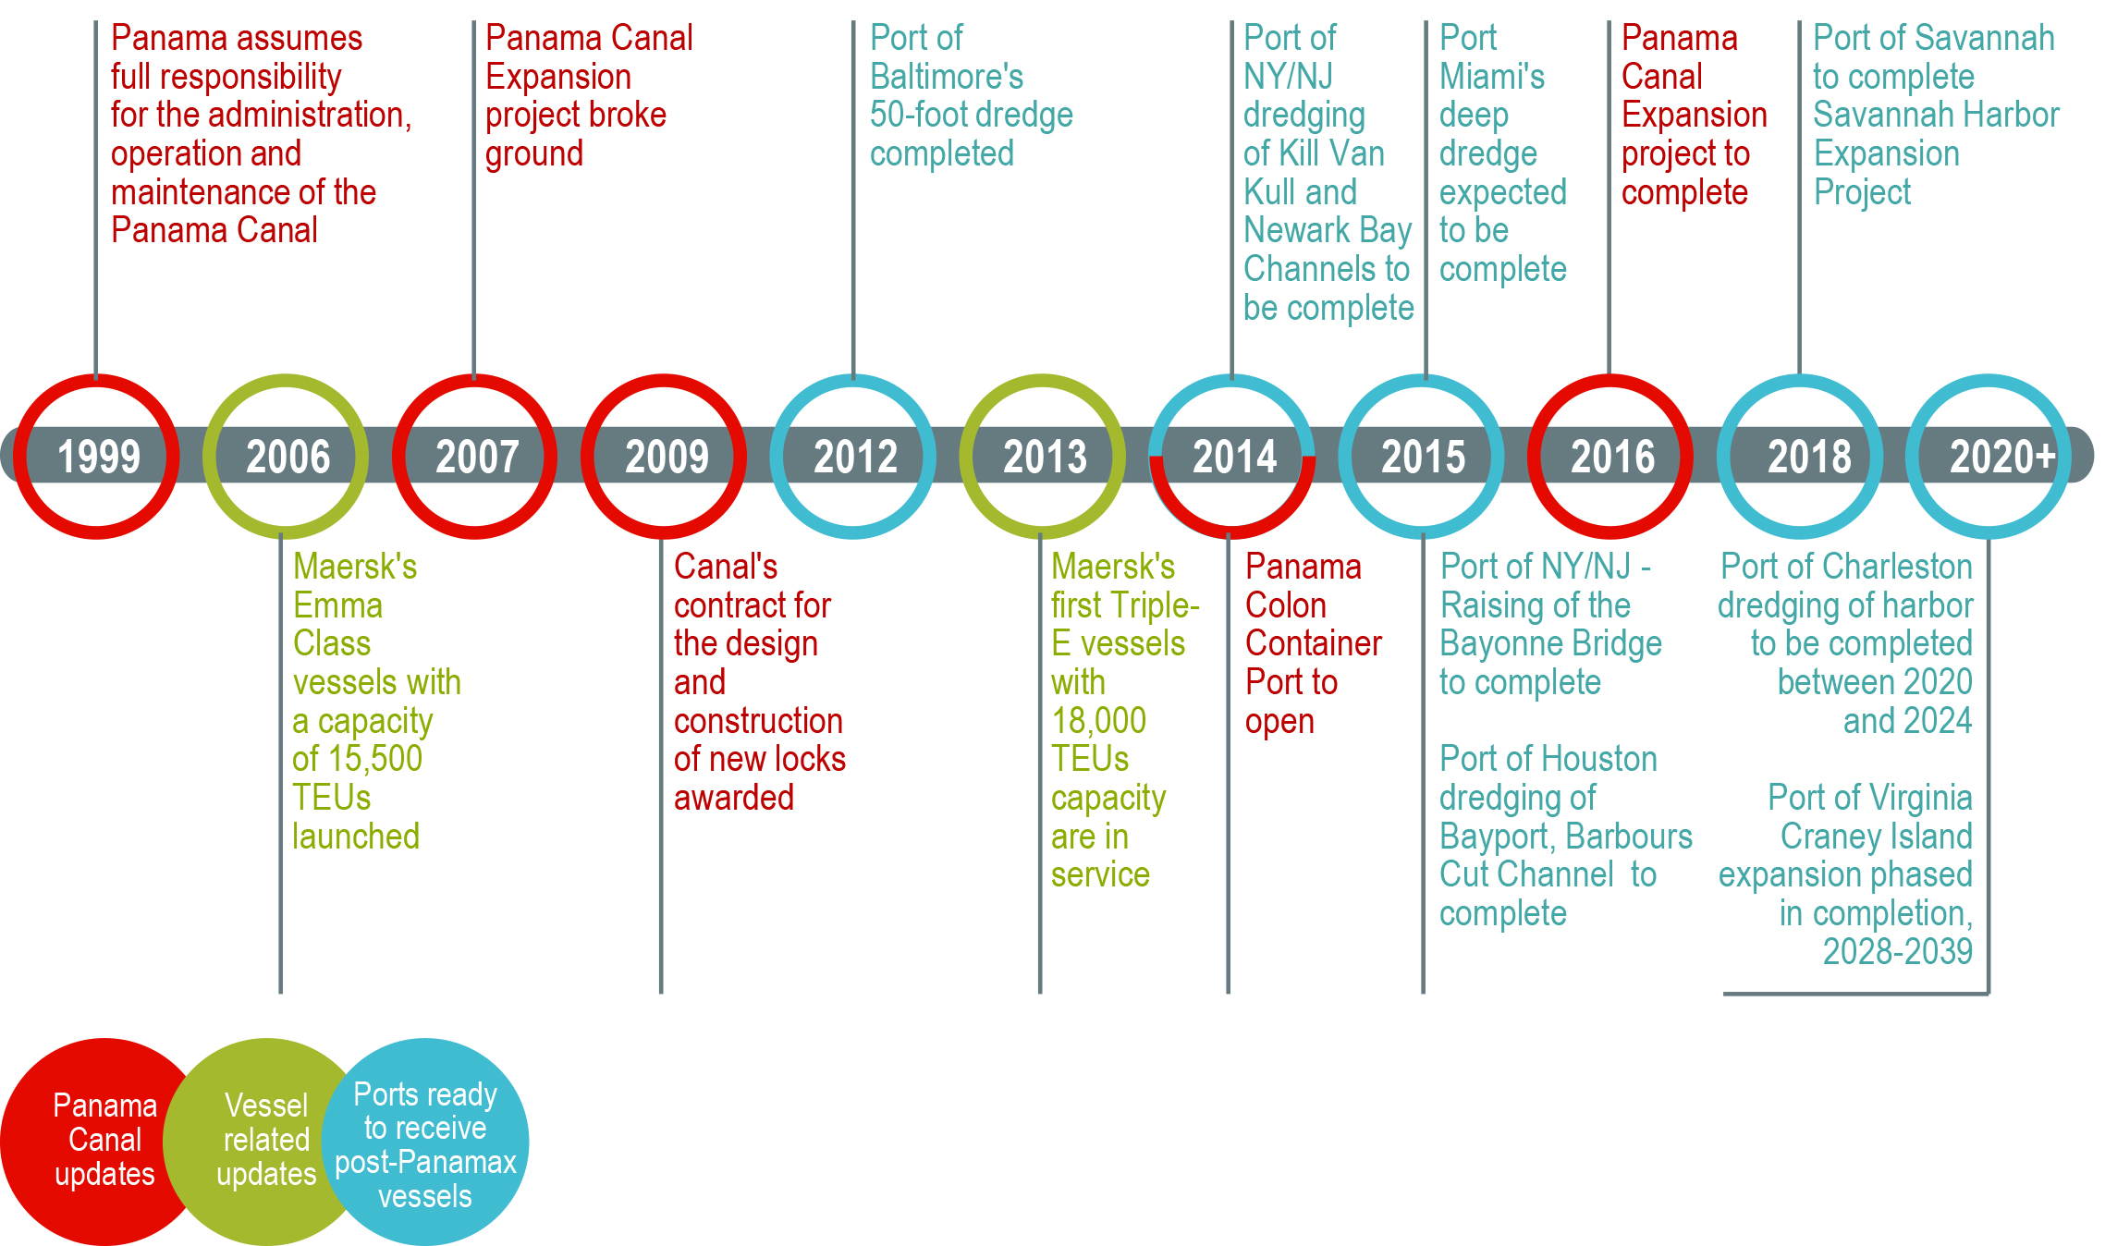
Keeping Pace with ships

Slide 28
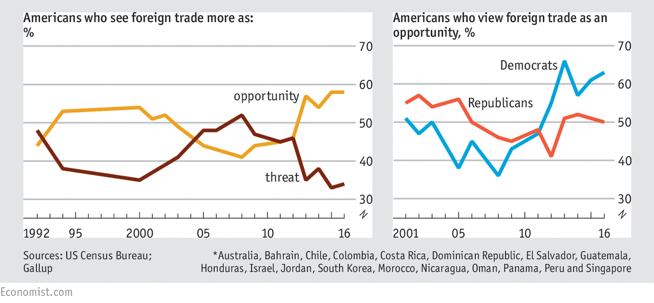
American Views of Trade
History of Tariffs

Slide 29
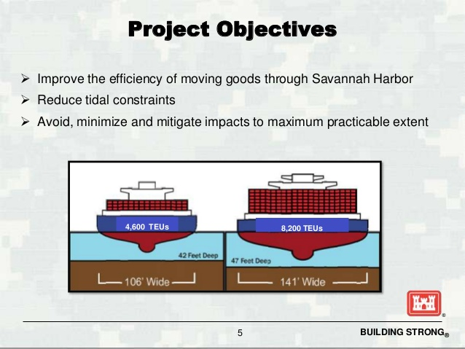
Keeping Pace with ships in Savannah, GA

Slide 30
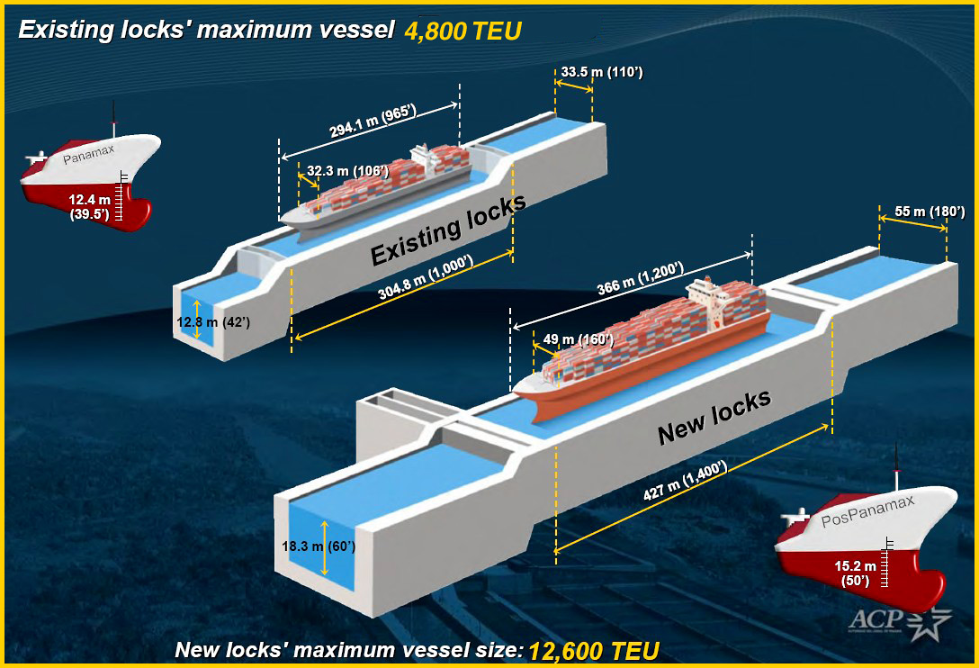
Keeping Pace with ships at Panama Canal

Slide 31
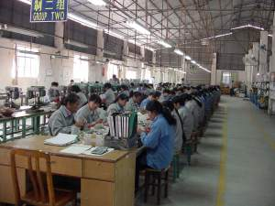
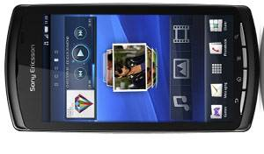
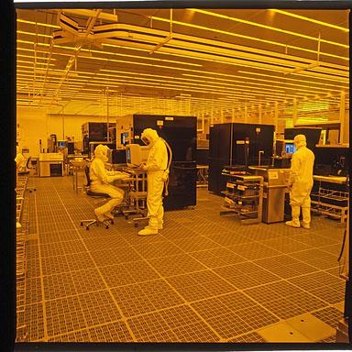
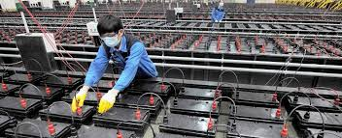
The trade
Everybody, an American engineering company has designed a new cell phone for Verizon.
A Chinese manufacturing company 王涌 (translated as Wang).
Chung, a Japaneses battery manufacturer produces batteries.
Tonight, an American microchip and processor manufacturer, makes the parts for the new phone.

Slide 32
The Miracle
The Everybody Wang Chung Tonight phone is produced and shipped around the world for sale.
Who wins?
Who loses?

Slide 33
The winners due to containers
Consumers pay less
Producers pay less to ship(before containers, 25% of cost of product was shipping, now it can cost 2.5 cents to ship a sweater 3,000 miles and 1cent to ship a beer)

Slide 34
The losers due to containers
Dock workers-due to standardization, fewer dock workers were initially needed (note- with more trade, more workers will be needed)
National Security- Nations can’t keep up with amount of trade giving terrorists opportunity to use containers for nefarious means(ABC News shipped depleted uranium to test system in 2003)

