Slide 1
Vocabulary
Tariff- tax on imported goods
Embargo- temporary stoppage of trade between nations
Free Trade- belief in no trade barriers
Protectionism- belief in strong trade barriers
Trade Barriers- things used to slow down trade(tariffs, embargo, etc)

Slide 2
What does the following mean?
“When trade crosses borders, then armies won’t.”
Snuggie

Slide 3
How much is this headline worth to Allstar Marketing?
“Snuggies are Blankets”
Why? What does it matter?

Slide 4
If a snuggie is classified as a robe(garment) the tariff is 14.9%, but if it is classified as a blanket, the tariff is 8.5%. For 2016 sales of $250,000,000, that adds up to $16,000,000.
Snuggie

Slide 5
What do these nations have in common?
Australia
Bahrain
Chile
Colombia
Costa Rica
Dominican Republic
El Salvador
Guatemala
Honduras
Nicaragua
Israel
Jordan
Korea
Morocco
Oman
Panama
Peru
Singapore

Slide 6
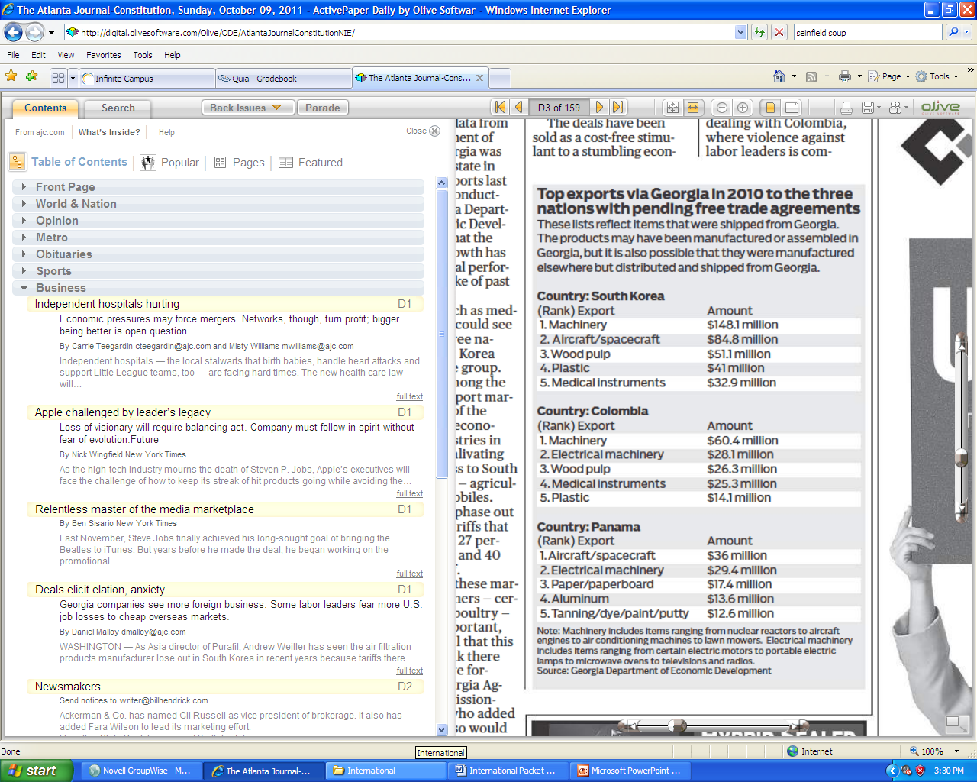
Free Trade Agreement w/ SK, Colombia, Panama

Slide 7
How can a nation restrict trade?
Trade barriers a nation may use include:
  Tariffs- tax on trade(for revenue)
    A 10% tariff on imported bananas
  Protective tariff- tax on trade to protect home industry
    A 20% tariff on cars to allow U.S. producers to compete
  Sanctions- restriction of trade to punish
    Limit trade with Iran because of terrorism ties
  Embargoes- ban on trade in order to punish
    U.S. place embargo on Syria to punish for human rights violations

Slide 8
  agricultural inspections- insures safety
    Inspecting beef from Argentina for Mad Cow Disease
    1989 Chile grape
  quotas/limits on goods- set number of items
    Limit number of cars Japan can import
  Standards- requirements set on goods to protect consumers
    Setting requirements for steel from China because of safety concerns
    VW Fine
  Subsidy-government payment to supplies to make their goods cheaper
    US farmers receive government subsidies for cotton

Slide 9
Politics versus reality
Generally, this is a very political issue. Some believe in protectionism while others believe in free trade. Your viewpoint depends on your perspective.
Economically speaking, free trade is better in the long run. However, it is easier to get elected by having a protectionist view.

Slide 10
Results
Trade Barriers raise domestic prices.
Often create unfair opportunities
Protects some at expense of others

Slide 11
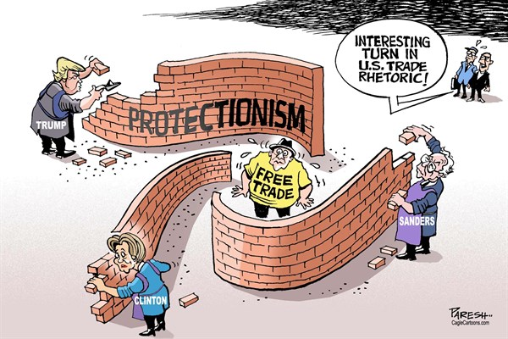
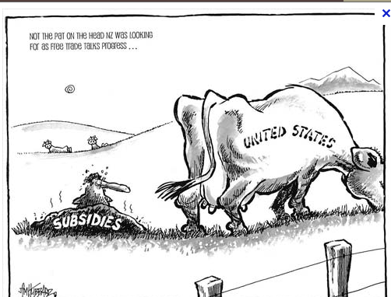
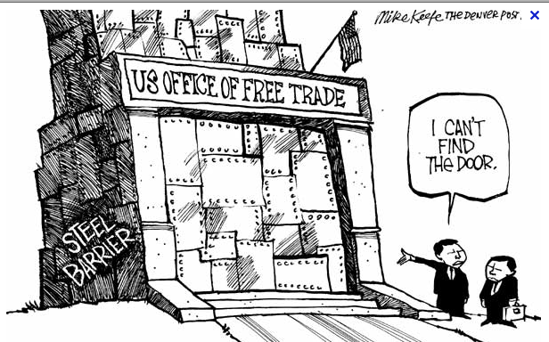

Slide 12
Example
Cost of production for phone made in China =$20
Shipping Cost= $1 New Cost=$21
Tariff=10% New Cost $23.10

Slide 13
Other concepts
Dumping-Selling goods abroad cheaper than domestically
Outsourcing- practice of hiring cheap foreign labor to replace domestic labor
Counterfeiting- illegally copying merchandise
  Problems- Dangerous because cut costs, violates copyright, hard to detect and trace
  90% comes from China

Slide 14
Video against trade
Is fair trade fair and helpful?

