Slide 1
Vocabulary
Allocate- to distribute
Comparative Advantage- having less opportunity cost than another
Absolute Advantage- simply better than another

Slide 2
What does your country do best?
Old Question- Why do companies move to China?
New Questions- Why are some goods once made in China now produced in Mexico? Why are some companies relocating back to the U.S.? Why is China buying farm land in lesser developed nations?

Slide 3
You decide
Singer/ Notes | Dr. Jenkins | Tania
High | 10 | 6
Low | 8 | 6
Dr. Jenkins and Tania are singing in a duet in the at your graduation(most likely We are the World). Dr. Jenkins can hit all 10 high notes while Tania can only hit 6. On the low notes, Dr. Jenkins can hit 8 while Tania can only hit 6. (If Tania chose the song, it would definitely be a communist song.)

Slide 4
The problem
It is evident Dr. Jenkins has more talent(duh) but, since it is a duet, who should sing which part?
The answer at the end.

Slide 5
Don’t forget the
Production possibility curve
Specialization
Division of Labor
Opportunity Cost

Slide 6
Why?
Why do we buy cheap products from China?
Why do we sell expensive items to China?

Slide 7
Trade “Advantages”
Absolute Advantage is when a nation is better at producing something than its trading partner. Absolute deals with the cost of production.
Comparative Advantage is when a nation has less opportunity cost than its trading partners.
The law of Comparative Advantage states that the total output is greatest when each product made by the country that has the lowest opportunity cost.

Slide 8
Advantages
Absolute advantage is not necessary for trade, but comparative is.
To find people's comparative advantages, do not compare their absolute advantages. Compare their opportunity costs(what is given up)

Slide 9
Note
Nation can have AA in both.
Nation can not have CA in both

Slide 10
Factors Which Determine Comparative Advantage
natural endowments such as resources,
availability and use of technology,
knowledge and human capital,
specialization, and
rapidly changing factors such as exchange rates
Video
Video 2

Slide 11
Calculating Comparative Advantage
1)Calculate opportunity cost(what is given up)(Losing/Gaining)
Lowest opportunity cost has comparative advantage
2)Cross Addition- highest total has CA
3)If all else fails, graph to scale

Slide 12
Who should do which?
Country/Good | US | Canada
Lumber | 15 | 20
Wheat | 30 | 10
US should trade ??? to Canada for ???

Slide 13
How will the trade work?
Country/Good | Namibia | South Africa
Diamonds | 10 | 25
Beef | 40 | 50
Namibia should trade ??? to South Africa for ???

Slide 14
How will the trade work?
Country/Good | Panama | Colombia
Coffee | 20 | 100
Bananas | 40 | 50
Panama should trade ??? to Colombia for ???

Slide 15
How will the trade work?
Country/ Good | Cheap | Expensive
China | 50 | 10
U.S. | 60 | 30
China should trade ??? to U.S. for ???

Slide 16
How will the trade work?
 | Gold | Silver
Burundi | 10 | 30
Rwanda | 5 | 50
Burundi should trade ??? to Rwanda for ???

Slide 17
Gains from Comparative Advantage
When countries specialize in producing the goods in which they have a comparative advantage, they maximize their combined output and allocate their resources more efficiently.
Comparative advantage=do what you do best and trade for rest

Slide 18
On a personal level
You should focus on your comparative advantage, not your absolute. It is not about what you do best, but your lowest opportunity cost.
Justin “I would rather make $10,000 for one day than $12,000 for two days of work”

Slide 19
Example- You car needs repair, you can
Fix it yourself
Research problem
Buy needed tools
Buy parts
Fix it yourself
You have used up time, energy, money, stress, and frustration
Take it to be fixed
Take car in
Costs more money

Slide 20
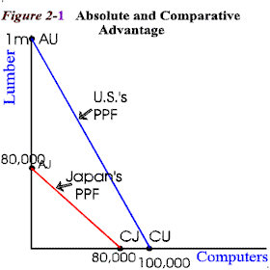
Illustrating Comparative Advantage
In the Graph, which nation has the comparative advantage in lumber? Computers?

Slide 21
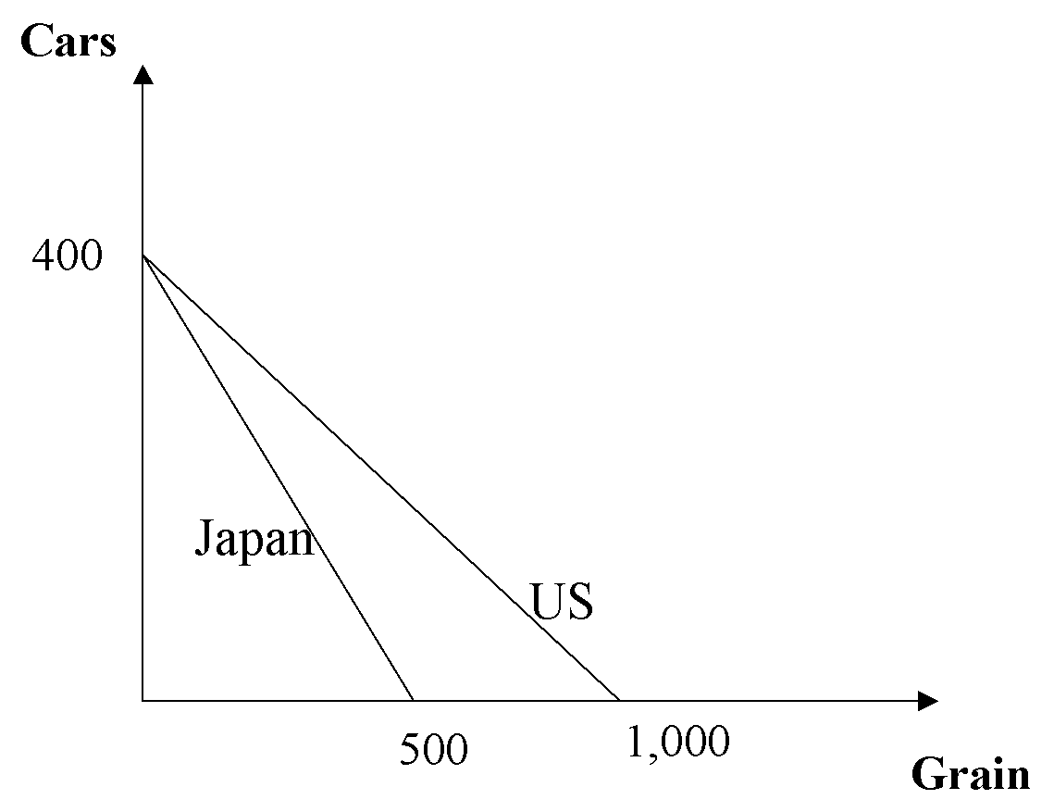
Review Time
Which nation has the comparative advantage in cars? Grain?

Slide 22
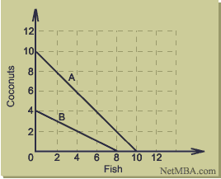
Review Time
Which nation has the comparative advantage in Coconuts? Fish?

Slide 23
You decide
Singer/ Notes | Dr. Jenkins | Tania
High | 10 | 6
Low | 8 | 6
Dr. Jenkins and Tania are singing in a duet in the at your graduation(most likely We are the World). Dr. Jenkins can hit all 10 high notes while Tania can only hit 6. On the low notes, Dr. Jenkins can hit 8 while Tania can only hit 6.

Slide 24
The solution
Who has the absolute advantage? Why?
Dr. Jenkins is better at both because he can hit more high and low notes.
Who has the comparative advantage in high? Why?
Dr. Jenkins because he only gives up 4/5 of high to Tania’s 1
Who has the comparative advantage in low? Why?
Tania because she only gives up 1 low to Dr. Jenkins’ 1 ¼.

Slide 25
HIgh Notes
Dr. Jenkins
Tania
Low Notes

Slide 26
Conclusion
Dr. Jenkins should sing the high notes and Tania should sing the low because of comparative advantage.

Slide 27
1)Based on the information, which is most likely to be true? A)Bolivia has absolute advantage in beef and should trade for bananas B)Bolivia should trade bananas for beef from Chile because of absolute advantage C)Chile should trade beef for bananas from Bolivia because of comparative advantage D)Chile has the comparative advantage in bananas and Bolivia has it in beef
Country/Good | Bolivia | Chile
Beef | 30 | 50
Bananas | 40 | 20

Slide 28
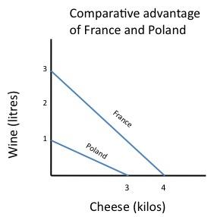
2)According to the image which is true?
A)France doesn’t need to trade because it has absolute advantage in both
B)Poland should trade cheese for wine from France
C)France should trade cheese for wine from Poland
D)France has the comparative advantage in both

