Slide 1
Vocabulary
OECD- organization of developed nations
Developing- poorest nations
Developed- more wealthy nations
Economies of Scale- growing to an extremely efficient organization

Slide 2
Rank your answers
1
2
3
4
5
6
7
8

Slide 3
The Countries
A=Argentina
B=Japan
C=Nigeria
D=Russia
E=Singapore
F=DR of Congo
G=Switzerland
H=Ukraine

Slide 4
Order/GDP per Capita/Rank
E Singapore $94,100/7th
G Switzerland $62,400/16th
B Japan $41,900/42nd
D Russia $27,100/74th
A Argentina $20,900/88th
H Ukraine $8,800/146th
C Nigeria $5,900/166th
F DR of Congo $800/226th
CIA Factbook 4/24/2019
FYI-
U.S. $59,300/19th
Albania $12,500/125th

Slide 5
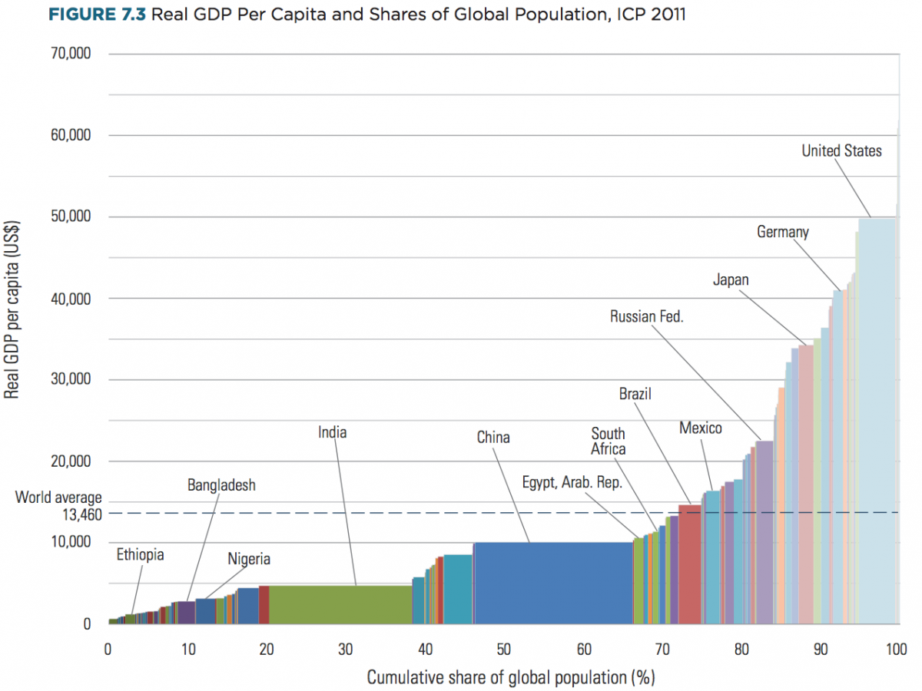

Slide 6
Time is takes to open a legal business
Peru-
Haiti-
Congo-
Brazil-
Venezuela-
Hong Kong-
U.S.-
Singapore-

Slide 7
Time is takes to open a legal business
Peru- 289 Days
Haiti- 196 Days
Congo- 155 Days
Brazil- 152 Days
Venezuela- 141 Days
Hong Kong- 11 Days
U.S.- 6 Days
Singapore- 4 Days

Slide 8
Why are some nations poor and others wealthy?
High investment levels in physical and human capital
Greater economic freedom, including lower taxes, fewer government regulations, sound monetary policy, protection of property rights, and decentralized decision-making in most sectors of the economy

Slide 9
Strong incentives to save, invest, and increase productivity (including property rights)
Competitive markets
Low inflation(Central Bank)
Political stability
Free trade
Private Property Rights
Ease of Firing Employees

Slide 10
Process
Incorporating these in a fledgling economy(old Soviet states) is not easy and will take time and sacrifice. It may take several generations to actually see the improvement. It may take personal and political sacrifice.

Slide 11
What is missing? What doesn’t count in determining wealth of nation?
Population(# or ethnicity)
Natural Resources
Location
Size of Nation
History of Nation

Slide 12
Categories of Nations
Developing- Nations which are in the process of industrializing(some are many years away) Once called 3rd World
Also Called Emerging
Examples?
Developed- Nations which have industrialized. Once called 1st World
Examples?
What is the difference?

