Slide 1
Vocabulary Day 6
WTO- Group monitoring world trade(make it fair)
EU- Free trade agreement block in Europe
NAFTA- Free trade agreement block in North America
World Bank(ADD)- loans money to poor countries for development
IMF- gives advice to developing countries on monetary policy

Slide 2
International Organizations
Groups that monitor and help facilitate trade.
World Bank
International Monetary Fund(IMF)
G8
World Trade Organization(WTO)

Slide 3
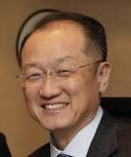
World Bank
The World Bank gives financial(loans and advice) assistance to developing nations.
The World Bank is a vital source of financial and technical assistance to developing countries around the world. We are not a bank in the common sense. We are made up of two unique development institutions owned by 184 member countries—the International Bank for Reconstruction and Development (IBRD) and the International Development Association (IDA). Each institution plays a different but supportive role in our mission of global poverty reduction and the improvement of living standards.
Dr. Jim Yong

Slide 4

International Monetary Fund
Promote economic and social progress in developing countries.
Gives advice to developing nations
Monitors nations monetary policy
Often has mixed results.
Christine Lagarde- Head of
IMF

Slide 5
World Trade Organization
Organization which monitors trade to ensure fairness.
Dumping- Selling goods abroad cheaper than domestically
Copyright violations
Labor practices

Slide 6
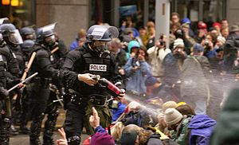
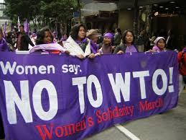
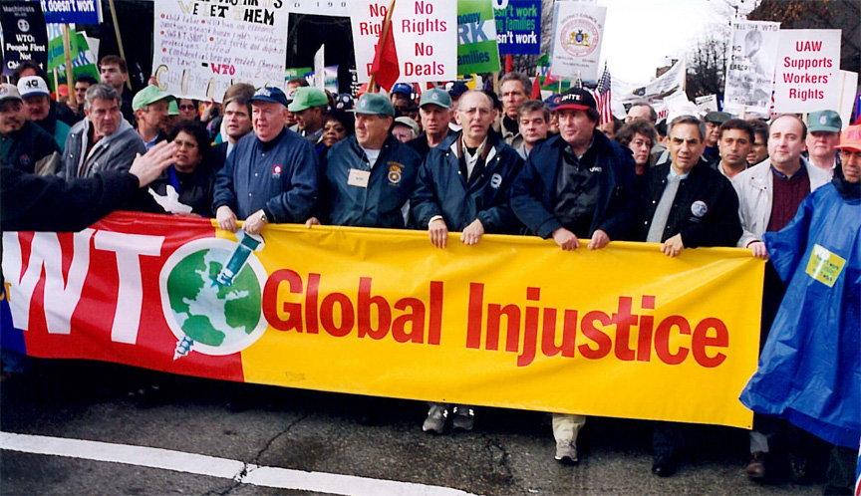
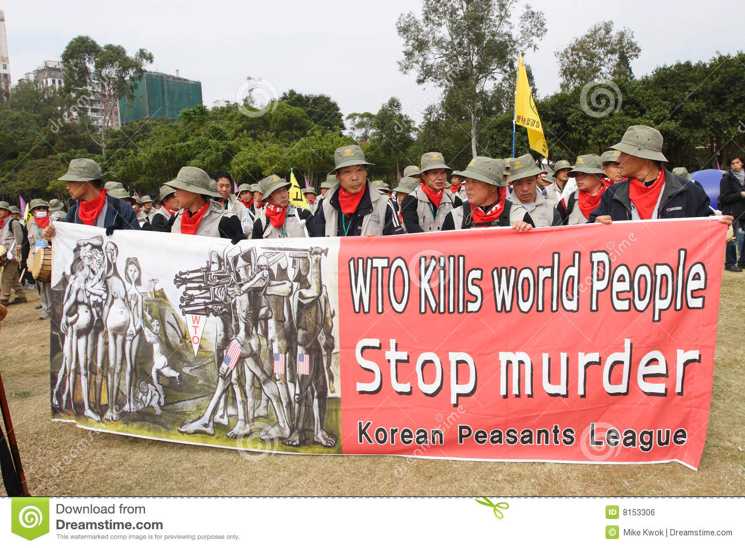

Slide 7
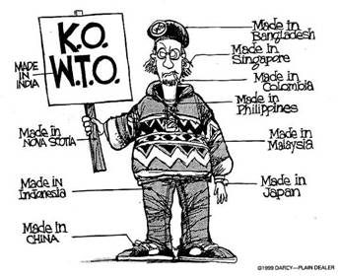
How is this ironic?

Slide 8
G8/7
Eight of the most economically powerful nations meet to discuss the world economy.
Members- Canada, U.S., France, Germany, Italy, Japan, United Kingdom, Russia.(Russia was recently kicked out of group over tensions with the Ukraine.)
Last meeting in June 2018 in Canada.
Meet at Sea Island, GA in 2004.

Slide 9
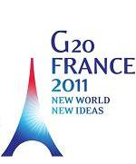
Other “G”s
G20-Representatives from 20 influential countries meet to discuss economic concerns
G40-Representatives from 40 influential countries meet to discuss economic concerns

Slide 10
International Trading Blocks
Group of nations that agree to lower trade barriers to increase trade.
European Union(EU)
North American Free Trade Agreement (NAFTA)
Association of South East Asia Nations
(ASEAN)
Check these out

Slide 11
The North American Free-Trade Agreement (NAFTA)
Trade agreement to lower tariff between the US, Canada, and Mexico which resulted in little if any trade barriers.
The North American Free-Trade Agreement (NAFTA) is an agreement signed by the United States, Mexico, and Canada in which the three countries agreed to establish all of North America as a free-trade zone.
Now USMCA- U.S., Mexico, Canada Agreement

Slide 12
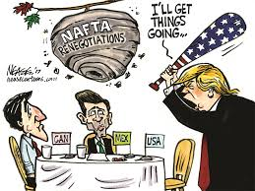
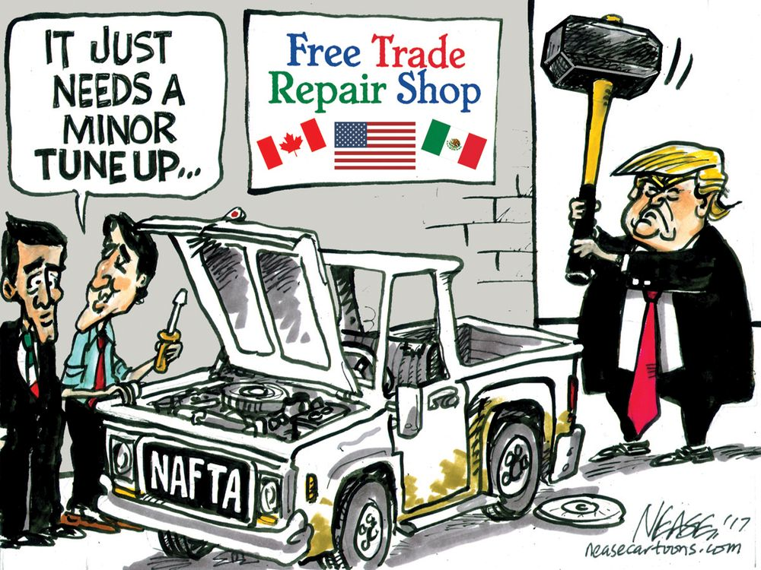

Slide 13
European Union
The European Union (EU) is the European trading bloc composed European nations of Austria, Belgium, Denmark, Finland, France, Germany, Greece, Ireland, Italy, Luxembourg, the Netherlands, Portugal, Spain, Sweden, and the United Kingdom.

Slide 14
Other Associations
Association of Southeast Asian Nations- ASEAN-promotes trade and progress in Southeast Asia
OPEC- Oil Producing and Exporting Countries
GATT- General Agreement on Trade and Tariff- promotes freer trade
BRIC-Brazil, Russia, India, China

Slide 15
Other
The US grants Most Favored Nation status to nation and gives them a lower tariff.

