Slide 1
Vocabulary Day 7
Exchange Rate- value of one currency in terms of another

Slide 2
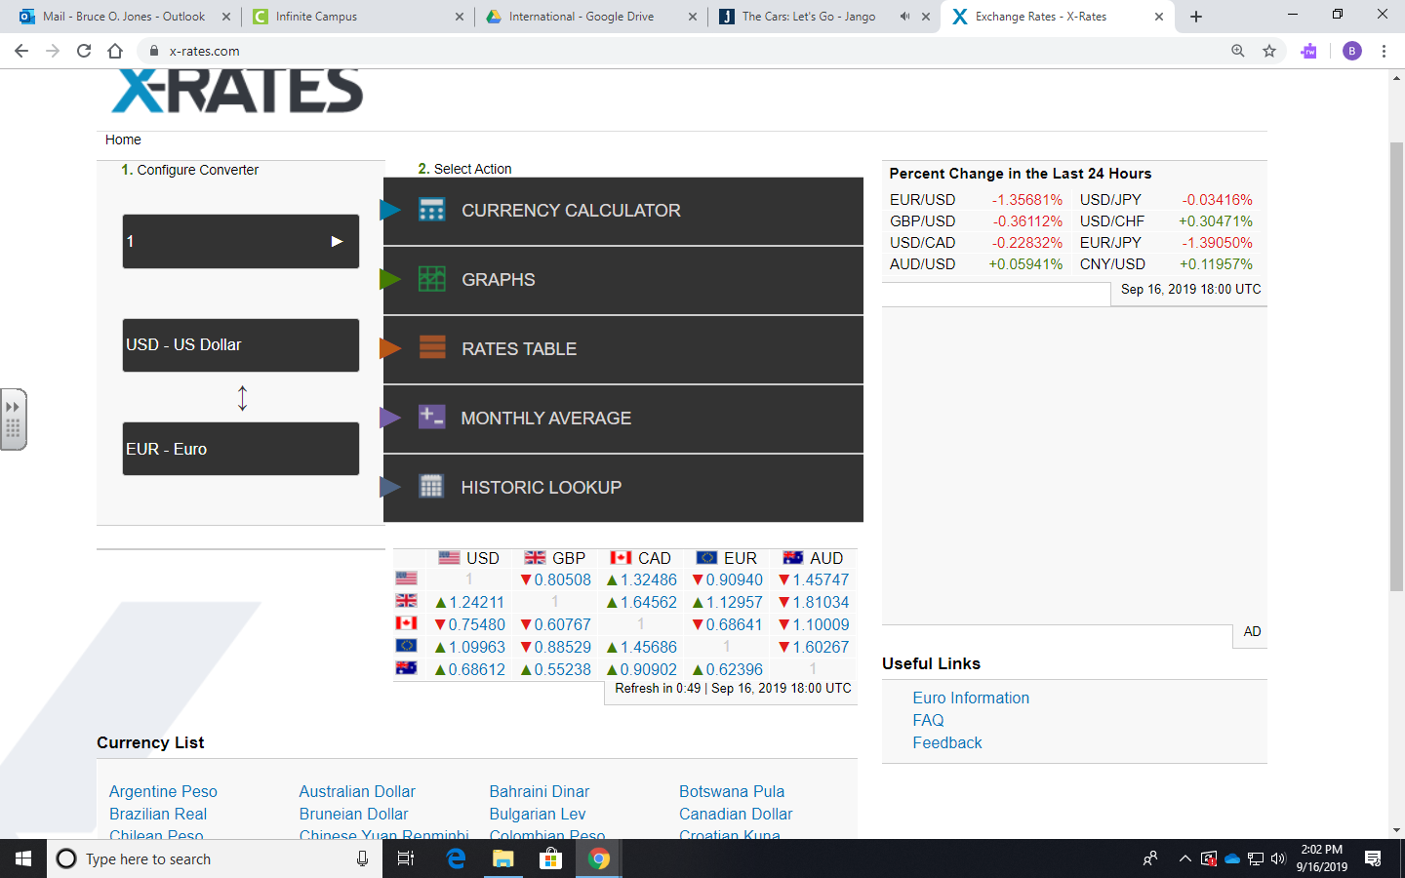

Slide 3
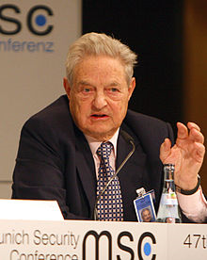
Who is this guy? Why is he important?

Slide 4
Who is this guy? Why is he important?
George Soros
He is referred to as
“The man who broke the Bank of England”. In 1992, on “Black Wednesday” he made a profit of $1 billion in currency trades.

Slide 5

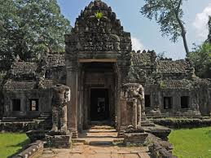

What did they do?
Preah Khan Temple in Cambodia and Sisters from Arizona.
Crime—
Punishment-
Deported
1,000,000 Riel fine
Was the fine fair?

Slide 6
Foreign Exchange Terms
Foreign exchange: money denominated in the currency of another nation or group of nations
Cash
Credit
Bank deposits
Other short-term claims (e.g., bonds)
Exchange rate: the price of a particular currency relative to another
Notes:
If we’re in the United States, “foreign exchange” means yen, euros, canadian dollars, pounds.
If you’re in England, the U.S. dollar is “foreign exchange.”

Slide 7
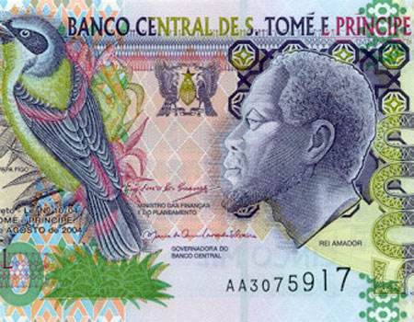
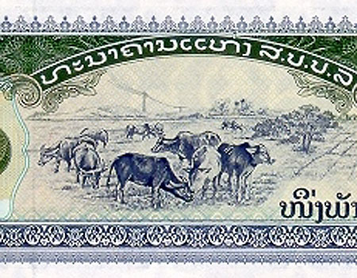
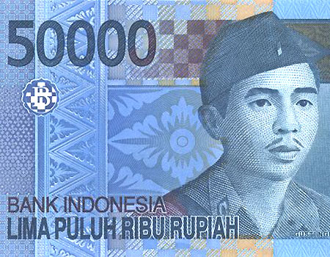
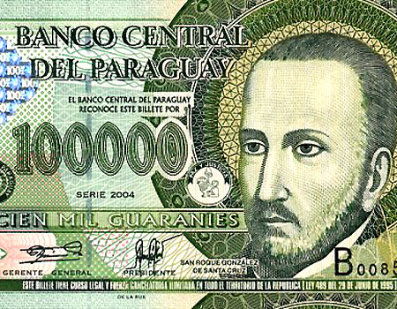
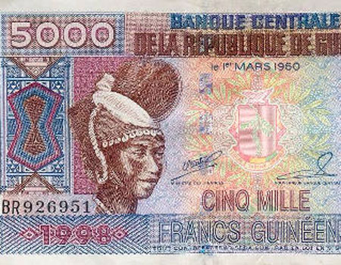
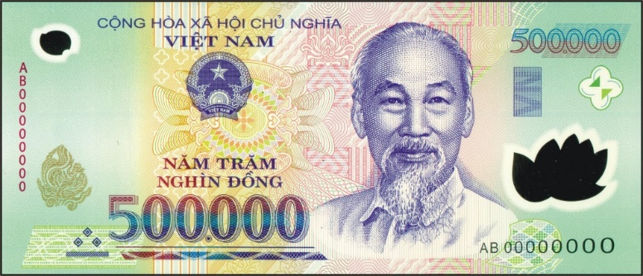
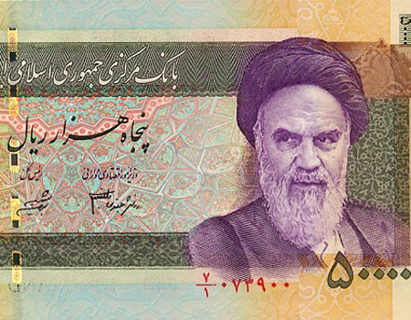
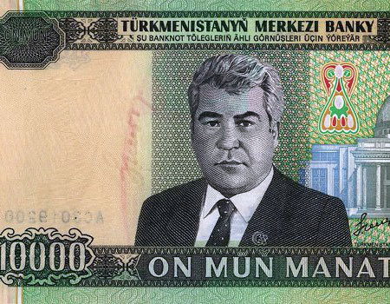
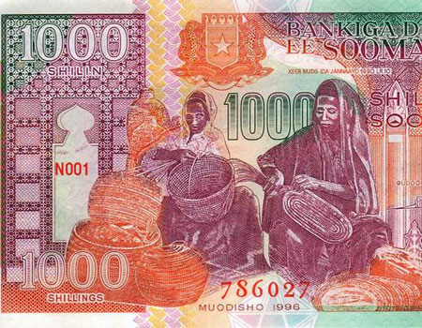
10 Worst Currencies(as of 9/16/2019)

Slide 8
10 Worst Currencies(as of 9/16/2019)
10 PARAGUAY $1 USD = 6,169.37 GUARANI
9 LAOS KIP $1 USD = 8,583.15
8 GUINEA FRANC $1 USD = 9,112.25
7 Indonesia $1 USD = 14,052.00 Rupiah
6 SAO TOME AND PRINCIPE $1 USD = 21,094.73 DOBRA
New Dobra 21.1253
5 VIETNAM $1 USD = 23,173.40 DONG
4 Turkmenistan $1 USD = 24,000 now 3.4 Manat
3 IRANIAN RIAL $1 USD = 42,052.50 RIAL
2 Somalia $1 USD = 35,000 now 56.2319 Shillings
1 ZIMBABWE $1 USD = 642,371,437,695,221,000 now 361.9 ZIMBABWEAN DOLLARS

Slide 9
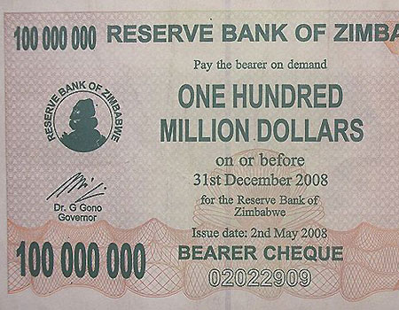

Slide 10
In Nominal terms, would you rather have
1 Euro
5 Swiss Francs
100 Japanese Yen
200 Indian Rupees
1000 Angola Kwanza
2000 South Korean Won

Slide 11
Would you rather have
1 Euro
5 Swiss Francs
100 Japanese Yen
200 Indian Rupees
1000 Angolan Kwanza
2000 South Korean Won
1 Euro=$1.10
5 Francs=$5.04
100 Yen=$.92
200 Rupees=$2.78
1000 Kwanza=$3.12
2000 Won=$1.68
As of 9/16/2019

Slide 12
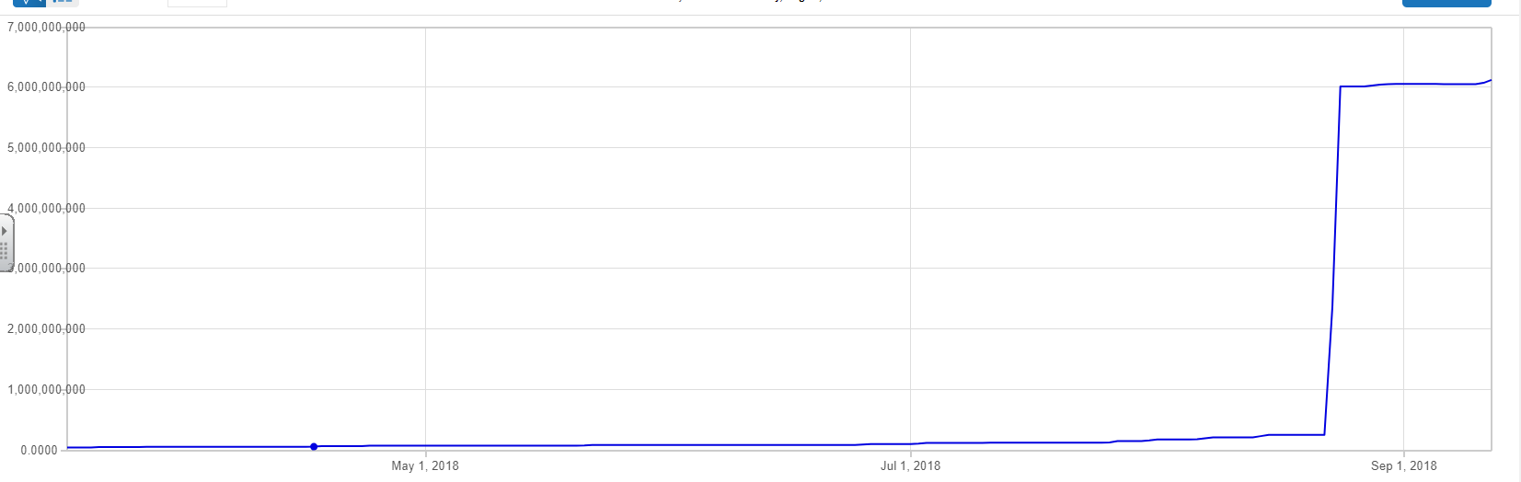
FYI
$1=6,119,460 Bolivars

Slide 13
Question
If $1 US is equal to 30.60 Nicaraguan Cordoba what is 1 Cordoba worth in US dollars?
If $1 US is equal to .76 St. Helena Pound, what is 1 SH Pound worth in US dollars?

Slide 14
2 Ways to Illustrate Exchange Rate
1 Currency A= ? Currency B
1 Currency B=? Currency A
To change one conversion to another, simply take the reciprocal.

Slide 15


Examples
$1 US = 83.60 Bangladeshi Taka
Or
1 Bangladeshi Taka = $.01196 US
1 Albanian Lek= .578 Bhutanese Ngultrum
Or
1 Bhutanese Ngultrum = 1.73 Albanian Lek

Slide 16
Important
Please note how exchange rates work. If you have a $1 and exchange it for Argentine Currency(Peso), you would receive 39.71(was 17.58 6 months ago). However, the value would remain relatively the same. So you are no richer.
Note- Factors such as supply/demand and cost of living will alter these results. Example, housing may be cheaper in Argentina.

Slide 17
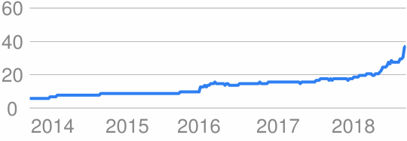
Argentine Peso in Free Fall 9/13/2018

Slide 18
Differences- Nominal vs Real
Nominal is what is posted
Example $1 US = 83.60 Bangladeshi Taka
Real is adjusted for price differences
Example $1 US = 83.60 Bangladeshi Taka but prices are ½ in Bangladesh, then the real rate is $1=167.2 BT.
Real ER=Nominal ER X (Domestic Prices/ForeignPrices)

Slide 19
Why and when do people deal with foreign money?
Sell abroad, and you may receive payment in foreign currency
Buy abroad, and you may have to pay in foreign currency
A foreign direct investment will have to pay expenses in foreign currency

Slide 20
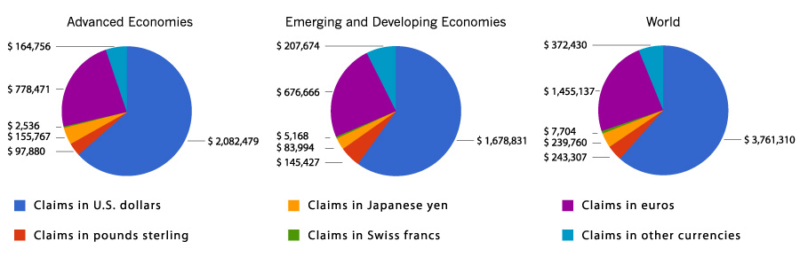
$1,200,000,000,000 in foreign exchange is traded every day
US dollar is most widely traded
involved in most of all international transactions

Slide 21
Foreign-Exchange Convertibility
Fully convertible currencies are those that the government allows both residents and nonresidents to purchase in unlimited amounts
“Hard currencies” are fully convertible
“Soft currencies” (or weak currencies) are not fully convertible
Typically from developing countries
Known as “exotic currencies”

Slide 22
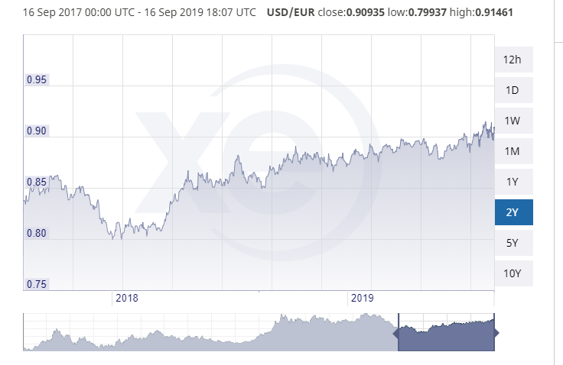
How do nations set currency policy/price?
“Floating” exchange rates
Supply and demand sets values
The value of most major currencies “floats”
Euro, Japanese yen, British pound, etc.

Slide 23
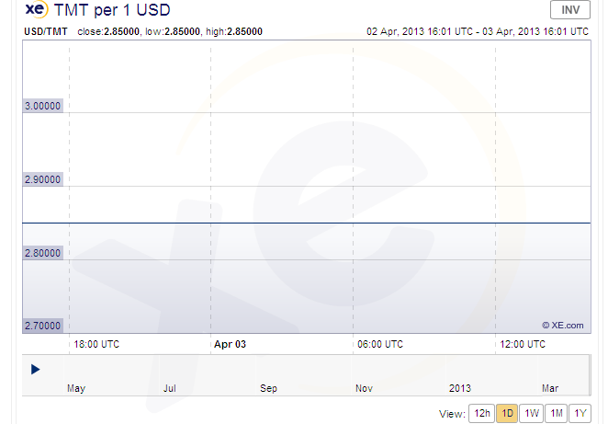
How do nations set currency policy/price?
There are three basic ways
“Fixed” or “Pegged” exchange rates
Governments decide the value of currency
Example: Hong Kong’s government keeps the value of its dollar at roughly US$0.128 (US$1=HK$7.80)

Slide 24
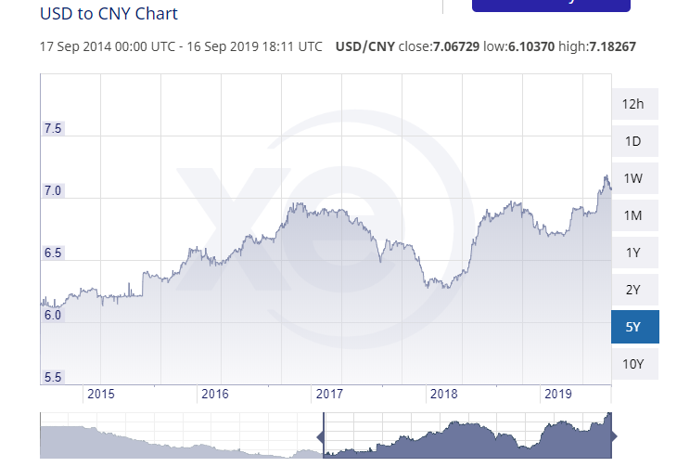
Exchange Rates
‘Dirty’ or ‘Managed’ Floating:
Where the exchange rate is allowed to float freely but intervention by governments or other agencies is carried out to manipulated to a rate for a desired purpose (China?)

Slide 25
Why would a country devalue its own currency?
To increase its GDP, however, its people are no better off.
GDP= C + I + G + X - M
If C,I,G stay the same. eXports will rise and iMports will fall. Increasing the GDP.

Slide 26
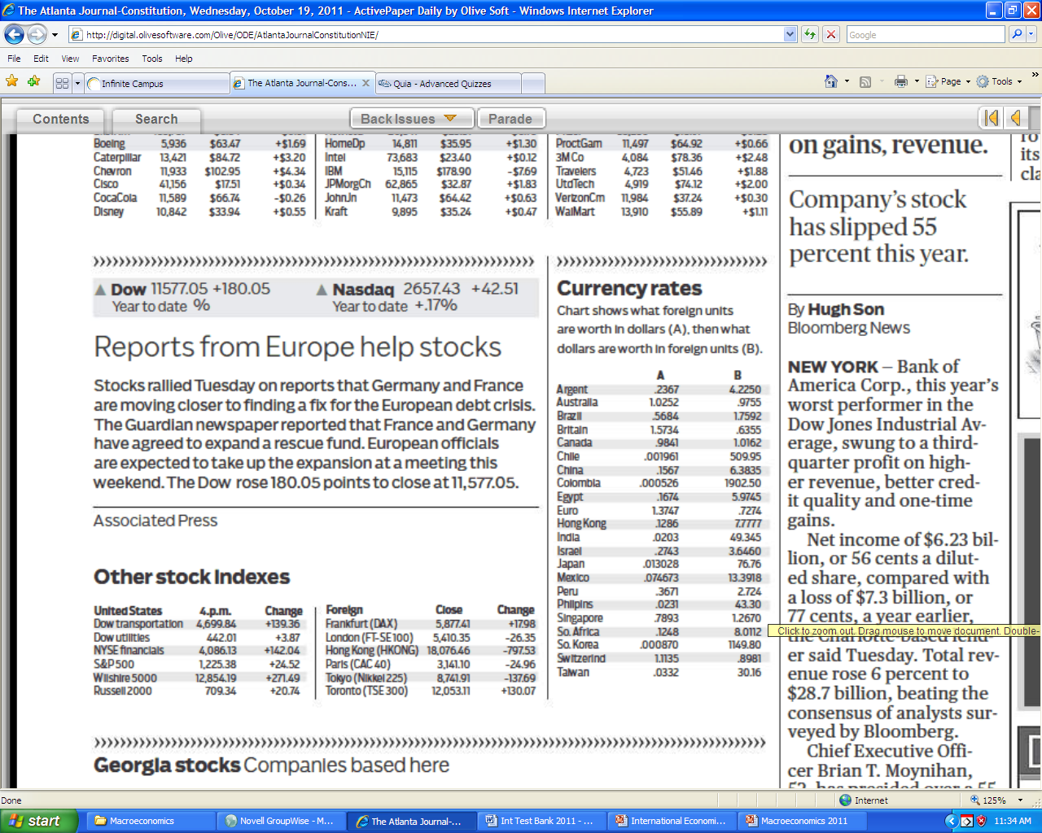
Where do you find it?

Slide 27
How would the following affect the U.S. Exchange rate?
“Fed prints out more money for stimulus”
“US in a recession”
“US has record deficit”
“US GDP grows 5%”

Slide 28
Why it is important to you!
Affects the value of the dollar(strong or weak).
Causes fluctuation is items exported or imported.

Slide 29
Strong versus Weak Dollar
Strong- Means Dollar is worth more in relation to other currency over time (appreciation)
Helps- Importers and consumers of imported goods
Hurts- Exporters
EX. Today$1=9Pesos
Next Week$1=10Pesos
Weak- Means Dollar is worth less in relation to other currency over time (depreciation)
Helps- Exporters
Hurts- Importers and consumers of imported goods
EX. Today $1=9Pesos
Next Week $1=8Pesos

Slide 30
Where do you find the rates and make exchanges?
Rate
Phones app
Websites
Certain Banks
Airport terminal
Newspaper
Exchange
Banks
Embassy
Airport terminal
Individuals??

Slide 31
 | GB Pound | US $ | Canadian $
GB Pound | 1 | 1.59855 | 1.78972
US $ | .62562 | 1 | 1.119577
Canadian $ | .55870 | .89311 | 1
As of 10/30/2014
What are the 2 ways to describe the exchange rate between Canadian $ to GB Pounds?
If you went on vacation in GB and converted $100 US, how many pounds would you receive?

Slide 32
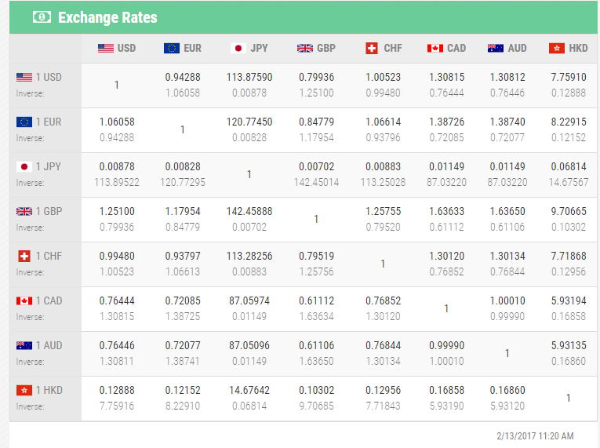
If you had 1,000,000 yen and converted it to US$, how much would you have?

Slide 33
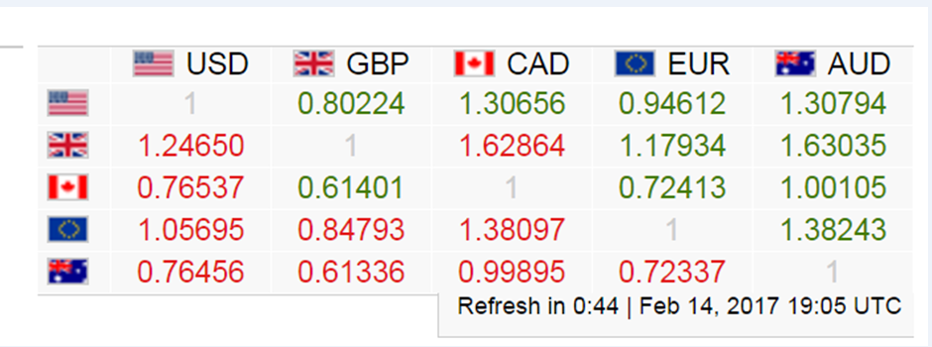
Based on chart, how much would 100 Euros be in $?

Slide 34
Based on chart, how much would 100 CAD be in GBP?

Slide 35
1)Mike makes microphones and makes money off exporting many to Manuel’s Mike Mansion in Monteray, Mexico. What type of dollar would Mike like the most?
A)Strong Dollar B)Appreciating Dollar
C)Weak Dollar D)Normalized Dollar
2)What headline will most likely make the Jonesian dollar weaker?
A)Jonesian jobless rate shrinks
B)Jonesian Central Bank raises rates
C)Jonesia suffers high inflation
D)Jonesia elects Mr. Jones King for Life

