Slide 1
Vocabulary Day 9
Balance of Trade- difference between traded goods between nations
Balance of Payments- difference between money leaving and entering nations
Trade Surplus- exporting more than importing
Trade Deficit- importing more than exporting
Subsidy- government incentive to produce or not to produce something(unfair trading practice)

Slide 2
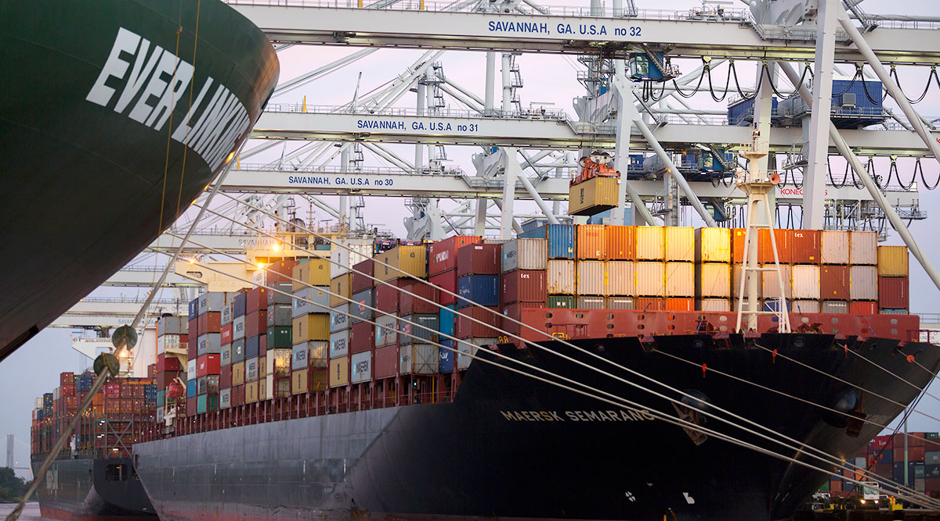
Savannah Port
How many 20’ containers were handled in Savannah Port during October 2018?
According to a GSU study, how many metro jobs rely on Savannah Port?

Slide 3
Trade News- 413,800 Containers
200,000 Jobs
Savannah Port Sets All-Time Container Record in October
The Port of Savannah’s Ocean Terminal increased trade in breakbulk cargo in October. Growth of 25.8% brought the total to 126,165 tons of commodities ranging from autos and machinery, to rubber, steel and lumber. Overall containerized volumes in October grew by 4,000 TEUs, or 1%, compared with the same month last year and by 13.6% (49,600 TEUs) compared with September 2018.

Slide 4
The Reason?
“A booming economy, strong consumer confidence and an expanding customer base have resulted in record trade through the Port of Savannah,” Georgia Ports Authority Executive Director Griff Lynch said at the board meeting Nov. 13.
https://www.ttnews.com/articles/savannah-port-sets-all-time-container-record-october

Slide 5
Balance of Trade
Our balance of trade compares the dollar value of the merchandise and services we buy from foreigners with the dollar value of the merchandise and services they buy from us.
Balance of trade is the monetary difference between imports and exports.
NPR-

Slide 6
Good or Bad
A trade deficit is not good or bad. For instance in the last recession, our trade deficit decrease, but the economy was bad.
Many developing nations dream of the day when they can have a trade deficit.
China ran a trade deficit in March 2015($7 Billion).

Slide 7
Deficits vs Surplus
Trade deficit occurs when imports exceed exports(not all bad).
Trade surplus occurs when exports exceed imports(not all good)
Both fluctuate with business cycle and exchange rate
A nation can have a surplus with some nations and a deficit with others.

Slide 8
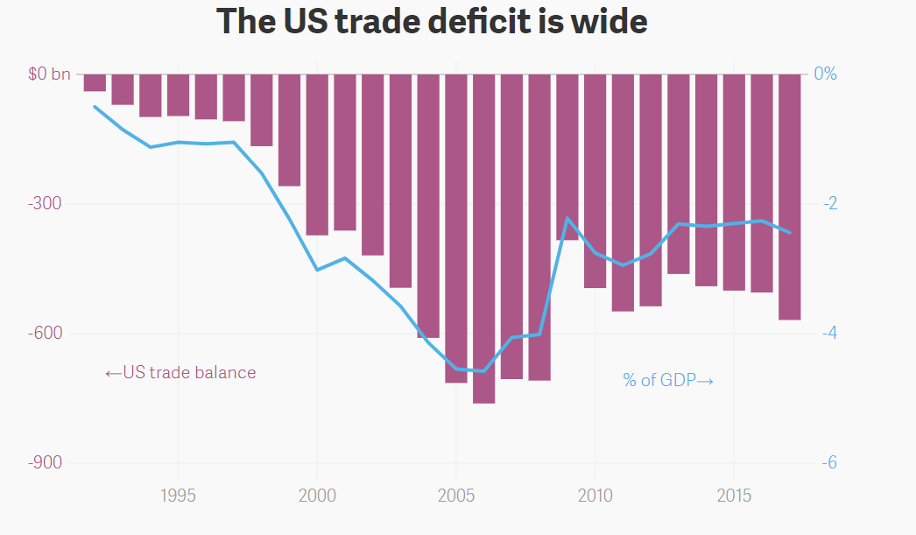

Slide 9
Quartz 5/3/2018
Shrinking America’s yawning trade deficit is much harder than simply blocking imports and boosting exports—and will likely involve tough tradeoffs, according to Guggenheim Partners’ Scott Minerd.
“There is a reason why the United States has a structural trade deficit. That’s because the world wants to hold the dollar as a reserve currency,” said Minerd while speaking on a panel at the Milken Institute 2018 Global Conference in Los Angeles on April 30. “If we insist that we have no trade imbalance, what we’re saying is that we no longer want to be the reserve currency.”
Running a chronic trade deficit is what any country must do if it aims for its currency to serve as a global reserve currency.

Slide 10
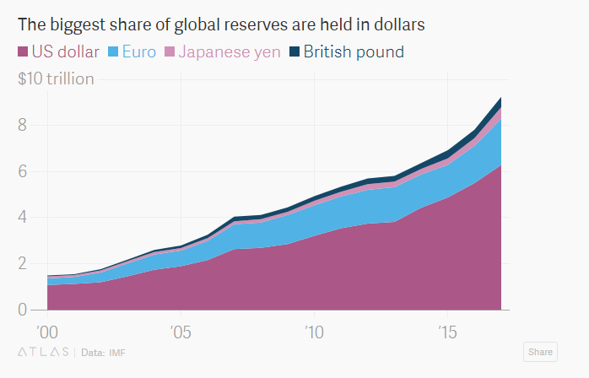

Slide 11
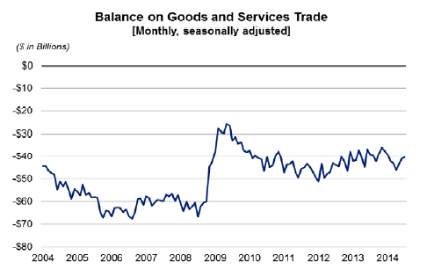

Slide 12
The primary U.S. trading partners are China, with a total trade of $636 billion; Canada, with $582 billion; and Mexico, with $557 billion. The trade deficit with China is $375 billion. It's responsible for 66 percent of the total U.S. deficit in goods. The other U.S. trading partners don't create much of a deficit.

Slide 13
What is the role of a strong or weak currency in trade deficits?

Slide 14
Balance of Payments
Amount of money which leaves and enter the country from another
Method countries use to monitor international monetary transactions
Balance of trade is included in balance of payments
Divided into 3 Categories
  Current Account- inflow and outflow of goods and services
  Capital Account- capital transfers(business use)
  Financial Account- money relative to investments

Slide 15
Balance of Payments Examples
You travel to France for spring break.
German business buys US machines.
Russian buys Google stock.
US sends aid to Haiti after earthquake.
US citizens works temporarily in Britain.
US treasury pays interest to Chinese investors.

Slide 16
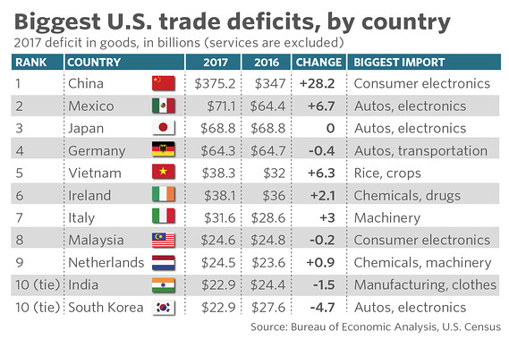
Top Ten Nations with U.S. Trade deficit(2017)

Slide 17
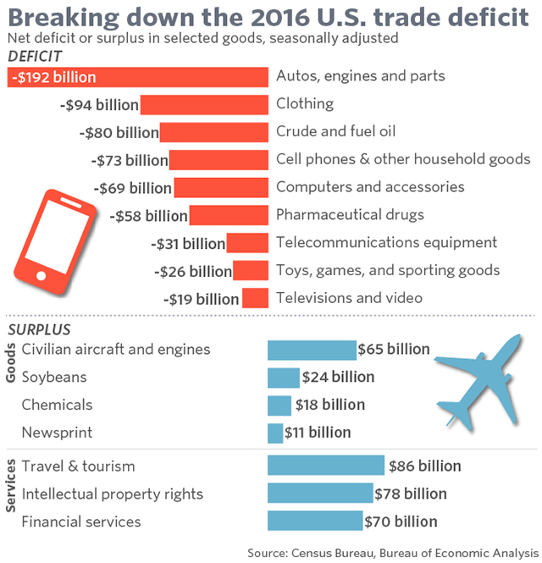

Slide 18
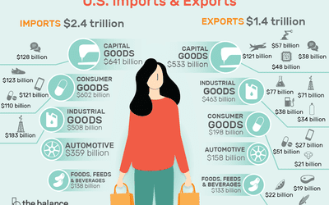

Slide 19
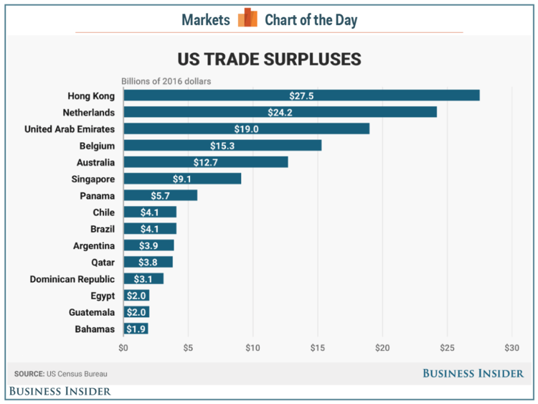
US Trade Surplus

Slide 20
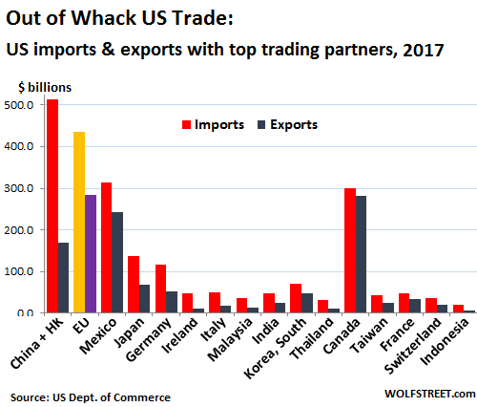

Slide 21
