Slide 1
Vocabulary
Incentive- something done for motivation
Fiscal Policy- Government attempt to manipulate economy with taxing and spending

Slide 2
Fiscal Policy
Fiscal policy is the use of taxing and spending to influence the economy (tax rebate and stimulus package)
This is done by the US Congress and the President.
Key Points
Goal of fiscal is to manipulate AD/AS.
The more money you have the more money you spend.
Overall goal is full employment and economic growth

Slide 3
Simple Fiscal Policy
FOLLOW THE MONEY!!!!!
An increase in taxes and/or decrease in government spending allows people to keep/have less money, the less they can spend and the economy can slow(in inflation).
A decrease in taxes and/or increase in government spending allows people keep/have more money, they can spend and the economy can grow(in recession).

Slide 4
Tools of Fiscal Policy- Manipulating the economy through taxes
Tax Rates- Lower or Raise them
Tax Incentives- Increase incentive to lower unemployment and decrease to lower inflation
Government Spending –Increase to “create jobs” and Decrease to reduce deficits

Slide 5
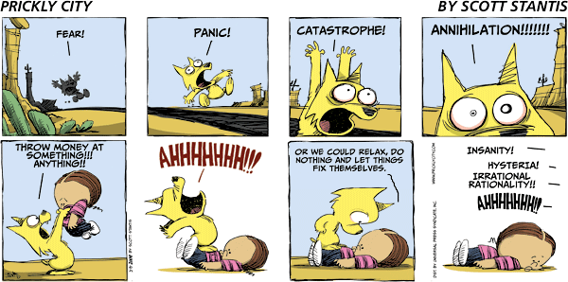
Why is fiscal policy enacted?

Slide 6
Types of Fiscal Policy
Restrictive/Tight/Contractionary-Slow down economy in an inflationary period(less government spending)
Expansionary/Easy-Speed up the economy in a recession(lower taxes and increase government spending)

Slide 7
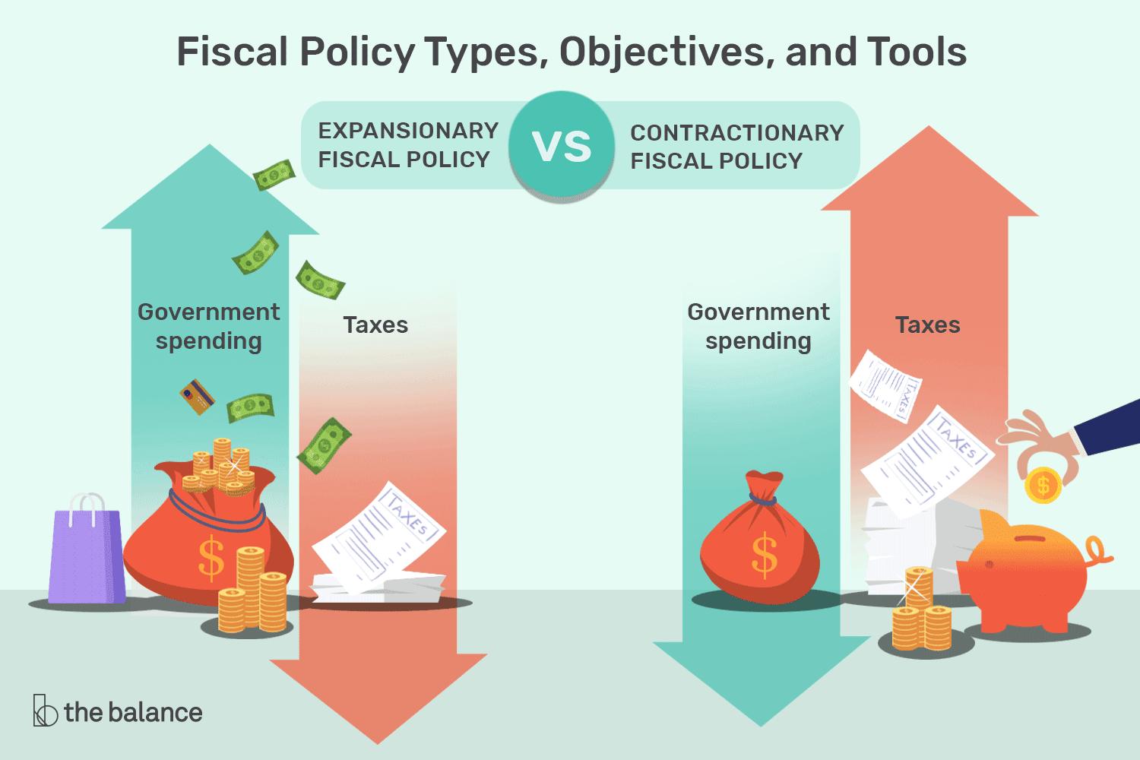

Slide 8
Simple Federal Budget Process(start October)
I. Executive Agencies submit needs
II. President submits budget proposal to Congress(February)
III. Senate/House create their own budgets
IV. Joint Conference meets converging budgets
V. Subcommittees in each chamber review and add to it.
VI. Chambers votes(usually doesn’t pass entire budget)
VII. Create/Pass temporary budgets(omnibus bills) to keep government funded for short term

Slide 9
Milton Friedman scenario about government spending
If you buy something for yourself with your money, you care about the quality and price.
If you buy something for someone else with your money, you care about the price.
If you buy something for yourself with someone else’s money, you only care about the quality.
If you buy something for someone else with someone else’s money, you don’t care about quality or price. That is government.

Slide 10
Problems
Restrictive may cause a recession.
Expansionary may lead to a larger budget deficit/debt.
What seems like a good idea, may backfire. (Yacht tax in 1990)
Politics
Few people will vote for a tax increase.

Slide 11
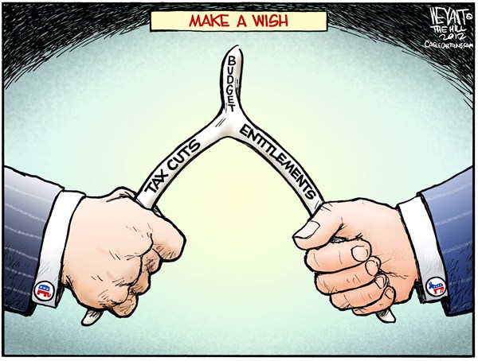
What does this mean?

Slide 12
Using Arrows illustrate Expansionary Fiscal Policy
Tax Rates Take Home Pay
Government Spending Jobs
Government Revenue

Slide 13
Using Arrows illustrate Restrictive Fiscal Policy
Tax Rates Take Home Pay
Government Spending Jobs
Government Revenue

Slide 14
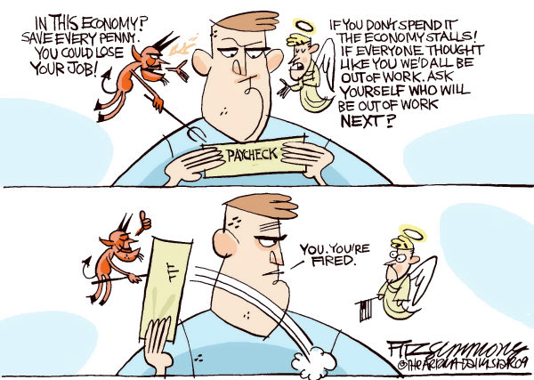
Why is he so confused?

Slide 15
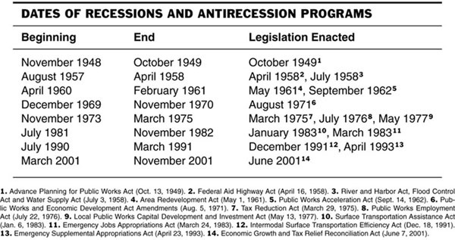
How does this show a limitation of fiscal policy?

Slide 16
Limitations of Fiscal Policy
Timing
Political Pressure- Partisanship
Unpredictable economic behaviors
Lack of Gov’t coordination
Video

Slide 17
Reality
Neither view of Fiscal Policy is perfect and have opportunity costs.
Cutting Funding- May cut funding to those in need, May hurt infrastructure, etc
  The law of diffuse costs versus concentrated benefits — when Congress creates a new program, the costs are spread out over hundreds of millions of taxpayers, but a small, intense interest group of beneficiaries is then born. That group then spends its time not only convincing legislators that the world could never have existed without taxpayers making it rain on their cause, but that even more money is now necessary to keep America from sliding backward.
Raising Taxes- Don’t keep as much of income, Not as much incentive, May drive high earners away

Slide 18
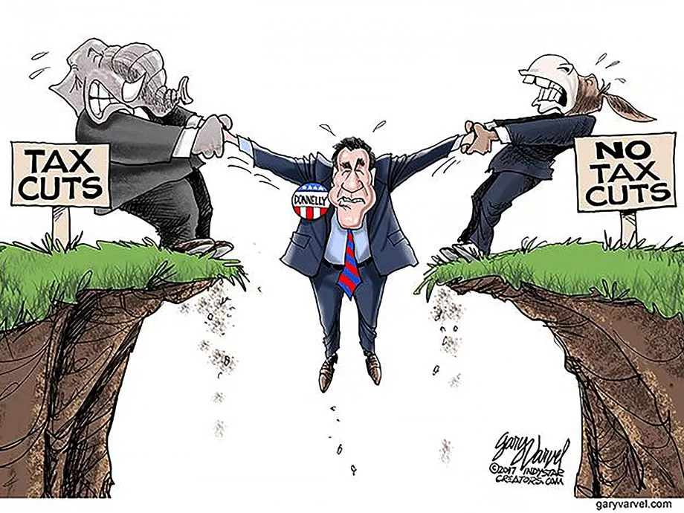

Slide 19
Political Pressure
Since fiscal policy is enacted by the Congress and the President, politics always play a role.
Watch this in elections.
Fiscal Ship Simulation

Slide 20
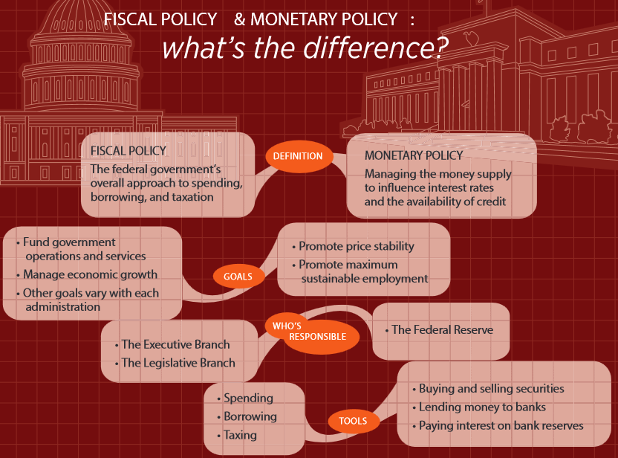
Video

