Slide 1
Day 11
Deficit- result of spending more than earning
Debt- total of all deficits
Surplus- result of spending less than earning
Government Revenue(add)- amount of money government collects
Recession- 2 Quarters of Negative GDP growth

Slide 2
As of 4/23/2019 at 8 AM
$22,232,252,852,569

Slide 3
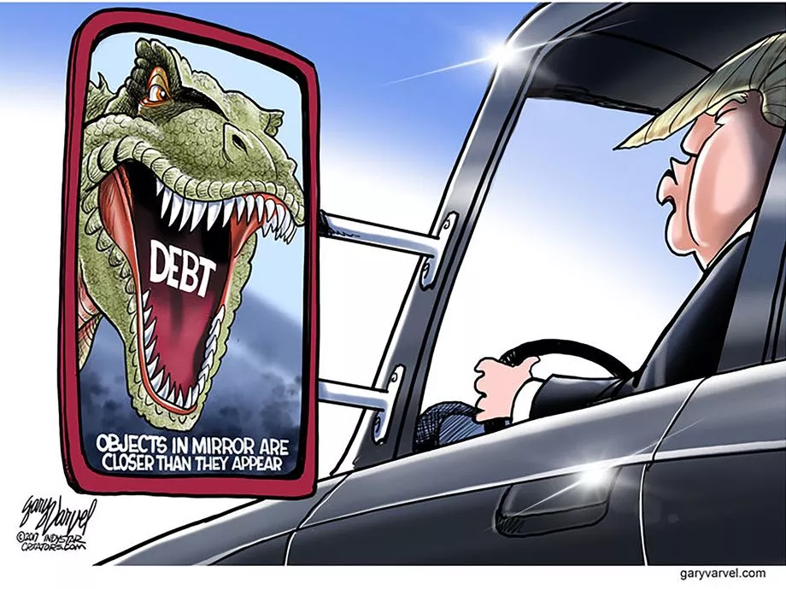

Slide 4
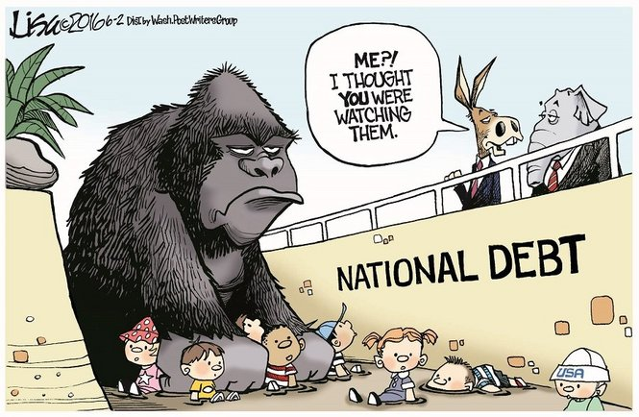

Slide 5
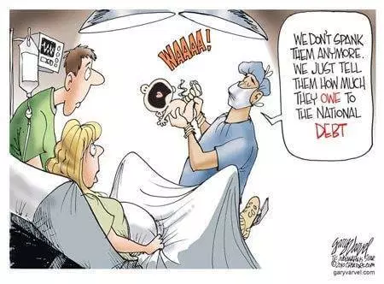

Slide 6
Jonesesia’s National Budget
GDP=$3,000,000,000
Total Revenue(in taxes)= $1,000,000,000
Total Expenditures=$1,100,000,000
Total Deficit=$100,000,000
Must sell Treasury Bonds to make up deficit. Also pay interest on bonds
Previous Debt=$200,000,000(w/ interest)
Total Debt=$300,000,000
Debt to GDP=10%

Slide 7
Definitions
Budget Deficit = excess of a government’s expenditures(spending) over its receipts(revenues) in a period of time(must borrow to make up the difference).
National Debt = total value of government indebtedness at a moment in time.
These two concepts are related since Government
accumulate Debt by running Deficits or
Reduce Debt by accumulating Surpluses.

Slide 8
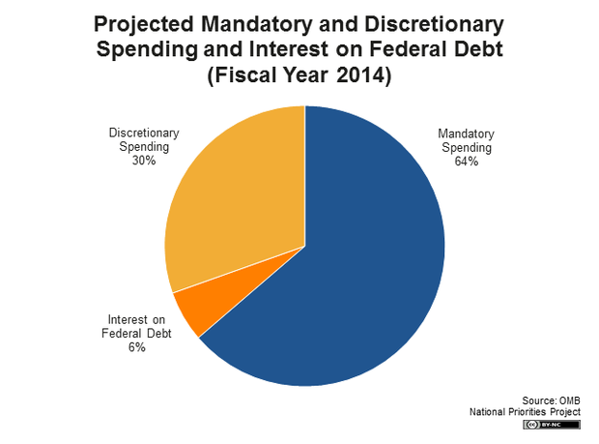
Discretionary vs Mandatory

Slide 9
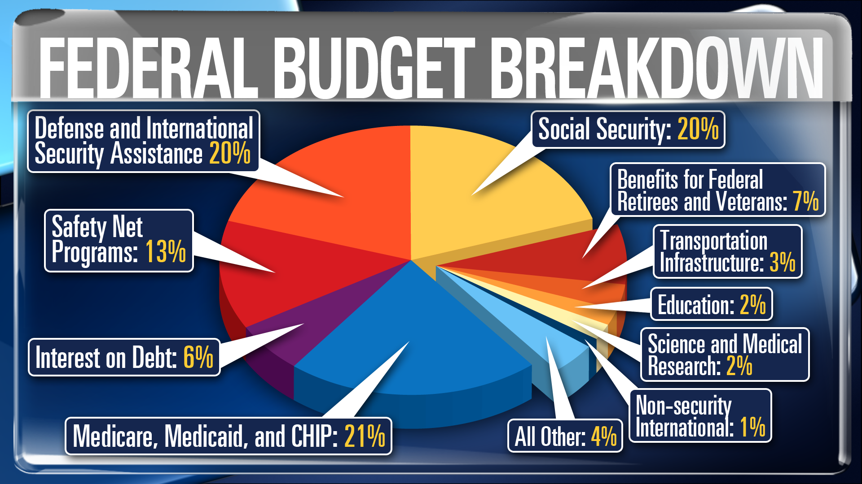

Slide 10
Questions
When did the US debt start?
Who was the last President to pay off national debt?

Slide 11
Questions
When did the US debt start?
•The US was founded on a debt. The American Revolution was largely funded by borrowing from citizens and other nations.
Who was the last President to pay off national debt?
•Andrew Jackson

Slide 12
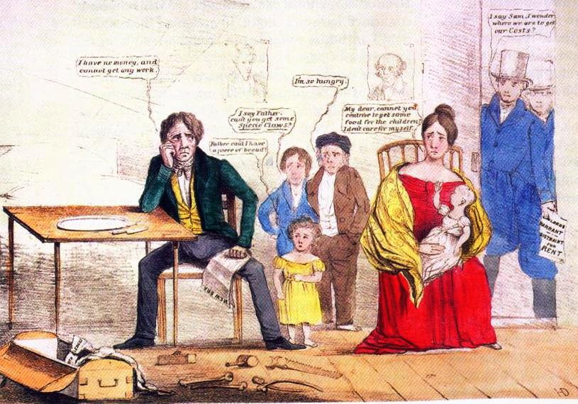
More on Jackson
Jackson paid off the debt by massively cutting government spending. This along with a banking crisis caused a recession, the United States’ first. However, this did not occur until he left office. The Panic of 1837 was the result of his policies, however they were left to his predecessor, Martin Van Buren. Van Buren continued Jackson’s philosophy and was defeated running for reelection in 1840.

Slide 13
Whose debt is worse?
Greece Debt $358,459,016,393
Italy Debt $2,529,644,262,295
China Debt $2,368,285,245,902
Mexico Debt $637,406,330,882
Canada Debt $1,531,120,710,158

Slide 14
Whose debt is worse?(Public Debt to GDP Ratio)
Greece Debt $358,459,016,393
184%
Italy Debt $2,529,644,262,295
136%
China Debt $2,368,285,245,902
21%
Mexico Debt $637,406,330,882
61%
Canada Debt $1,531,120,710,158
100%

Slide 15
How is it calculated?
National Debt is the total amount owed to those the government has borrowed money from(to finance current/previous purchases).
Best indicator of national debt is not total amount, but the percentage of GDP.
Example- If a nation has a debt of $1,000,000 and a GDP of $1,000,000. it has a 100% national debt.

Slide 16
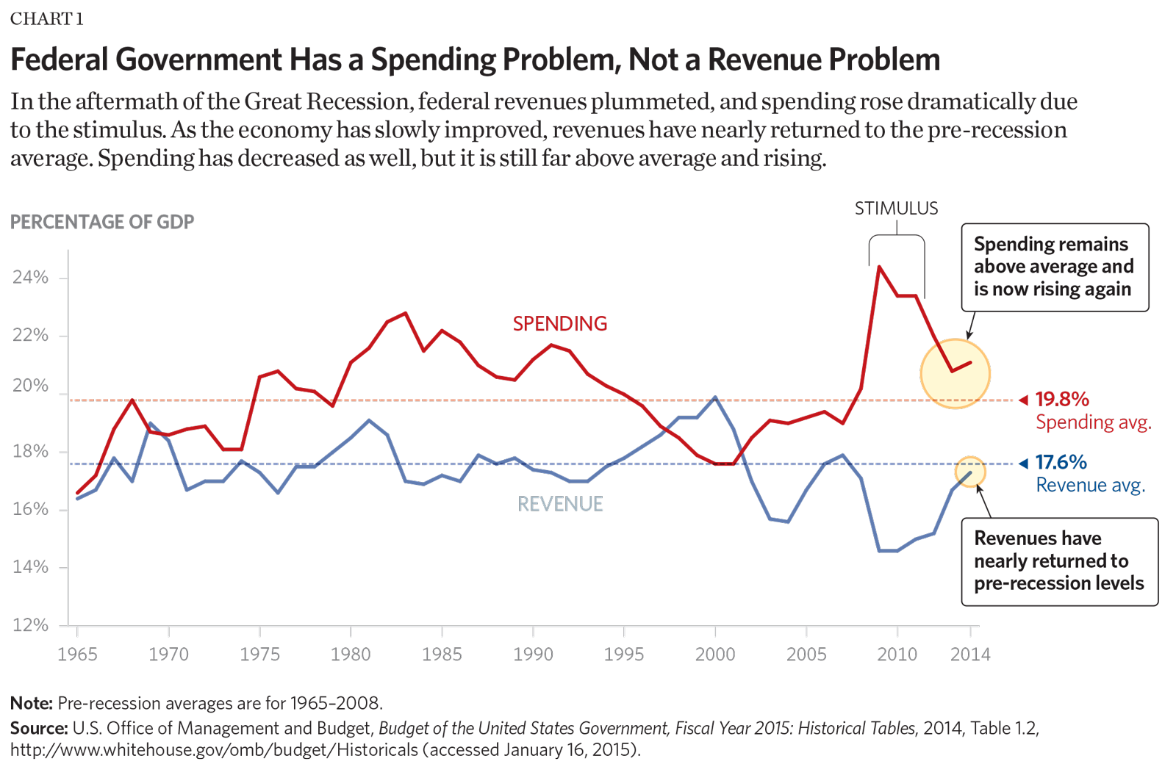
Historical Revenue and Spending

Slide 17
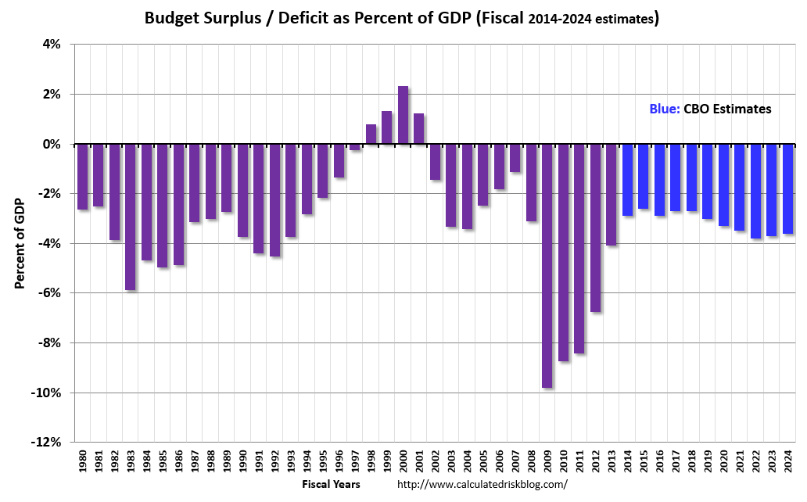

Slide 18
Top 10(You don’t want to be in) based on Debt to GDP Ratio
1)Japan
2)Greece
3)Portugal
4)Italy
5)Bhutan
6)Cyprus
7)Belgium
8)U.S.A
9)Spain
10)Singapore
https://learn.stashinvest.com/10-countries-with-largest-national-debt-to-gdp

Slide 19
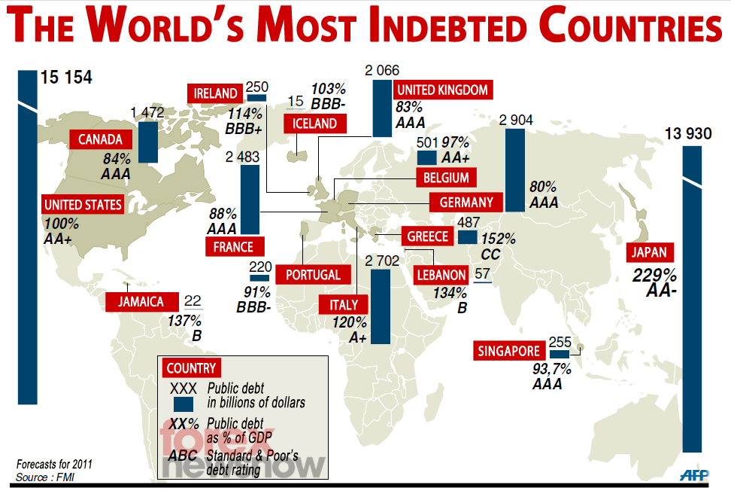

Slide 20
How is the debt financed?
When the government spends more than it brings in, then it must borrow the difference. Some of this is done by selling bonds(which pay interest) to investors. Sometimes the government takes money from one program and gives it to another.

Slide 21
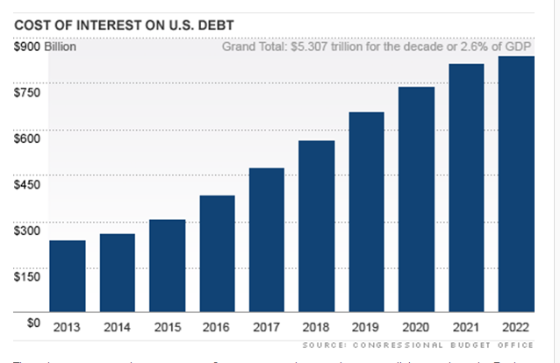

Slide 22
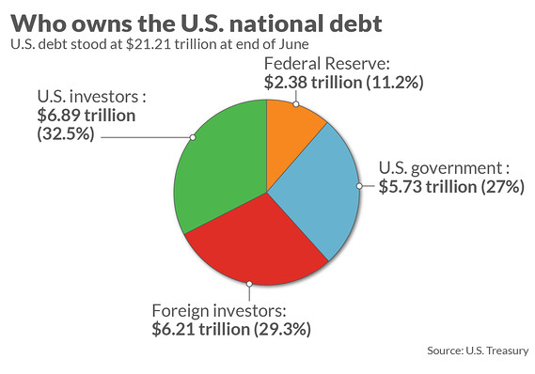
Who owns the Debt?

Slide 23
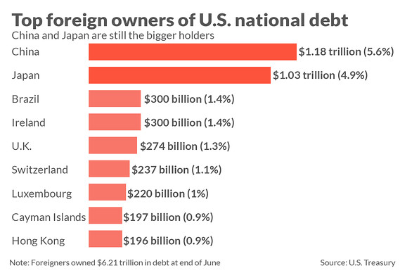
Which countries own the most U.S. debt?

Slide 24
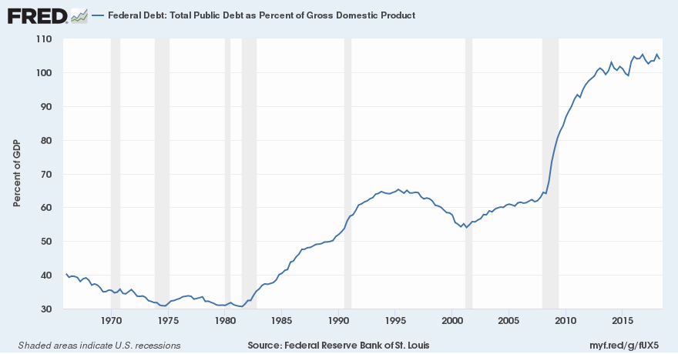
What is the relationship between recessions and national debt?

Slide 25
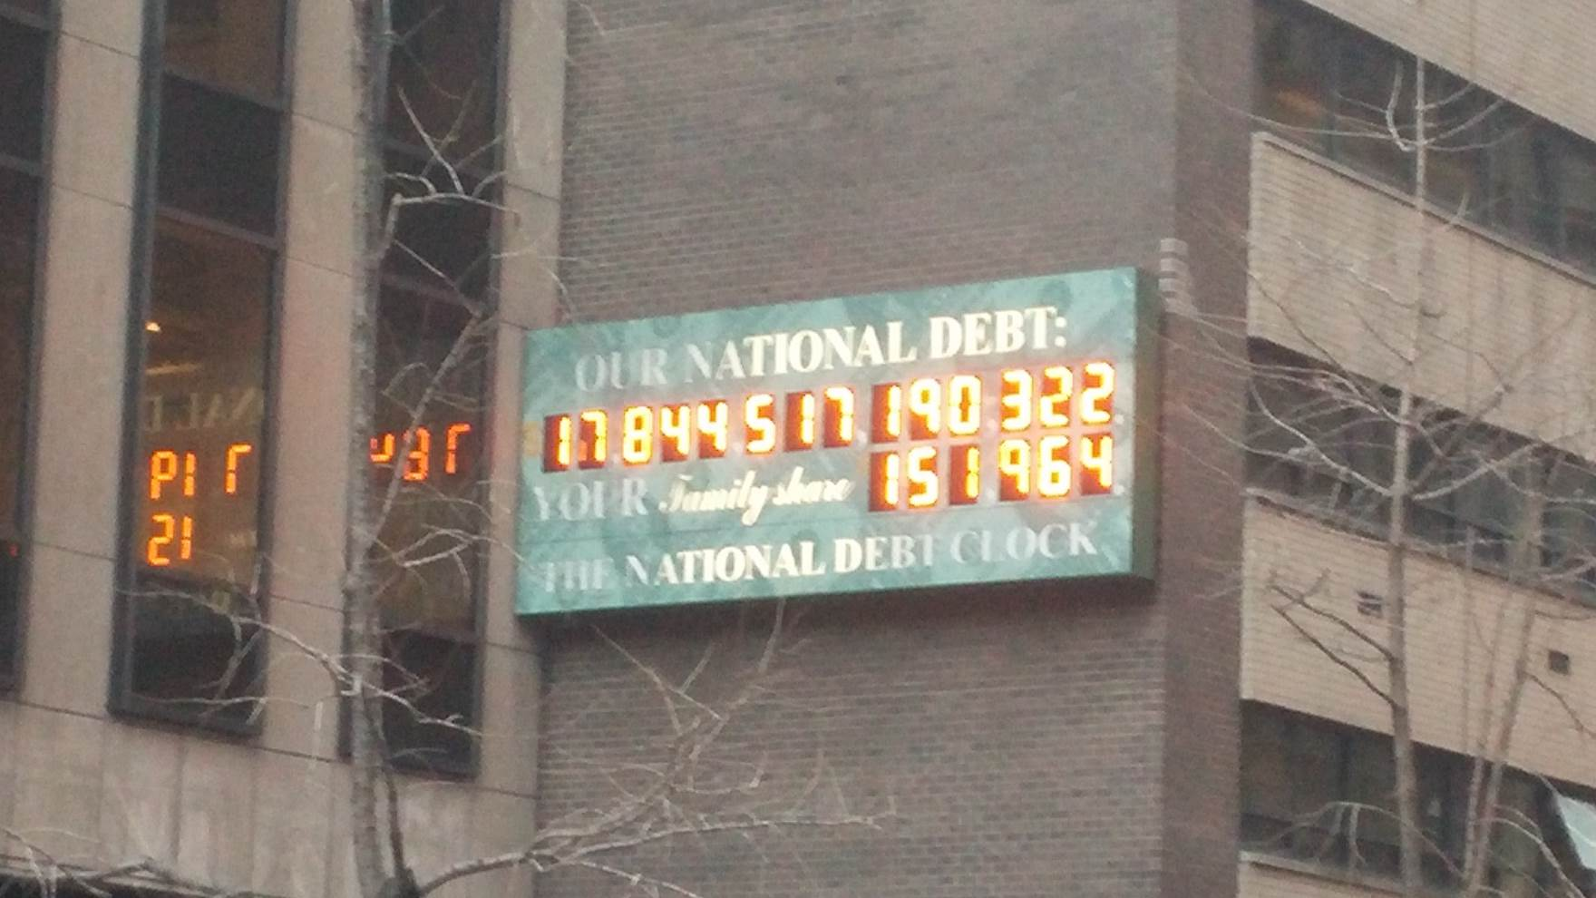

Slide 26
Who owns the debt?
Much of the debt is owed to the American people. However, foreign citizens and governments can own it also.
Who Else?
Are we the only nation with debt?
NO!!!!!!!!!!!!!!!

Slide 27
Should we balance the budget?
Not always. In times of recession, people are making less money so tax payments will be less.
The amount of debt is not as important as the percentage of GDP it represents.

Slide 28
Important Points
This is a huge political football. Both parties argue about it.
4 Ways to reduce debt- 1)raise revenue 2)reduce spending 3)Sustained Economic Growth 4)Combination
Building a debt in a fully employed, peacetime, and prosperous economy is dangerous.
Debt ceiling or limit is voted on by Congress. Recently raised by Congress.

Slide 29
Are you the U.S. or Greece?
Nations, like consumers have credit ratings. However, the scores are like grades. The highest is AAA. As of 2016, US was AA+. Lowest was Puerto Rico with a CCC- and Mozambique has a CC.
http://www.tradingeconomics.com/country-list/rating

Slide 30
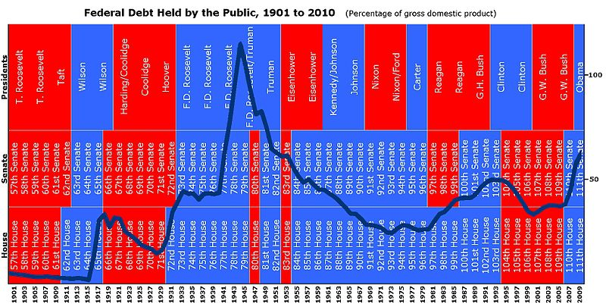
Debt by President

Slide 31
Where are we going with the debt?
Debt interest payments will rise. Some estimates have debt interest payments will be more than 50% of government expenditures in 20 years.
Taxes or fees will be raised(slowing economy).
Department of Treasury will have trouble finding lenders. To attract more lenders, raise interest, which raises payments.

