Slide 1
Jenksesia
Jenksesia had a GDP of $1,400,000,000 in 2018. The President is up for re-election in 2019. She claims the country is doing well.
How do we know? What do we look at?

Slide 2
Economic Growth
Economic Growth is measured and based on Real GDP. It is a percentage in the growth from the previous year. Sustained positive growth is the goal. Economic growth is illustrated by the business cycle.
It is a way to compare a country’s economy over time. All nations desire for the overall economy to improve.

Slide 3
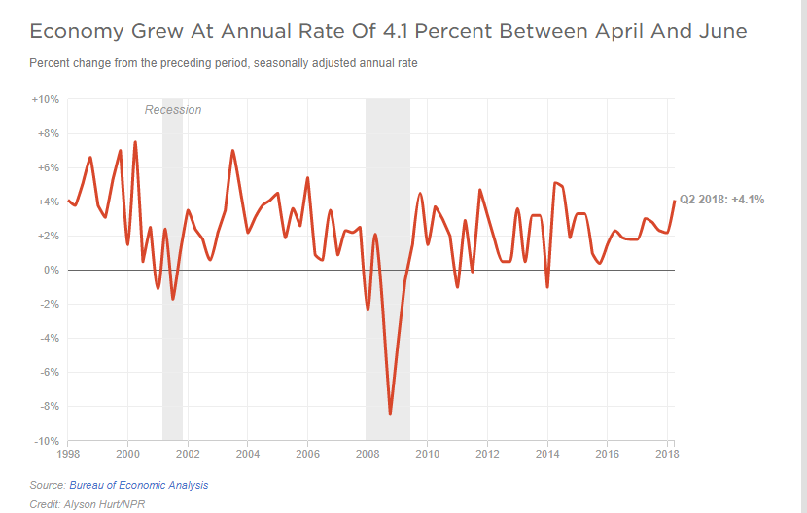
ECONOMIC GROWTH
Actual and potential growth
Economic growth & the production possibility curve
Economic growth & the business cycle
fluctuations in actual growth
the phases of the business cycle
the irregularity of the cycle
long-term output trend
Notes:
4

Slide 4
ECONOMIC GROWTH
the benefits of economic growth
increased consumption
reduces other macro problems(unemployment, poverty rate, etc)
scope for redistribution
the costs of economic growth
current opportunity costs(benefit now but “pay” later)
may generate extra wants
adverse social effects
environmental costs
depletion of resources
Notes:
7

Slide 5
Calculating Economic Growth
(Year 2 Real GDP/Year 1 Real GDP)-1= Economic Growth %
Example-
(2013 Real GDP) 13.088 T/(2012 Real GDP)12.703=1.030308-1= 3%

Slide 6
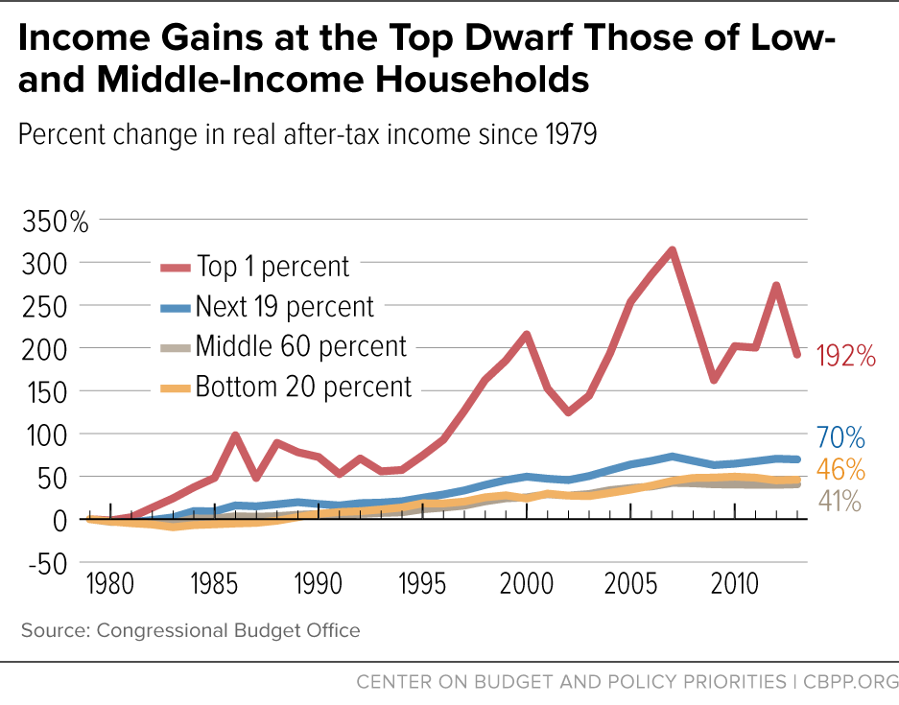
Analogy
A rising tide lifts all boats.
What does it mean and is it true?

Slide 7
Would the following cause/result positive or negative economic growth ?
Businesses begin series of layoffs
Federal Reserve expands money supply
Americans have positive view of the future
Crisis in Middle East could cause U.S. action
Businesses begin huge investments for expansion
Americans fear economic crisis in future
Peace deal reached in several worldwide conflicts

Slide 8
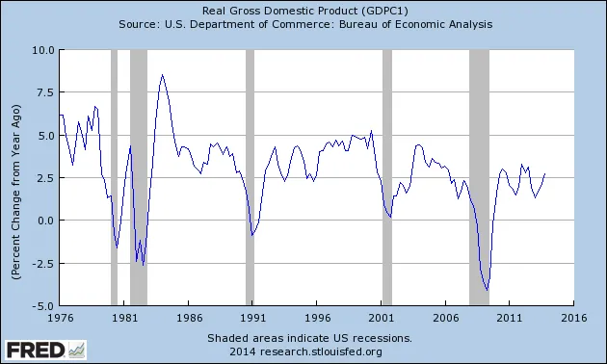
Real Gross Domestic Product

Slide 9
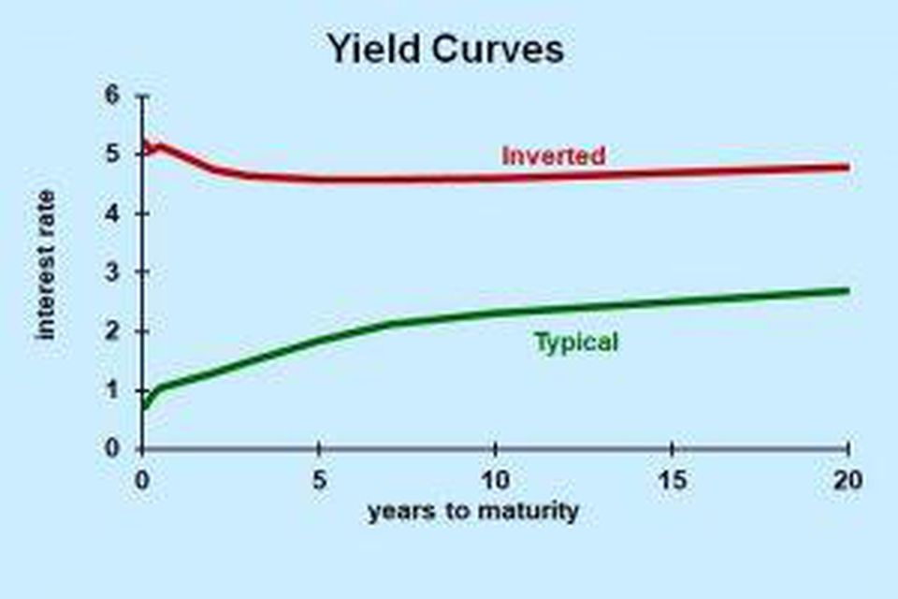
What is this and why is it important?

Slide 10
Economic Growth will matter more over the next year. Why?

Slide 11
How is the economy like a roller coaster?

Slide 12
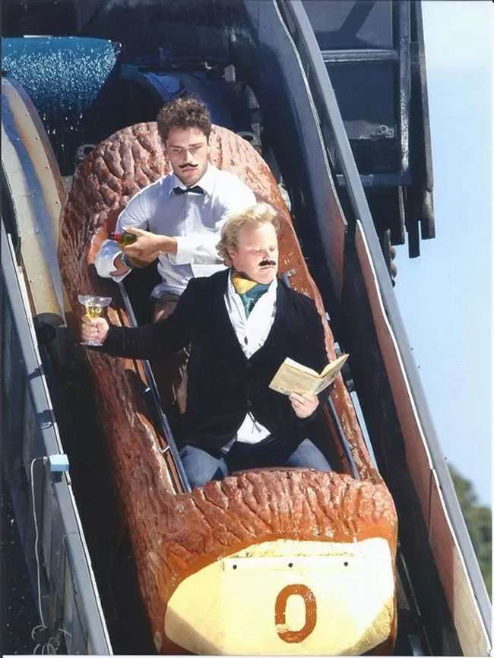
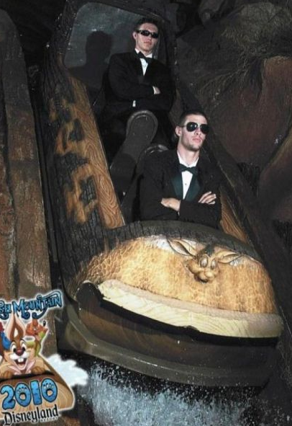
How is the economy like a roller coaster?
Sometimes, it’s great.

Slide 13
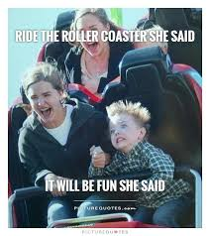
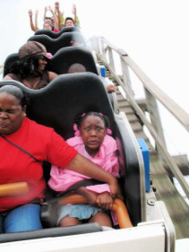
How is the economy like a roller coaster?
Sometimes, it’s scary

Slide 14
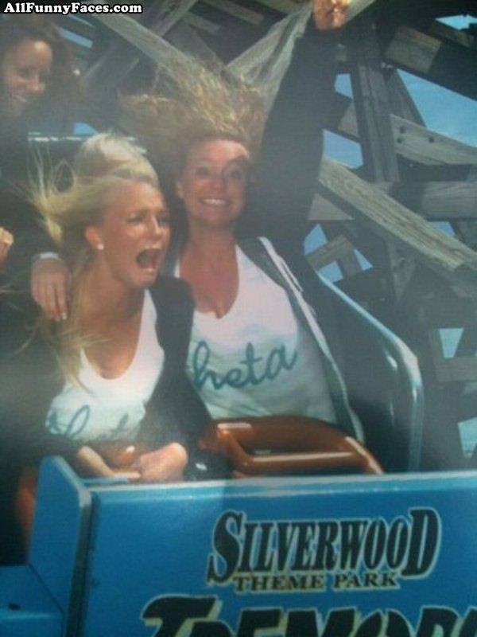
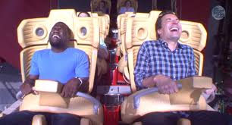
How is the economy like a roller coaster?
Sometimes it’s both

Slide 15
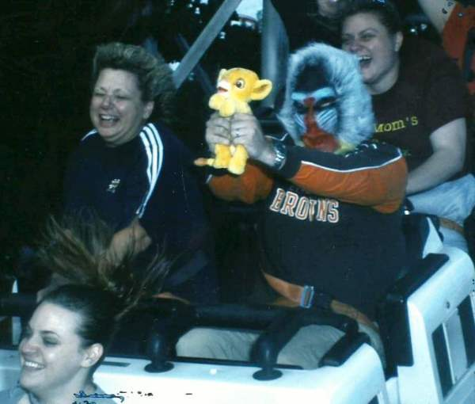
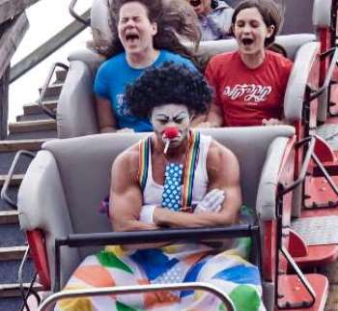
How is the economy like a roller coaster?
Sometimes you don’t know what to expect

Slide 16
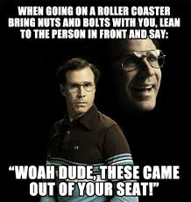

Slide 17
Business Cycles
Business cycles are the ups and downs in a market’s activity(%increase or decrease in real GDP).
The business cycle is made up of 1)expansion(recovery)-upward movement, (positive growth)
2)peak-high point
3)contraction(recession)-downward movement(negative growth)
4)trough-lowest point

Slide 18
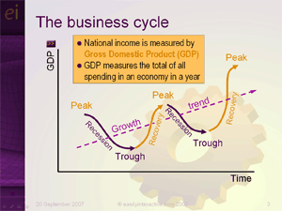

Slide 19
The Business Cycle
Growth (NY)
Potential Growth
Actual Growth
Boom/Overheating
Growth/Upturn
Decline/slowdown
Recession/Slump
Time

Slide 20
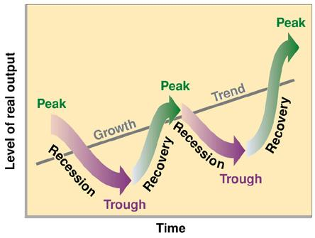
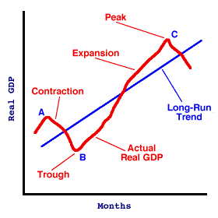

Slide 21
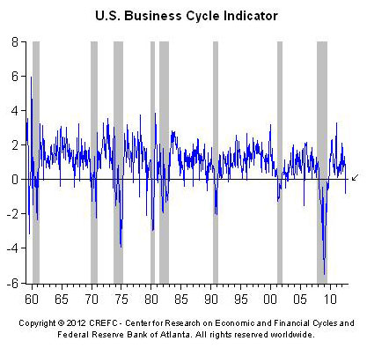
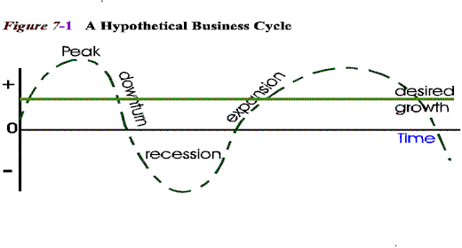

Slide 22
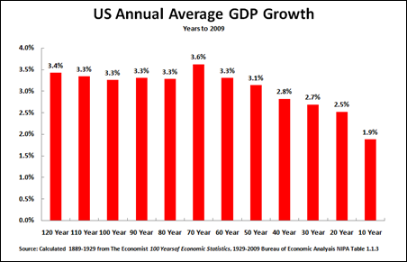
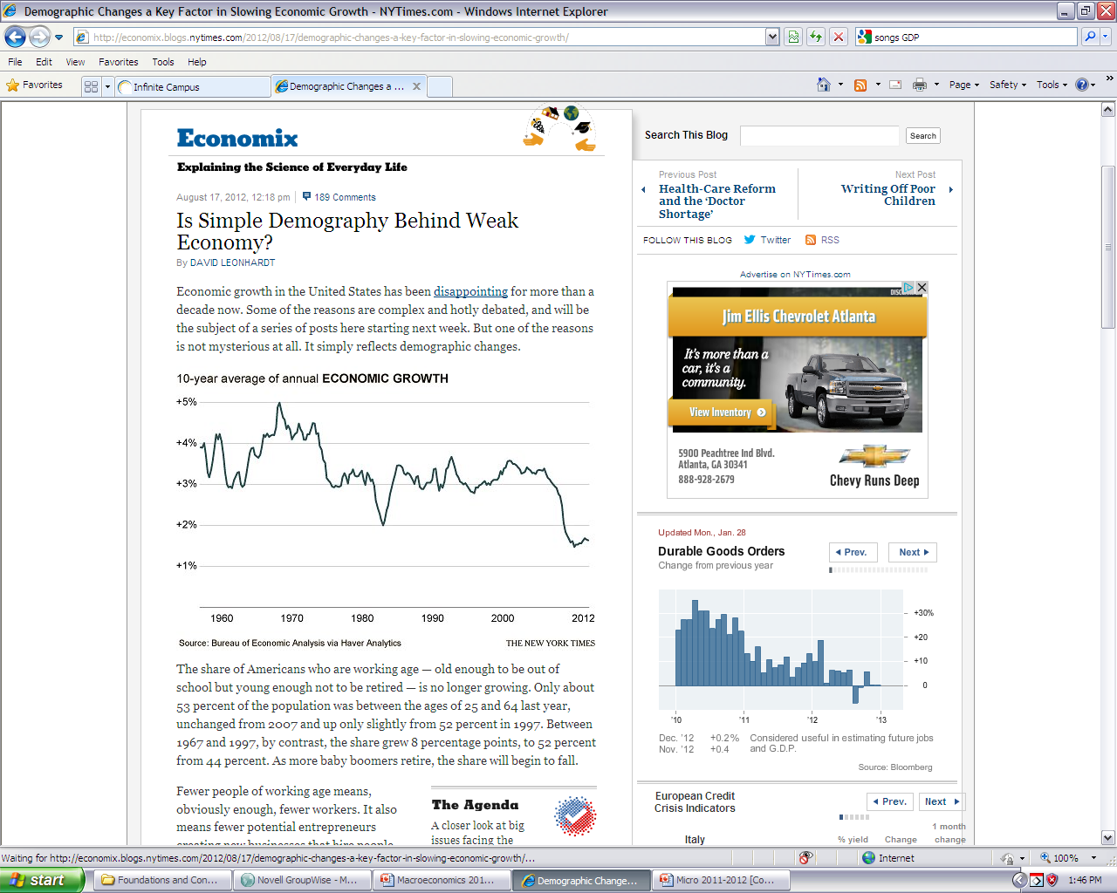

Slide 23
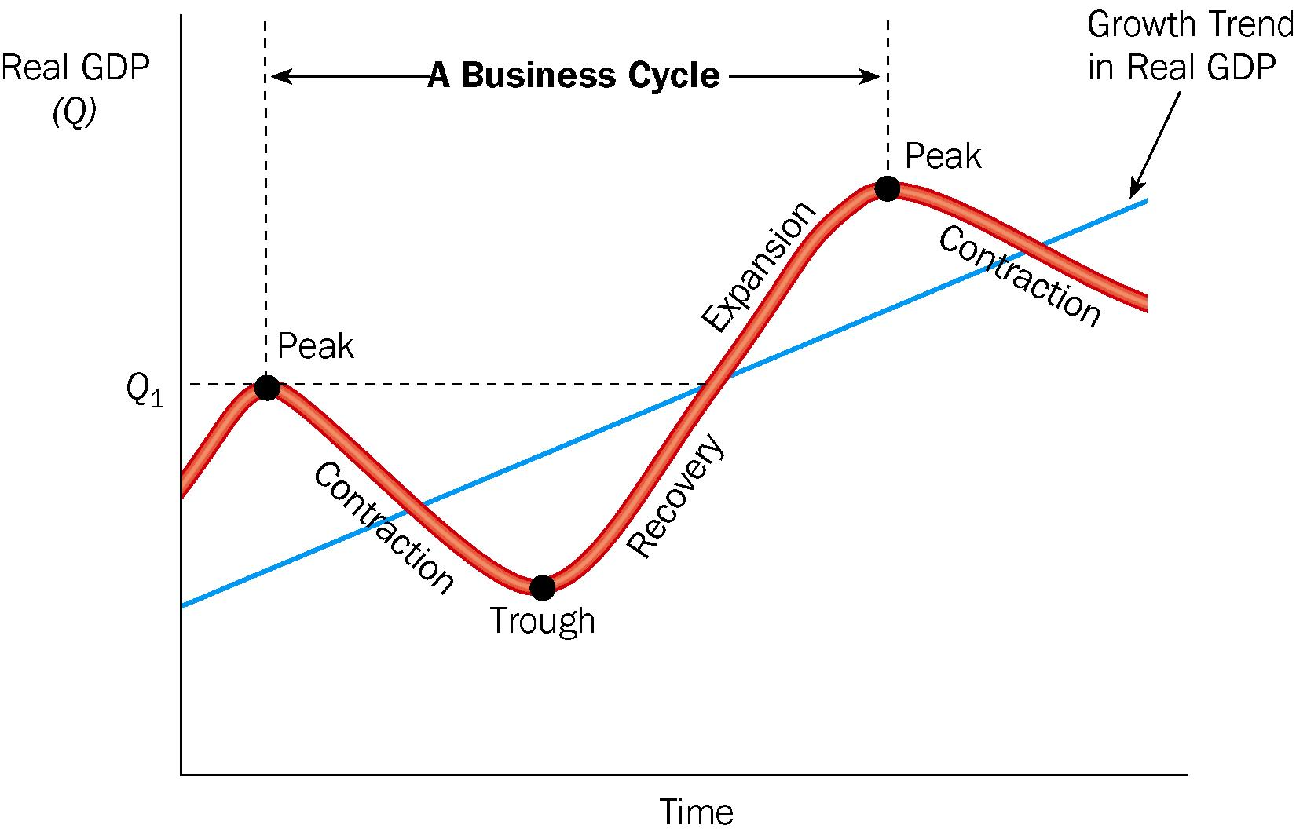

Slide 24
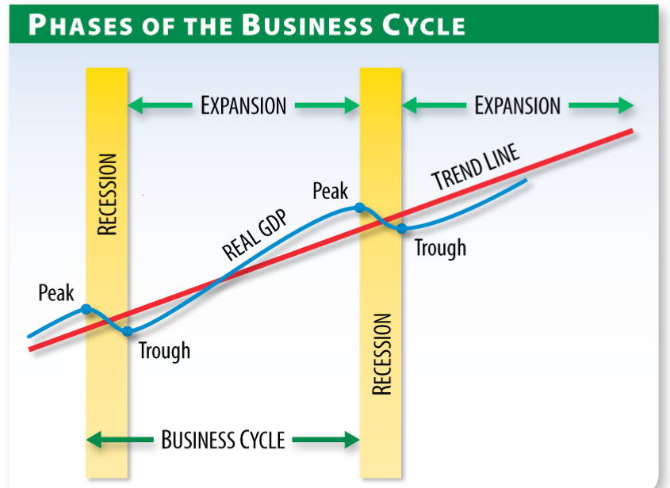

Slide 25
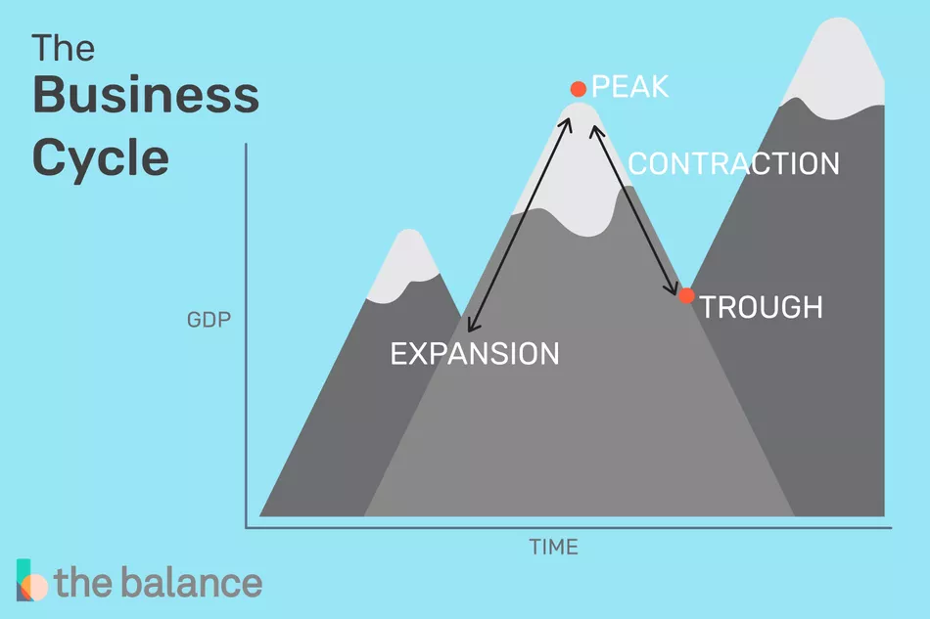
Personal Reaction to Cycle

Slide 26
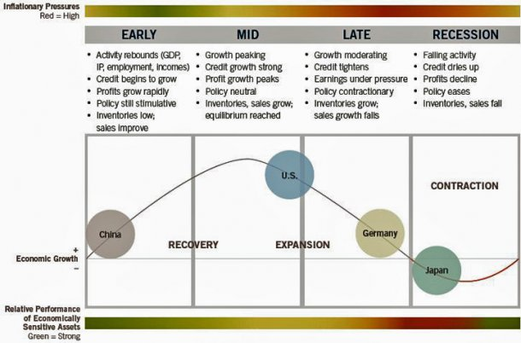

Slide 27
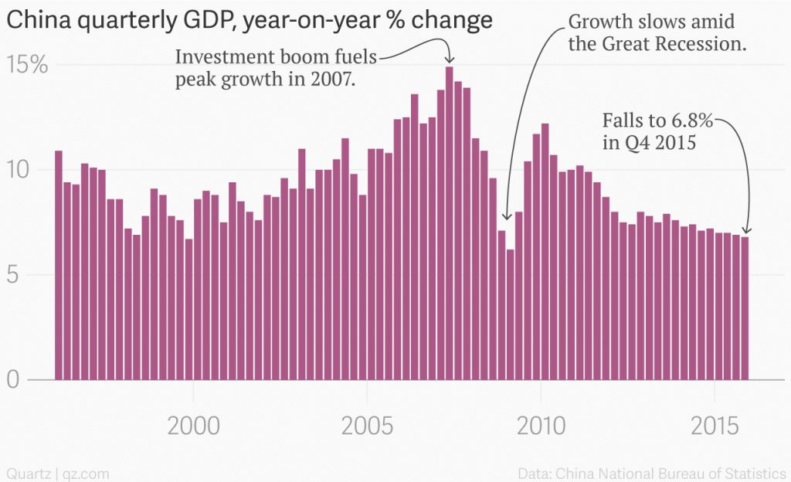
China announces

Slide 28
Business Cycle Review(Peak or Trough)
Best time to look for a job
Lowest crime rate
Most Foreclosed houses
Most divorces
Best time to sell house
Shrinking GDP
More coupons issued and used
Best Bargains
Good time for luxury stores
More shoplifting crimes
Good time for repo men
Worst time to sell a yacht
Most bankruptcies
More optimism
Best time to buy a house
Lowest Fertility

Slide 29
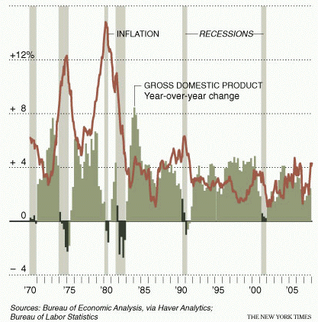
Scenarios
Recession- negative growth for 6 months
Depression- negative growth for 12 months
Stagflation-recession with high inflation

Slide 30
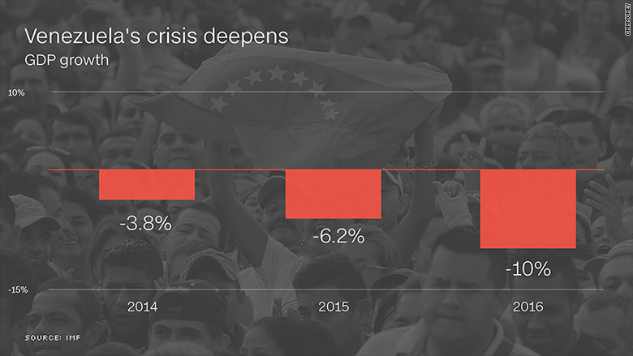
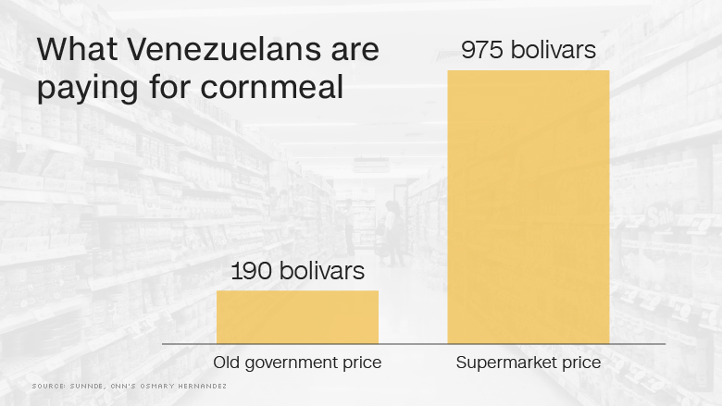
Tragic Case- Venezuela
Three quarters of the population has lost an average of nearly 20 pounds in body weight.

Slide 31
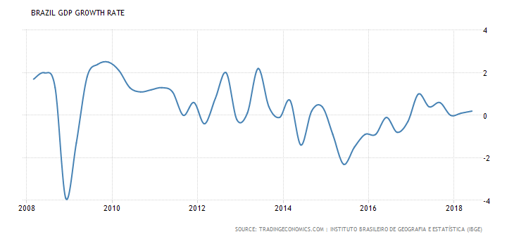
Growth Rates Affect Elections- Brazil

Slide 32
What causes business cycles?
Business Investment such as buying new machinery, promoting efficiency, and R&D.
Money and Credit- availability of money and credit (influenced by government)
Public Expectations about the future.
External Factors such as foreign developments.

Slide 33
Can it be predicted?
Professionals try to predict business cycles. How do they do it?
Unique predictors

Slide 34
Indicators of the Business Cycle
3 Types
Leading indicators anticipate direction of economy(future), include building permits, order of goods, price of raw materials.
Coincident indicators describe the current economy(now), include personal income, sales volume and production levels
Lagging indicators describe the economy several months before(past), include consumer credit and size of business incomes.

Slide 35
Why does the business cycle matter?
1)Determines government policies(spending, taxes, etc)
2)Influences interest rates on homes and cars
3)Influences credit(loans, cards, etc)
4)Influence business decisions( prices, wages, etc)
5)Influences people's economic attitudes
Basically, it can influence money you have in your pocket now and in the future.

Slide 36
Economic Growth Video
http://www.mruniversity.com/courses/principles-economics-macroeconomics/growth-rate-real-gdp-per-capita?utm_source=MacroAnnot&utm_medium=NextAnnot&utm_campaign=MRUYTAnnotation

