Slide 1
Vocabulary
CPI-Consumer Price Index- Measure of inflation
Inflation- general increase in prices on average

Slide 2
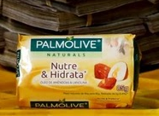
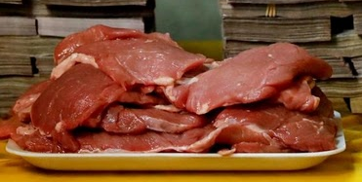
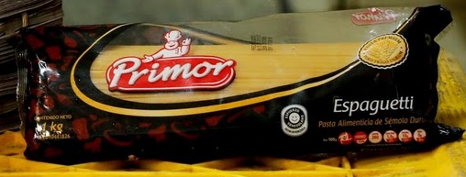
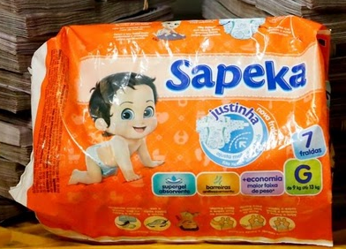
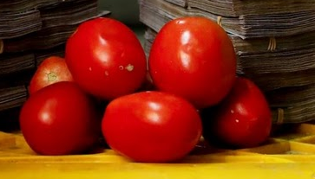
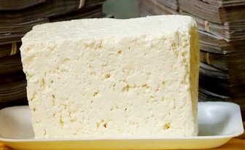
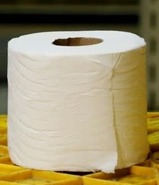
Price is Right - Venezuelan Style
5,000,000
8,000,000
9,500,000
2,600,000
7,500,000
3,500,000
2,500,000

Slide 3
Price is Right - Venezuelan Style
5,000,000
8,000,000
9,500,000
2,600,000
7,500,000
3,500,000
2,500,000

Slide 4
More on Venezuela
Brazil Sends Military To Border To Cope With Flood Of Fleeing Venezuelans

Slide 5
Inflation What is it?
Inflation is the general rise in prices on the average.
General prices are determined by aggregate demand (total demand) and aggregate supply (total supply).
Inflation over time

Slide 6
How do you calculate it?
Consumer price index is a measure of the average change over time in the price of a fixed group of products. This tells how much money consumers have in relation to other years. What??
Producer price index is the measure over time in the prices of goods and services bought by producers. What??

Slide 7
Calculating the Consumer Price Index and the Inflation Rate
Determine what goods are most important to the typical consumer: Fix the Basket
Find the prices of each of the goods and services in the basket for each point in time: Find the Prices
Use the data on prices to calculate the cost of the basket of goods and services at different times: Compute the Basket’s Cost
Designate one year as the Base Year, which is the benchmark for yearly comparison.
Notes:
8
8

Slide 8
The final step includes using the CPI to calculate the Inflation Rate, which is:
the percentage change in the price index from the preceding period
Example:
Base Year is 2015
Bundle of goods in 2015 = $1,200
The same bundle in 2016 cost = $1,272
CPI = ($1,272 - $1,200)/1200 X 100 = 6%
Prices between 2015 & 2016 increased 6%
Notes:
9
9

Slide 9
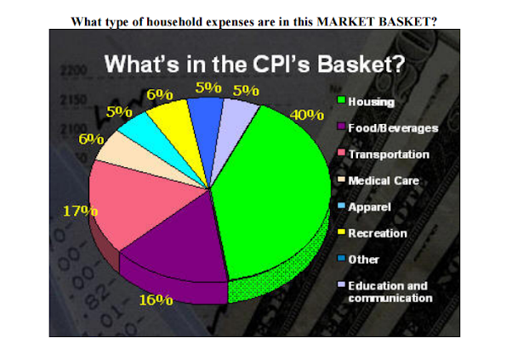

Slide 10
Inflation Rate
The inflation rate is the percentage average rise in prices.
It is calculated by:
((CPI Year B-CPI Year A)/ CPI Year A) X100

Slide 11
Drawback of CPI
1)Only used to measure prices in urban market

Slide 12
graphing causes inflation?
Demand-pull inflation occurs consumers buy more(increasing AD)
Cost-push inflation occurs when producers raise prices to cover higher resource costs. An example is higher gas prices.

Slide 13
Demand-pull inflation
AS
Price level
P₂
P₁
AD₂
AD₁
O
Q₁
Q₂
National output

Slide 14
Cost-push inflation
AS₂
AS₁
Price level
P₁
AD
O
Q₁
National output

Slide 15
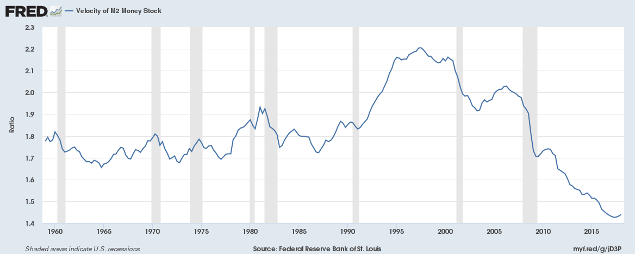

Slide 16
Why is inflation bad?
Uncertainty. Producers and consumers don’t know how prices will change.
Destroys value of dollar
Feeds itself(panic)

Slide 17
What are its effects?
Purchase power of the dollar(decreased)
Value of Real Wages(decreased)
Interest Rates (increased to combat inflation)
Savings and Investing(decreased)
Production Costs(increased)
Lender’s returns(decreased)
Serving size(decreased)

Slide 18
Problems in adjusting for inflation
Substitution effect
Buy cheaper similar goods
New Goods are introduced
Cell Phones, internet service, etc
Unmeasured quality change in products
Items cost more but are better

Slide 19
Final Note
Inflation is basically inevitable. Ideal inflation rate is 2-3%. Anything much higher is dangerous.
Deflation is the general decrease in prices, however this is just as bad if not worse than inflation because
“cost” of debt rises
Businesses sit on money and don’t invest
Workers may not be as motivated
Labor markets are not as efficient

Slide 20
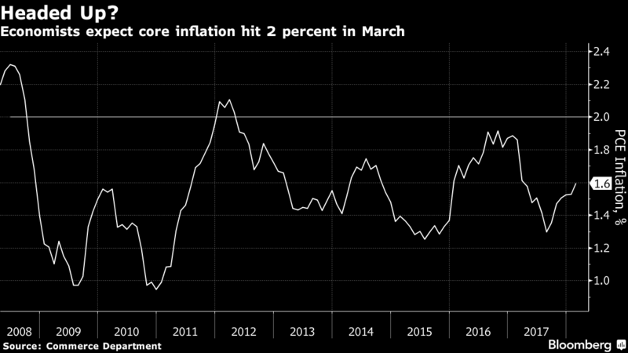

Slide 21
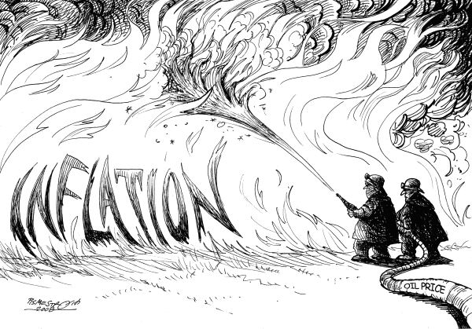
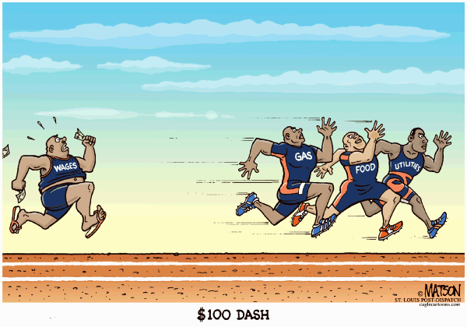
What do these imply about inflation?

Slide 22
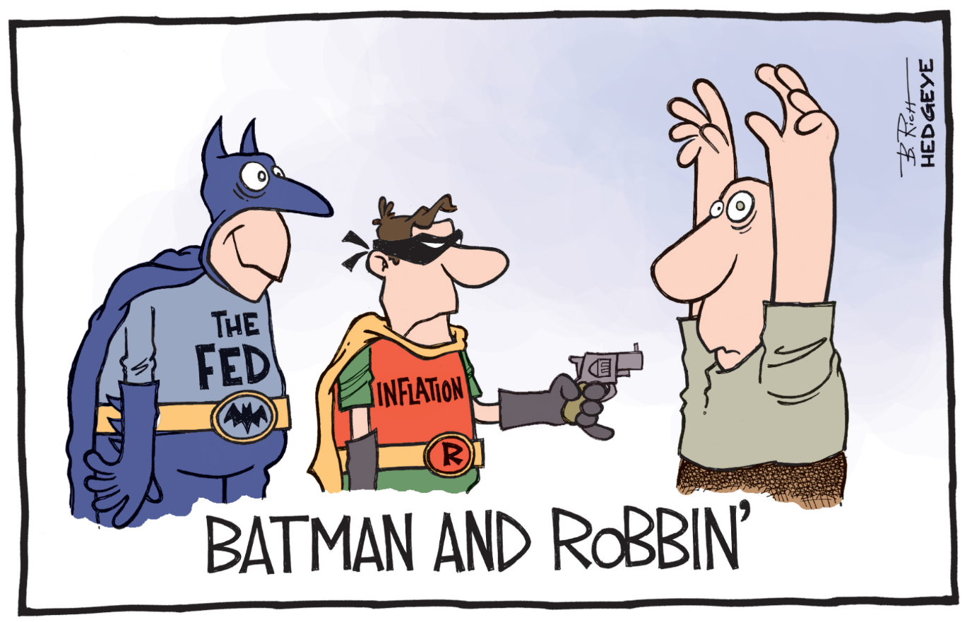
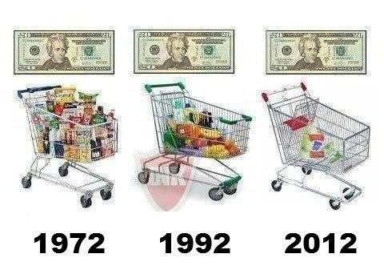

Slide 23
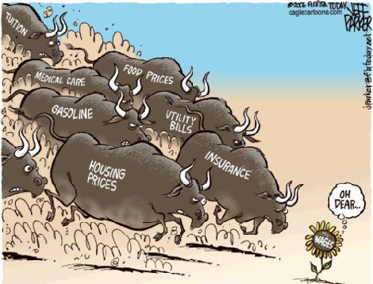
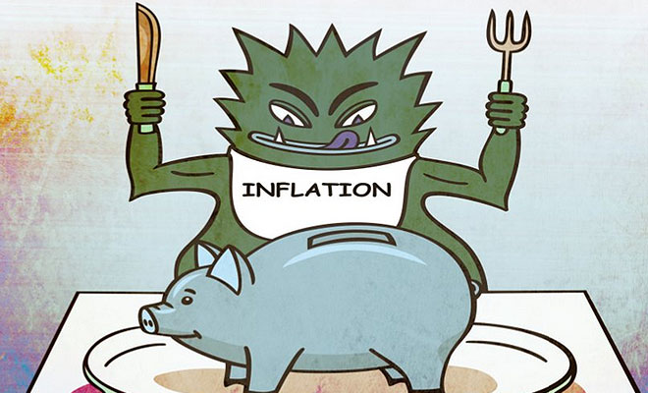

Slide 24
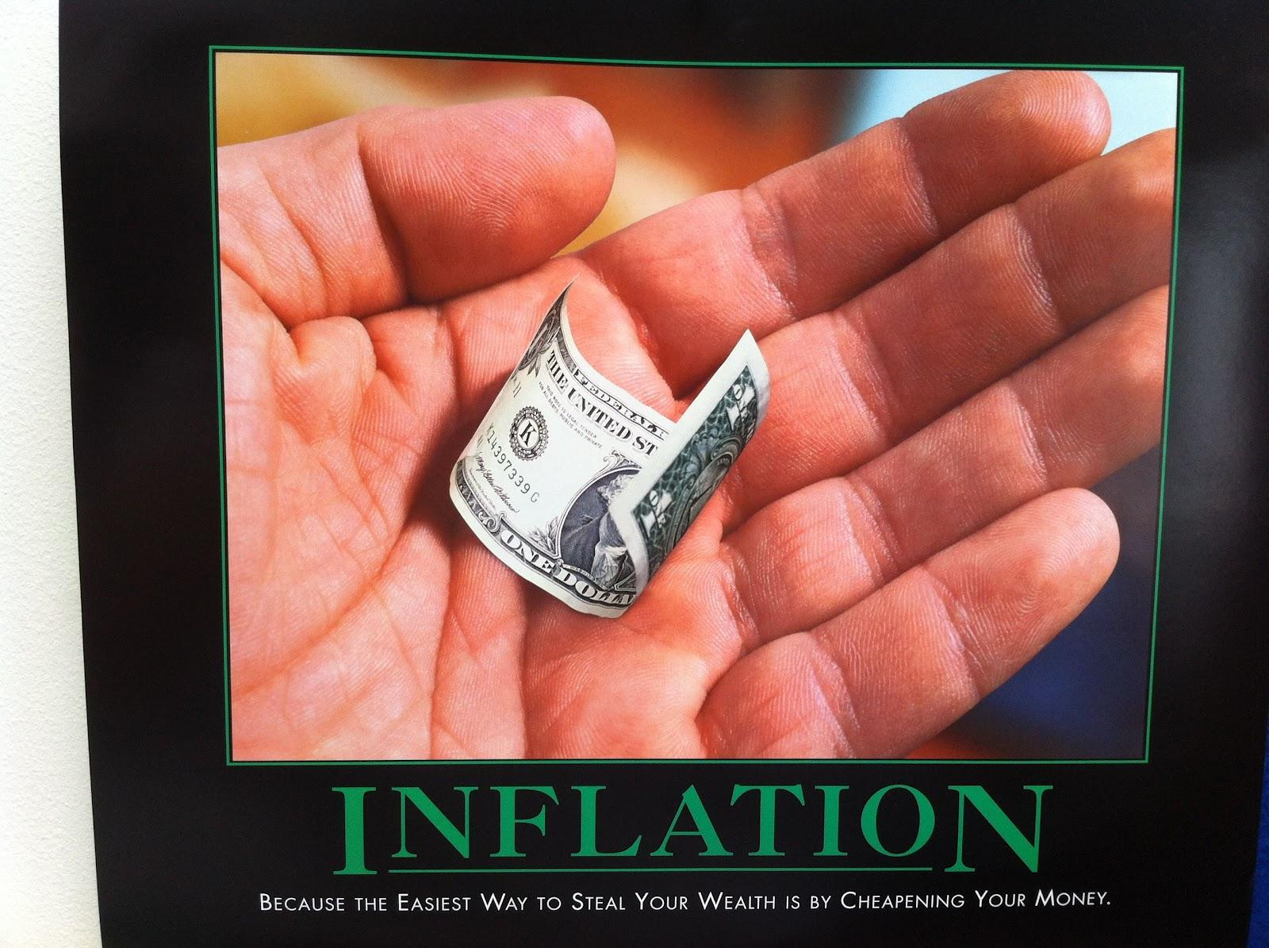

Slide 25
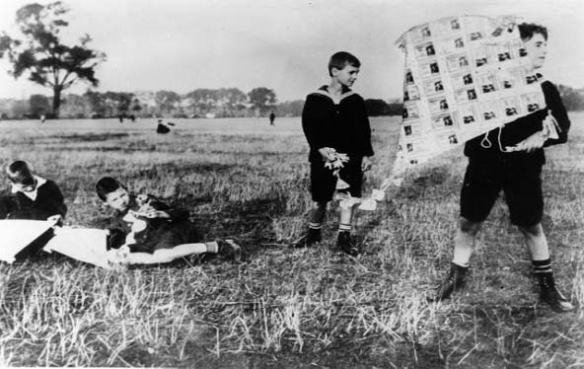
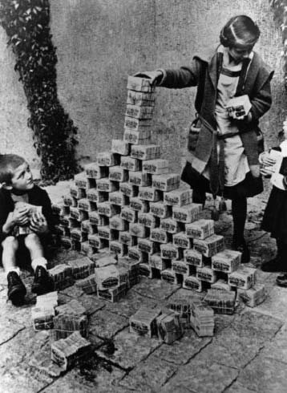
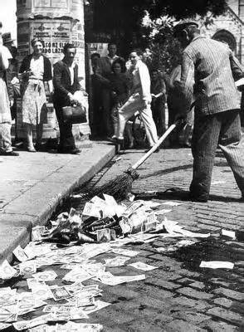
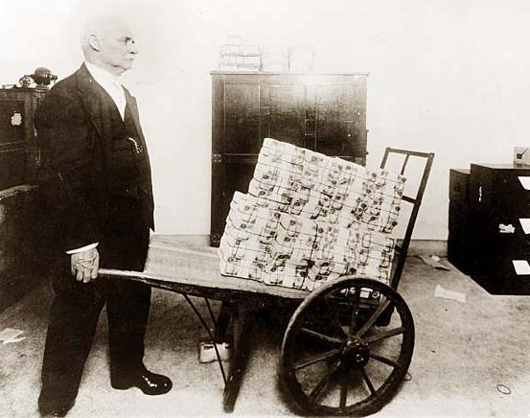
Historical Inflation

Slide 26
Hyper Inflation
Nation | Inflation | Time for prices to Double
Germany(1923) | 20.9% per day
Greece(Oct. 1944) | 13,800% per month | 4.3 days
Yugoslavia(Jan. 1994) | 313,000,000% per year | 34 hours
Zimababwe(Nov 2008) | 79,000,000,000% per month
Hungary(1946) | 195% per day | 15.6 hours

Slide 27
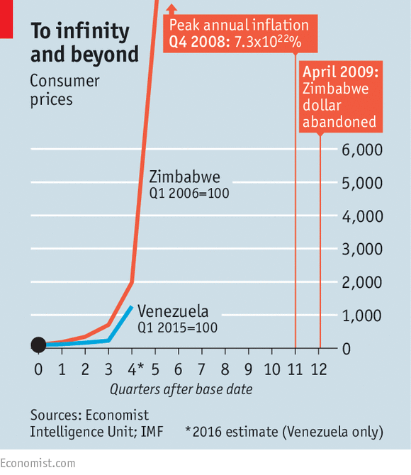
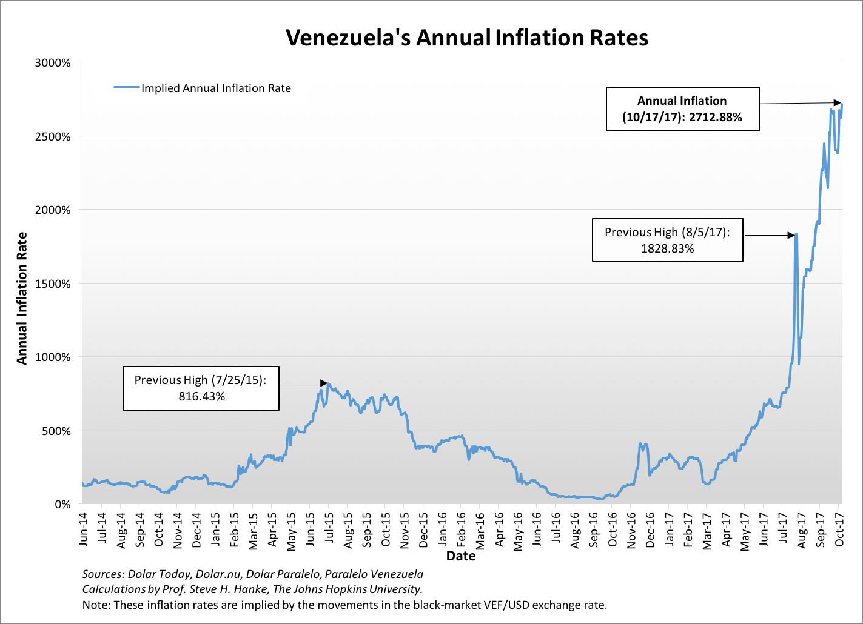
You want to be a trillionaire?

Slide 28
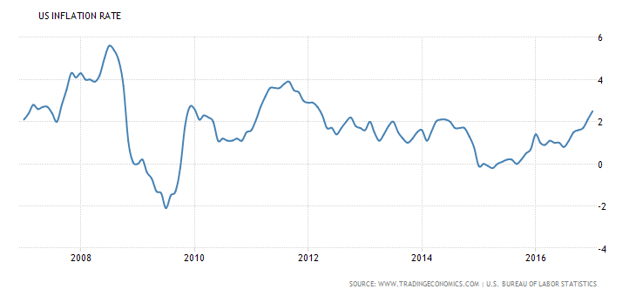
Is deflation good?

Slide 29
$100 in 2016 equal how much in the following years???
1916-$4.46
1926-$7.67
1936-$5.83
1946-$7.80
1956-$12.06
1966-$13.80
1976-$20.03
1986-$44.99
1996-$65.24
2006-$82.20

Slide 30
What cost $100 in the following years would cost $?? in 2016
1916-$2258.57
1926-$1327.79
1936-$1692.46
1946-$1287.87
1956-$842.30
1966-$730.46
1976-$459.21
1986-$217.57
1996-$152.53
2006-$120.23

Slide 31
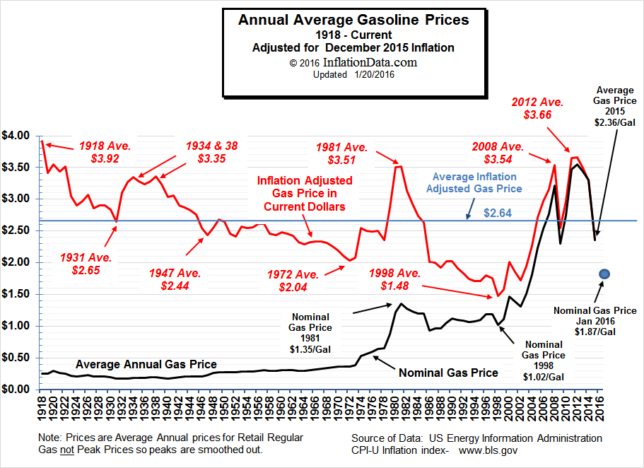
Gas Prices

Slide 32
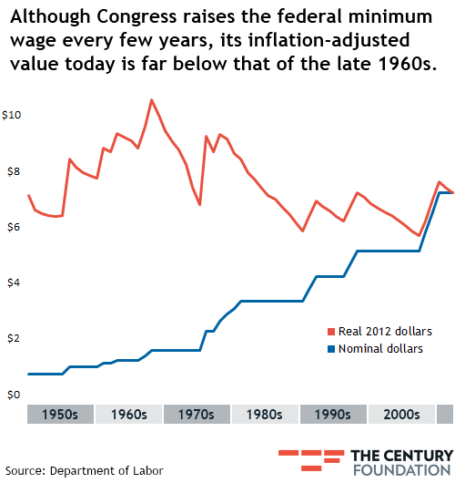
Minimum Wage and Inflation

Slide 33
Minimum Wage
1964 was $1.25 an hour, that equates to $9.83 in 2016
1994 was $3.35 an hour, that equates to $5.50 in 2016

Slide 34
Video Review
Who wants to be a Trillionaire?
Measuring Inflation
Venezuela

Slide 35
Draw Demand Pull and Cost Push Inflation
Aggregate
Supply
Price
Level
P^{E}
Aggregate
Demand
Q^{E}
Real GDP or
Quantity of Output
Notes:
10
10
10

Slide 36
Cost of Tuition and Fees for College
1964- $249= $1,190 in 1994 and $1,900 in 2014
1994- $1600=$2,555 in 2014
2014-$6000

Slide 37

Gas and
inflation

Slide 38
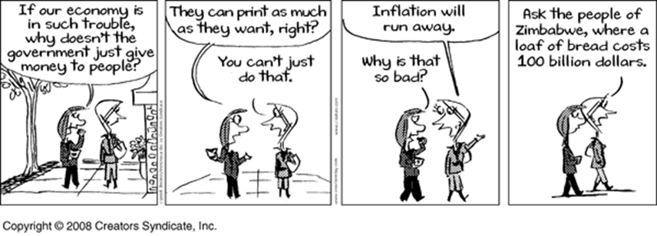

Slide 39
Question
Does printing out more money always cause inflation?
No- Inflation is also calculated as Money X Velocity(how fast it is used). If there is more money but no one is spending it, then there is no inflation.
Inflation=Money X Velocity
Quantitative Easing explained

Slide 40
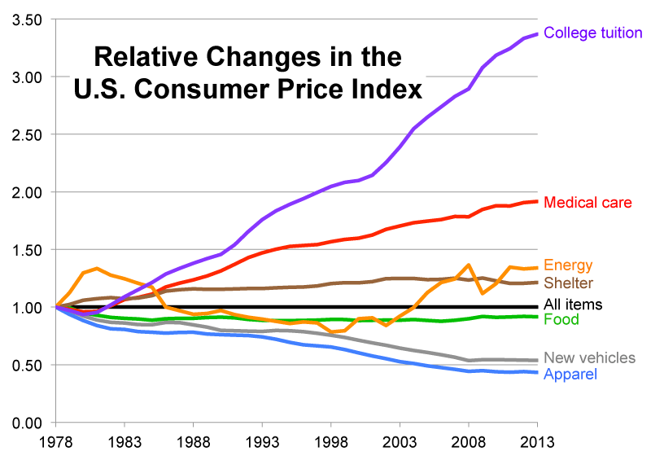
College Tuition

Slide 41
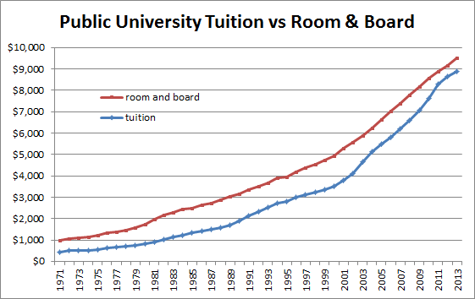
College Tuition over Time

Slide 42
