Slide 1
Vocabulary
Structural Unemployment- unemployed due to job is no longer needed b/c of nature of technology
Cyclical Unemployment- unemployed because of business cycle(recession)
Frictional Unemployment- in between jobs

Slide 2
What does employed mean?
All persons who did any work for pay or profit during the survey week.
All persons who did at least 15 hours of unpaid work in a family-operated enterprise.
All persons who were temporarily absent from their regular jobs because of illness, vacation, bad weather, industrial dispute, or various personal reasons, whether or not they were paid for the time off.

Slide 3
What does unemployed mean?
1)Not have a full time job
2)Available to work
3)Actively looking for work(4weeks)
4) were not working and were waiting to be called back to a job
5)Not one of the exceptions

Slide 4
Who does not count(exceptions)?
Some don’t count in the calculations.
What are some examples?
Homemakers
Full time students
Disabled
Those collecting Social Security
Those not seeking a job.

Slide 5
What is the unemployment rate and how is it tallied?
The unemployment rate is the percentage of people that are actively seeking jobs who do not have one. What is the rate now?
There are a few ways to tally it. The main way the government tallies it is by a survey of 60,000 households that rotate every 4 months. This is compiled by the U.S. Government’s Dept. of Labor.
Full employment is about 95%. Ideal unemployment is between 4-6%
Each nation has a definition of unemployment rate.

Slide 6
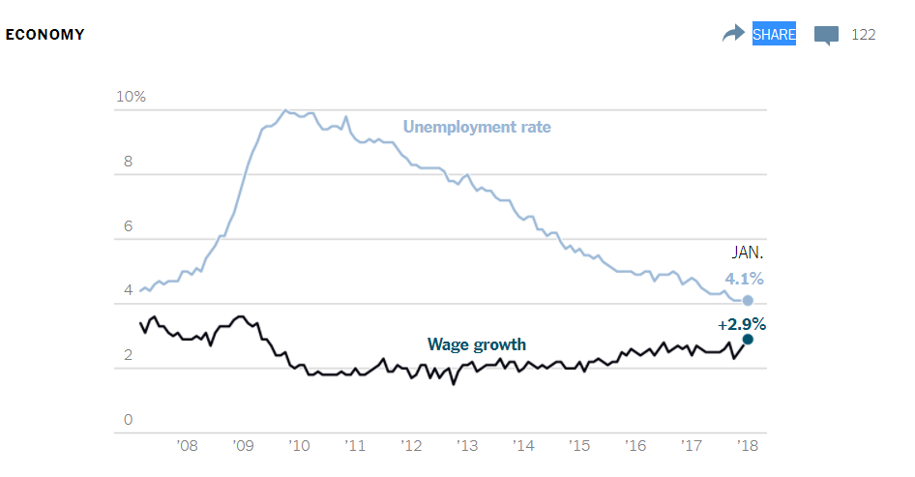

Slide 7
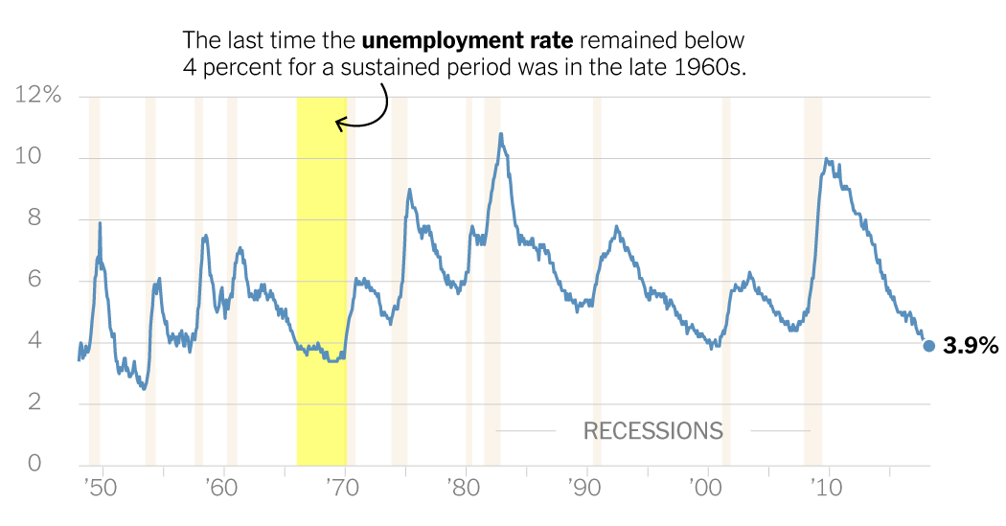

Slide 8
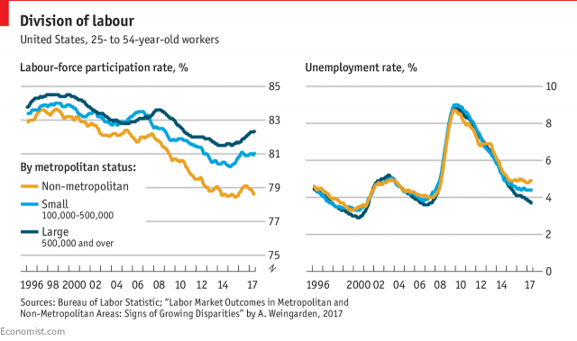

Slide 9
Labor Force
The Labor Force is the sum of those who are considered employed and those actively seeking to be employed(exceptions do not count).

Slide 10
Unemployment Formula
Unemployment Rate = (Unemployed Workers / Total Labor Force) * 100
Example- 1000 people live in Jenkinsesia. 500 are in the labor force and 450 have a job. What is the unemployment rate?
Unemployment Rate= 50/500
Rate is 10%
Can be misleading because people may drop out of labor force.

Slide 11
Calculate
5000 people live in Jenkinsesia. 3000 are in the labor force and 2800 have a job. What is the unemployment rate?
Notes:
6%

Slide 12
Calculate
In Millions
Civilian Population | 270
People Incapable of Working | 70
People Not Looking for Work | 60
Employed Workers | 133
Using the table above, the unemployment rate is:

Slide 13
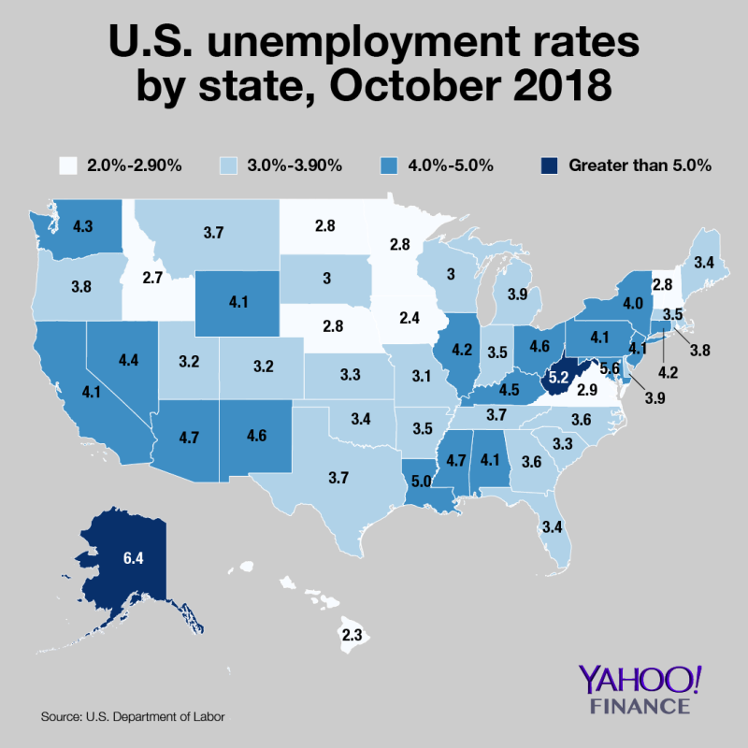
Current

Slide 14
Review Time
Who calculated unemployment?
Why is 5% a good unemployment figure?

Slide 15
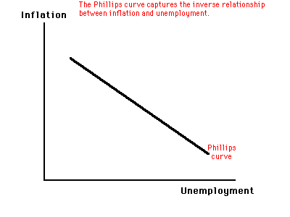
Inflation and Unemployment
What is the relationship between inflation and unemployment? Why?
Which is better?

Slide 16
Types of unemployment
Frictional
In between jobs, Fired or Quit(can’t solve)
Structural
Due to changes in technology or structure of employment, lack of marketable skills(retrain)
Seasonal
Regular fluctuations in employment due to season(summer, Christmas, etc.)(can’t solve)(gov’t adjusts %)
Cyclical
Employment changes due to business cycle, recession (most impact)

Slide 17

Fad Or The Future? Robot-Made Burgers Wow The Crowds In San Francisco
How does the headline above involve minimum wage and structural unemployment?

Slide 18
Drag the Dot to the correct
Structural Cyclical
Frictional Seasonal

Slide 19
Remember
Frictional
N
B
E
T
W
E
E
N
M
Structural
K C
I H
L I
L N
S E
S
R
E
Cyclical
E
S
S
I
O
N

Slide 20
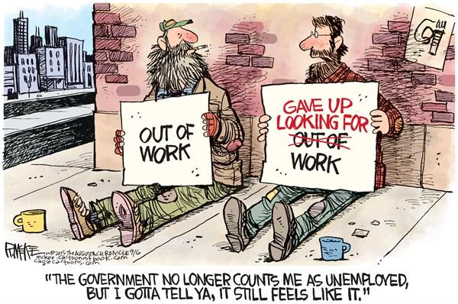
Other areas of Employment
Discouraged workers-those who want a job , but are too discouraged to look for one.
Underemployed- those employed who are not taking advantage of their skills, example a rocket scientist working at Wal-Mart in the deli.

Slide 21
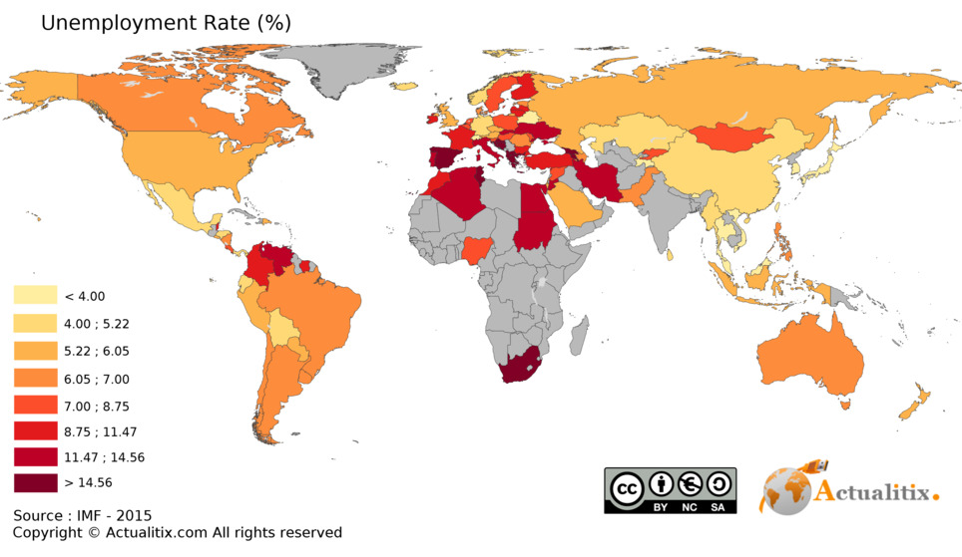

Slide 22
What about cases of overlap?
When the population is classified according to who is employed, unemployed, and not in the labor force on the basis of their activities during a given calendar week, situations are often encountered where individuals have engaged in more than one activity. Since individuals are counted only once, a system of priorities is used to determine status. Labor force activities take precedence over non-labor force activities and working or having a job takes precedence over looking for work.

