Slide 1
Vocabulary
FED- abbreviation for Federal Reserve Bank; Central Bank of the US

Slide 2
Possible Economic Problems
High Unemployment
Low or Negative Real GDP Growth Rate
High Inflation
Recession
Hyper inflation
Stagflation

Slide 3
Economic Goals
Unemployment Rate between 4-6%
Real GDP Growth Rate of 3-4%
Inflation Rate of 1-2%
Expansion on the Business Cycle

Slide 4
Who tries to achieve these goals?
Who is the most powerful man in America?
The Federal Reserve AKA The FED
AKA The Central Bank of the US

Slide 5
Overall Government Economics Targets
Inflation Rate 1-1.7%
Growth Rate 2-3%(Real GDP)
Unemployment Rate 5%
Balanced National Budget

Slide 6
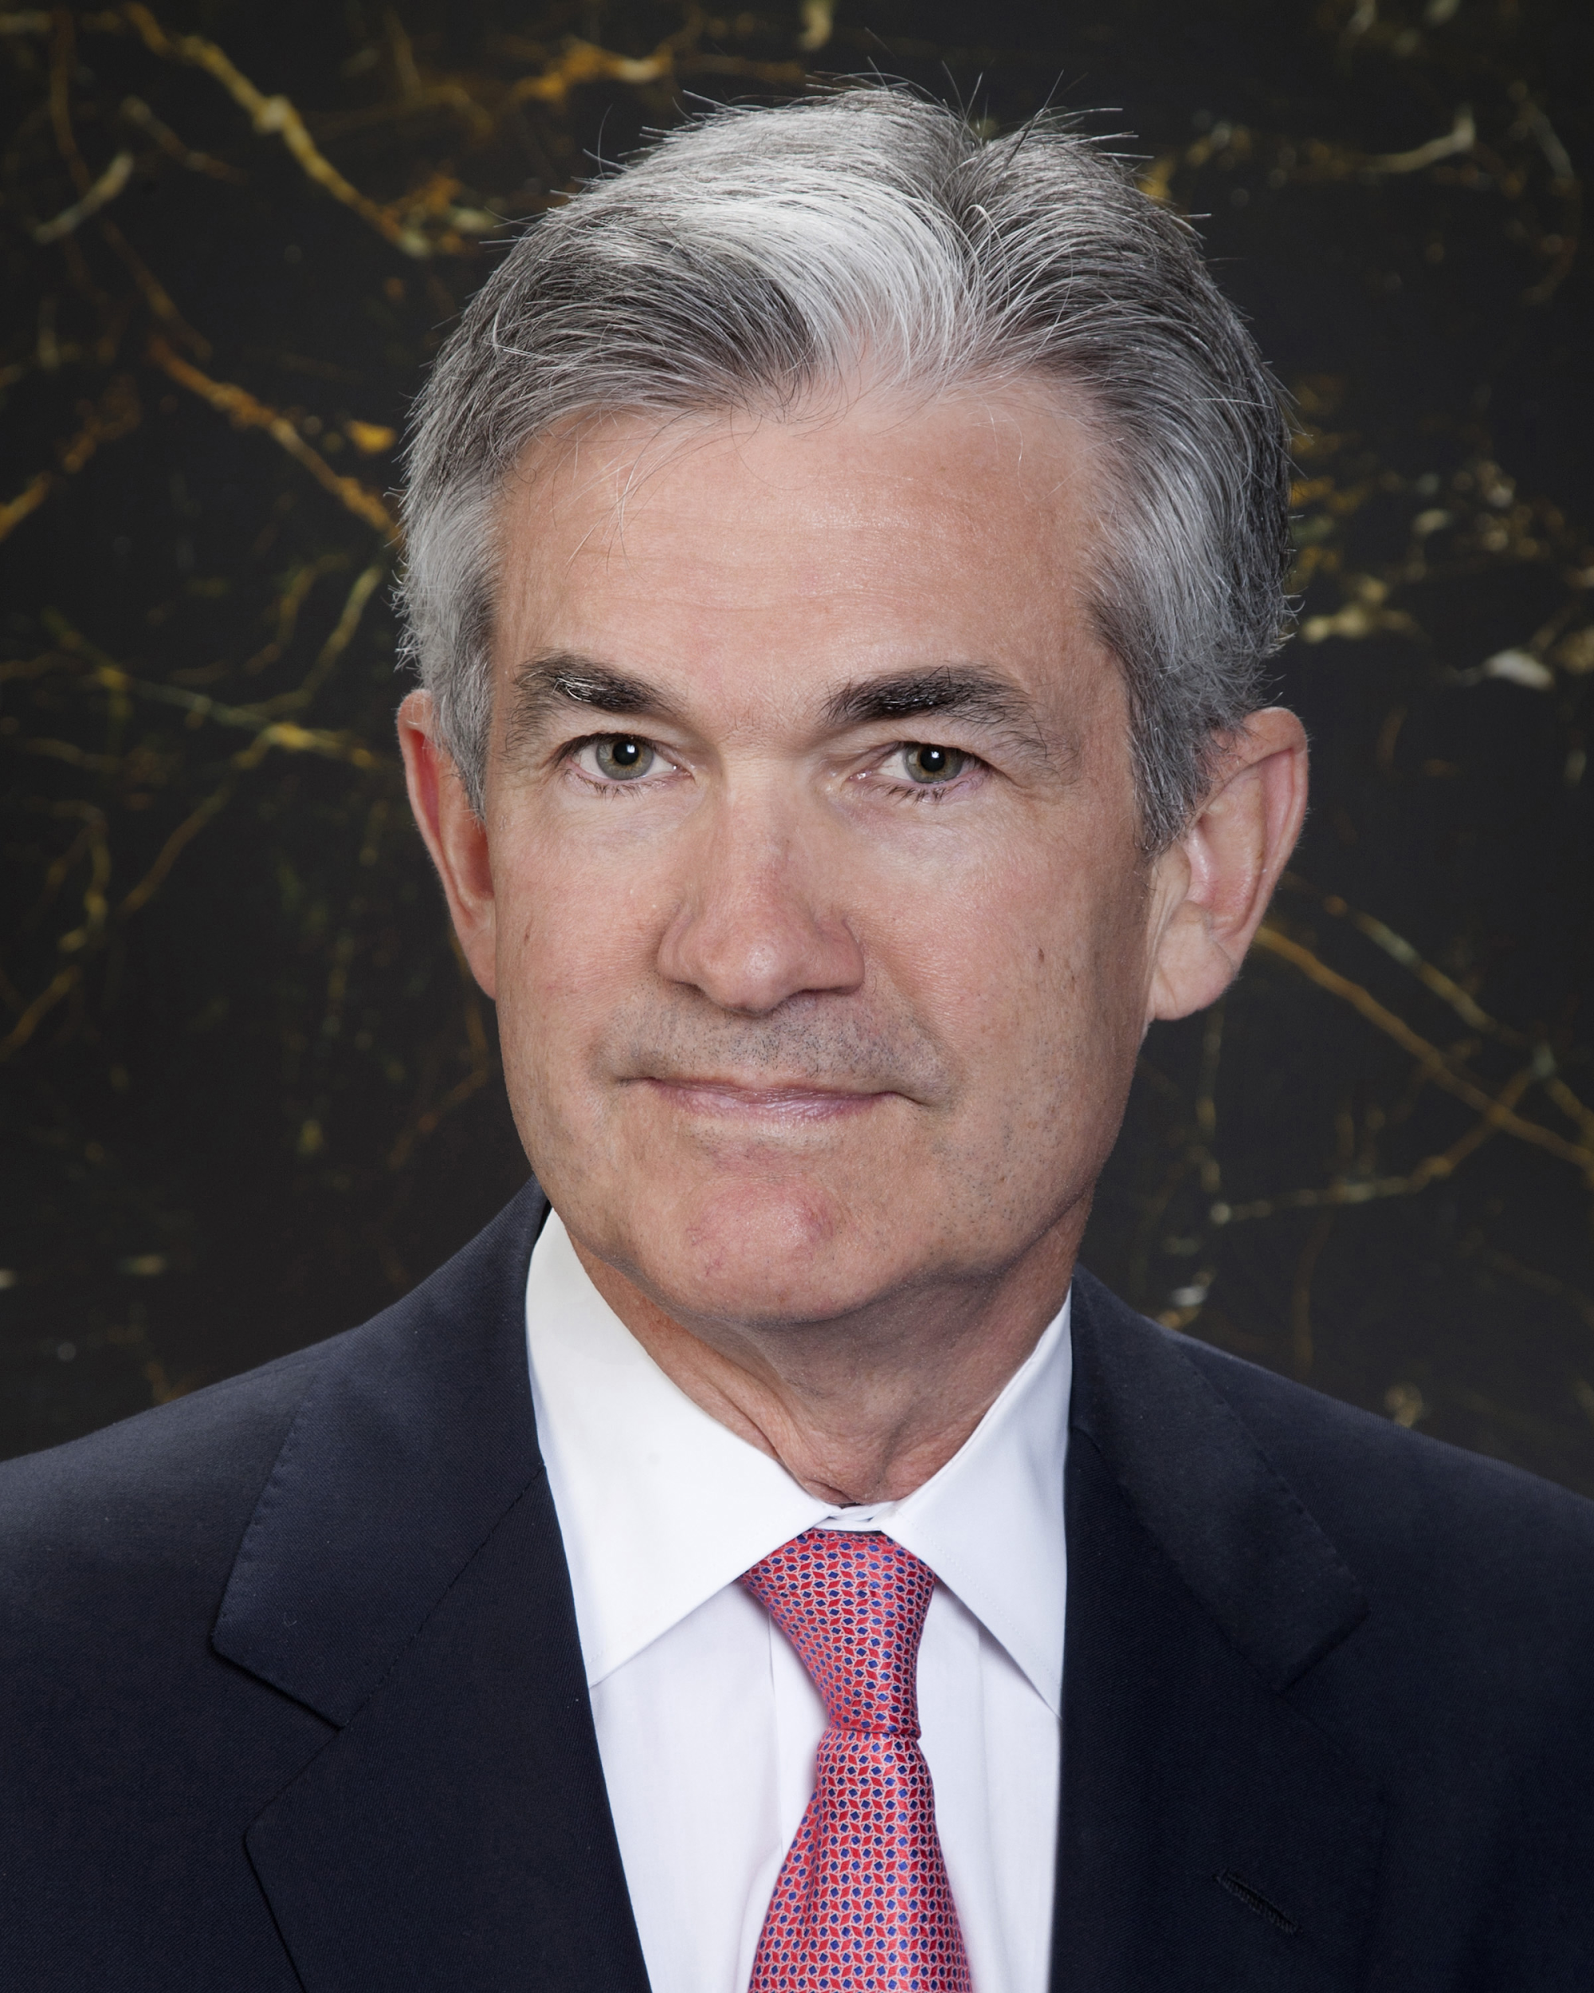
Jerome Powell
Why is he so powerful? 1)Independent powers 2)Non-political 3)”Chief” Economist for US
"The mandate of the Federal Reserve is to serve all the American people, and too many Americans still can't find a job and worry how they'll pay their bills and provide for their families. The Federal Reserve can help if it does its job effectively.“ Janet Yellen 2014
Federal Reserve Building

Slide 7
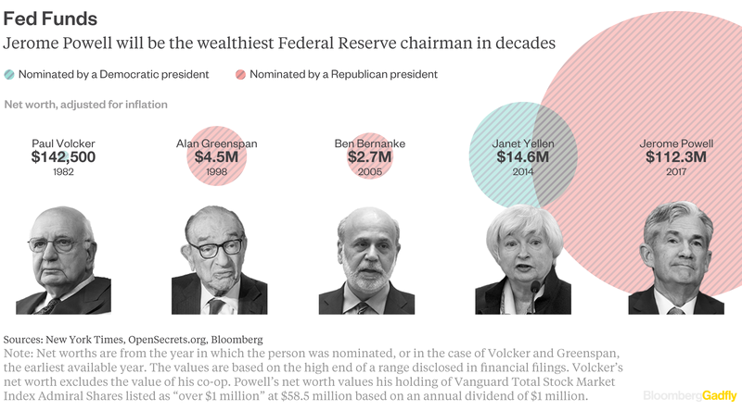
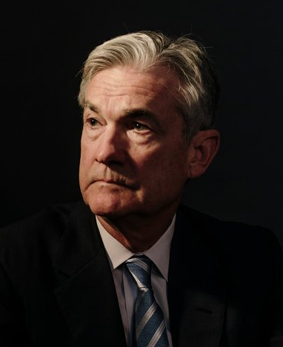
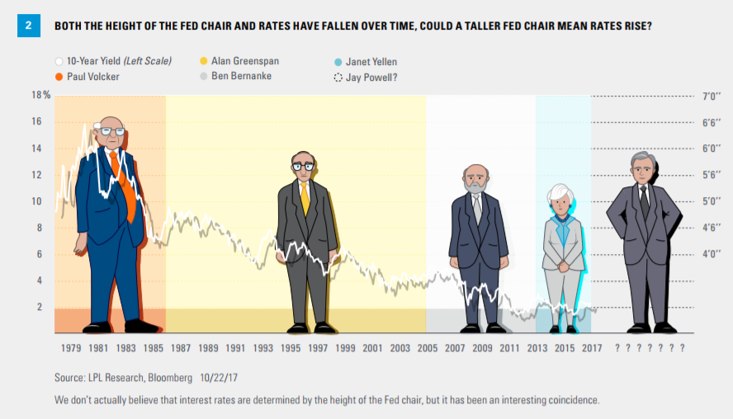
Started on Feb. 5, 2018
Jerome Powell

Slide 8
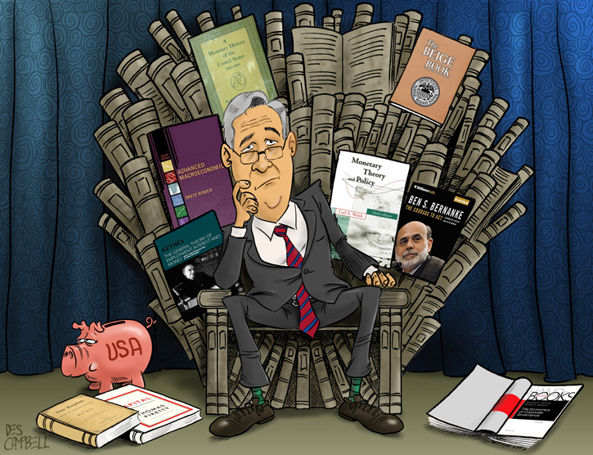
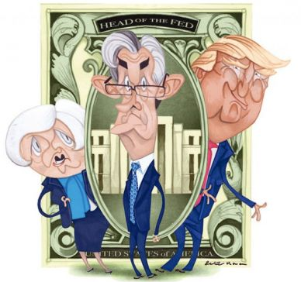

Slide 9
Reasons for the Fed
Stability to the banking system
Set interest rates
Central authority for banking
Stabilize the economy

Slide 10
Organization of the Fed
National- Board of Directors/Governors consisting of 7 members appointed by the President for 14 year terms
District Level- 12 Federal Reserve district banks
Regional Level-25 regional branch offices
Local Level- Member Banks about 3,000 national and 1,000 state
Open Market Committee

Slide 11
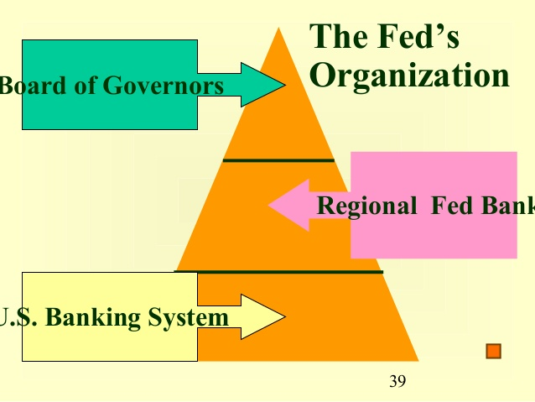

Slide 12
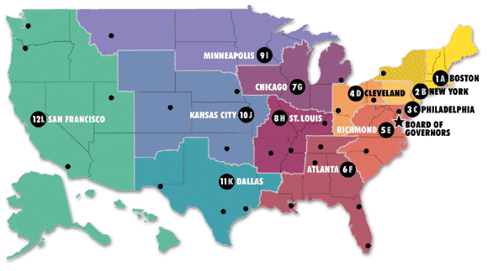

Slide 13
Role of the Fed
Supervise Member Banks
Stress Tests- Simulations run to check if banks are “healthy”
Holding of Cash Reserves for banks to borrow from
Controls Money supply

Slide 14
What Fed does for Banks
It keeps track of, processes, and clears checks.
It loans money out to member banks in need. This is an “insurance” for member banks.

Slide 15
What Fed does for Government
Serves as government’s bank
It holds the government's deposits
It is the checking account for the Treasury
Records spending of federal funds
Advises Legislative and Executive branch of economic situations and policy

Slide 16
What Fed does for Government
Supervising member banks in a regulatory manner.
Regulating the money supply
Producing Money and Coins
Destroying worn out money and replacing it with new
Review

Slide 17
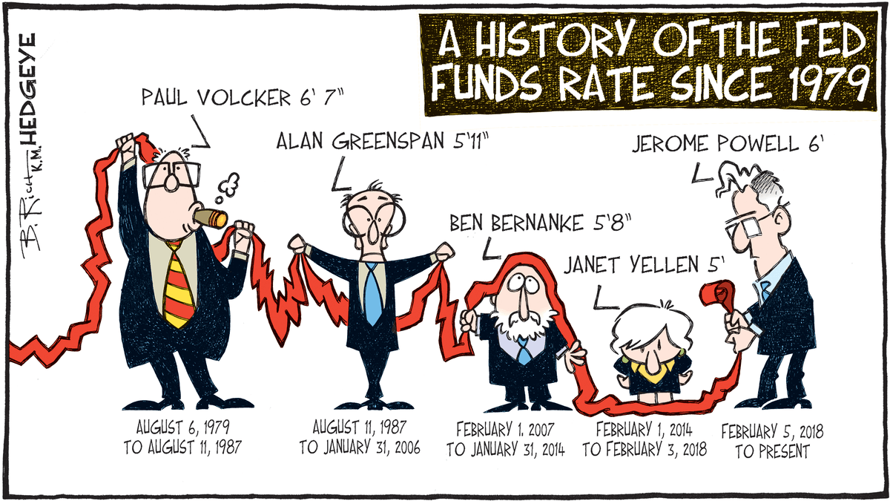
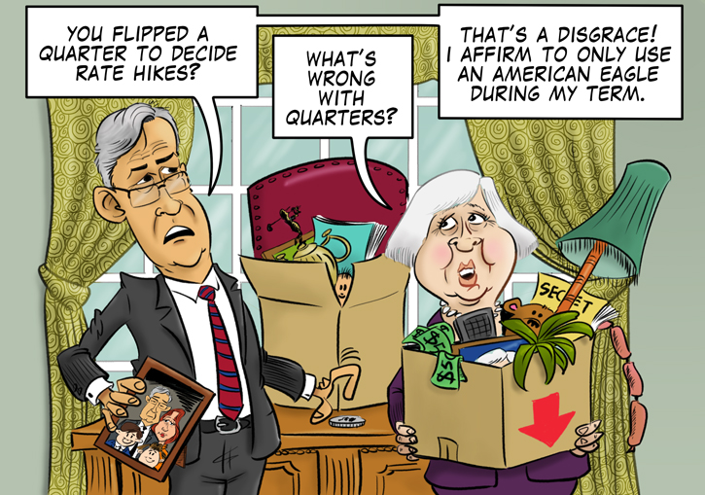
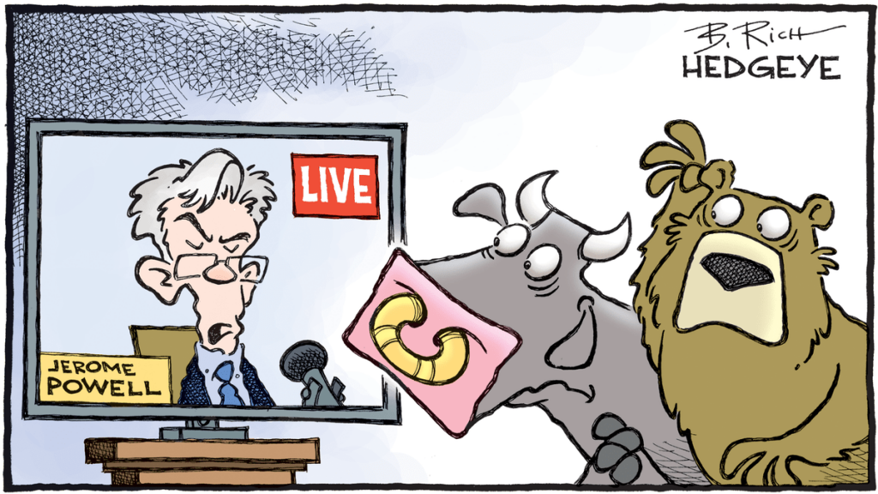

Slide 18
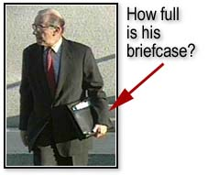
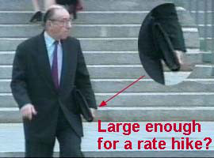
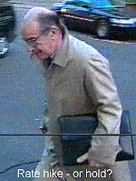
Alan Greenspan Role of the Fed
The job of the Fed is to take away the punch if the party gets out of hand and to spike the punch if the party slows down.

Slide 19
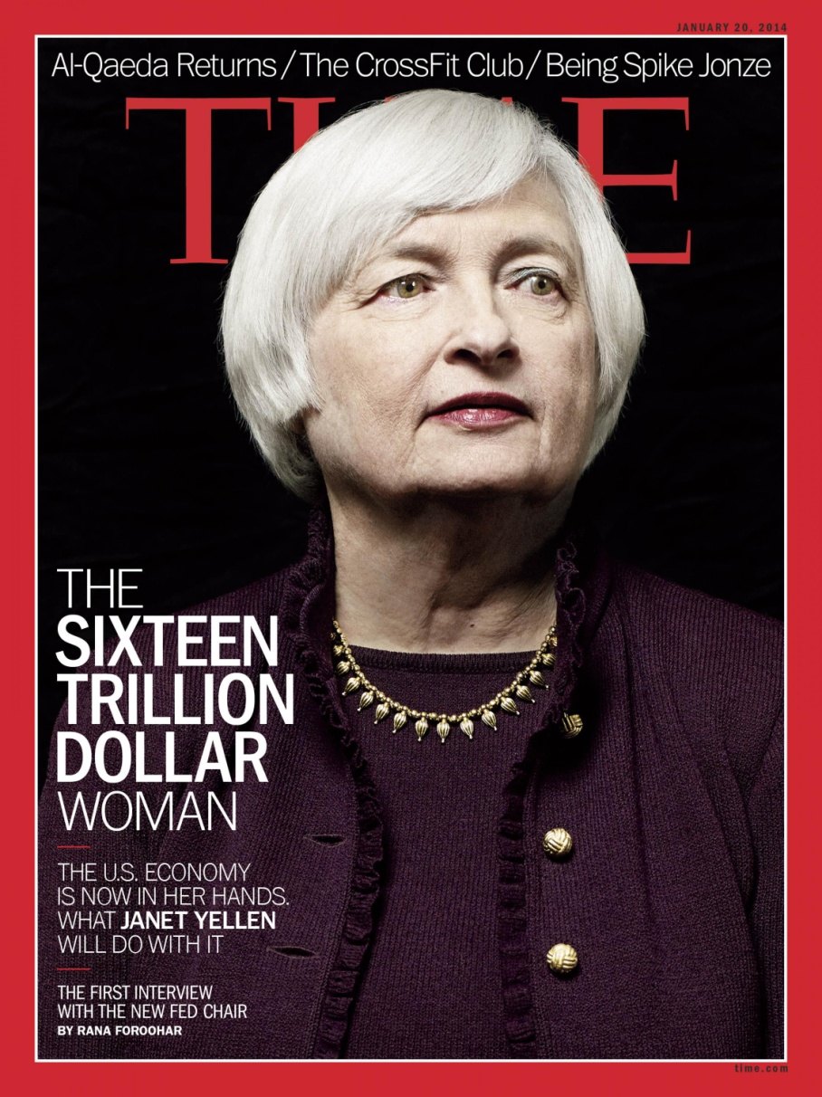
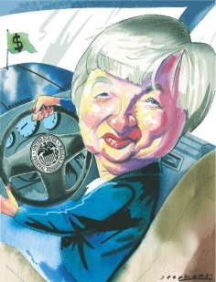
Why is she the $16 Trillion Woman?

Slide 20
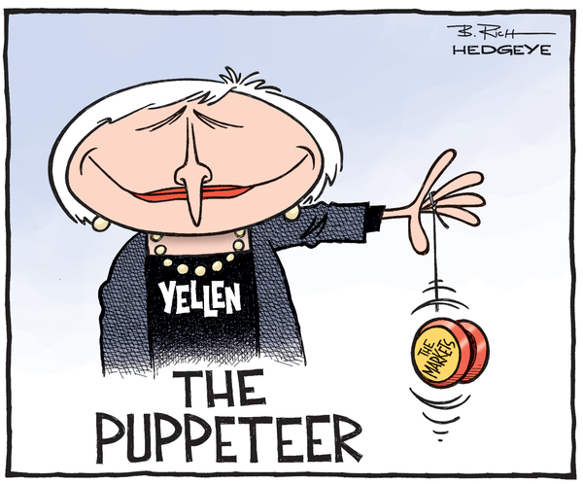
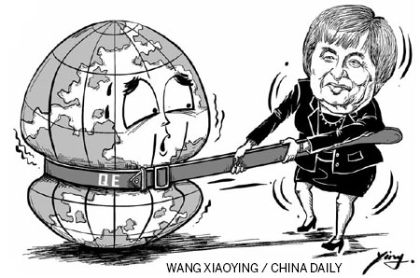
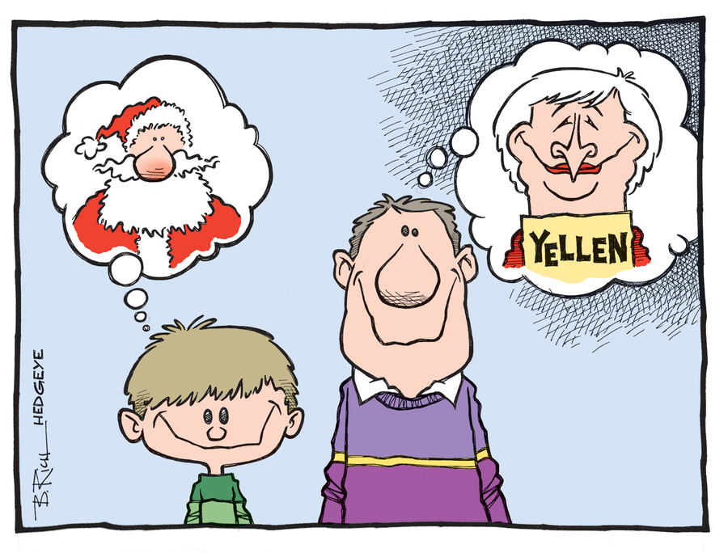
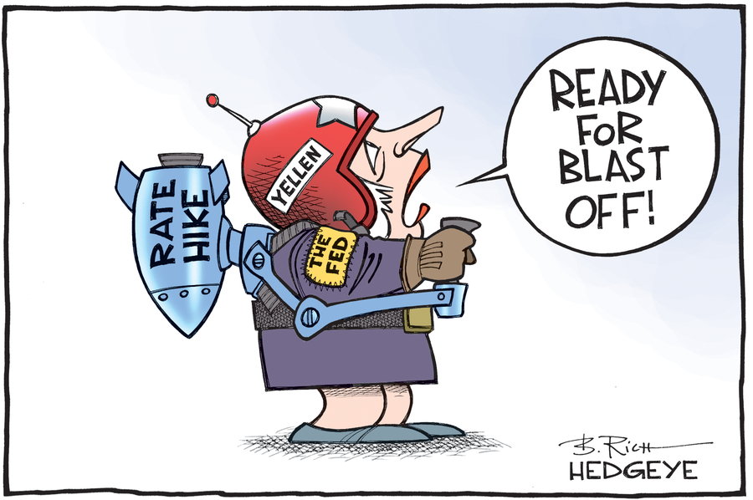

Slide 21
So what happens?
Economic Scenario
Real GDP has fallen by 2%
Inflation is .1%
Unemployment is at 9%
Aggregate Demand has dropped(along with Consumer Confidence)

Slide 22
So what happens?
Economic Scenario
Real GDP has risen by 2%
Inflation is at 9%
Unemployment is at 3.2%
Aggregate Demand has increased(along with Consumer Confidence)

Slide 23
So what happens?
What should be done?
Who will do it?

