Slide 1
Vocabulary
Monetary Policy- FED attempt to manipulate economy with supply of money
Interest Rate- rate charged on borrowed money
Reserves- percentage of money banks must keep on hand
Securities-Investments bought from the government

Slide 2

Fed in the News March 2017
http://www.usatoday.com/story/money/personalfinance/2017/03/15/federal-reserve-interest-rate-hike-mortgages-credit-cards-auto-loans-savings-rates/99179006/
http://www.foxbusiness.com/markets/2017/03/13/federal-reserve-bank-atlanta-has-new-president.html
Raphael Bostic

Slide 3
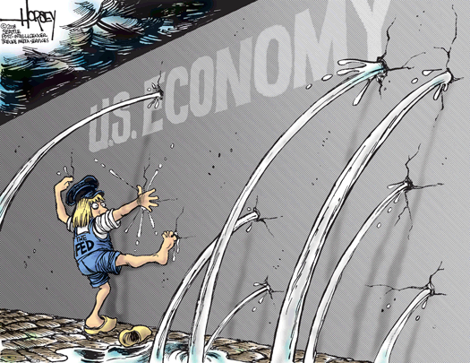
What does the FED do and why do I care?
The overall goals of the Central Bank are economic growth with low inflation and stable prices.

Slide 4
Central Bank Action
Argentina Hikes Interest Rate To 60 Percent In Bid To Halt Currency's Fall

Slide 5
Monetary Policy
Monetary policy is the plan to expand or contract the money supply in order to influence the cost, availability of credit, and the business cycle.
The monetary policy is determined by aggregate demand and the money supply.

Slide 6
Simple Monetary Policy
FOLLOW THE MONEY!!!!!
An increase in supply of money people have, the more they can spend and the economy can grow more (in recession).
A decrease in supply of money people have the less they can spend and the economy can slow down (in inflation).

Slide 7
Types of Monetary Policy
Easy/Expansionary Monetary Policy increases the money supply, lowers the interest rate and allow more money to be borrowed. This is done mainly in a recession to speed up economy and to increase aggregate demand, create jobs, reduce unemployment, and stimulate the economy.
Tight/Restrictive Monetary Policy decreases the money supply and raises the interest rate in order to lower inflation and reducing aggregate demand.

Slide 8
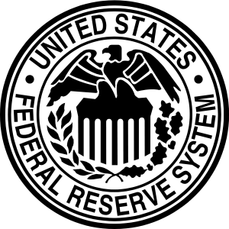


Draw arrows to explain Easy Monetary Policy

Slide 9
Tools/Parts of the Monetary Policy
Discount Rate(Federal Funds Rate)-The interest rate the Fed charges member banks.
Fed lowers the discount rate to encourage banks to borrow and increases bank reserves. Thus expanding the money supply(easy). This is done in a recession.
Fed raises the discount rate to discourage banks from borrowing and decreases reserves. Thus contracting the money supply(tight). This is done in an inflationary period

Slide 10
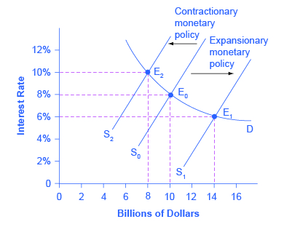
1)What is relationship between money supply and interest rates?

Slide 11
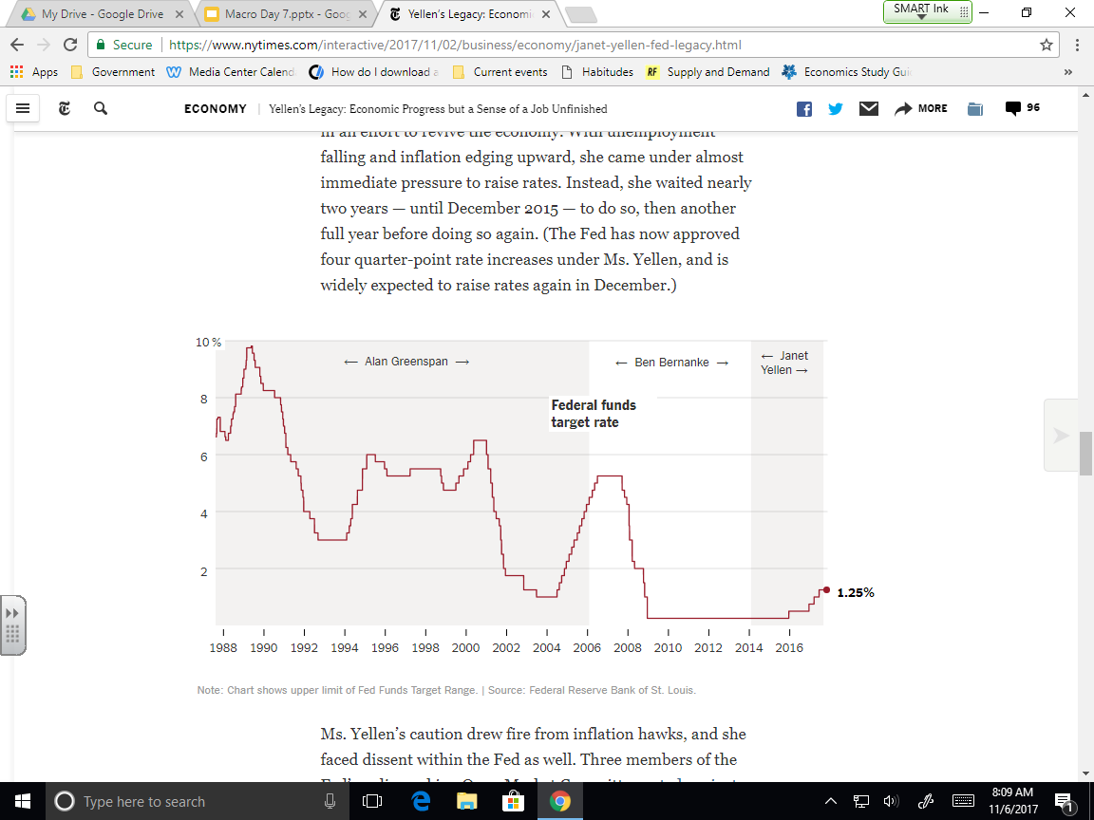
1)What conclusions can you draw from this?
2)How can it be good news that the Fed Fund Rate is increased?

Slide 12
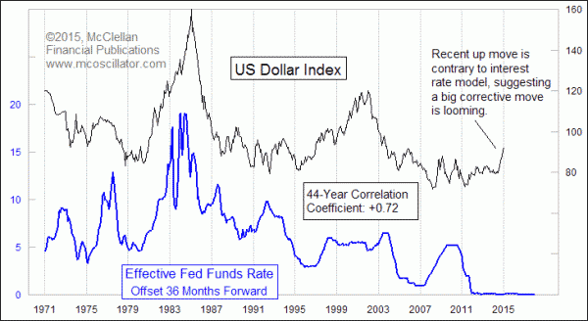
What can you learn about the value of the Dollar internationally based on the graph?

Slide 13
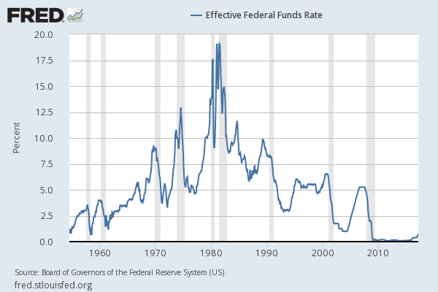
What was the problem in 1974 and 1982?

Slide 14

Draw arrows to explain how changing Discount Rate affects the Money Supply
Raise Interest Rate Supply
Lower Interest Rate Supply

Slide 15
Parts of the Monetary Policy
Reserve Requirement- amount of money a bank holds in reserves
Fed lowers the requirement to allow bank more loans, decrease interest rates, and increase aggregate demand and production, thus expanding the money supply(easy). Done in recession.
Fed raises the requirement to allow bank fewer loans, increase interest rates, and decrease aggregate demand and production, thus contracting the money supply(tight). Done for inflation.
Rate depends on the size of the bank holdings/deposits and has not changed in years, so this is rarely used.

Slide 16
Draw arrows to explain how changing Reserve Requirement affects the Money Supply
Raise Reserve Requirement Supply
Lower Reserve Requirement Supply

Slide 17
Parts of the Monetary Policy
Open Market Operations-Buying and selling securities
Fed buys gov’t securities to increase bank reserves, money supply(easy), aggregate demand, and aggregate production thus expanding the money supply. This is done in a recession
Fed sells gov’t securities to decrease bank reserves, money supply(tight) and aggregate demand thus contracting the money supply. This is done to combat inflation.

Slide 18
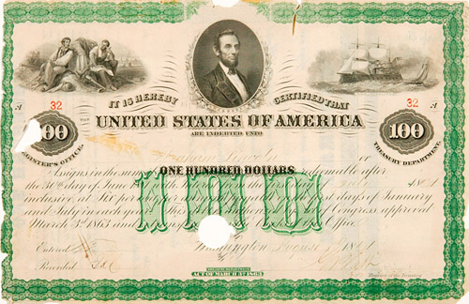
Draw arrows to explain Buying Securities
What happens to the Money Supply?

Slide 19
Draw arrows to explain Selling Securities
What happens to the Money Supply?

Slide 20
Parts of the Monetary Policy
Interest Paid on Reserves
Fed raises rate paid to banks for keeping reserves(tight). This persuades banks from lending money to consumers to spend.
Fed lowers rate paid to banks for keeping reserves(easy). This persuades banks to lend money to consumers to spend.

Slide 21
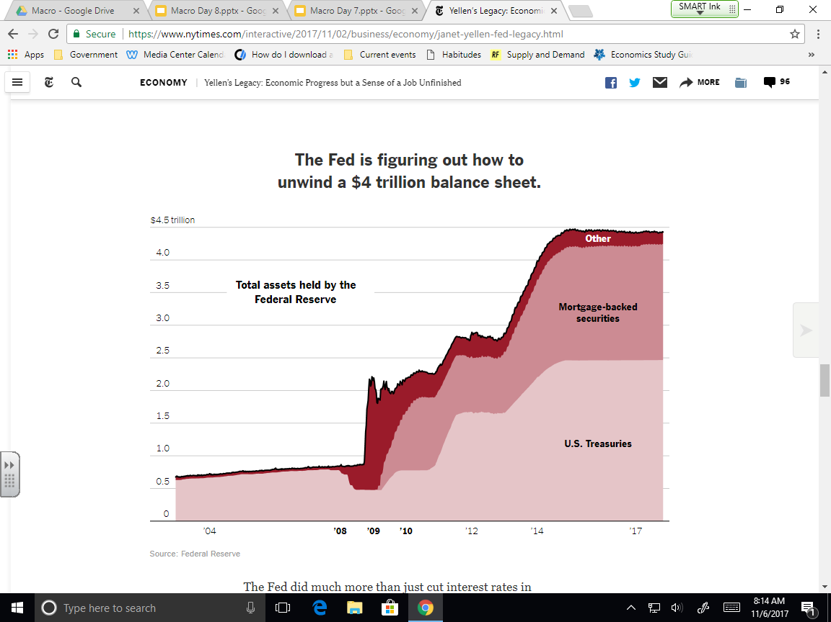

Slide 22
Monetary Policy Summary
Inflation Fears | Recession Fears
-Reduce Money Supply -Contractionary/ Restrictive/Tight | -Increase Money Supply Easy/Expansionary
-Fed Sells Securities -Raise Discount(interest) Rate -Raise Reserve Requirement -Raise Interest Paid to Bank Deposits | -Fed Buys Securities -Lower Discount(interest) Rate -Lower Reserve Requirement -Lower Interest Paid to Bank Deposits

Slide 23
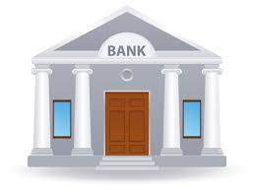
Draw arrows to explain Raising Interest on Reserves
What happens to the Money Supply?

Slide 24
Draw arrows to explain Lowering Interest on Reserves
What happens to the Money Supply?

Slide 25
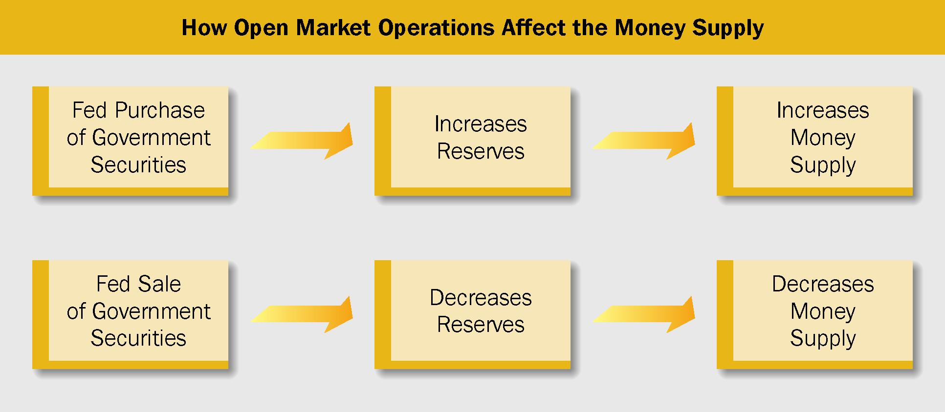
Open Market Operations

Slide 26
Parts of the Monetary Policy
Margin Requirements- Sets percentage amount of money you need to have on hand to buy stocks. Low increases investment. High decreases investment.
Credit Regulation- Sets credit terms. Easier(longer) terms are easy money policy. Stricter(shorter) terms are tight money policy.
Moral Suasion- The persuasion the Fed has on other parts of government.

Slide 27
Monetary Policy Limitations
Economic Forecasting- Not always accurate
Time Lags- Takes time to have an effect
Priorities and Trade Offs- Determining what is important
Lack of Coordination- Not all working together
Conflicting Opinions- Not everyone thinks the same.

Slide 28
Reminder
Buy(Fed) Securities
Easy Monetary Policy
Lower Reserve Requirement
Lower Discount Rate
Lower Interest Paid
BELLL

Slide 29
Reminder
Sell(Fed) Securities
Tight Monetary Policy
Raise Reserve Requirement
Raise Discount Rate
Raise Interest Paid
STRRR

Slide 30
Why does it matter?
*It directly affects the economy.
*It indirectly affects your finances.
Interest rates paid on loans
Interest rate earned on savings
*Value of Dollar vs other currencies

Slide 31
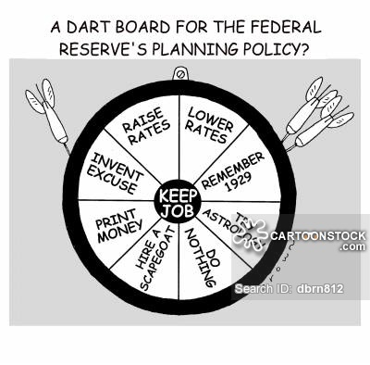

Slide 32
Circle what Fed would do in Recession
Increase Money Supply
Decrease Money Supply
Sell Securities
Raise Discount Rate
Raise Interest on Reserves
Buy Securities
Raise Reserve Requirement
Lower Reserve Requirement
Lower Discount Rate
Lower Interest on Reserves

Slide 33
Circle what Fed would do in High Inflation
Increase Money Supply
Decrease Money Supply
Sell Securities
Raise Discount Rate
Raise Interest on Reserves
Buy Securities
Raise Reserve Requirement
Lower Reserve Requirement
Lower Discount Rate
Lower Interest on Reserves

Slide 34
Easy Monetary Policy- More money in economy, done in a contraction or recession
Tool | Result
Easier Credit Regulation | Easier access to loans
Lower Margin Requirement | More investments
Buy Securities | Put money in economy
Lower Discount Rate | Cheaper to borrow
Lower Reserve Requirement | Banks can loan more money
Raise Interest Paid on Reserves | More money for Fed to use

Slide 35
Tight Monetary Policy- Less money in economy, done in high inflation
Tool | Result
Tight Credit Regulation | Less access to loans
Raise Margin Requirement | Less investments
Sell Securities | Take money from economy
Raise Discount Rate | More expensive to borrow
Raise Reserve Requirement | Banks can loan less money
Lower Interest Paid on Reserves | Less money for Fed to use

Slide 36
Tight Monetary Policy- Less money in economy, done in high inflation
Tool | Result
Tight Credit Regulation | Less access to loans
Raise Margin Requirement | Less investments
Sell Securities | Take money from economy
Raise Discount Rate | More expensive to borrow
Raise Reserve Requirement | Banks can loan less money
Lower Interest Paid on Reserves | Less money for Fed to use

Slide 37
Circle what Fed would do in High Inflation
Before the Great Recession
After the Great Recession

Slide 38
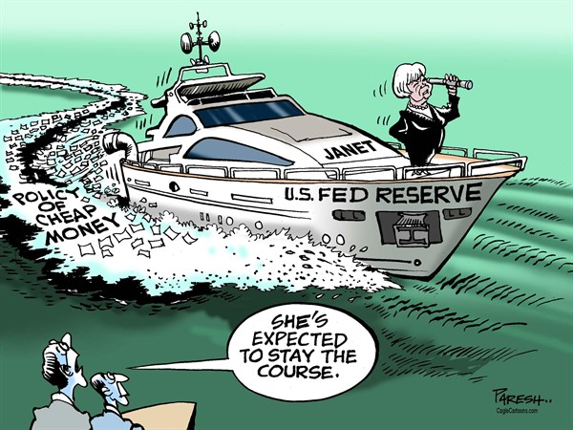
How is this the opposite of what is going on now?

Slide 39
