Slide 1
Day 9
Progressive Tax- Taxes which take a higher percentage from the wealthy
Regressive Tax- Taxes which take a higher percentage from the poor

Slide 2
Types of Taxes
Proportional-AKA flat tax- the same percentage is taxed for all- example is sales tax
Regressive-tax which takes more from “poorer” people in society- example is sales tax
Progressive-tax which takes more from “wealthy” people in society- example is income tax

Slide 3
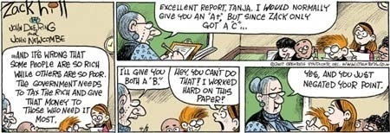
Progressive Grades in School

Slide 4
What taxes do we pay?
Individual income tax- collected by employer(Progressive)Federal, State, and Local
Corporate income tax- income tax on corporations(Progressive) Federal, State, and Local
Social Security tax(FICA)-collected and matched by employer(proportional and regressive)Federal
Customs-Tax on imported goods

Slide 5
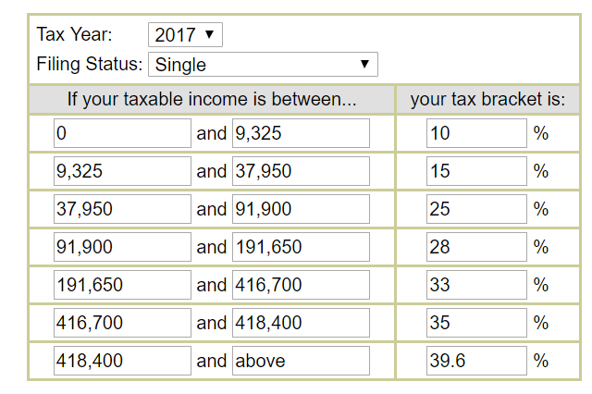
Income Taxes
$50K $8,239
$100K $20,982
$250K $65,899
$1M $351,819

Slide 6
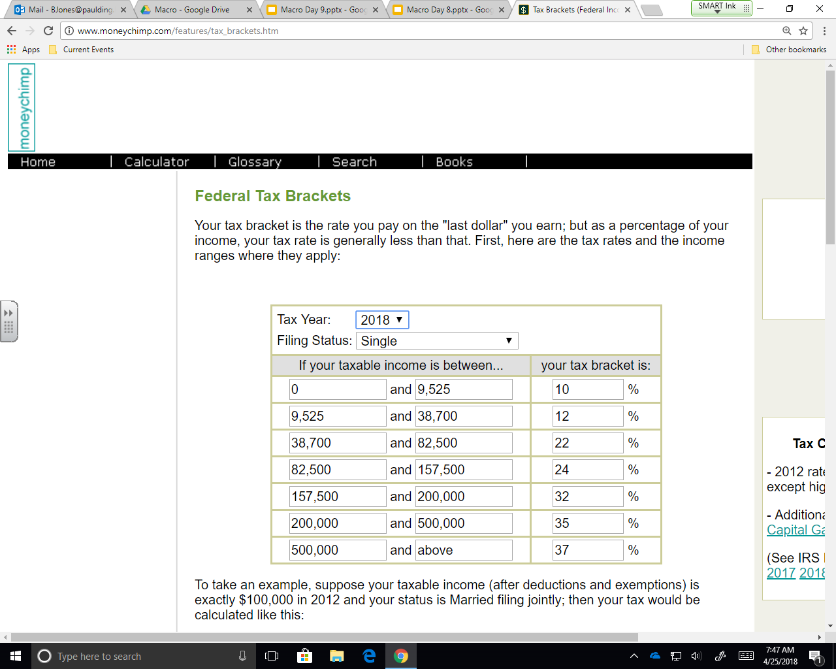
Income Taxes
$50K $6,940
+$1,299
$100K $18,290
+2,692
$250K $63,190
+$2,709
$1M $335,690
+16,129

Slide 7
Property Tax-tax on property(land and buildings)-does not take into account income- State and Local
Sales tax- Tax on sale of certain goods and services-(regressive)- State and Local(SPLOST)
Excise Tax- tax on manufacture and sale of goods(gas)
Estate tax- tax on estate of deceased person
Gift Tax- tax on large gifts
Capital Gains Tax- tax on profits from investment

Slide 8
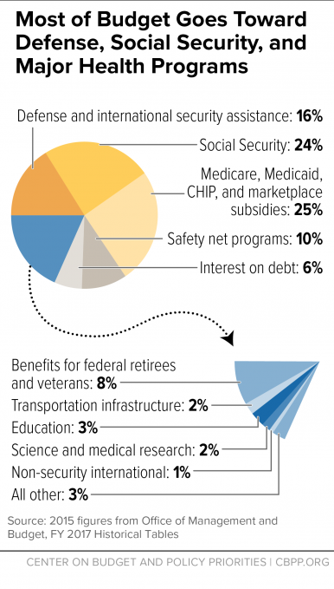
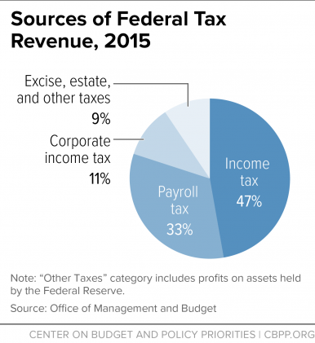
Federal Revenue- where money comes from
Federal Spending where money goes

Slide 9
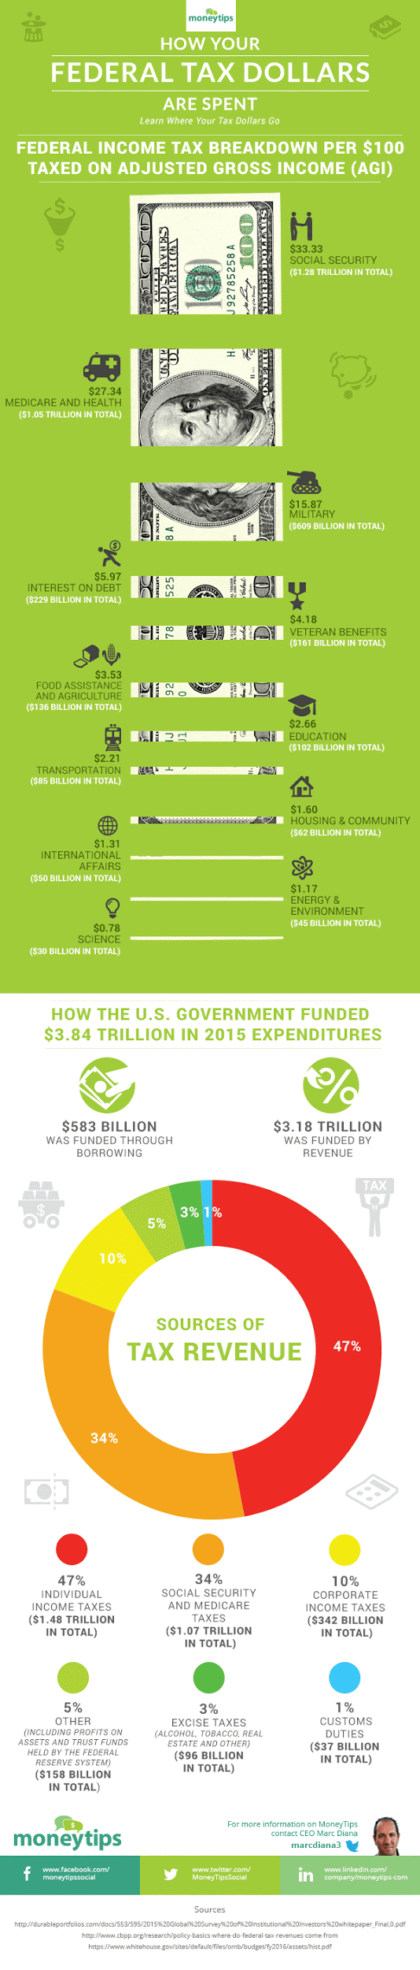

Slide 11
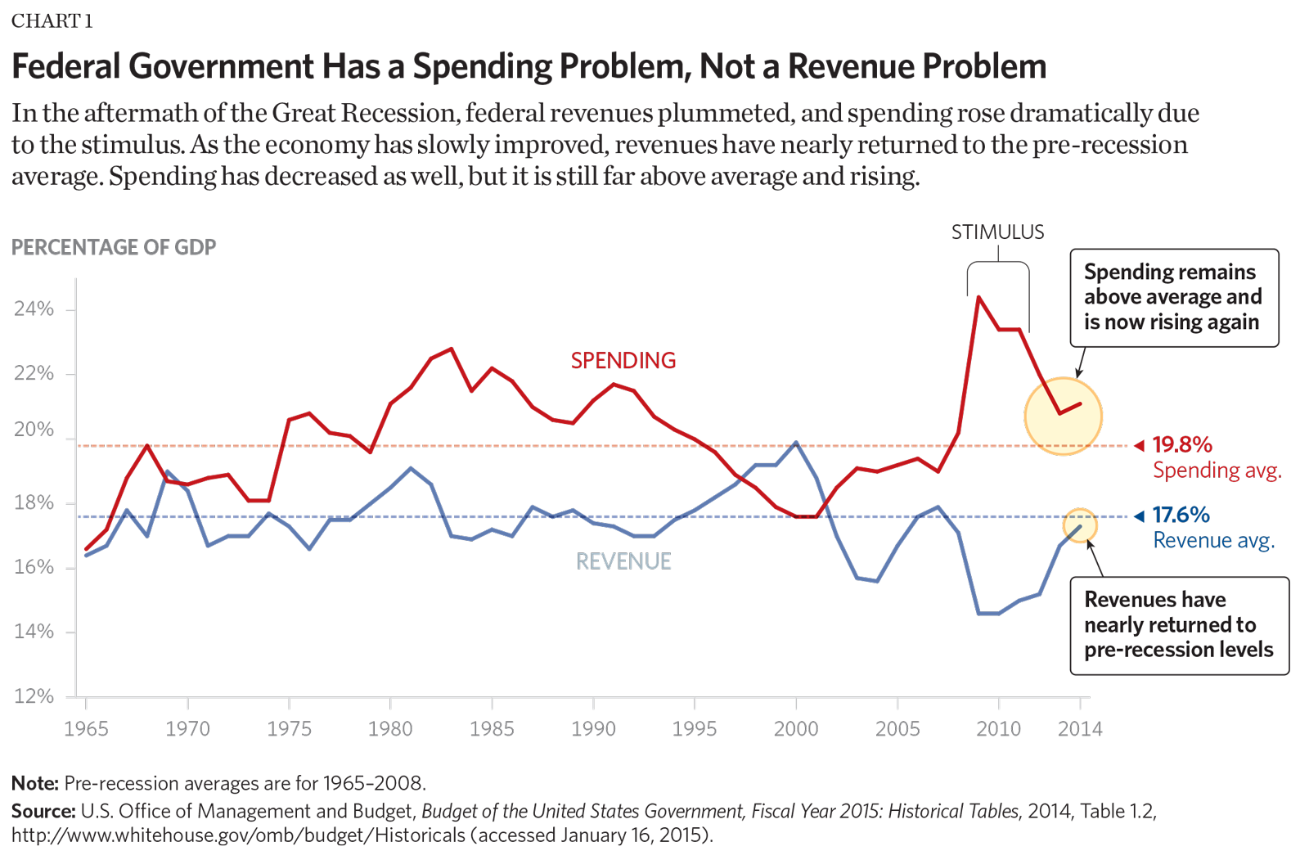
Historical Revenue and Spending

Slide 12
Think
Taxes are necessary to pay for services. What are some possible ways to adjust the system?
Static vs Dynamic
Taxes Matter in Moving

Slide 13

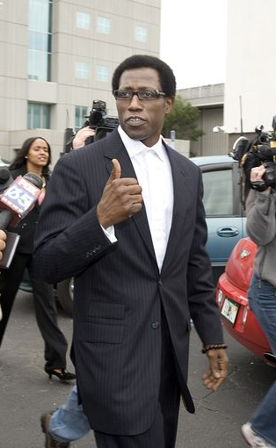

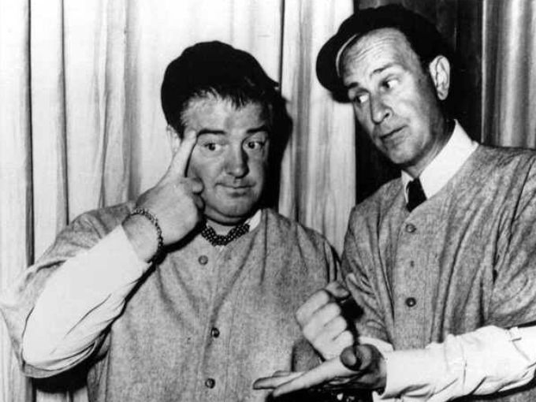




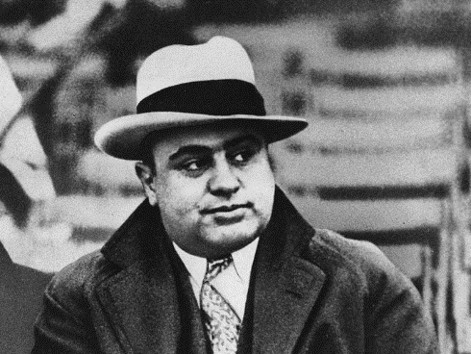

What do they have in common?

Slide 14
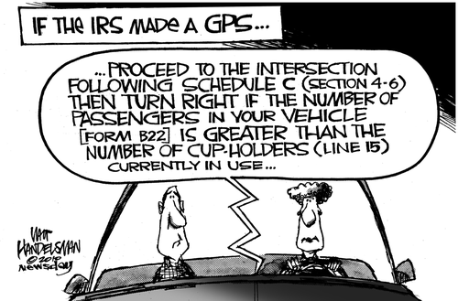
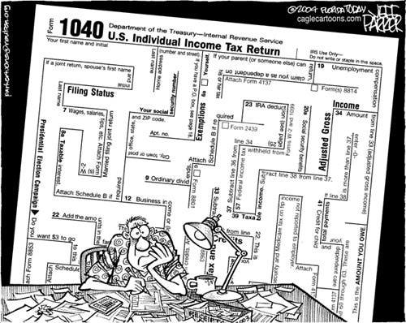
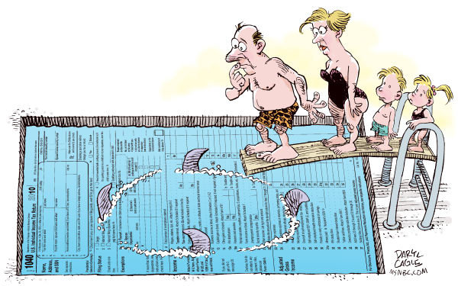
Taxes in images

Slide 15
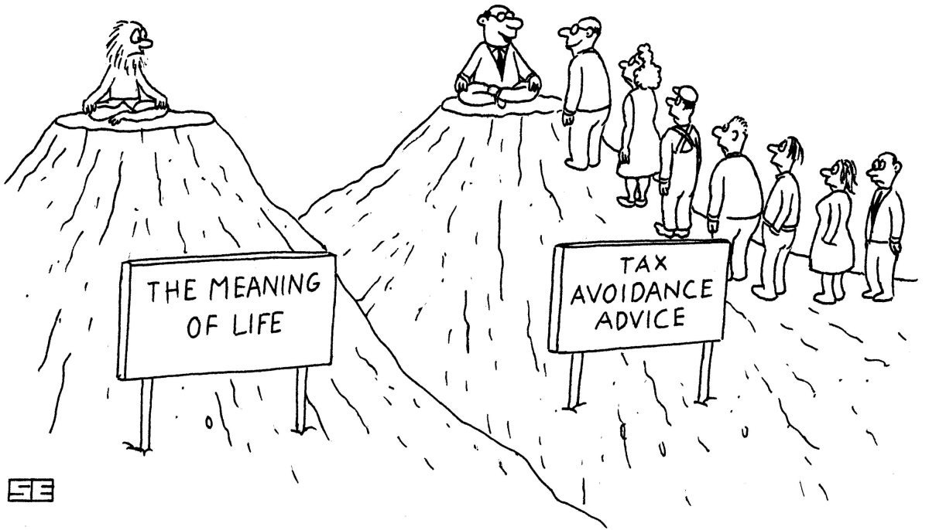

Slide 16

Tax news 4/15/2017
IRS 'drains Tori Spelling and Dean McDermott's bank accounts'... weeks after she welcomes their fifth child
It is not known how much the couple owe in unpaid taxes. However it emerged last year that they had been issued with a lien for $707,487.30 in unpaid federal taxes for their 2014 bill alone.

Slide 17
Other Terms
Tax Deduction-sum deducted from the total income
Tax Credit-sum deducted from the total amount a taxpayer owes
Refund-Money you overpaid in taxes
April 15- Last day to file taxes for previous year
W2
1040
Audit-IRS “checks” your returns more thoroughly
http://www.moneychimp.com/features/tax_brackets.htm

Slide 18
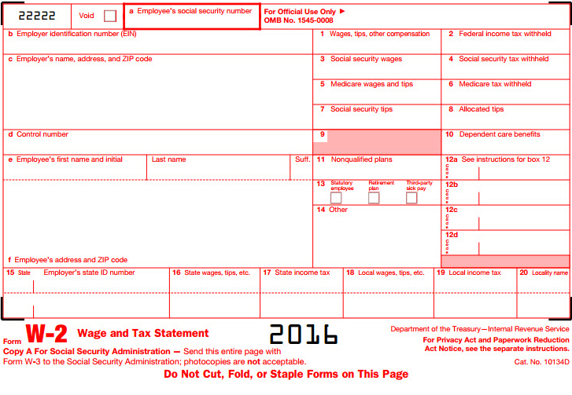

Slide 19
1040
Collecting taxes simulation

Slide 20
Joe Smoe
Filing Single
Gross Income = $50,000
Federal Income Taxes paid=$8,530
(paid every pay period)

Slide 21
Joe Smoe
Gross Income = $50,000
Deductions
Mortgage interest paid=$5,000
Charity=$5,000
Adjusted Gross Income=$40,000
Taxes really owed=6,030
Paid=$8,530
Difference of Refund=$2,500

Slide 22
Pay
People have to pay taxes when they file because they did not take out enough taxes throughout the year to cover them. These are mostly self-employed people.
Ex. Earned $50,000
Paid $4,000 through year
After deductions, owed $6,250
Pay $2,250

Slide 23
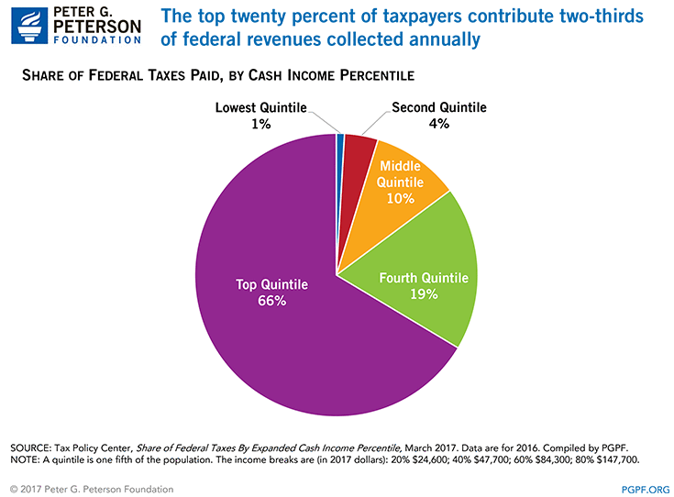

Slide 24
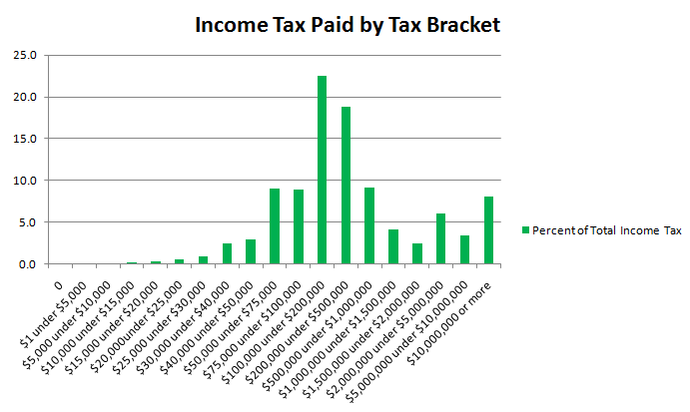

Slide 25
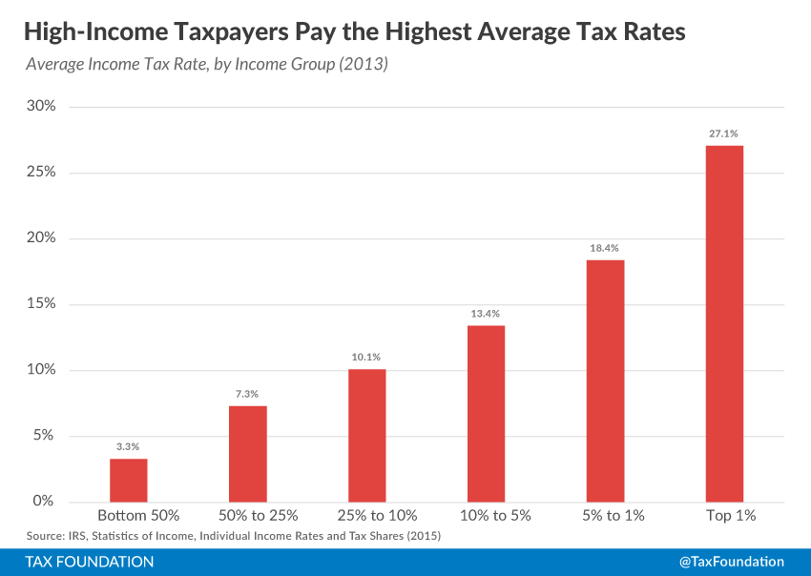

Slide 26
How do tax rates affect you?
1)Tax Rates/Deductions affect your wallet
Higher taxes = less money for you
2)Tax rates are political

