Slide 1
Vocabulary
Resource(Factor) Market- part of Circular Flow where FoP are sold
Product Market- part of Circular Flow where products are sold
Circular Flow-Transfer of products and factors between sectors of the economy
Microeconomics- The study of the small decisions in the economy
Notes:
Play Round and Round you turn me

Slide 2
Microeconomics
Studying the invisible hand and small decisions in the economy.

Slide 3
Governing.com
Georgia, for example, has the biggest film tax credit program in the country. Last year, the state saw $2.7 billion in direct spending from productions in exchange for $800 million in tax credits, according to state figures.
Next door, Alabama has used tax credits over the last two decades to beef up its auto manufacturing industry, making it the "auto capital of the South." Video

Slide 4

What does this have to do with our area?

Slide 5
What does this have to do with our area?
Lockheed Martin’s Marietta assembly plant got a dose of good news at the end of 2015. The major military supplier and arms maker announced a $5.3 billion order by the U.S. government to buy 78 C-130J Super Hercules transport planes. Lockheed said the planes will be delivered in 2016 to 2020.

Slide 6
The Consequence
Gov’t receives taxes from Bob, Jimmy, Sally
Sally receives a wage from Straight Back
Sally, Bob, Jimmy pay taxes on incomes(as well as their businesses)
Gov’t pays Lockheed for planes
Jimmy pays Straight Back, a chiropractor, for services
Bob receives a wage from Lockheed for his labor
Outback gives Jimmy a wage for his labor
Bob gives Outback money for dinner

Slide 7
Who/What will be affected?
Lockheed Workers
Restaurants
Stores
Governments(Federal, State, Local, etc)
Etc.

Slide 8
Circular Flow of the Economy
SSEMI1 The student will describe how households, businesses, and governments are interdependent and interact through flows of goods, services, and money.
a. Illustrate by means of a circular flow diagram, the Product market; the Resource (factor) market; the real flow of goods and services between and among businesses, households, and government; and the flow of money.

Slide 9
Circular Flow
The CF is an illustration of the interconnectedness of the economy. It shows transfer of the FoP, payments, and goods and services between Households(labor), businesses, and the government.

Slide 10
Basic Model of Circular Flow
Simple give and take relationship between 2 sectors – Businesses and Households
Businesses give Households income and goods and services in the Product Market.
Households give Businesses labor and payments for goods and services in the Factor Market.

Slide 11

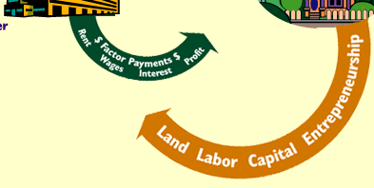
Click here

Slide 12
More involved Circular Flow
Give and take relationship between 3 sectors- Business, Households, and Government

Slide 13
Business
Businesses receive payments in return for goods and services.
Businesses receive labor in return for income.
Businesses pay taxes in return for services.

Slide 14
Households
Households give labor in return for income.
Households give taxes in return for services(Government).
Households give payments in return for goods and services(Businesses)

Slide 15
Government
Government receives taxes in return for goods and services.
Government receives labor in return for income (Households).
Government receives goods and services in return for payments(Businesses)

Slide 16
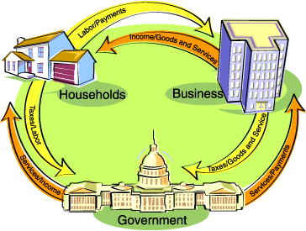

Slide 17
Questions to ponder
1)Why would the government pay unemployment to people?
2)What is a negative aspect of people saving too much money?
3)What happens when the economy slows down?

Slide 18
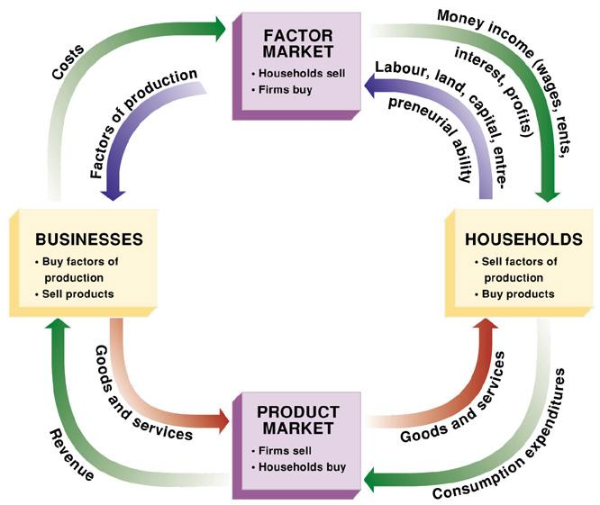

Slide 19
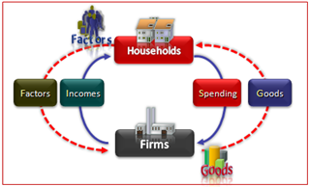

Slide 20
Markets
Factor Market is where the Factor of Production flow from households to businesses in exchange for wages, rent, payments.
Product Market is where the finished goods flow from businesses to households in exchange for payments.

Slide 21
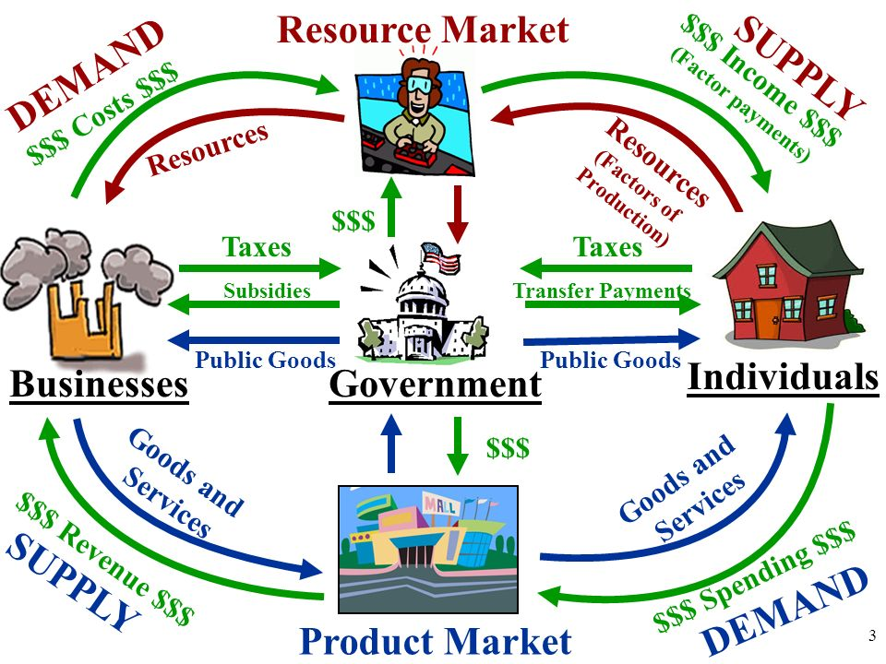

Slide 22
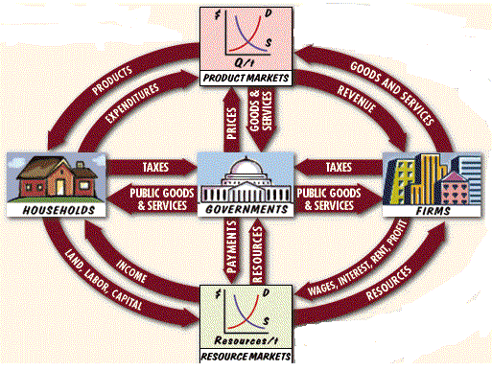

Slide 23
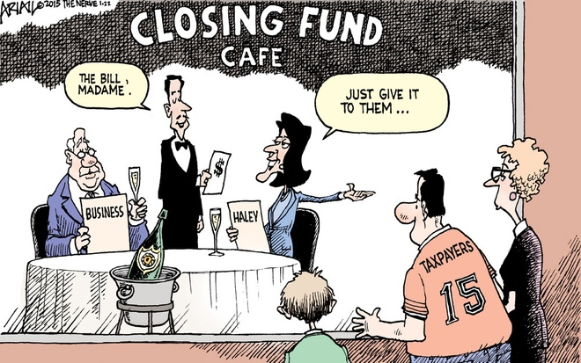
View of Tax incentives

Slide 24
New York’s tax incentive package to Amazon, worth $1.2 billion, has been controversial among the region’s top Democrats, including U.S. Rep. Alexandria Ocasio-Cortez and former New York Mayor Michael Bloomberg, even as Amazon has promised thousands of new jobs and several billion dollars in investment. “Inviting an anti-union monopolistic enterprise into our city only makes sense if you want to make New York into a city where it’s impossible for working-class people to live,” says Salazar

Slide 25
Examples
What are some examples in the product market?
What are some examples in the factor market?

Slide 26
Items to Note
Both are basic models.
These only work in mostly capitalist economies.
Why doesn’t it work in mostly command economies?
The models are not perfect.
There are some missing items. What are they?

Slide 27
The Circular Flow
Costs
Factors of Production
Money Income
Resource Market
Rent, Wages
Interest, Profit
Land Labor
Capital Management
Businesses
Government
Taxes
Households
Government Spending
Goods & Services
Product Market
Revenue
Consumption Expenditures
Investment
Saving
Exports
Imports

Slide 28
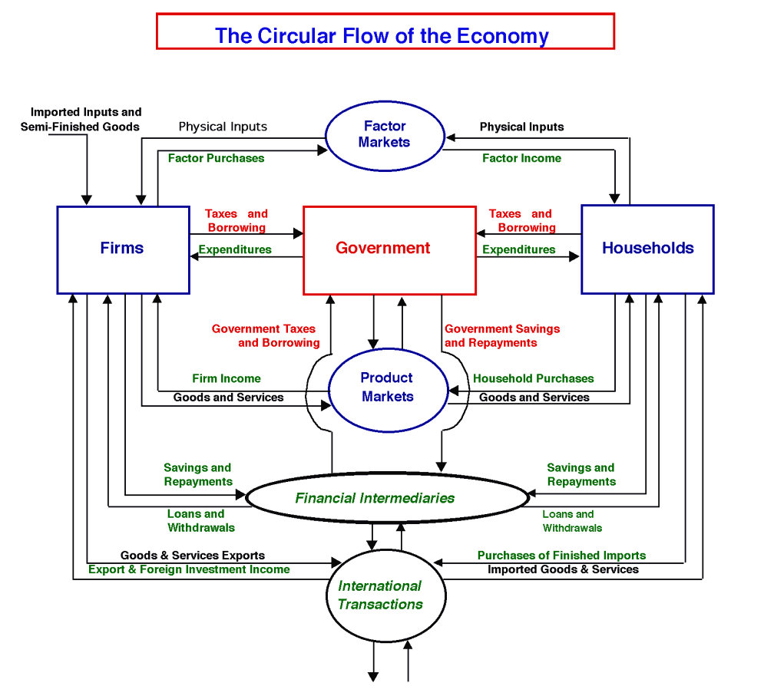
Really complicated model

