Slide 1
Vocabulary
Shortage- situation where quantity demanded exceeds supply
Surplus- situation where quantity supplied exceeds demand
Price Control-situation in which government sets a price for good not at equilibrium
Price Floor- government set price above equilibrium causing a surplus
Price Ceiling government set price below equilibrium causing a shortage

Slide 2
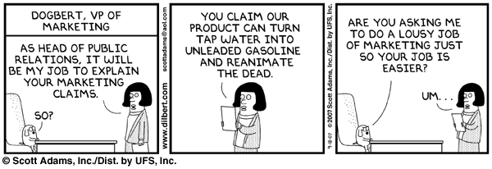
Government in Microeconomics
Government’s role in Microeconomics is to level the playing field with out tilting it. The government passes laws restricting and encouraging certain economic behaviors. This is often referred to as regulation.

Slide 3

Encourages
  Fair Pricing
  Competition
  Disclosure
  Truth in Advertising
Restricts
  Trusts/Monopolies
  Price Discrimination
  Collusion
  Unfair labor practices

Slide 4
Proposals
1)Since the price of gasoline is much cheaper, there should be a law that sets a maximum price for gas.
2)Since it is now so expensive to live, the government should raise the minimum wage to $12 an hour.
What’s the worst that can happen?

Slide 5
What do these have in common?
Federal government raising minimum wage to help working poor
New York City’s rent control policy to make housing more affordable
Venezuela’s option to set price controls to stave off inflation
President Nixon set price controls on gas in the early 1970’s

Slide 6
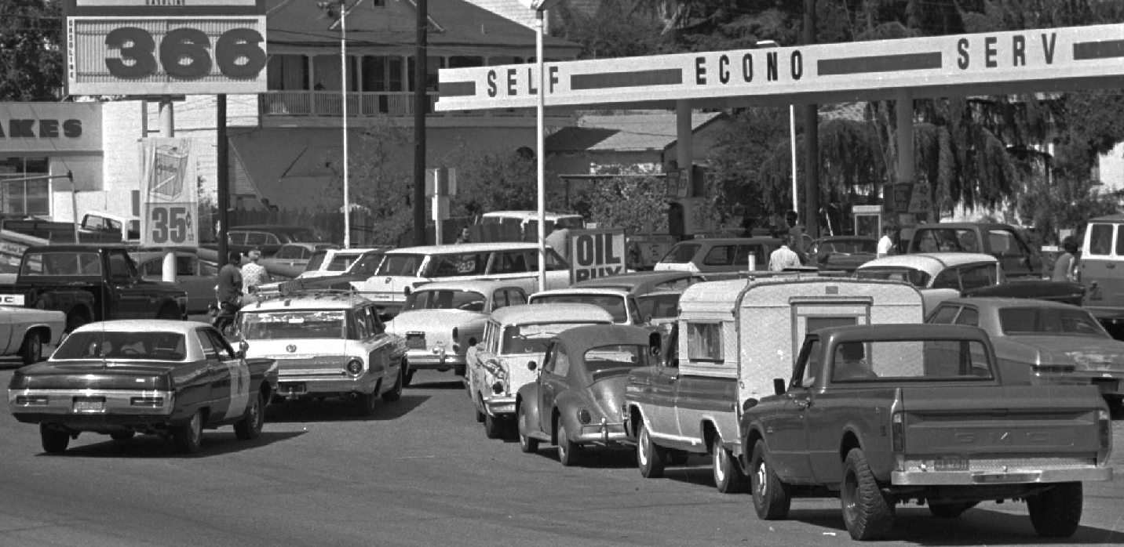
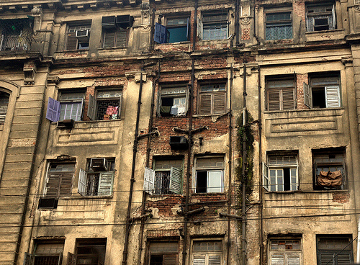
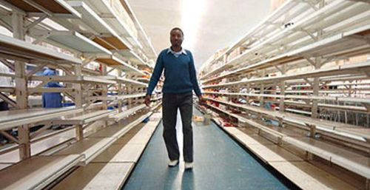
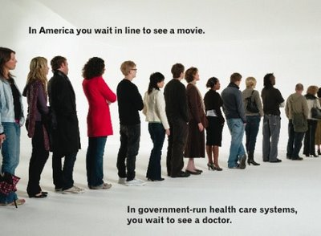
Results of Good Intentions

Slide 7
Setting Prices
The government sometimes sets prices to protect consumers and producers from price swings (the demand and supply DOES NOT change)
Price controls set prices through price ceilings and price floors and are often politically motivated by delaying problems for later.

Slide 8
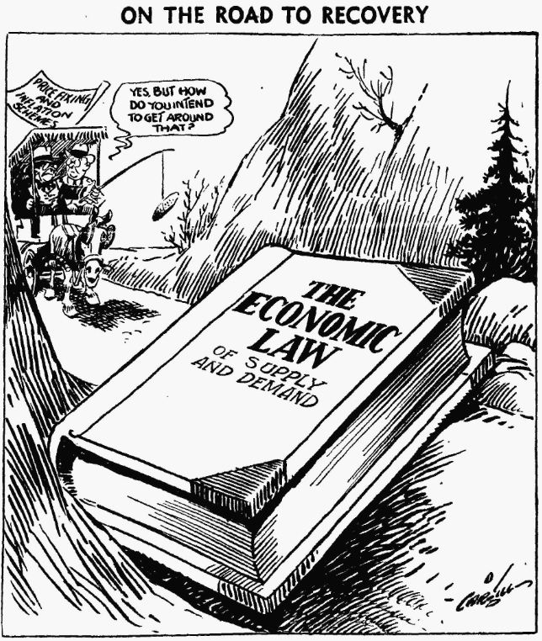

Slide 9
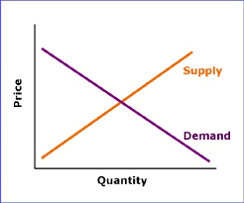
Apartment in Hiram Dilema

Slide 10
Price Ceiling
A government regulation that sets a maximum price below equilibrium for a good that producers cannot change.
Often done to fight inflation.
Some examples include rent control.
Consequences- Tend to create shortages, “helps” consumer.
Cost of “Free Healthcare”
https://www.mruniversity.com/courses/principles-economics-microeconomics/rent-control-mumbai-india

Slide 11
Price Ceiling
Price
S
P_{e}
PC
PC
D
Excess Demand
Quantity
Q_{S}
Q_{e}
Q_{D}

Slide 12
Minimum Wage Workers
# Workers | Individual Hourly Wage | Total Hourly Wage | Total Wages Paid for 8 Hours

Slide 13
Price Floors
Government regulation that sets a minimum level above/on top of equilibrium for prices
Price floors are most common price control.
Examples of price floors are set prices for agricultural products. The government will set a base price for a product that will guarantee farmers an income

Slide 14
Price Floors con’t
Another example of price floors are the government setting a minimum wage, the lowest amount a worker can legally be paid by an employer
Consequences- Tends to create surplus, “helps” producers
Nashville Limos
Uber?

Slide 15
https://www.foxnews.com/politics/15-minimum-wage-hikes-payroll-tsunami-hurt-small-businesses
The American Action Forum calculates that minimum wage hikes will kill 261,000 jobs -- with most of the losses concentrated in New York and California.

Slide 16
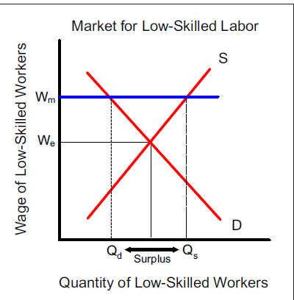
Veto Minimum Wage in Illinois

Slide 17
Not just in America
South Korea’s soaring minimum wage
The government plans to raise the minimum wage 55% above its present level
Oct 25th 2017 by T.R. | SEOUL
SOUTH KOREAN workers don’t often have cause for cheer. They slog for more hours than their counterparts in any other member of the OECD, a club of mostly rich countries, apart from Mexico. Yet the worst-off, at least, will soon be far better rewarded for their toil. Next year the country’s minimum wage will leap by 16.4% to 7,530 won ($6.65) an hour, the most vigorous hike since 2000. The government wants the lowest-paid to earn 10,000 won an hour by 2020—a total increase of 55%.

Slide 18
Pro
Labour activists have long cherished the idea of a 10,000-won wage floor.
They argue that it is only fair that workers in the world’s 11th-biggest economy get a larger share of the riches.
It will probably reduce inequality, too.
Con
Small businesses claim the increase will force them to lay off staff. A survey by the Korea Federation of Micro Enterprise found 92.4% of respondents are considering cutting back on workers. This could pose a serious problem, since most people on the minimum wage work for smaller firms, not conglomerates such as Samsung.
Even so, at a certain level employers could begin to cut back.

Slide 19
Research
A 2015 University of New Hampshire survey found that nearly three-quarters of surveyed US labor economists are opposed to a broad $15 minimum wage. Even left-of-center economists from the Obama and Clinton administrations have advised against such a wage hike. And a recent study of San Francisco restaurants, conducted with user review data from YELP, found an increase in closures for median-rated restaurants following an increase in the city’s minimum wage.

Slide 20
Positives and Negatives of Fight for 15
Positive
1.Some low-skilled, limited-experience workers will benefit if they are able to keep their jobs
Negative
1.Low-skilled workers who lose their jobs
2. Low-skilled workers who can’t find a job
3. Workers who keep their jobs
4. Companies and small businesses who hire unskilled and low-skilled workers
5. Consumers and patrons of small businesses, book stores and restaurants

Slide 21
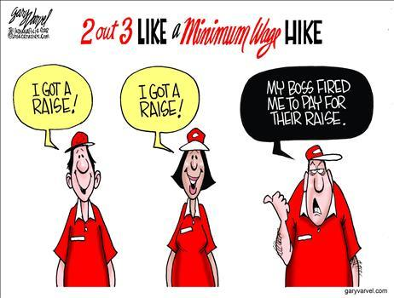
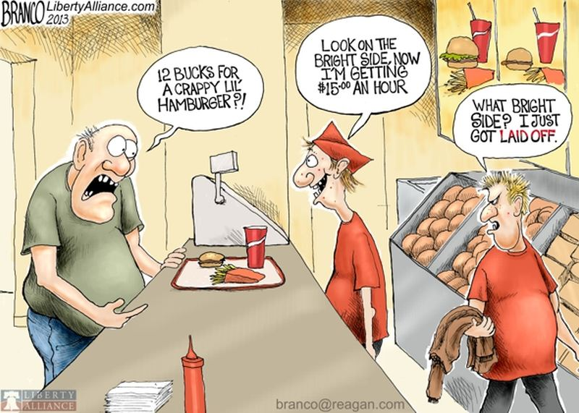
Economic Viewpoint

Slide 22
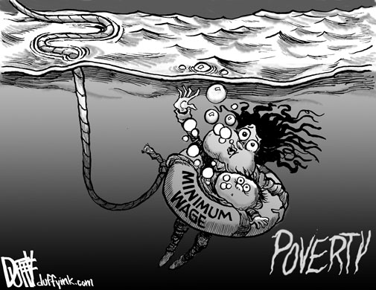
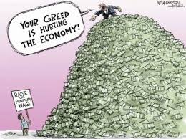
Emotional Viewpoint

Slide 23
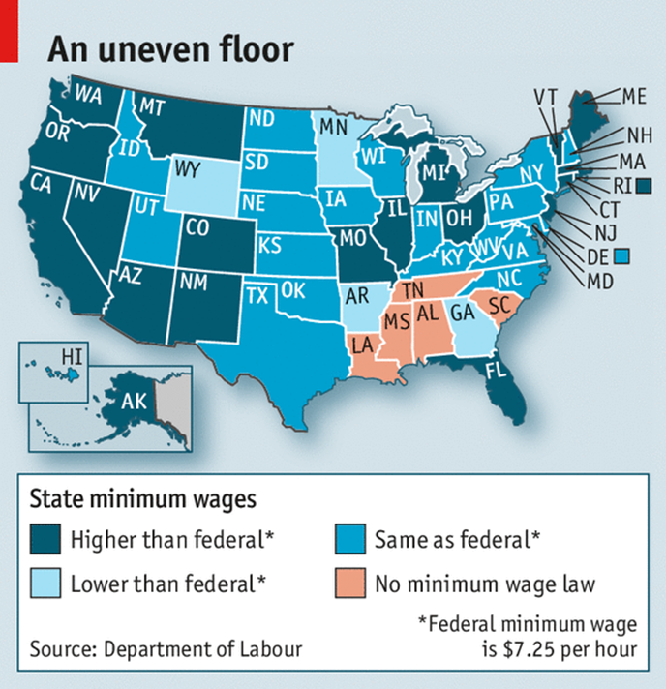

Slide 24
Summary
CONSUMERS
BELOW
I
L
I
N
SHORTAGE
F
L
TOP
PRODUCER
SURPLUS
Alphabetical
Ceiling= below=shortage
Floor=top=surplus

Slide 25
Review
What are the 2 types of price controls?
Which one is most common?
What are the effects of each?
Why would the government institute them?

Slide 26
