Slide 1
Yap
Over 500 miles in open water
5 days in a canoe pulling a raft
12 feet to 1 inch in diameter
May take as many as 20 men to move
@6,800
@ 1/8 the size of Paulding County

Slide 2
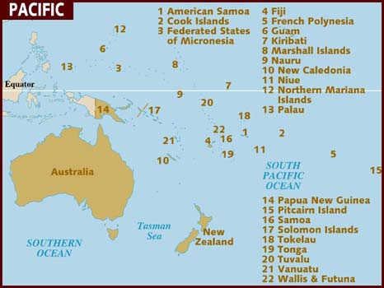
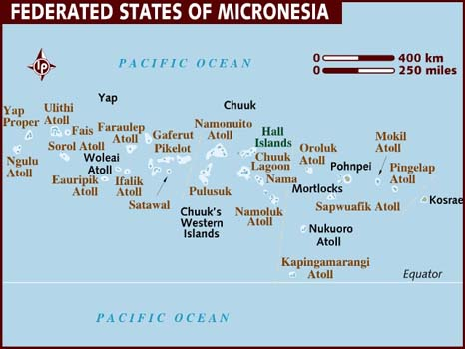
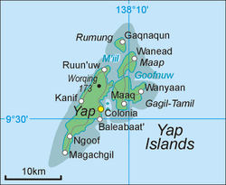

Slide 3
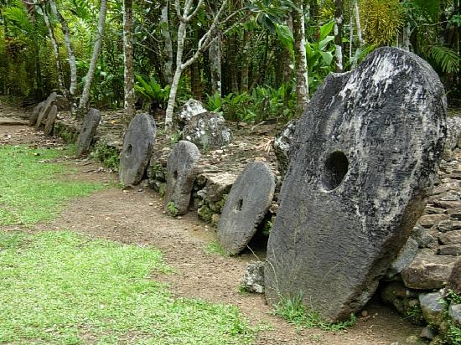
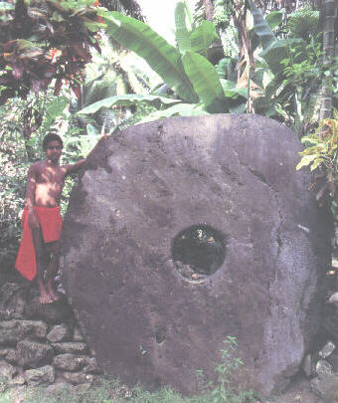
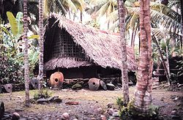
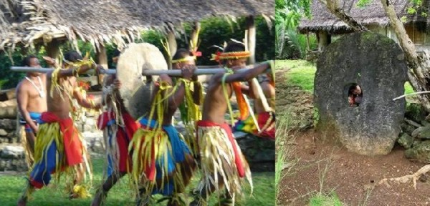
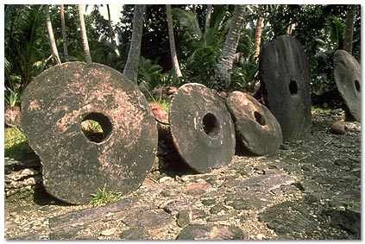

Slide 4
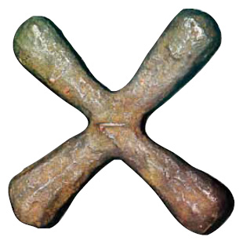
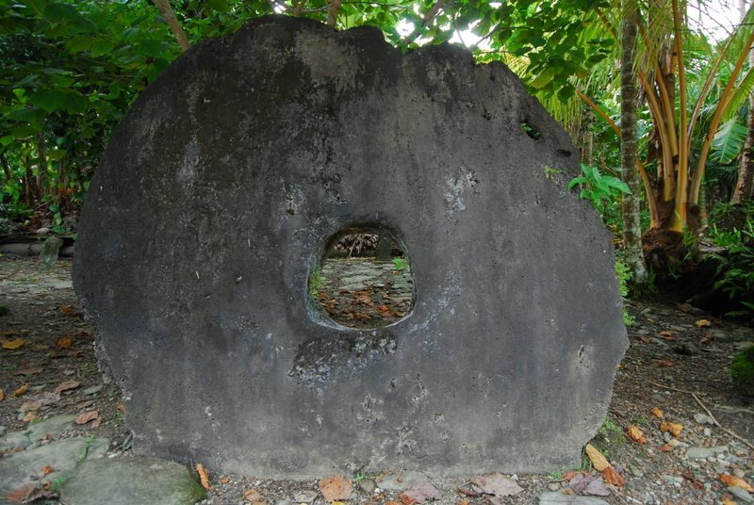
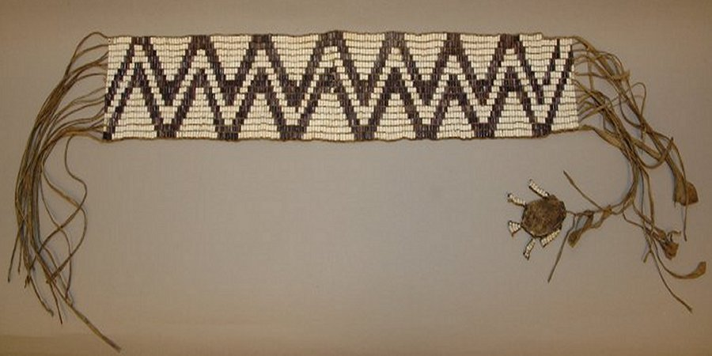
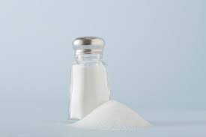
What do the following have in common?

Slide 5
Yap
SSEMI1
b. Explain the role of money as a medium of exchange and how it facilitates exchange.

Slide 6
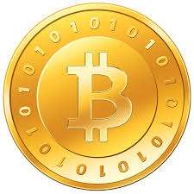
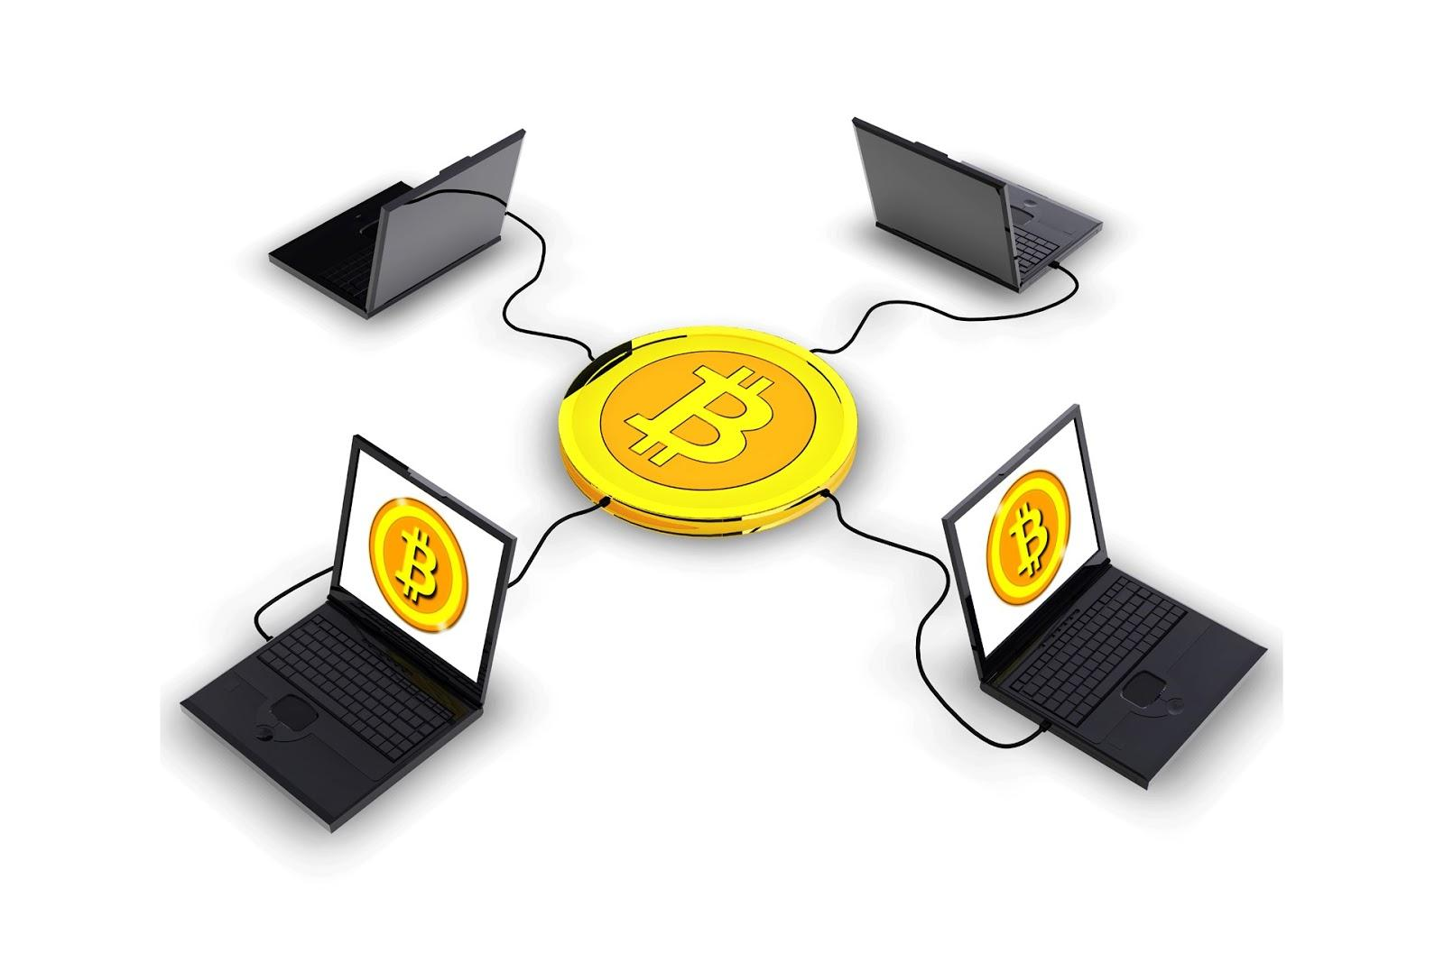

Slide 7
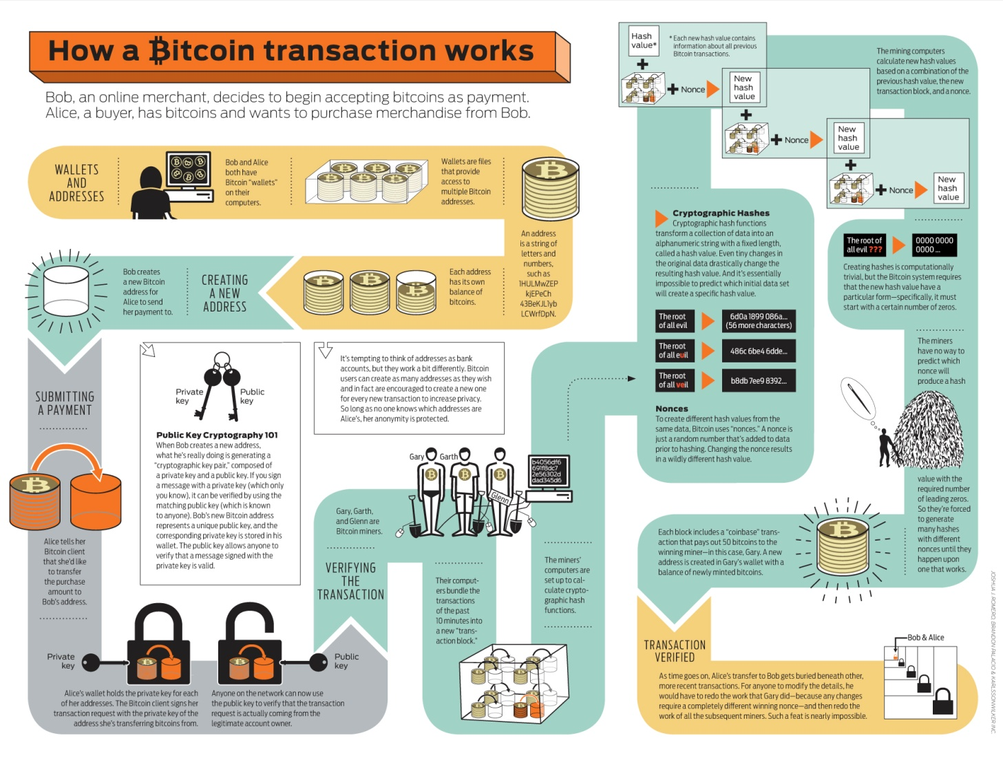

Slide 8
Money
Venezuela

Slide 9

Brief History of Money

Slide 10
Why is money important in an economy?

Slide 11
Why is there a need for money?
Something to compare.
No need to barter.
Easier to carry

Slide 12
What is the function of Money
Medium of Exchange- something accepted as payment
Standard of Value- gives a standard of value of things
Store of Value- it stores value because 1)it is nonperishable and 2)it keeps its value over time

Slide 13
Characteristics of Money
Durable-used multiple times
Portable-easily carried
Divisibility-can be divided
Stability in value-keeps value fairly well
Acceptability-people accept it

Slide 14
Federal Reserve Notes anyone?

Slide 15
Sources of Money’s Value
Commodity Money- something that has its own value-example gold, silver
Representative Money- something that can be exchange for something of value
Fiat Money- something of value because a government says so- example U.S. coins and paper money

Slide 16
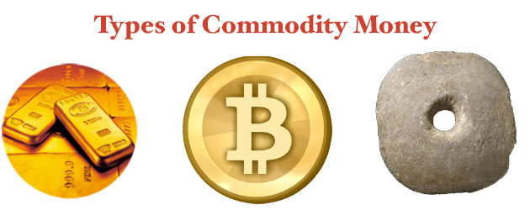
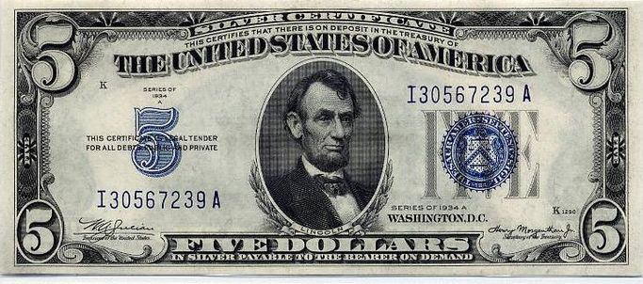
Chaos In North Korea As Currency Devalued By 100 To 1
Vincent Fernando
Dec. 1, 2009, 8:36 AM

Slide 17
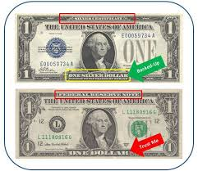
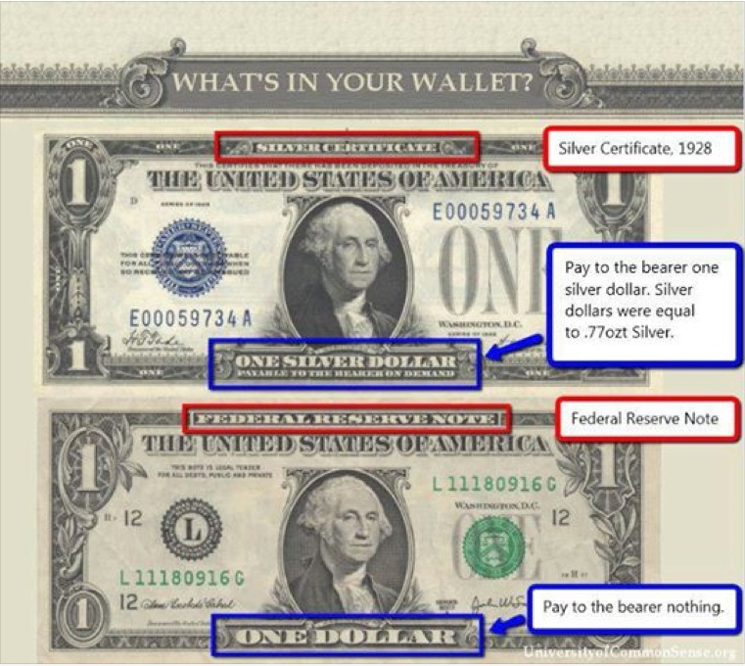
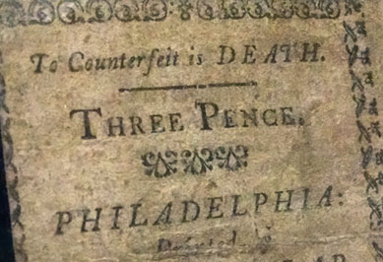

Slide 18
Forms of Money
Currency
Coins
Demand Deposits- AKA checks
Near Money-financial assets

Slide 19
The need for Money
How many chickens equal a cow?
How many bushels of barley for a goat?
How many horses for an acre of land?
How much salt for a shield?
How many tulips for a leaf of tobacco?

Slide 20
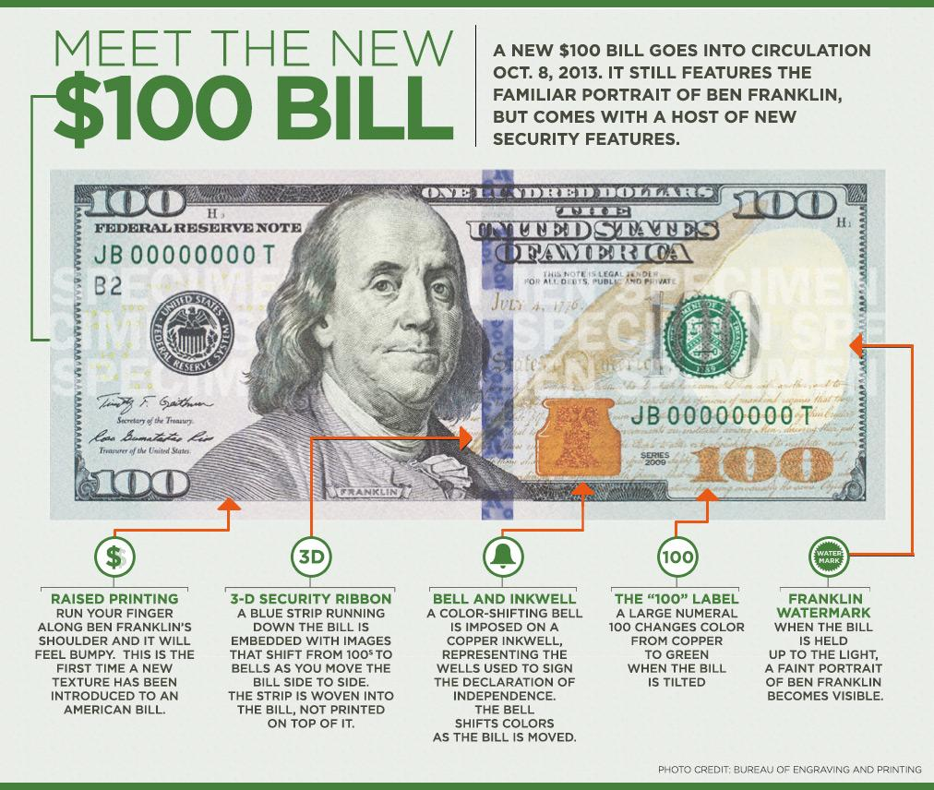
Security of Money

