Slide 1
Vocabulary
Corporation- business with ownership separate from management
Sole Proprietorship- business owned by one individual
Partnership- business owned by 2 or more individuals

Slide 2
What type of business should I work in or own?
SSEMI4 The student will explain the organization and role of business and analyze the four types of market structures in the U.S. economy.
a. Compare and contrast three forms of business organization—sole proprietorship, partnership, and corporation.
b. Explain the role of profit as an incentive for entrepreneurs.

Slide 3
Firms
Types of firms
  sole proprietorship
  partnership
  corporation

Slide 4
Sole proprietorship
Single owner
Advantages:
  autonomy
  Easy to start
Disadvantages
  difficult to acquire funds
  unlimited liability
  Less specialization
  Less longevity
Most common form of business organization (by number of firms)
Accounts for a small share of total output.

Slide 5
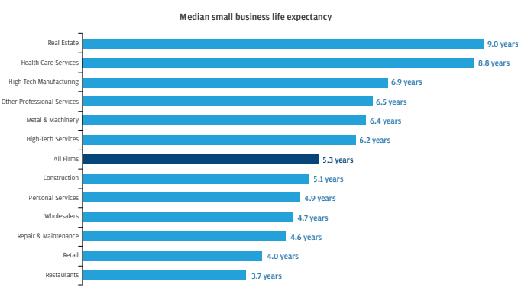

Slide 6
Partnership
Two or more individuals share ownership
Advantages:
  Pooled wealth and resources
  Easier to raise money
Disadvantages:
  Loss in autonomy (relative to sole proprietorship)
  Unlimited liability
  Shared profits
  Possible conflict/instability

Slide 7
Corporation
A legal entity separate from its owners
Advantages
  limited liability
  Easier to raise money
  Specialized management
  Unlimited life
Disadvantages
  separation of ownership from control
  Difficult starting
  More bureaucratic
  More government control
Most output is produced by corporations

Slide 8
Corporate Ladder
CEO
Board of Directors
Stock Holders

Slide 9
Other Examples
LLC-Limited Liability Corporation
Franchise- Sell ideas/products to others for a fee
Coop- members are part owners
Non Profit- businesses working for no profit(Goodwill, etc)
Conglomerate- Large multi faceted corporations

Slide 10
Trends
Vertical Integration- Buying up entire chain of supply
Amazon- trying to deliver own products
Wal-Mart- seeking to create banking services/credit cards
Disney- Creating delivery system for content

