Slide 1

Vocabulary
Curve-representation of demand or supply schedule
Demand-amount of a good or service consumers are willing and able to pay at a series of prices
Supply-amount of a good or service producers create at a series of prices

Slide 2

How many are willing and able to buy a candy bar the following prices?
Price $ | Quantity #
.20
.40
.60
.80
1.00
1.20
1.40
Is there a pattern to the numbers?
What is it?
Why do you think it is that way?

Slide 3

How many are willing and able to buy a monthly subscription Spotify?
Price $ | Quantity #
$4
$6
$8
$10
$12
$14
$16
Is there a pattern to the numbers?
What is it?
Why do you think it is that way?

Slide 4
What is Demand?
Will you buy a Mercedes for $20,000?
Will you buy a candy bar for $1?
Why is gold more valuable than glass?
Demand is the amount of a good or service that a consumer is willing and able to buy at various possible prices during a given time period.

Slide 5
Law of Demand
1)A principle that states there is an inverse relationship between the price of a good and the amount of it buyers are willing and able to purchase.
2)A principle that states an increase in a good’s price causes a decrease in quantity demanded.

Slide 6
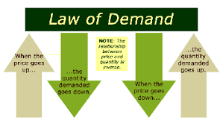

Slide 7
Law of Demand Concepts
Substitution Effect-Tendency to substitute similar lower priced goods. Ex. The price of Tylenol increases will cause the demand for it to decrease while consumers use substitute generic items. Not all items have substitutes. Milk, gas, etc.
What are some other examples?
Notes:
off brand - cheaper because they don’t have to advertise

Slide 8
Law of Demand Concepts
Income effect-Based on the change in purchasing power (income people have to spend on goods); Ex. If good is on sale, purchasing power is increased, if good’s price rises purchasing power is decreased. This has a strong impact on demand.

Slide 9

Law of Demand Concepts
Diminishing Marginal Utility- Natural decreases in the utility of a good or service as more units of it are consumed. Ex. You pay full price for the first and second hamburger, but the third one is not useful because of it diminished utility.

Slide 10
Demand Schedule
List of quantity of goods that consumers are willing and able to buy at a series of possible prices.
#
$
10
0
8
1
4
2
1
3
0
4

Slide 11
Demand Curve
The representation of the demand schedule on a graph.
The X axis represents number or quantity demanded (on bottom) and the Y axis represents the price or dollar amount (on the side).

Slide 12
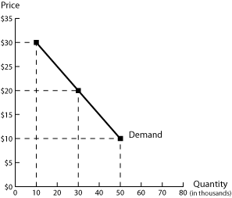
Demand Curve Example

Slide 13
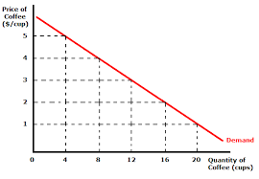
Label and Graph the following for Falcons T-Shirts
Price | Quantity
10 | 20
20 | 16
30 | 10
40 | 8
50 | 4

Slide 14
Implications of Demand
The job of sellers is to create demand. One chief way is advertising.
The job of sellers is to determine the demand for a good.

Slide 15

At what price would Spotify be able to sell a monthly subscription?(assuming it costs $5 each to produce)
Price $ | Quantity #
$2
$4
$6
$8
$10
$12
$14
Is there a pattern to the numbers?
What is it?
Why do you think it is that way?

Slide 16
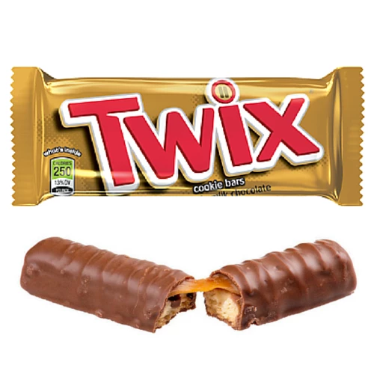
If you had a candy bar, at what prices would you sell it? (Let’s assume it costs you .50 to produce it)
Price $ | Quantity #
.20
.40
.60
.80
1.00
1.20
1.40
Is there a pattern to the numbers?
What is it?
Why do you think it is that way?

Slide 17
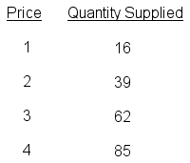
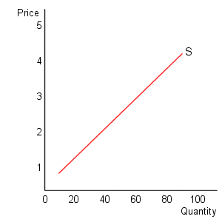
Supply
Supply: the relationship that exists between the price of a good and the quantity supplied in a given time period, ceteris paribus.

Slide 18
Law of supply:
A direct relationship exists between the price of a good and the quantity supplied in a given time period, ceteris paribus.

Slide 19
The law of supply is the result of the law of increasing cost. Since the marginal opportunity cost of supplying a good rises as more is produced, a higher price is required to induce the seller to sell more of the good or service.

Slide 20
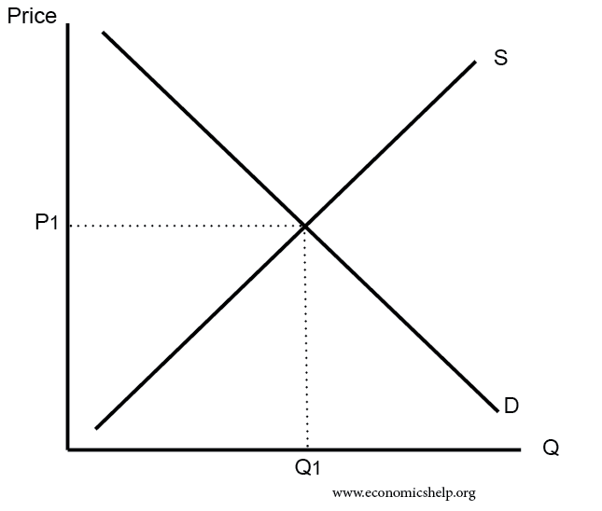
A Market
A market is the interaction of demand(consumers) and supply(producers). Businesses like Amazon, Ebay, and dating website have created a market. Others startups are trying to create a market
The Market generally refers to the Stock Market.

Slide 21
Label and Graph the following for Falcons T-Shirts
Price | Quantity
10 | 4
20 | 8
30 | 10
40 | 16
50 | 20

Slide 22
Reminder
Demand=Consumers/Buyers want lowest price, curve goes top left to bottom right (southeast)
Supply=Producers/Sellers want highest price; curve goes bottom left to top right(northeast)

