Slide 1
Vocabulary
Equilibrium Price-place where supply and demand curve meet
Market Clearing Price-same as equilibrium price
Allocate- to distribute
Incentive- a motivation

Slide 2
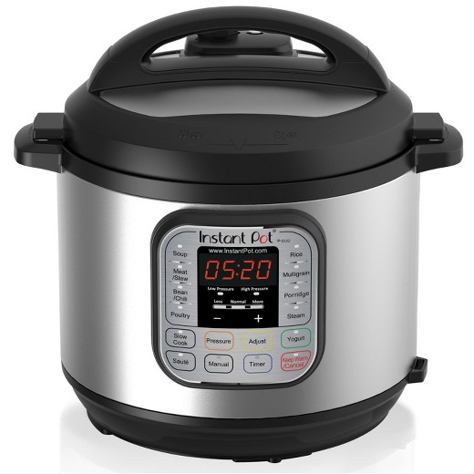
What is a good price for this?
Is $70? $120? $210 a good price

Slide 3
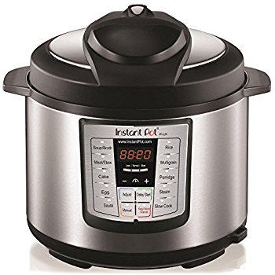
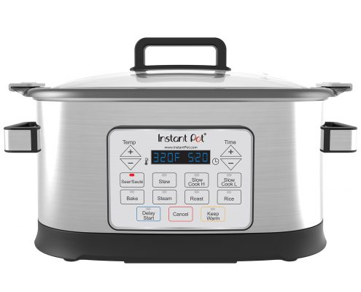
How about now?
Biggest/Best is $119
Medium/Middle
Smallest is $79

Slide 4
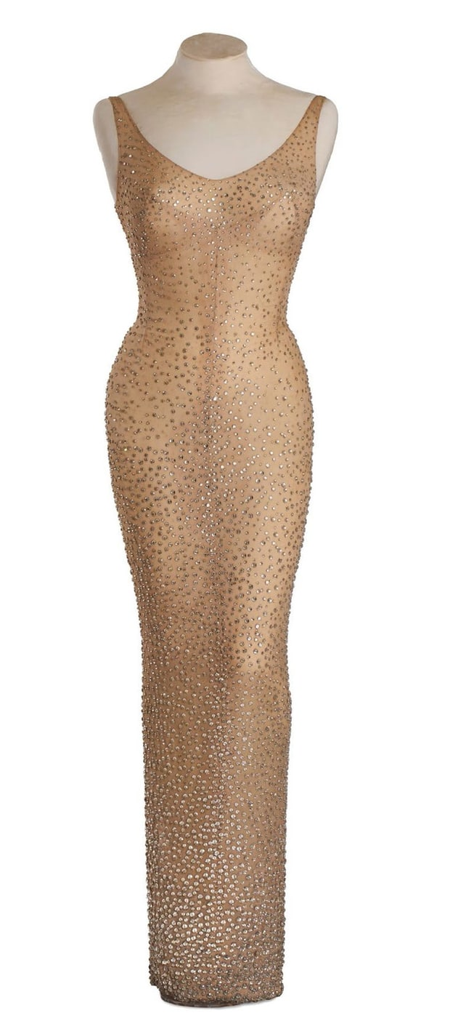
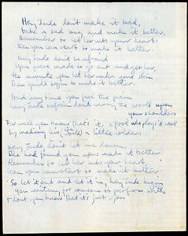
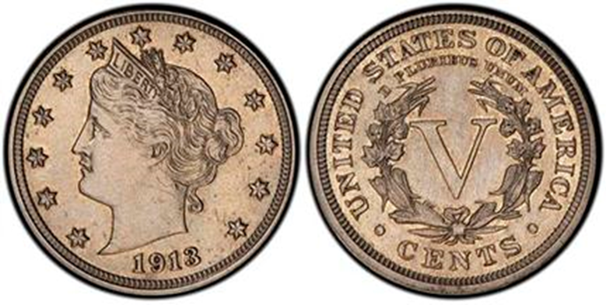
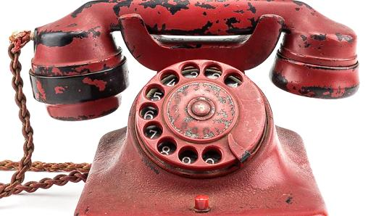
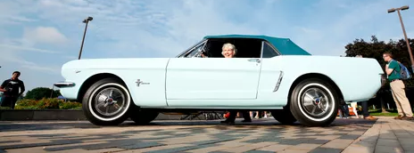
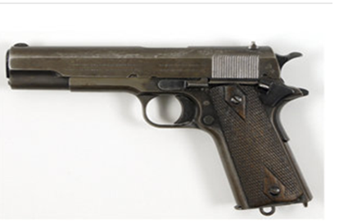
Rank these items in terms of price.

Slide 5
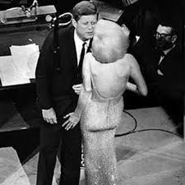
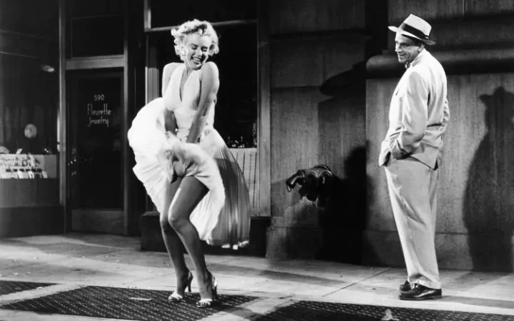
$4,800,000(2016)
$5,600,000 in 2011

Slide 6
$3,175,200 (2013)

Slide 7

Reportedly worth $350,000-$450,000

Slide 8
On sale 4/10/2018 for $375,000

Slide 9
$250,000 (2017)
Why?
It was called the most dangerous weapon of WWII. It was Hitler’s personal phone.

Slide 10
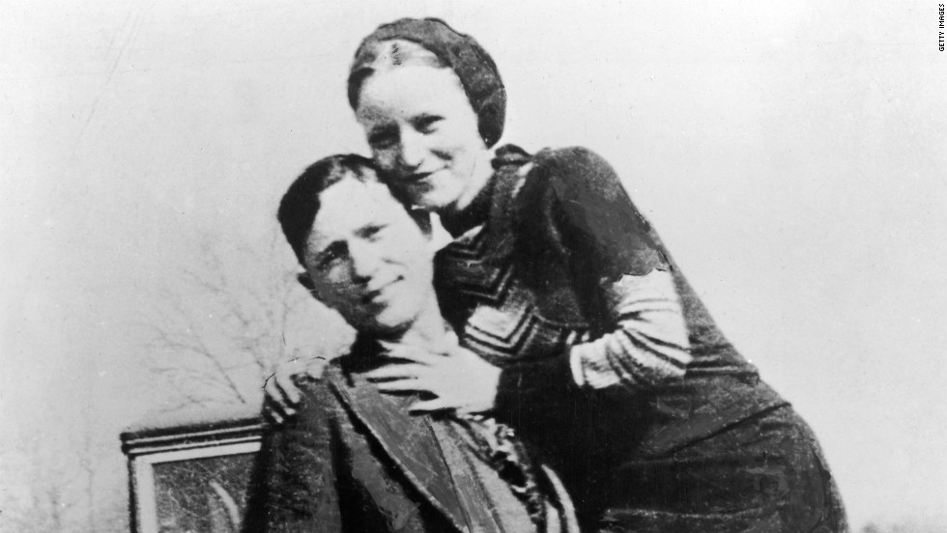
$240,000 (2012)
Clyde Barrow’s Colt .45 sold for $240,000 while Bonnie Parker’s Colt .38 snub nose sold for $264,000.

Slide 11

Why did the price of this card skyrocket from $.10 to $10-$20?
That is a 10,000-20,000% increase!!!
Notes:
Menendez brothers

Slide 12
Price
Price is generally determined by the intersection of supply and demand. Due the constant shifting of supply and demand, price constantly changes. Price is also called market equilibrium or market clearing price.
In a market economy, prices often determine how resources are allocated.

Slide 13
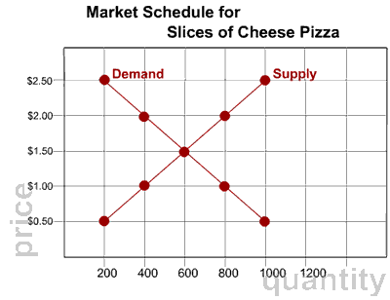

Slide 14
What if
If the price of a widget starts at $10 and then is lowered to $8, what would you think?
What caused it?
What if the opposite happened, from $8 to $10?
What caused it?

Slide 15
Benefits of the Price System
Information
Incentives
Choice
Efficiency
Flexibility
Think about recent stock market drop.

Slide 16
Information
Knowledge of resource prices allow producers to determine how much they must pay to make the products Consumers also use research to make informed buying decisions
Feedback from the market and resources gives consumers and producers information
Video

Slide 17
Incentives
Encourages people to behave in a certain way based on conditions
The combination of high and low costs generally encourages producers to supply more goods and services
High prices generally encourage reductions in the quantity demanded

Slide 18
Choice
The higher the incentive to supply products to the marketplace, the greater the choice of products supplied
Consumer preferences determine what is produced
ex - Athletic clothing is generally more expensive, but is highly demanded

Slide 19
Efficiency
Provides for the efficient use of resources
Prices indicate what the consumers are willing to buy If producers are not aware of what is currently demanded in the marketplace, they could unknowingly waste raw materials
High prices = higher production
Low prices = less production

Slide 20
Flexibility
Supply and demand of products change almost constantly
Market depends on consumer interests and needs at a given time
Higher prices determine how low supplies will be distributed
ex - If a freeze destroys a crop, prices will raised accordingly

Slide 21
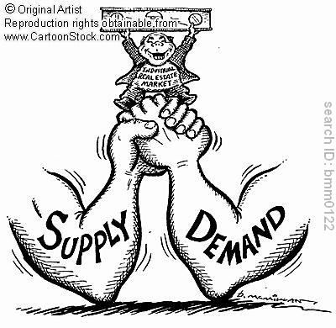

Slide 22
What about the clearance rack?
Often times the market equilibrium is difficult to find or it changes, so business may have the price set above the market price. Therefore, there is a surplus of that good. So the price must be lowered to sell the product.
In a market economy, prices are generally self correcting (the invisible hand).

Slide 23
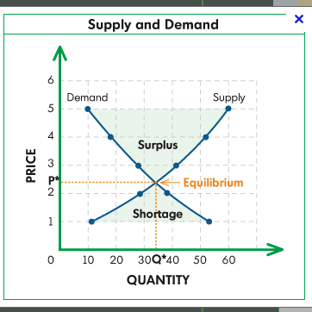

Slide 25

Hula Hoops
Price Video Review

Slide 26
Impact of Single Shifts in Supply or Demand
Curve | Direction of Shift | Effect on Price | Effect on Quantity
Demand | Left | Decrease | Decrease
Demand | Right | Increase | Increase
Supply | Right | Decrease | Increase
Supply | Left | Increase | Decrease

Slide 27
