Slide 1

Vocabulary
Determinant- factor which shifts demand or supply curve

Slide 2
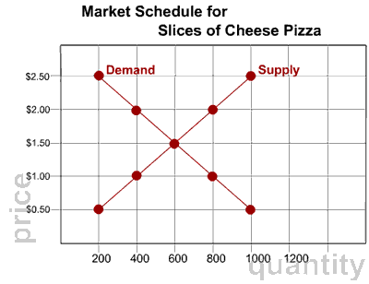

Slide 3
SSEMI3 The student will explain how markets, prices, and competition influence economic behavior.
a. Identify and illustrate on a graph factors that cause changes in market supply and demand.

Slide 4
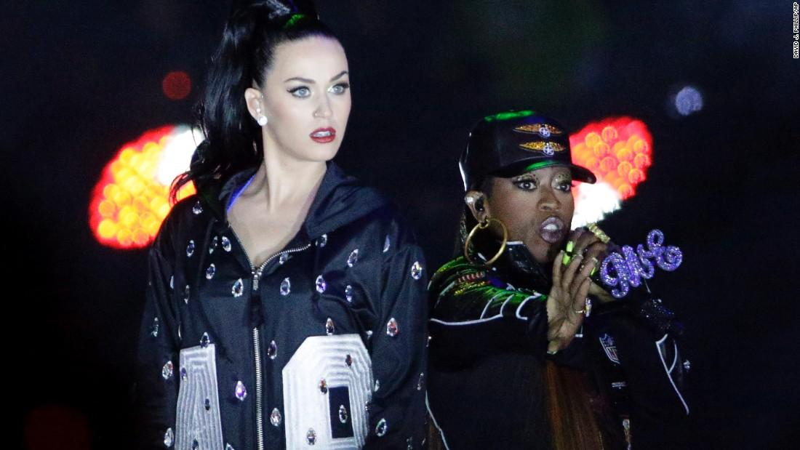
What did this cause (economically)?
Those same folks apparently rushed to iTunes to download Elliott's music. Eight of her songs cracked the iTunes top 200 chart, including 2002's "Work It," 2001's "Get Ur Freak On" and 2005's "Lose Control."
Those songs also electrified Spotify. Streams of Elliott's music increased a whopping 676%, the music service reported.

Slide 5

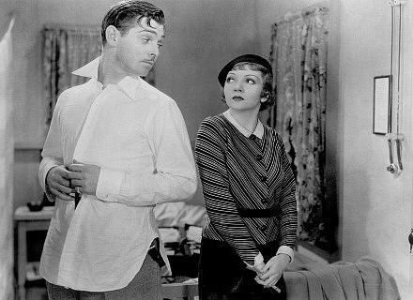
What does this movie have to do with t-shirts?

Slide 6
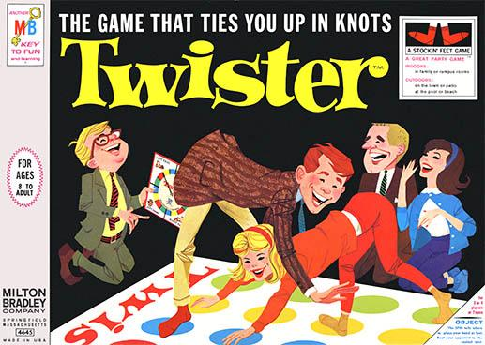
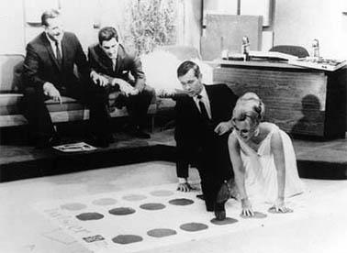
How did a late night TV show save Twister?

Slide 7
How did a late night TV show save Twister?

Slide 8

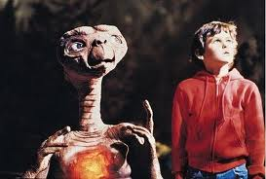
How do these relate?

Slide 9
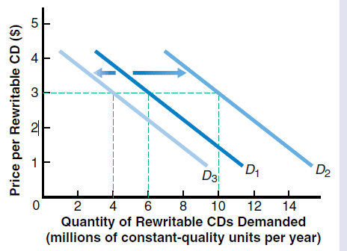
Shifts in Demand
Shifts in the demand curve are dictated by the determinants of demand.
Note-Movement along the curve is due to a price change, not a shift.

Slide 10
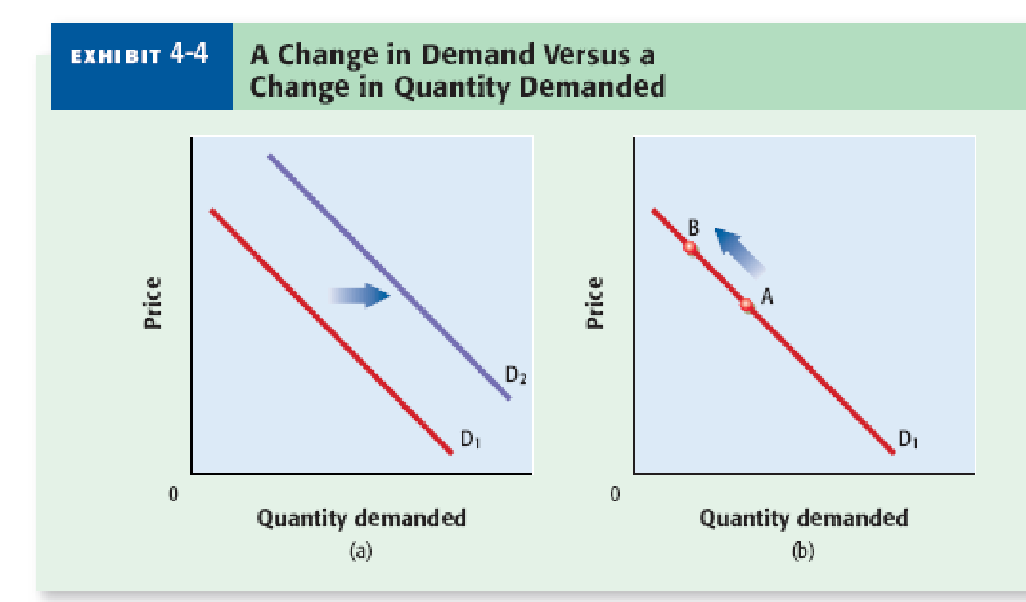
Difference between change in demand and quantity demanded
Change in demand is shift of entire curve
Change in quantity demanded is simple change in # on same curve

Slide 11
Important
An increase in demand is a shift to the right (not up)
A decrease in demand is a shift to the left (not down).

Slide 12
Determinants of Demand
The determinants are- TIRES
Tastes- Consumer Preferences(Commercials/Ads)
Income- Amount of money consumers have
Related Goods-
Substitute(Replaces) Coke=Pepsi
Complimentary(Associated with) Peanut Butter & Jelly
Expectations- Consumer view of future of market/price
Size- Market(# of potential consumers) area by either 1)Business Decision 2)Government Decision 3)Technology

Slide 13
Effects of Determinants
Determinant | Change | Effect on Demand
Taste | Decline | Decrease, shift to left
Income | Decline | Decrease, shift to left
Related Goods
Substitute Goods | Sub. $ decrease | Decrease, shift to left
Complimentary Goods | Rel. $ decrease | Increase, shift to right
Expectations | Future $ increase | Increase now, shift right
Size of Market | Shrinks | Decrease, shift to left
Examples

Slide 14
The Opposite is True

Slide 15
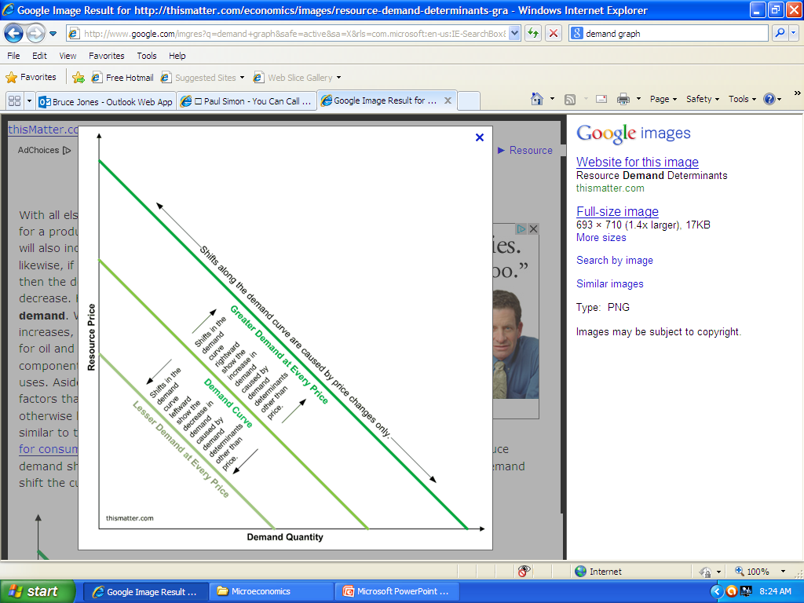

Slide 16
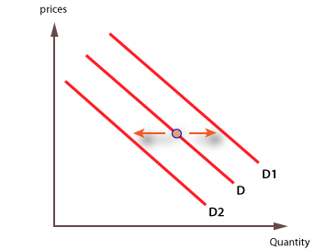
Write the # correct line
1)An increase in demand
2)A decrease in demand
3)The item becomes more popular
4)The price of substitute falls
5)The price of complement falls
6)The item is available to more people

Slide 17
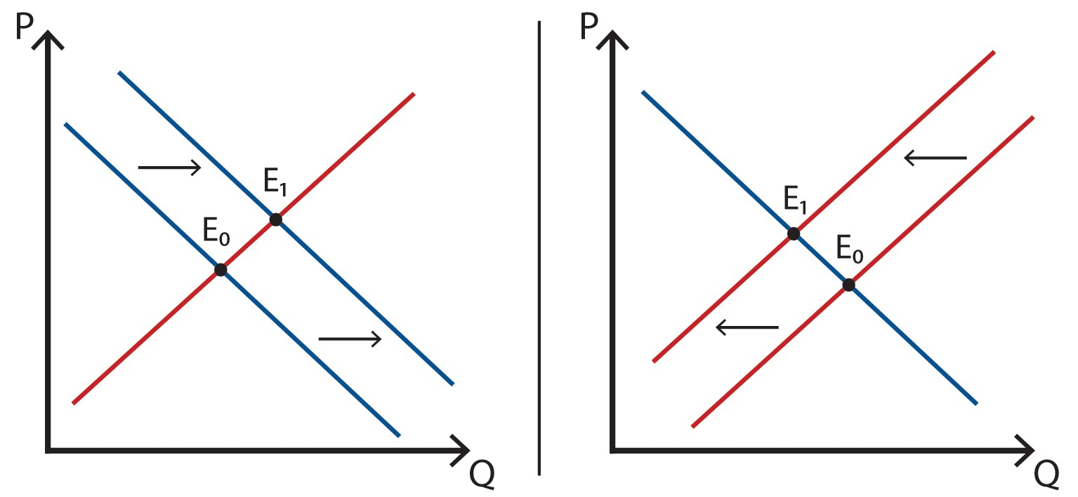
Effect on Price

Slide 18
Impact of Shifts in Demand
Curve | Direction of Shift | Effect on Price | Effect on Quantity
Demand | Left(Decrease) | Decrease | Decrease
Demand | Right(Increase) | Increase | Increase

Slide 19
Steps in Supply/Demand Shifts
1)Determine if situation involves supply(making/producing) or demand(buying)
2)Determine if there will be an increase or decrease
3)Determine how this will affect price and quantity

Slide 20
