Slide 1
Vocabulary
Subsidy-a government payment to producers to influence the supply of a good

Slide 2
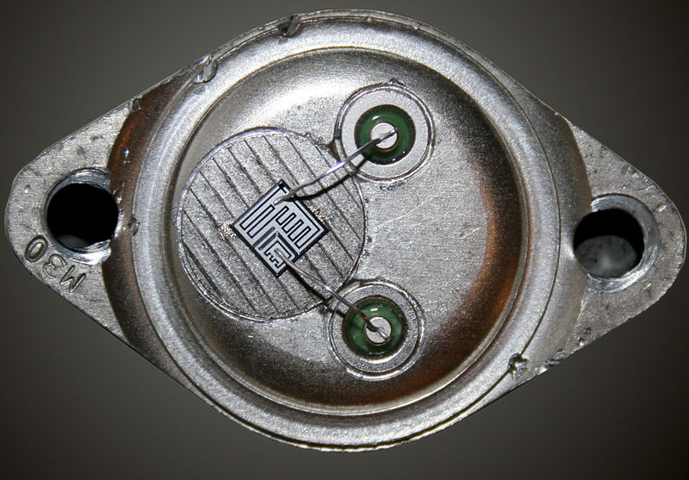
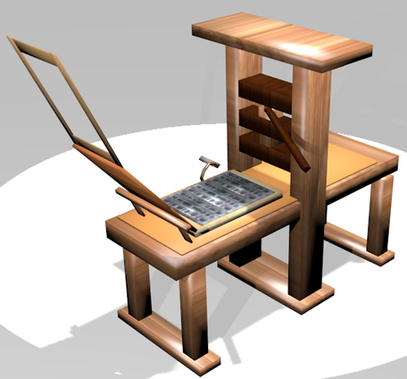
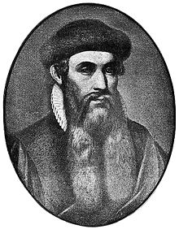
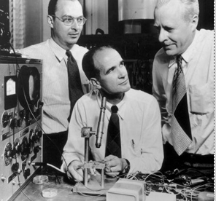
What do these have in common?
John Bardeen, Walter Brattain and William Shockley

Slide 3
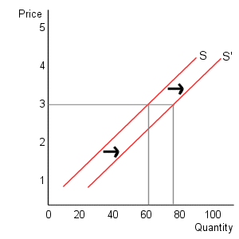
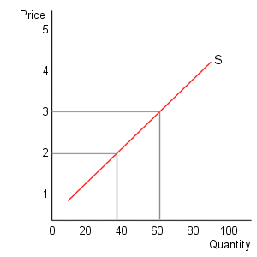
Note
An increase in supply shifts the supply curve to the right(usually lowers price)
A decrease in supply shifts the supply curve left(usually raises price)
Change in Supply Change in # Supplied

Slide 4
Change in supply Change in quantity supplied

Slide 5
Determinants of supply= TIGERS
*Technology- Productivity, Efficiency
*Inputs- Price of resources to make product
*Government Tools- 1)Taxes on production 2)subsidies- government payments to influence production 3)regulation- government rules
*Expectations- Producers view of the future
*Related Goods- Price of related goods and services
*Size of Market- Number of Producers

Slide 6
Affect of Determinants of Supply
Determinant | Change | Effect on Supply
Technology/Prod. | Increase | Increase
Input (Resource) $ | Increase | Decrease
Gov’t Taxes | Increase | Decrease
Gov’t Regulation | More strict | Decrease
Gov’t Subsidy to produce | Increase | Increase
Expectation | Future less | Increase now
Related goods $ | Increase | Decrease
Size of Market- # of Producers | Increase | Increase

Slide 7
The Opposite is True.

Slide 8
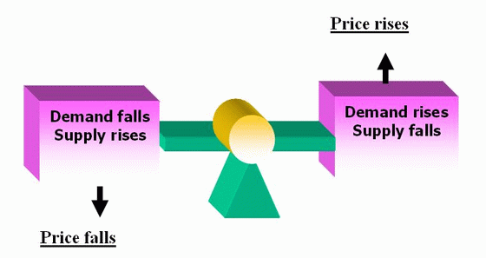

Slide 9
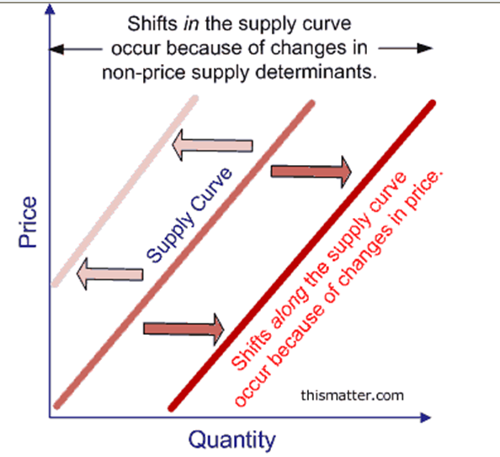

Slide 10
Steps in Supply/Demand Shifts
1)Determine if situation involves supply(making/producing) or demand(buying)
2)Determine if there will be an increase or decrease
3)Determine how this will affect price and quantity

Slide 11
Examples
1)Dr. Benson Honeydew of Muppet labs announces a breakthrough! We can now make blue suede shoes out of old beer cans. What happens to the equilibrium price and equilibrium quantity of blue suede shoes?
2)The Affordable Care Act was billed as a way to expand health care and control costs. As a result of the ACA, what happens to the equilibrium price and equilibrium quantity of health care?
3)A huge vegan fad sweeps the nation at the same time a new breed of locusts destroys thousands of vegetable farms crops. What will happen to the equilibrium price and equilibrium quantity of vegetables?

Slide 12
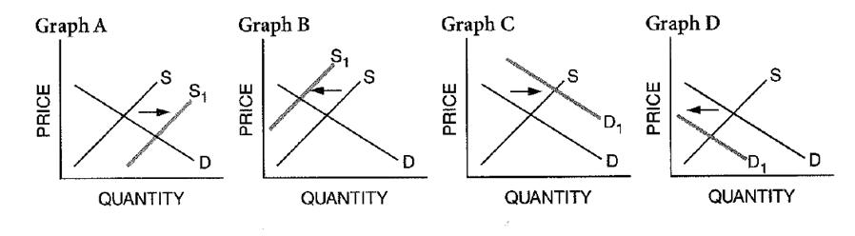

Slide 13
Impact of Single Shifts in Supply
Curve | Direction of Shift | Effect on Price | Effect on Quantity
Supply | Right(Inc) | Decrease | Increase
Supply | Left(Dec) | Increase | Decrease
Demand | Left(Decrease) | Decrease | Decrease
Demand | Right(Increase) | Increase | Increase

Slide 14
Wyoming Cattle
Using blockchain technology, Wyoming cattle farmers hope to increase demand for Wyoming cattle and increase supply by using technology.

Slide 15
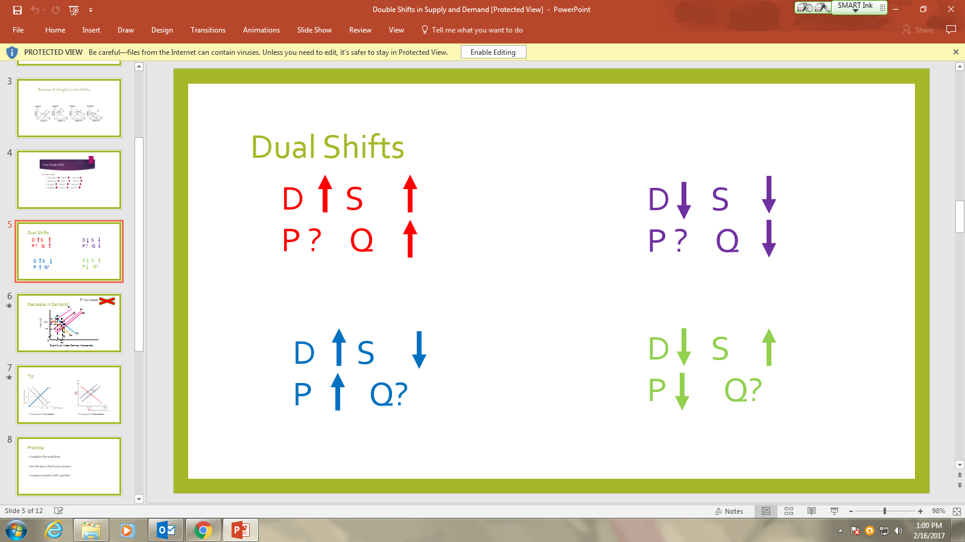
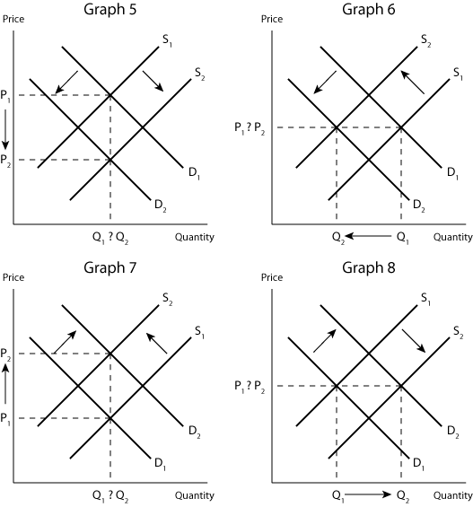

Slide 16
