Slide 1
Vocabulary
Monopoly-situation in which one firm controls the market
Market- interaction of supply and demand
Pure Competition- situation in which there are many firms in the market
Profit- Total Revenues minus Total Losses ; works as an incentive to enter market

Slide 2
Market Structure
Market structure refers the number of producers in the market. It only affects the supply curve.

Slide 3
Market Structure | Pure Competition | Monopolistic Competition | Oligopoly | Monopoly
# of Sellers | Many | Many | Few | One
Price Setting Power | None(Price Taker) | Limited | Some | Price Setter Extensive
Product Differentiation (Non-Price) | None | Fair Amount to Attract Consumers | Yes/No | None

Slide 4
Market Structure | Pure Competition | Monopolistic Competition | Oligopoly | Monopoly
Advertising | None | Fair Amount | Some | None, Public Relations
Barriers | None | None | Yes- Too large to compete | Yes- Gov’t
Examples | Tomato Farmer | Insurance Companies | Auto Maker | Electricity Producers

Slide 5
Market Structure | Pure Competition | Monopolistic Competition | Oligopoly | Monopoly
Long Run Profits | None | None | Yes | Yes
PC and MC both earn short run, but when more competition enters, profits slow.

Slide 6
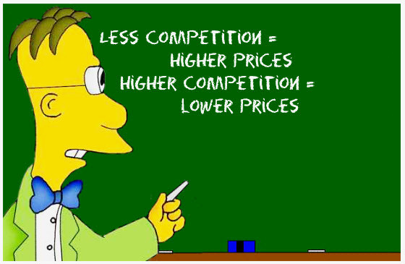
Summary

Slide 7
Airplanes
What kind of market is there in large passenger airplanes?

Slide 8
“Control”
Having “control” of the market is not 100%. In most cases, governments determine how much control of a market one company can have. In many large corporate mergers, the government reviews it to make sure it does not hurt the consumer(Delta and Northwest merger). Usually done by FTC(Federal Trade Commission). Many mergers and acquisitions are rejected.

Slide 9
If government believes company has a monopoly, government must prove so in court. If found to have a monopoly, then company is broken up.(Bells)
Different governments have different standards of what is a monopoly.

Slide 10
Other
Cartel- a formal agreement between competing firms(OPEC)
CNN10 March 25
Collusion- an agreement to limit competition (usually smaller scale)(illegal)

Slide 11
Types of Legal Monopolies
Natural Monopoly-a firm is more efficient and has smaller production costs market situation where the costs of production are minimized by having a single firm produce the product
Geographic Monopoly- based on absence of other sellers in a certain geographic area(only gas station in town)

Slide 12
What’s a “Deleb”? Who’s the Richest? 2017(in Millions)
1) Michael Jackson $75 (2009) | 6) Tom Petty$20(2017)
2)Arnold Palmer $40 (2016) | 7) Prince $18 (2016)
3) Charles Schulz $38 (2000) | 8)Theodor Geisel $16 (1991)
4) Elvis Presley $35 (1977) | 9)John Lennon $12 (1980)
5) Bob Marley $23 (1981) | 10)Albert Einstein $10 (1955)
2013

Slide 13
Technological Monopoly-monopoly based on ownership or control of a manufacturing method, process, or advancement (copyrights and patents) “Pay for Delay”
Governmental Monopoly-monopoly government owns and operates(trash collection in NYC)

Slide 14
Note
You can’t copyright fashion or clothing designs.
Except maybe cheerleader uniforms.
Song lyrics/beats are copyrighted.

Slide 15
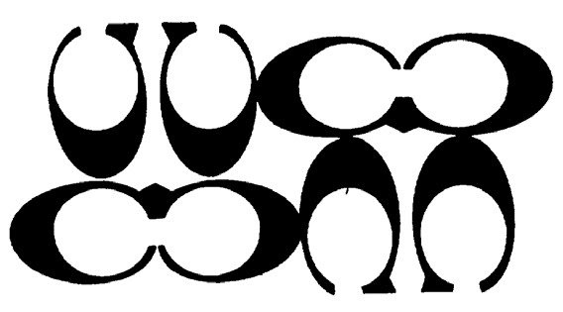
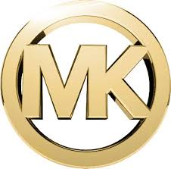
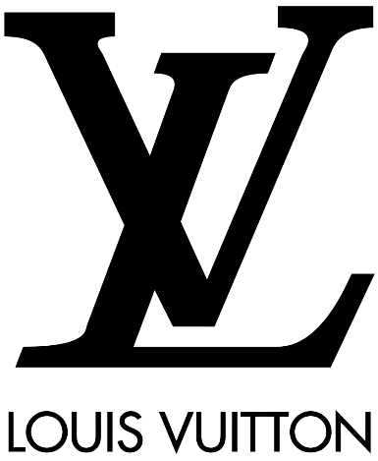
What do the following have in common?
Soft Kitty
Let’s Get Ready to Rumble!
BAM!
They are who we thought they were.
Let’s Roll!
I am here so I don’t get fined.
Happy Birthday
Martin Luther King, Jr.

