Slide 1

Welcome to AP Human Geography!

Slide 2

What is AP?
Advanced placement-
Offers college credit to those who score a three or better on the AP Human Geography Test
Score of 3= credit for one class or 3 credit hours.
Score of 4 or 5- 2 classes or 6 credit hours.

Slide 3
Pros and Cons of AP
Pros-
  Receive 2 high school credits for passing the class
  Highest Weighted GPA
  Possible College Credit providing you pass the AP Exam means:
    Cheaper than taking college classes: $85 compared to $850 a class
    Take what you want in college because this stuff is done!
Cons-
  Analyzing college level materials.
  Large amounts of college level reading and note-taking
  Large amounts of intensive writing activities.

Slide 4

Educational Expectations
You will have to READ and WRITE often, and at the college level.
Active participation!
  Those that participate almost always do better on the exam!

Slide 5

The Test
Section 1
75 Multiple Choice Questions
60 minutes
Percentage of total grade= 50%
Guessing= is ok!
AP Test: Thursday, May 13

Slide 6

The Test
Section 2
Free- Response Questions
3 Multi-part short answer questions that ask you to define and apply Human Geographic Terms to the real world
75 minutes
We will discuss how to do this later
AP Test: Tuesday, May 13

Slide 7
7 Units of Human geography
1. Geography Its Nature and Perspectives

Slide 8
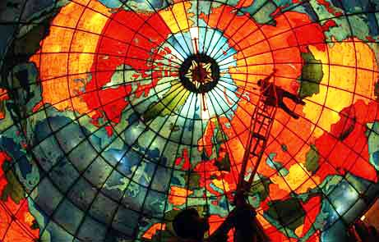

Slide 9
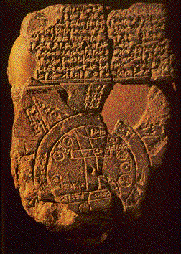

Slide 10
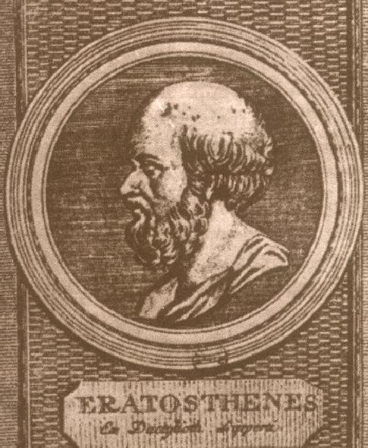

Slide 11
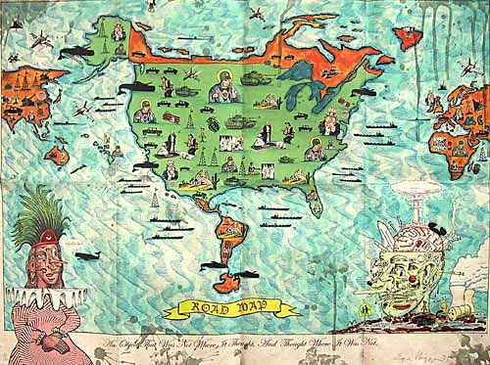

Slide 12
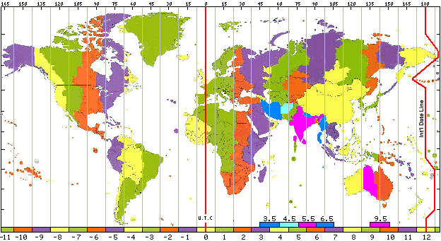

Slide 13
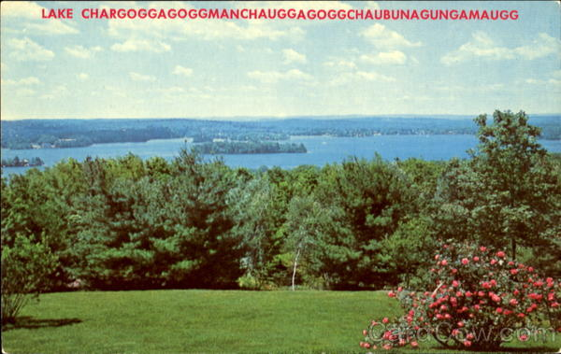

Slide 14


Slide 15
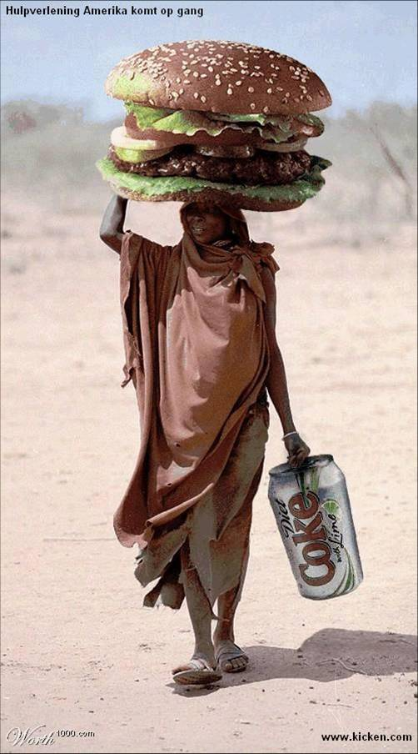

Slide 16
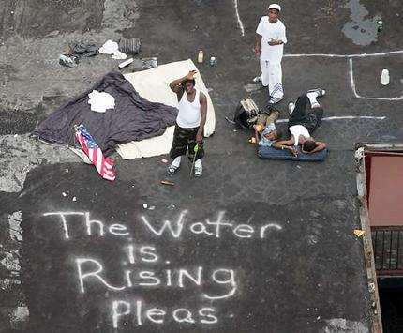

Slide 17
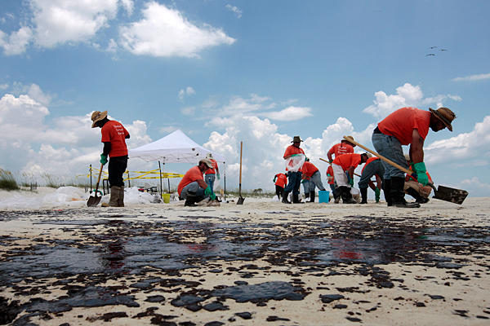

Slide 18
7 Units of Human geography
2. Population

Slide 19


Slide 20
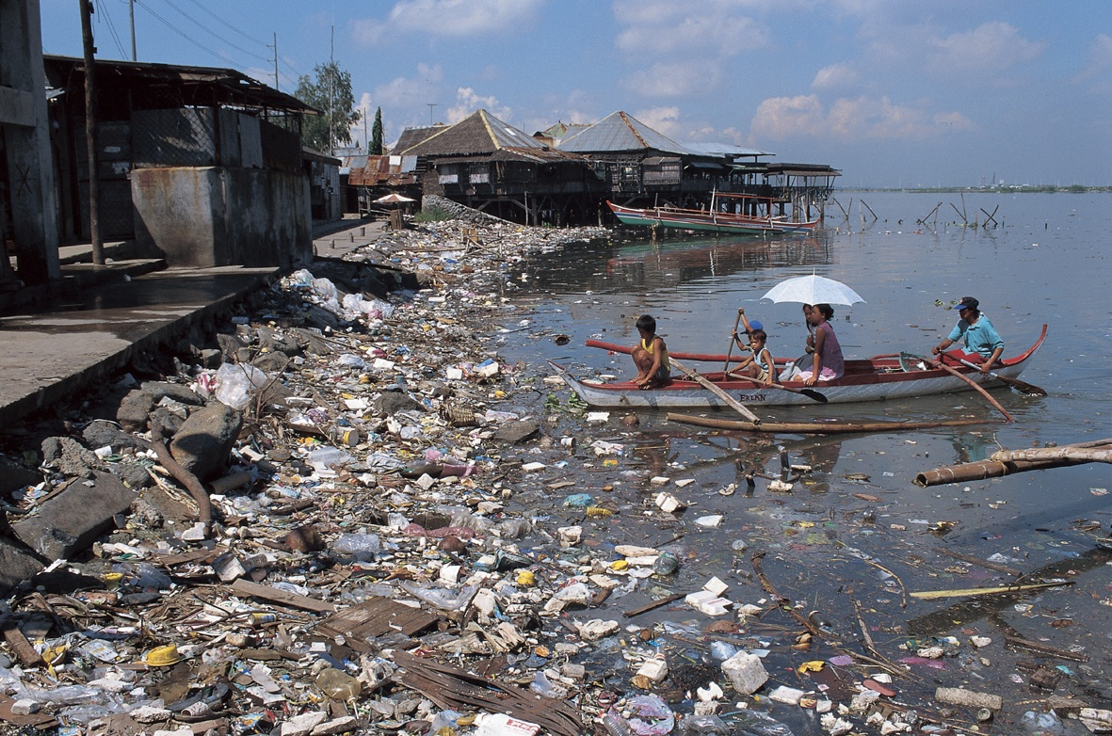

Slide 21
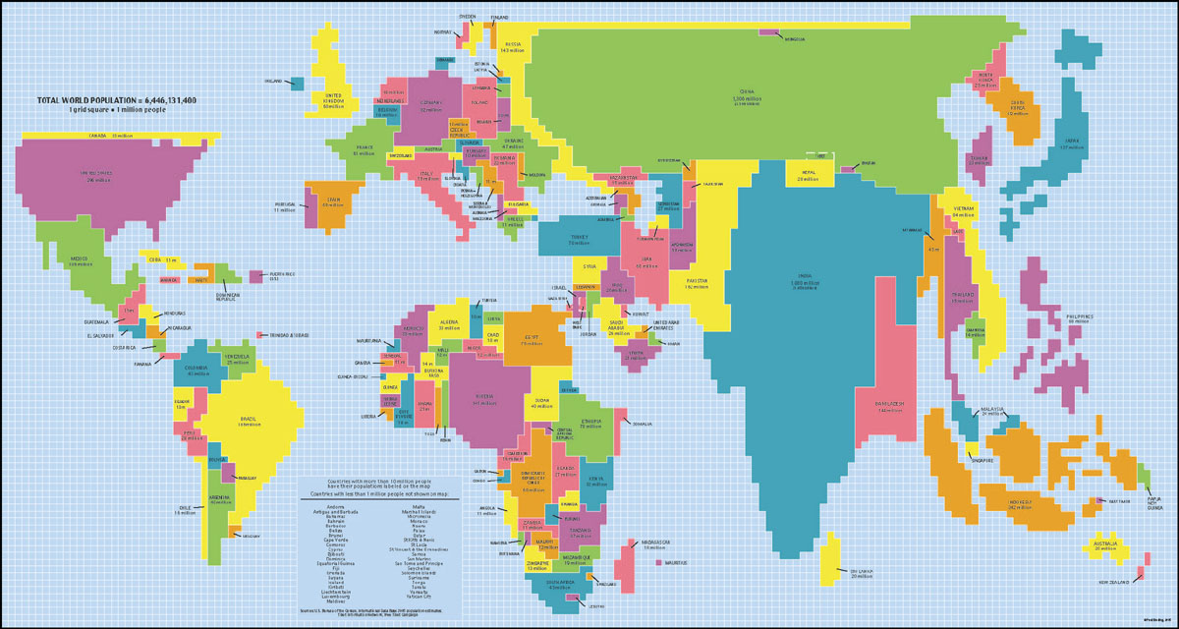

Slide 22
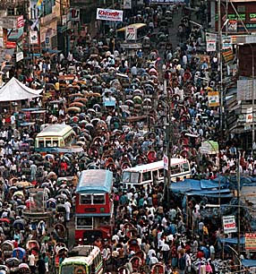

Slide 23

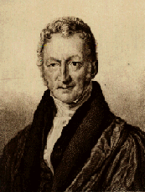

Slide 24
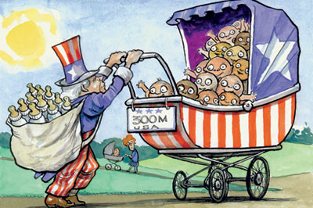

Slide 25
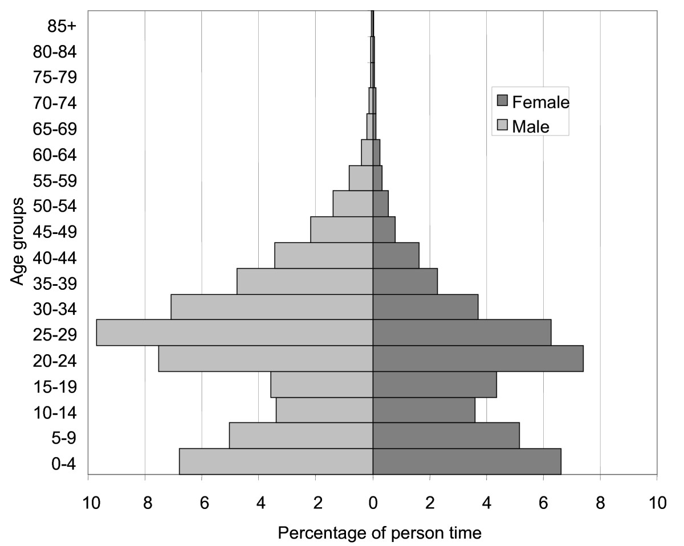

Slide 26
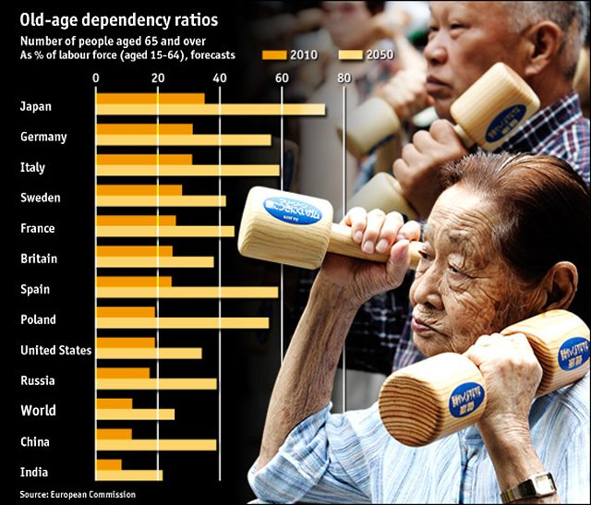
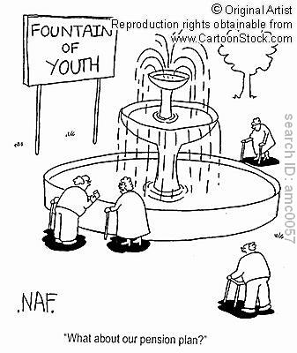

Slide 27


Slide 28


Slide 29
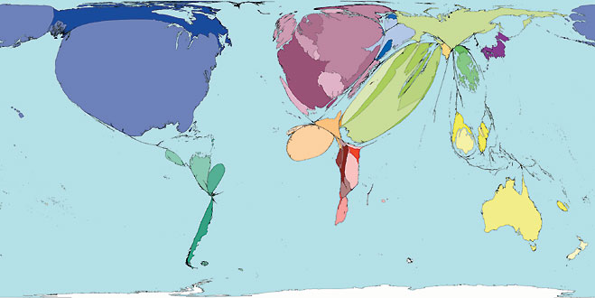

Slide 30
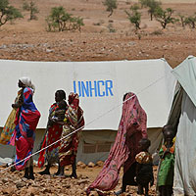

Slide 31
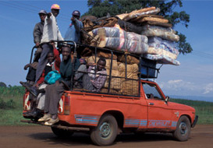



Slide 32
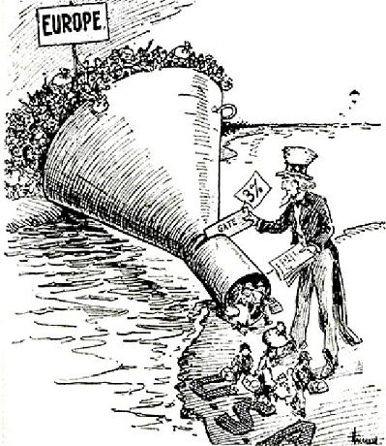


Slide 33
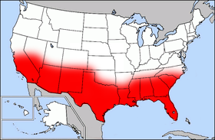

Slide 34
7 Units of Human geography
3. Cultural Patterns and Processes

Slide 35

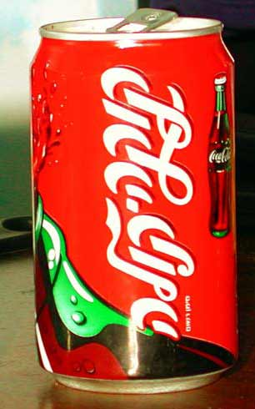


Slide 36
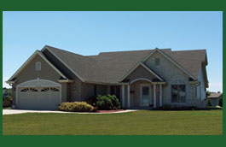
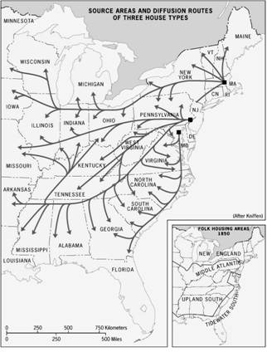
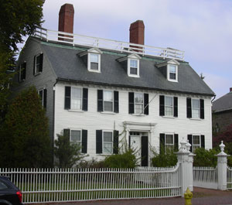

Slide 37
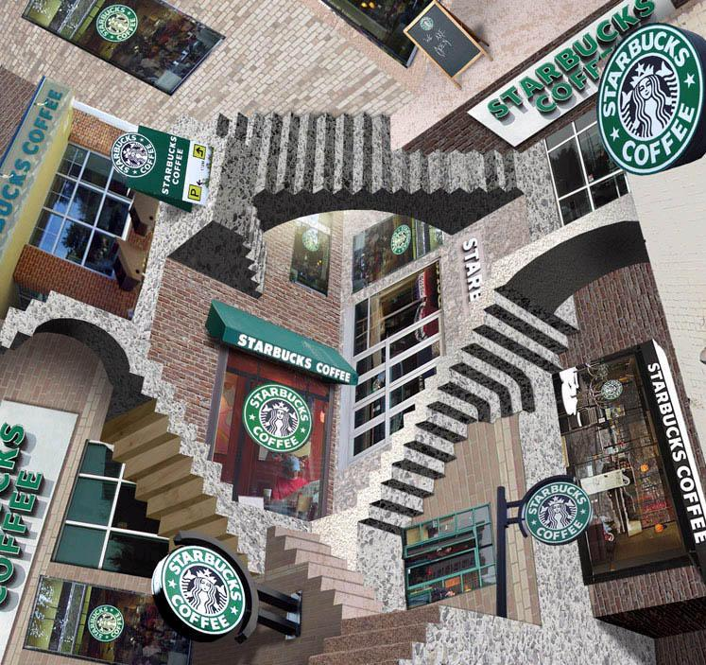

Slide 38
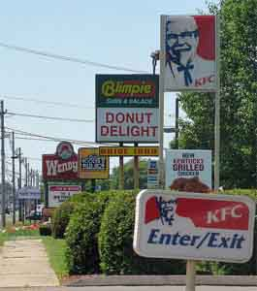

Slide 39
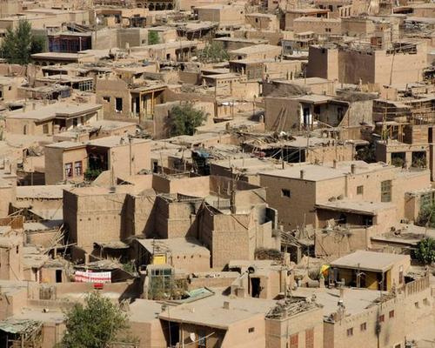

Slide 40
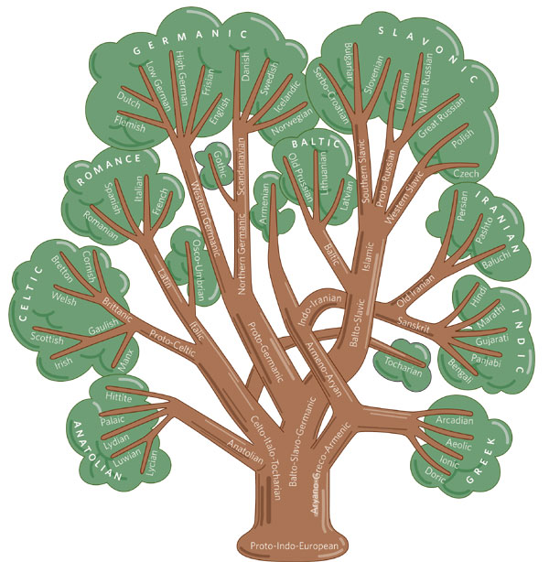

Slide 41


Slide 42


Slide 43



Slide 44
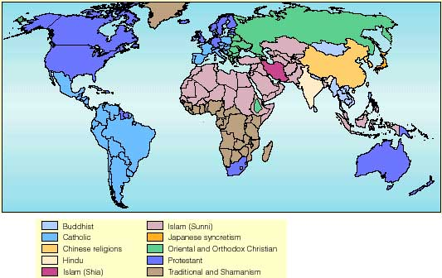

Slide 45
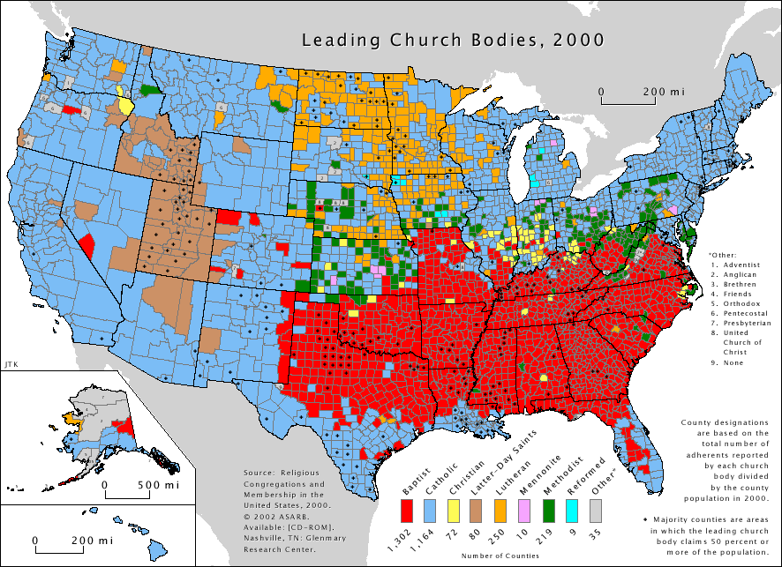

Slide 46


Slide 47
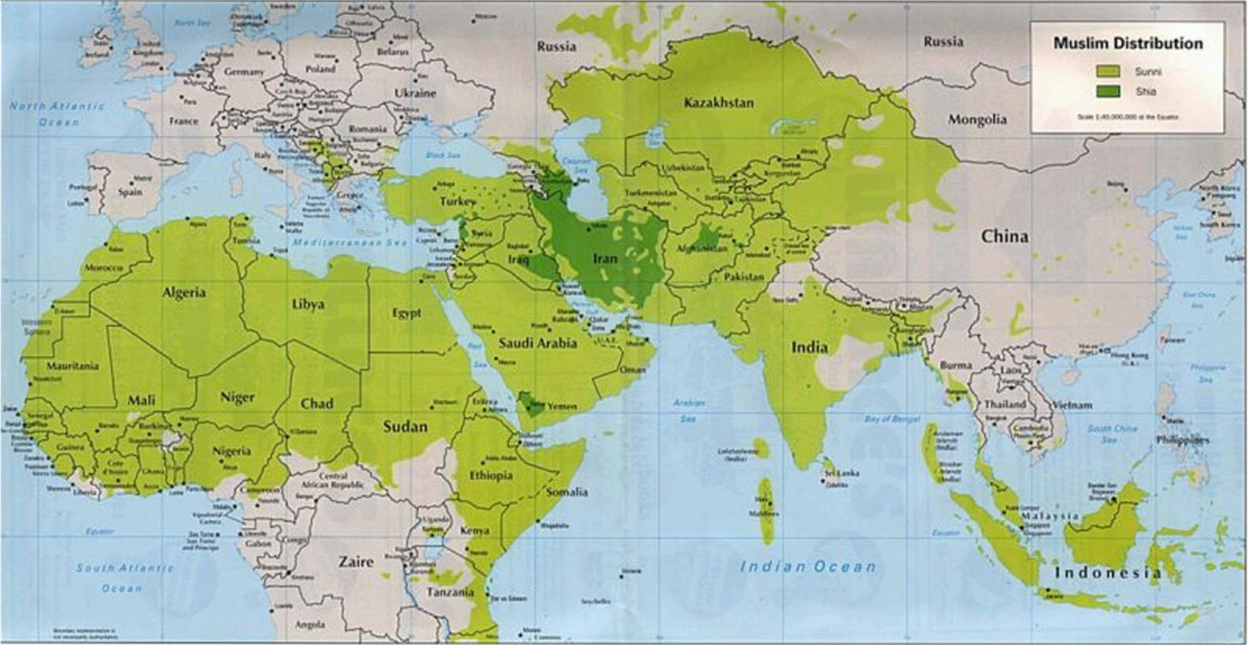

Slide 48

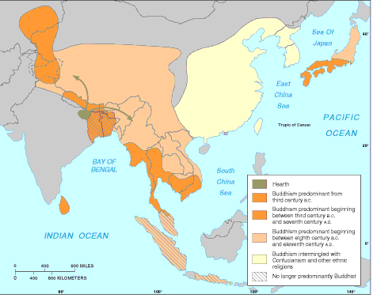

Slide 49
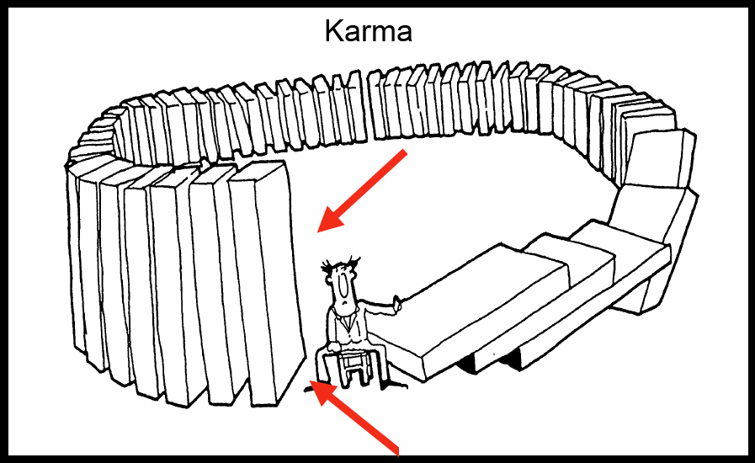

Slide 50


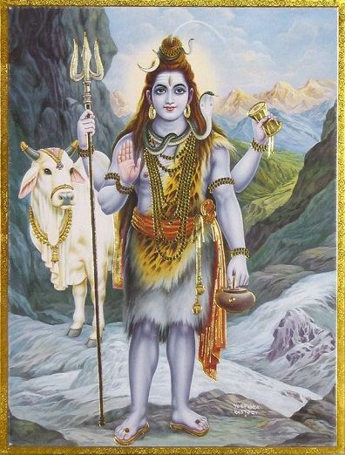

Slide 51
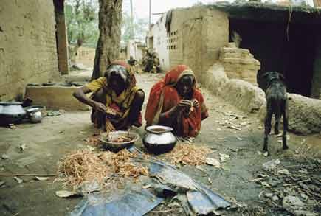
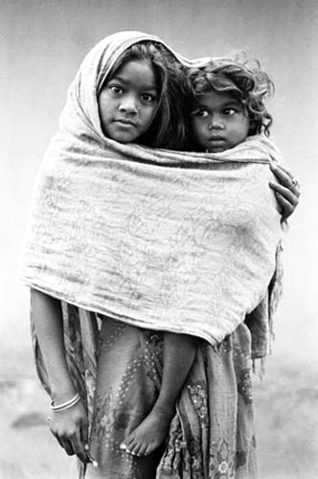
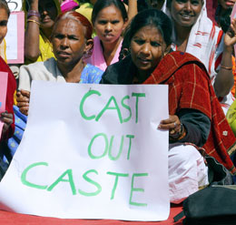
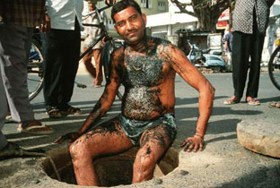

Slide 52

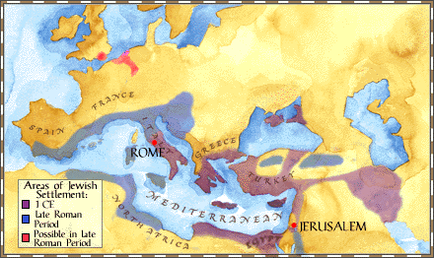

Slide 53

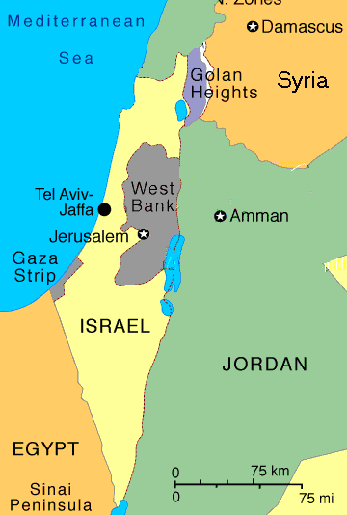

Slide 54
7 Units of Human geography
4. Political Organizations in Space

Slide 55
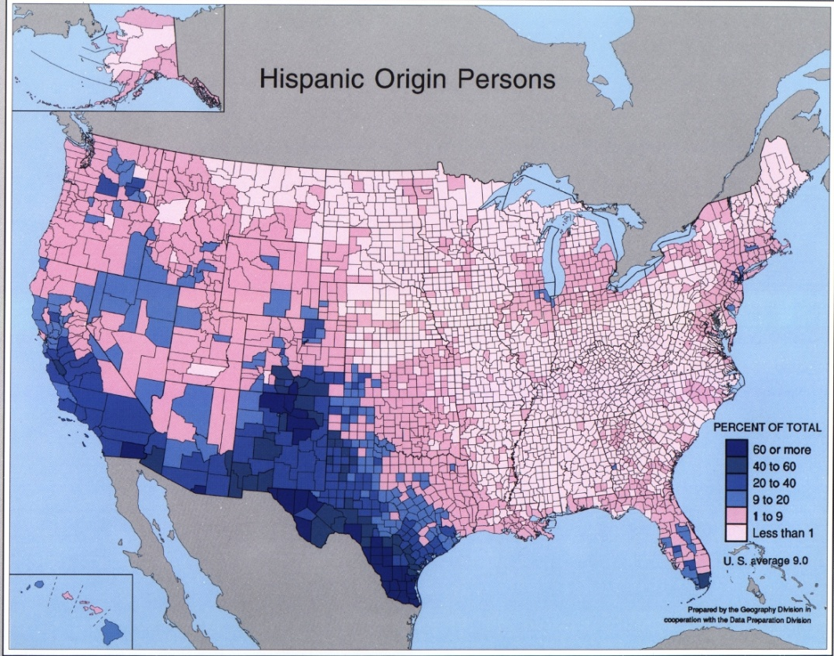
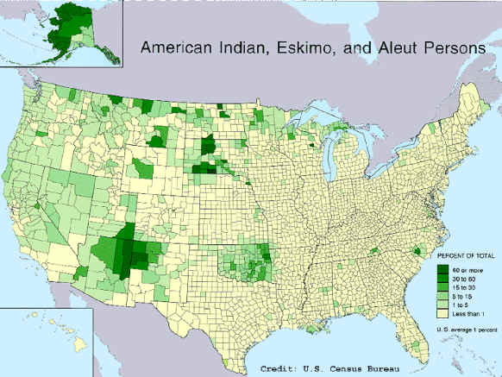

Slide 56
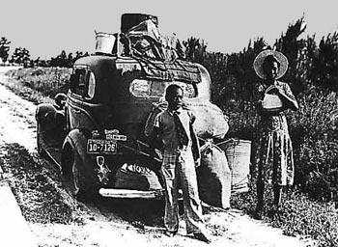

Slide 57


Slide 58
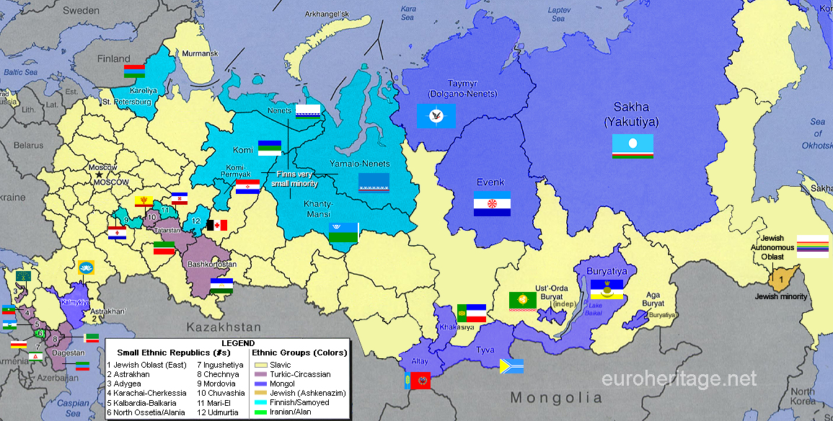

Slide 59
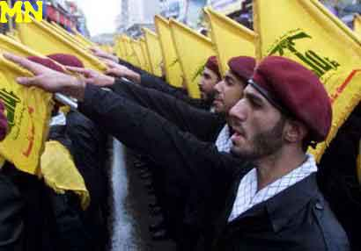

Slide 60
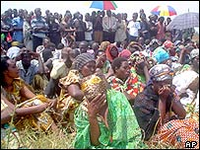
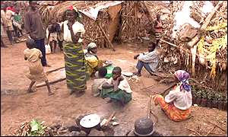

Slide 61
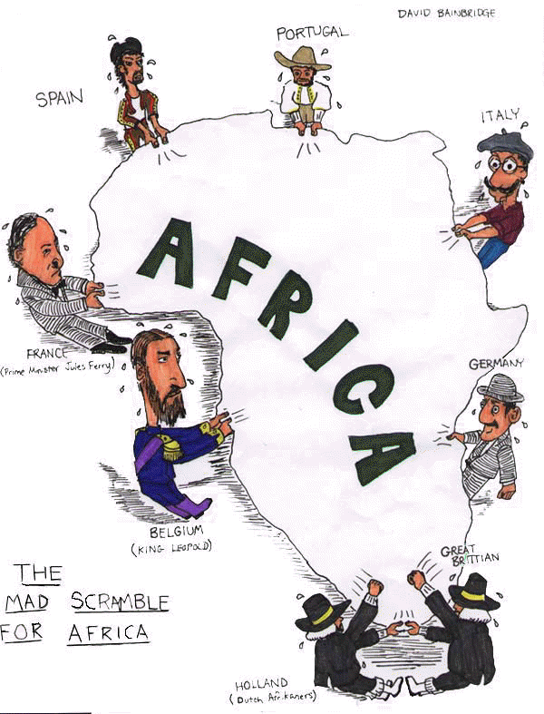

Slide 62


Slide 63


Slide 64



Slide 65


Slide 66


Slide 67


Slide 68


Slide 69


Slide 70


Slide 71


Slide 72


Slide 73
7 Units of Human geography
5. Agriculture and Rural Land Use

Slide 74



Slide 75



Slide 76


Slide 77


Slide 78


Slide 79


Slide 80


Slide 81


Slide 82


Slide 83



Slide 84




Slide 85


Slide 86



Slide 87


Slide 88



Slide 89



Slide 90



Slide 91
7 Units of Human geography
6. Industrialization and Economic Development

Slide 92



Slide 93



Slide 94



Slide 95




Slide 96



Slide 97




Slide 98




Slide 99




Slide 100



Slide 101


Slide 102



Slide 103




Slide 104


Slide 105



Slide 106




Slide 107





Slide 108



Slide 109



Slide 110



Slide 111




Slide 112



Slide 113


Slide 114



Slide 115


Slide 116


Slide 117


Slide 118


Slide 119


Slide 120


Slide 121


Slide 122
7 Units of Human geography
7. Cities and Urban Land Use

Slide 123



Slide 124



Slide 125


Slide 126


Slide 127


Slide 128


Slide 129


Slide 130


Slide 131


Slide 132




Slide 133



Slide 134


Slide 135


Slide 136


Slide 137

~The End~

