Slide 1
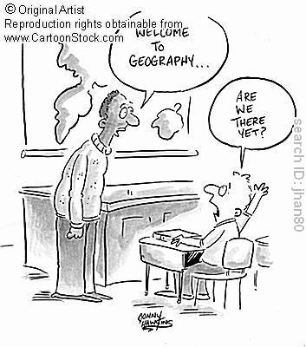
Warm Up Answer on your own notebook paper. You do not have to write in complete sentences and you do not have to copy the question.
Name three things you think you will learn in this class
Why do you think Geography evolved as an academic discipline? Describe 1 reason
What is the Date and time for the 2013 AP Human Geography Exam?
Explain, in your own words, the following vocabulary terms:
Space
Scale
Projection

Slide 2
Welcome to AP Human Geography!!!
D-Day is Tuesday May 13th at 12:00 PM!!!

Slide 3
Why does Geography Matter?

Slide 4


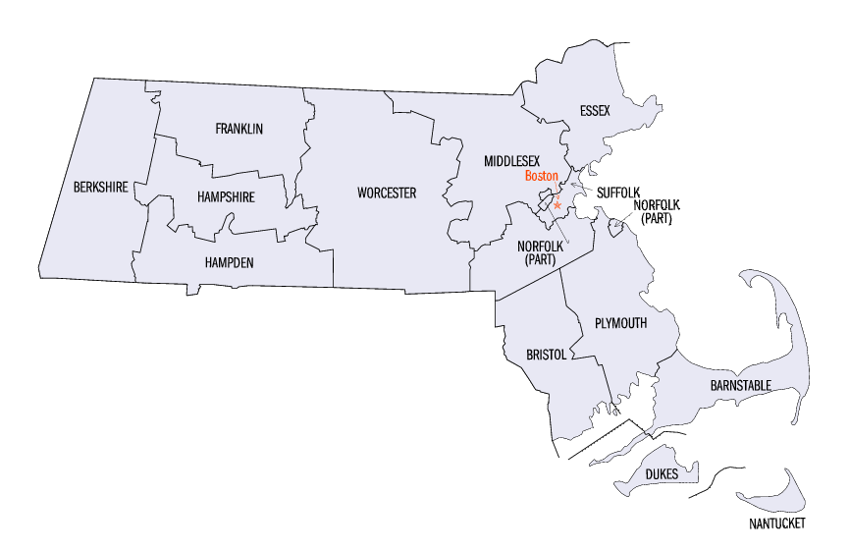
The new signs at the corner of routes 10 and 141 displayed the route numbers inside an outline of the state of Alabama. What is the problem with this?
Routes 10 and 14 are in Massachusetts

Slide 5
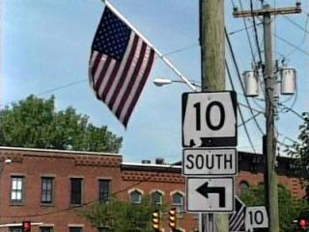
No one seemed to notice when the wayward signs went up about a year ago.

Slide 6
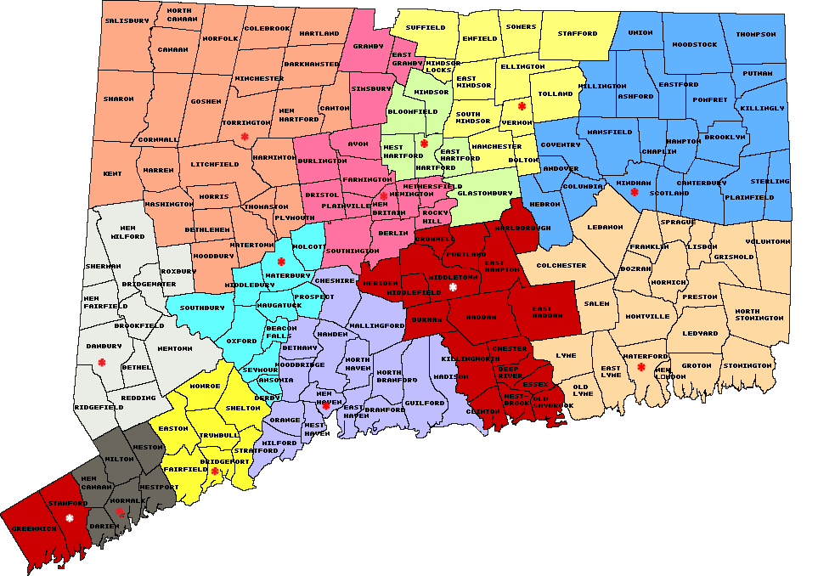
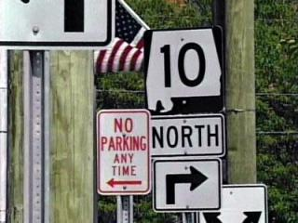
One contractor noticed but thought the shape was Connecticut turned upside down.

Slide 7

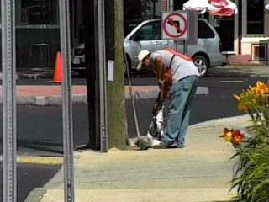
The signs have been taken down and will be replaced with traditional Massachusetts signs -- black numbers on a white square or rectangle.

Slide 8
Unit 1 Human Geography: Its Nature and Perspectives
What in the world is Human Geography?

Slide 9
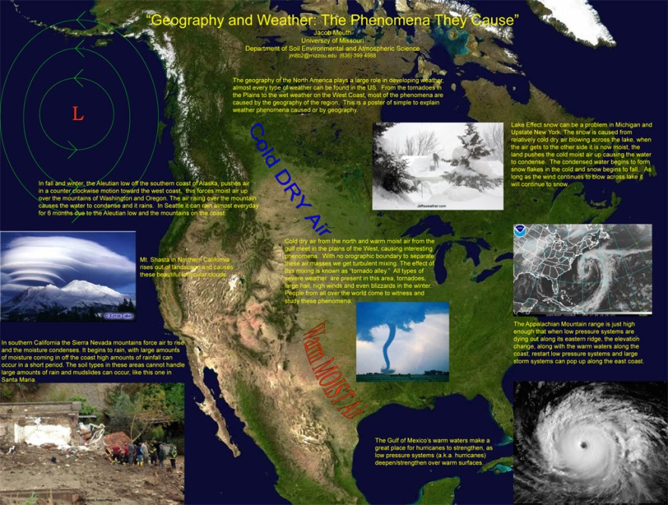
The Spatial Perspective
The Spatial Perspective: The Geographic Perspective
Studies the logical arrangement
of natural and human activities across the globe
Principally, looks at the “Where”
Answers: Where are things located?
Secondly looks at the “Why”
Answers: Why are things
located there?

Slide 10
Is this an important Perspective?
Imagine you are an entrepreneur trying to open your own restaurant.
Where are you going to open it???
2 locations: 1 is in downtown Myrtle Beach, the other is in Aynor
Why would either one be a good or bad location?

Slide 11
THE WHERE!
Analyzing Maps and their Contemporary Tools

Slide 12
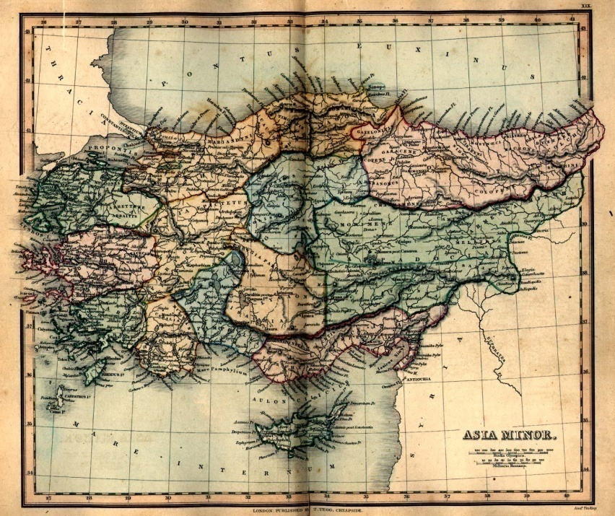

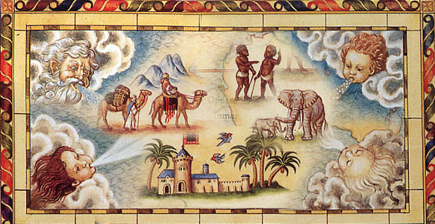
The First Geographers
The ancients (Greeks, Romans, Chinese, Northern Africans)
Why would geography develop?
Practical reasons
Money! Food! Jewels! Fabrics!
Needed to create safe trade routes to far off lands

Slide 13
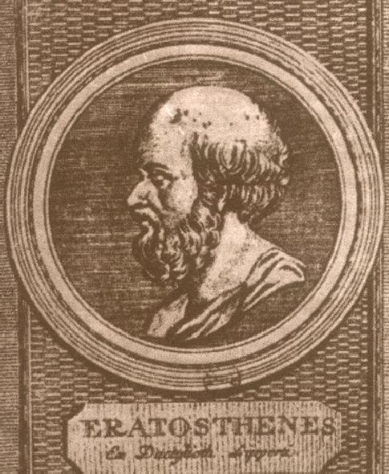
Eratosthenes
Did Scholars really think
the Earth was flat?????
NO!
300 BC Greek scholar,
Eratosthenes, accurately
calculated the Earth’s
circumference
Coined the term
“Geography”
~ “Earth-Writing”
Geo means Earth
Graphy means Writing

Slide 14
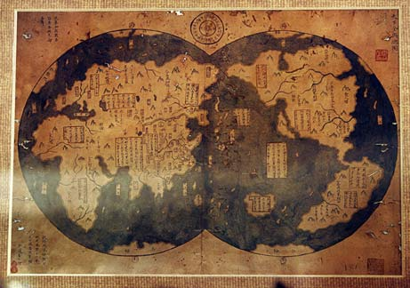
The Identifying Factor of Geography
The Map!
A flat, scaled, model of all or part of the Earth’s surface

Slide 15
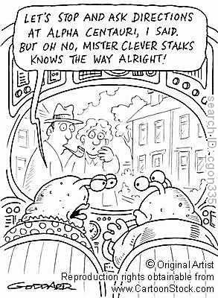
Cartography
The science of map making
2 purposes of maps
As a reference material
Ex: What’s the shortest route to my friends house?
Depicts the distribution of human activities
Ex: What’s the predominant religion in the country of South Africa?

Slide 16
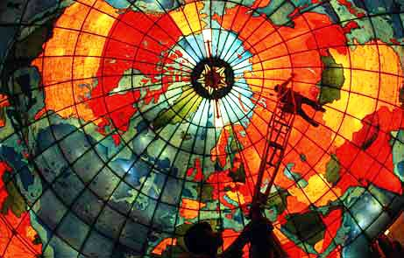
Some maps are very artistic

Slide 17
The First Cartographers
Oldest surviving: Babylonians
Clay tablets around 2300 BCE
Aristotle (384-322 BCE)
Indicated the Earth was spherical
Looked at Earth’s shadow and the movement of the stars in the sky
Eratosthenes : What did he do? (300 BCE)
Divided the Earth into 5 climates: middle torrid zone, 2 arctic zones at the top and bottom, and 2 temperate bands between

Slide 18
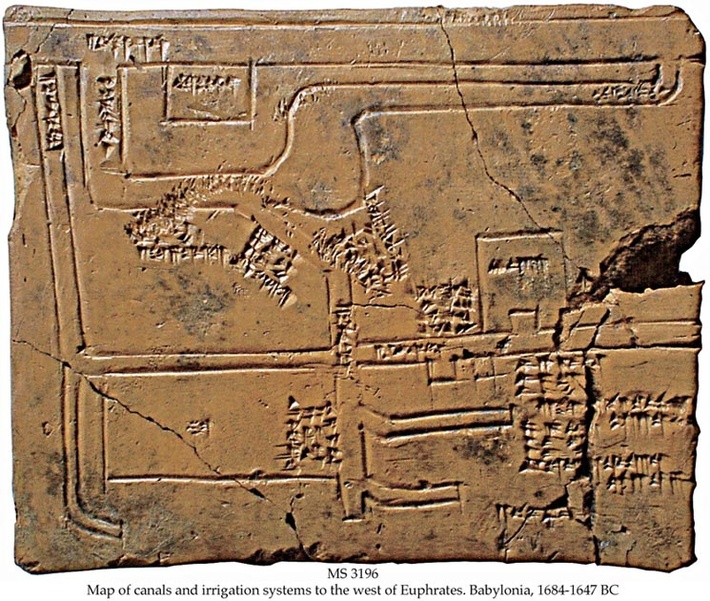
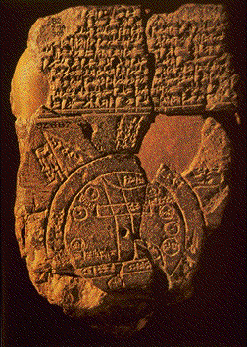

Slide 19
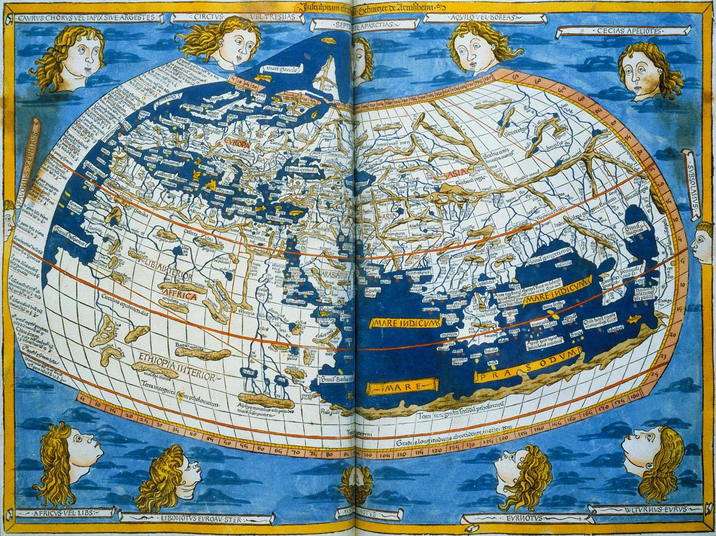
The First Cartographers Cont’
Ptolemy
Wrote the Guide to Geography
Basic principles of map making and tons of maps!

Slide 20
The First Cartographers Cont’
Early European map making
Less mathematical
Inaccurate flat discs
Mystical
Pictures of fierce animals and monsters
Age of Exploration
Columbus, Magellen, etc. explored new areas, keeping accurate accounts of what they saw
Cartographers such as Mercator translated the info into accurate maps
Bernhardus Varenius (early 1600’s) wrote Geographia Generalis : for 100 years was the standard for Geography

Slide 21
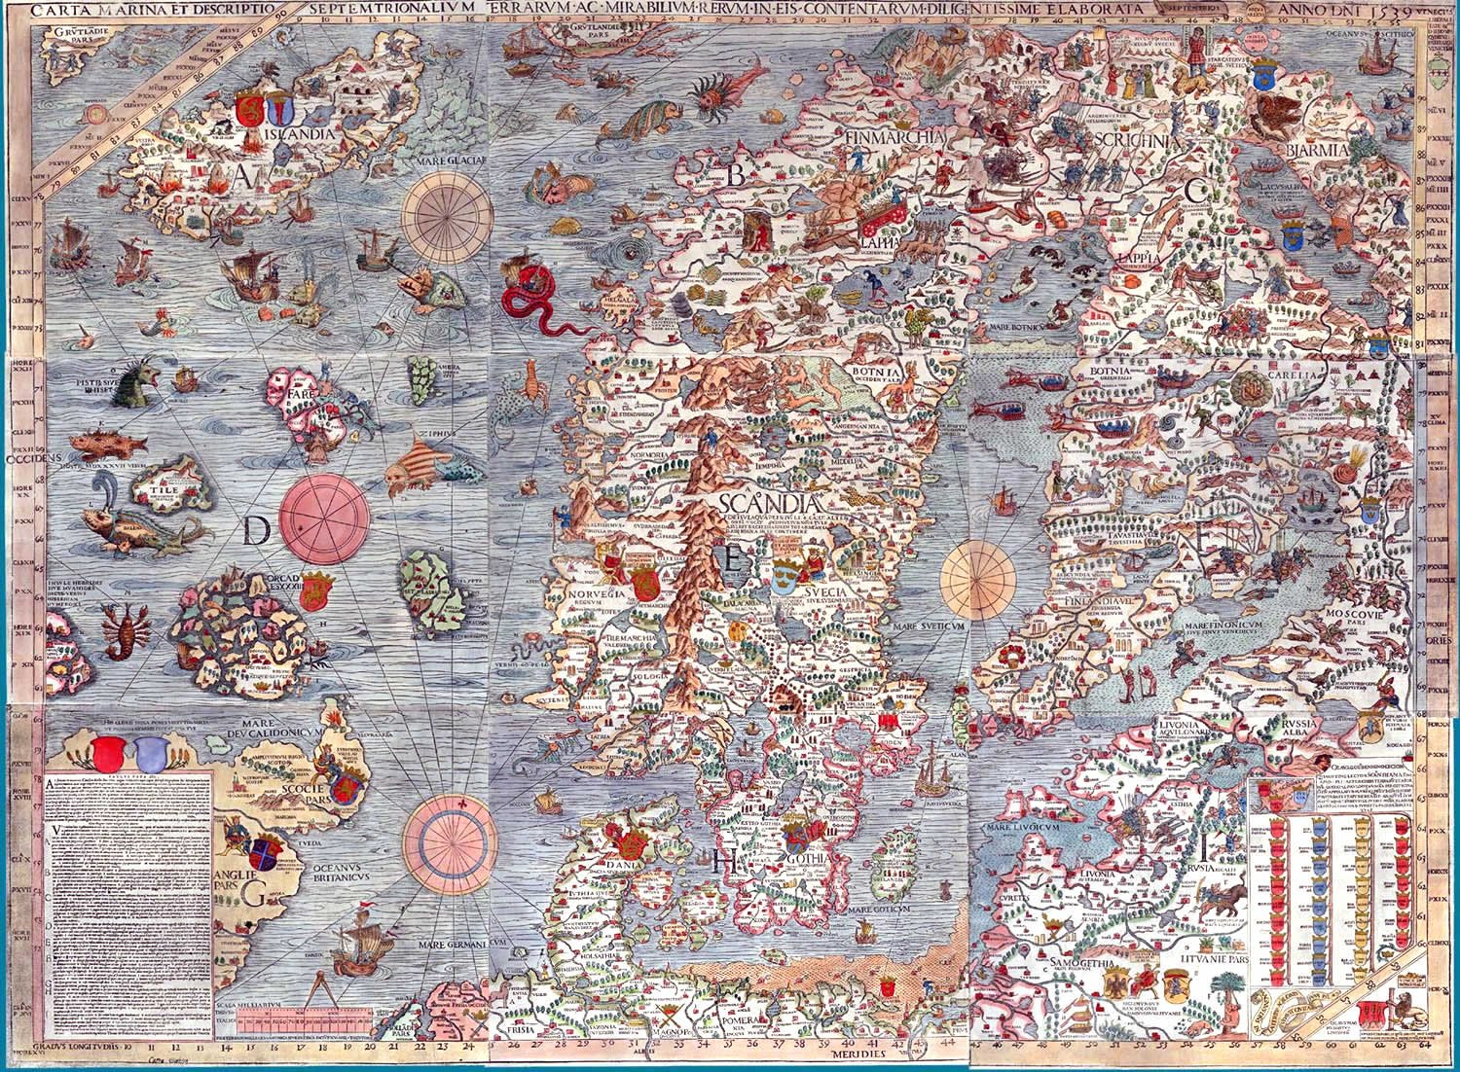

Slide 22
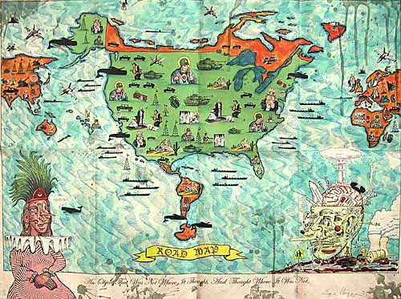

Slide 23
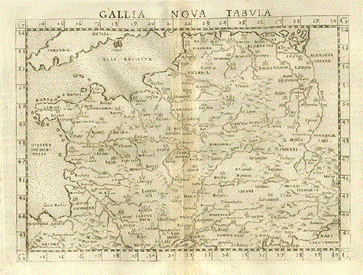
France

Slide 24
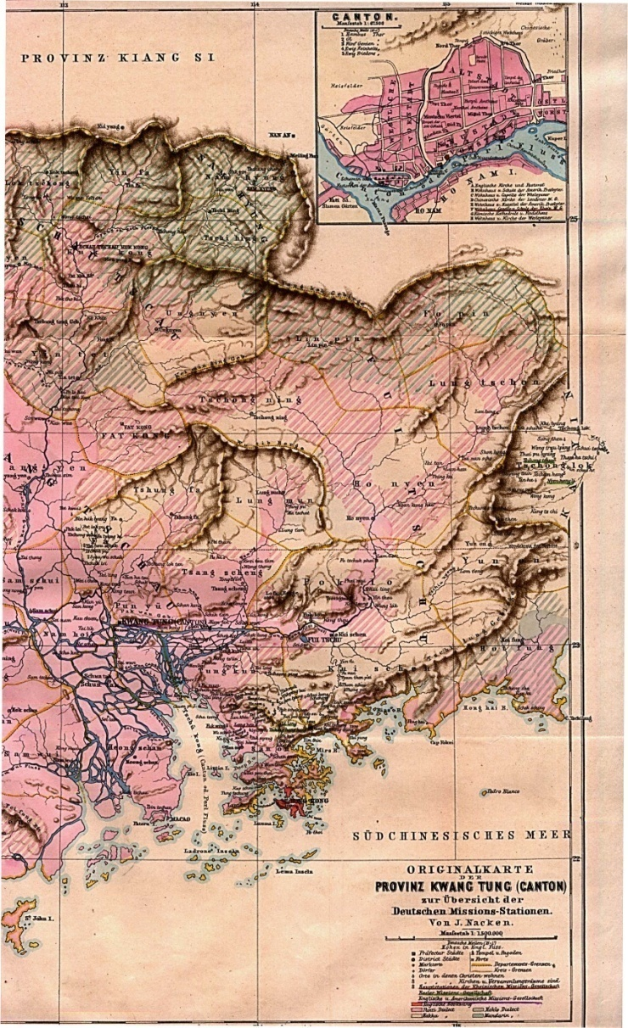
The First Cartographers Cont’
Early Chinese Map Makers
First in 5 BCE, described China’s economy by province
Phei Hsiu (Fei Xiu) “Father of Chinese Cartography”
First elaborate Chinese country map in AD 267

Slide 25
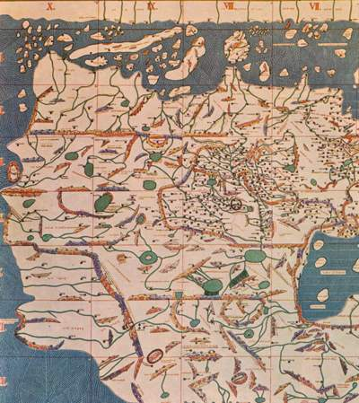
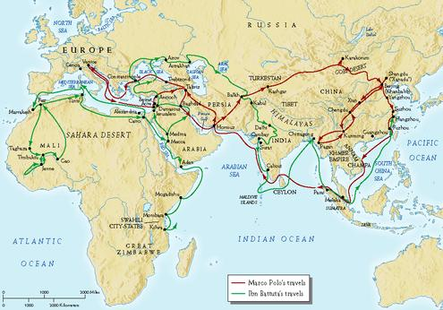
The First Cartographers Cont’
al-Idrisi
1154, perfected Ptolemy’s work
Ibn-Battutah
1304-1368 wrote Rihlah (Travels)
Mapped and described 75,000 miles of Muslim land in N. Africa, S. Europe, and most of Asia

Slide 26
Reading Assignment
Read the following article: How Maps Lie
While you read the article consider the following questions.
After reading write 2 AP paragraphs (10 sentences) that address these questions.
Do viewers trust maps? To what extent is this trust warranted?
How does bias and “distracters” blur the reality of maps?
How will you use this information as we continue in the class?
You do not have to answer all the questions but should demonstrate a general understanding of the article and its significance.
5pt Extra credit: Bring either a copy of a map or a map on your thumb drive that represents the “white lies” of maps

Slide 27
Scale and How Maps Lie

Slide 28
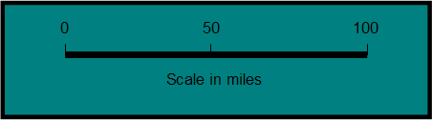
Cartographer’s 2 Big Decisions
1. Map Scale
Refers to the relationship between the size of an object on a map and its actual size on Earth
Present the info in 3 ways
Fraction (1/24,000) or Ratio (1: 24,000)
(both sides same value 1 inch = 24,000 inches)
A written statement (1 inch equals 1 mile)
Or a graphic bar scale
Which would have more detail: a notebook paper size map of the world or a notebook paper size map of this classroom?
So does a world map have a small scale or a large scale?

Slide 29
What kind of scale?
“One inch to 5 miles”
Verbal scale
Notes:
One inch on the map equals five miles on the surface of the earth. Note the different units: inch vs. mile.

Slide 30
What kind of scale?
1:316,800 or 1/316,800
Fractional Scale
Notes:
Expressed as a ratio (:) and as a fraction (/): both are fractional scales or Representative Fractions (R.F.). No unit of measurement is shown because the unit can be anything. If it is inches, then the statement is read this way: “One inch on the map equals 316,800 inches on the surface of the earth.”

Slide 31
What kind of scale?
Graphic Scale
Notes:
Excellent for computer maps because the scale changes with the size of the map on the computer screen.

Slide 32
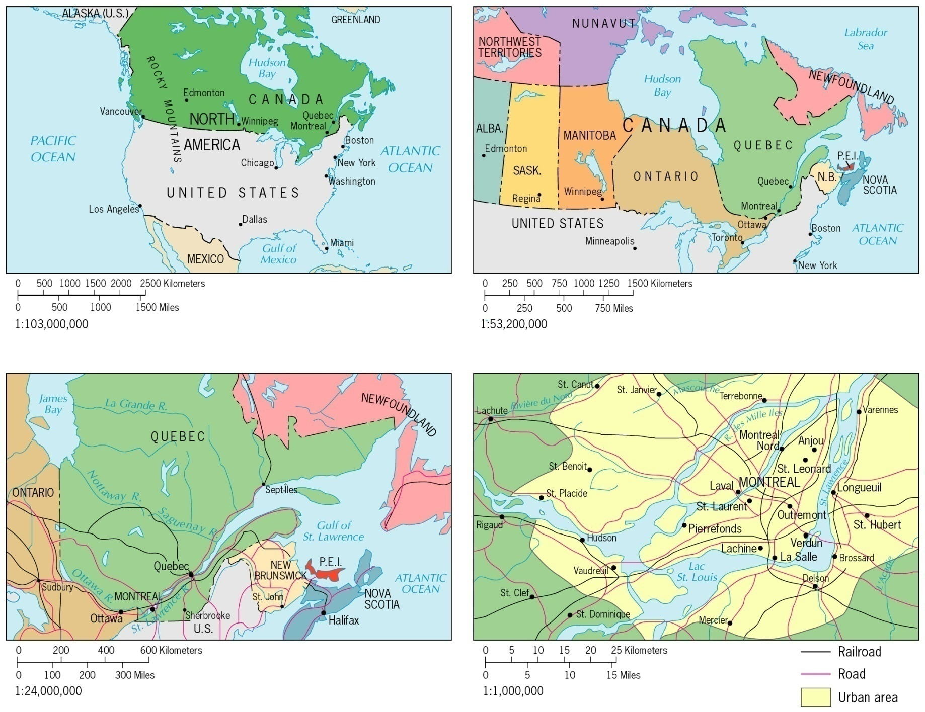
Notes:
A typical textbook illustration showing how maps vary in scale, in the proportion of the earth’s surface they are able to show on a single page. What two different methods are used to portray scale on these maps? But only one of the two methods of portraying scale on these maps is accurate – the graphic scale.

Slide 33
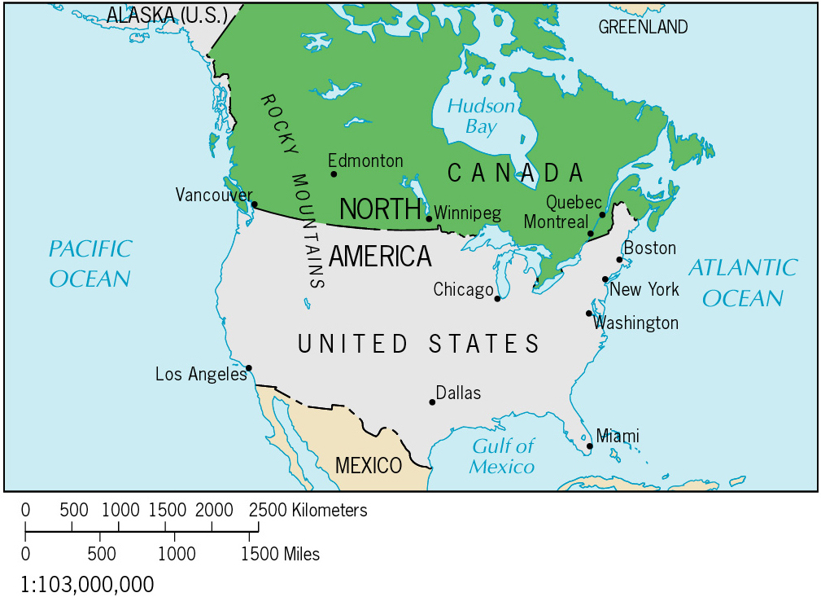

Notes:
Would you agree that the same map is shown at two different scales? If so, the fractional scale on each map cannot be correct for both maps. In fact, it is correct for neither (it was correct for the size of the map that appeared in the text which carried this illustration.)

Slide 34
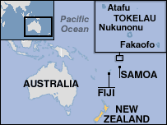
Scale: One of the “map essentials”!
Notes:
What is missing? Any reference to map scale. Here are three maps in one – all produced at a different scale. Yet, a scale is shown on none of them.

Slide 35

When scale is not shown on a map – Beware!
Notes:
An advertisement (Conde Nast Traveler) from 2007. When scale is not shown on a map – beware! On this map, Peru has clipped off Alaska so as not to show the Pacific Ocean at scale. The Japanese are wealthy enough to be world tourists (and they have historical connections with Peru). Their trip across the Pacific to Peru seems only as long as Europeans’ trip across the Atlantic.

Slide 36
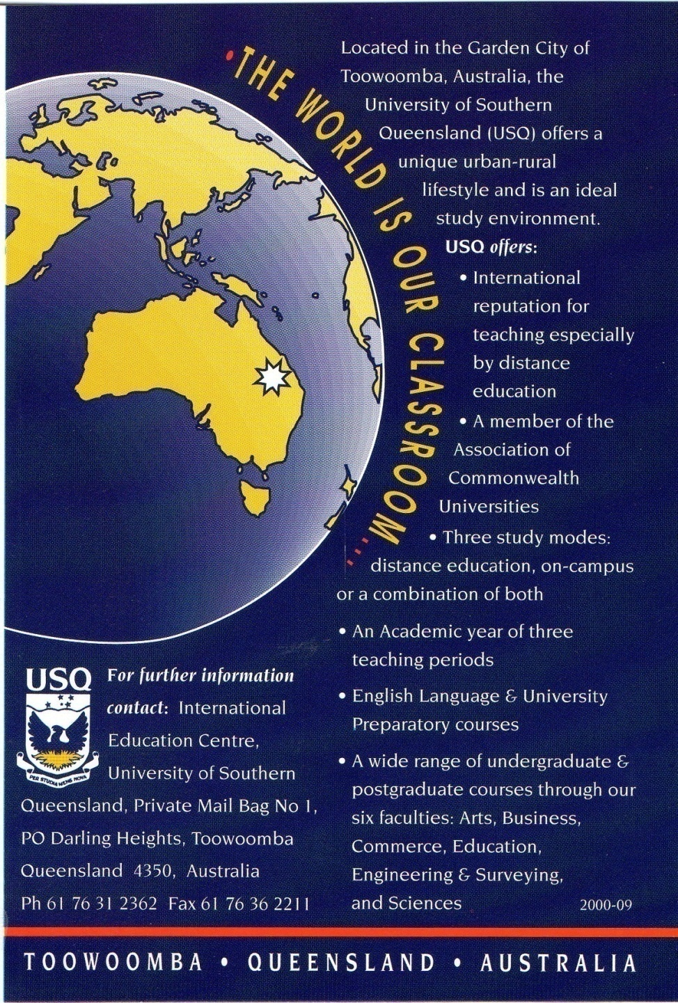
Notes:
Advertisement 2004

Slide 37
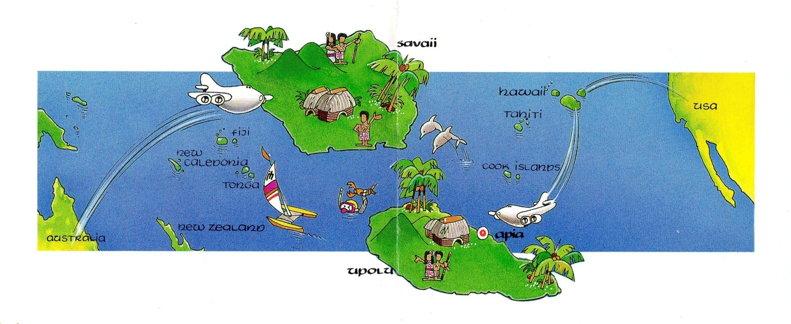
Notes:
“Western Samoa The Cradle of Polynesia 1995” How could there be a reference to scale on this map. Samoa is made to look larger than the USA. There are other problems, too: directional relationships are not true.

Slide 38
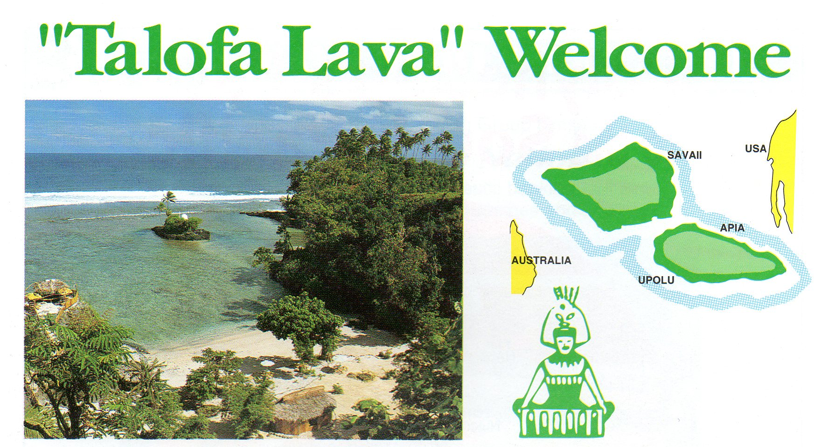
Notes:
“Western Samoa The Heart of Polynesia 1995” A pattern develops, “lieing with scale” (“lieing with maps”) is something that all small island nations do. Here is the second example from Western Samoa.

Slide 39
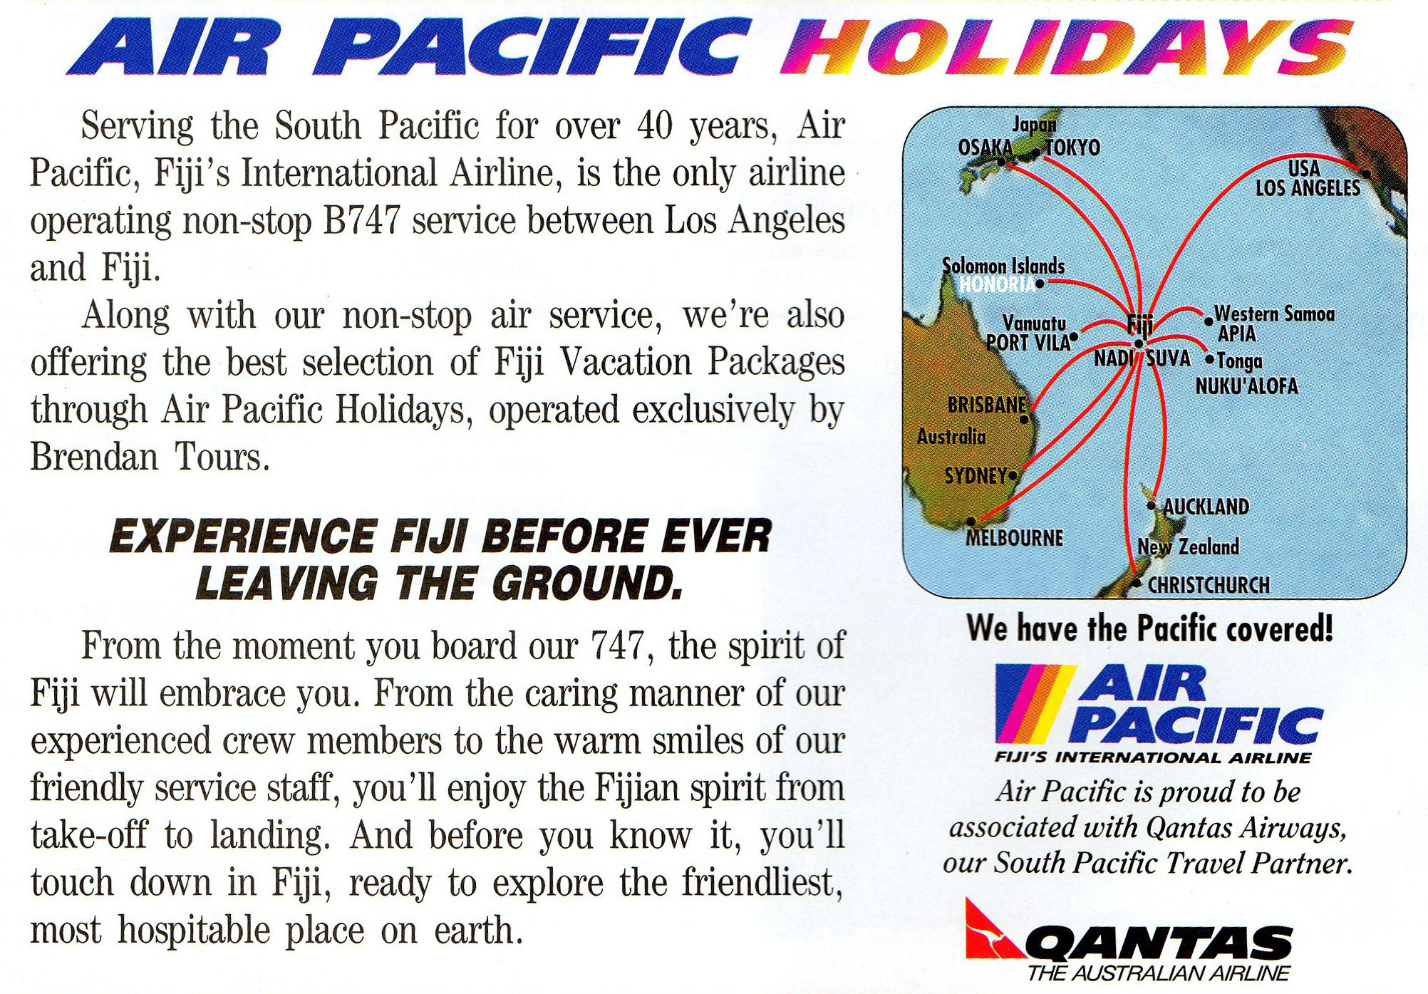
Notes:
“The Fiji Islands” 1996 travel brochure. Not just Samoa distorts scale to increase its gravity on the world travel map, so does Fiji (in this case, the companies that serve Fiji’s tourist market).

Slide 40
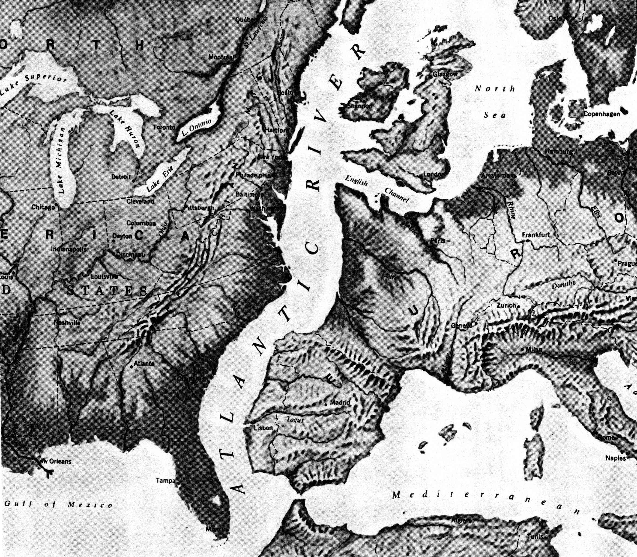
Notes:
Did we drift off into plate tectonic theory? What scale has been used to show the Atlantic Ocean?

Slide 41
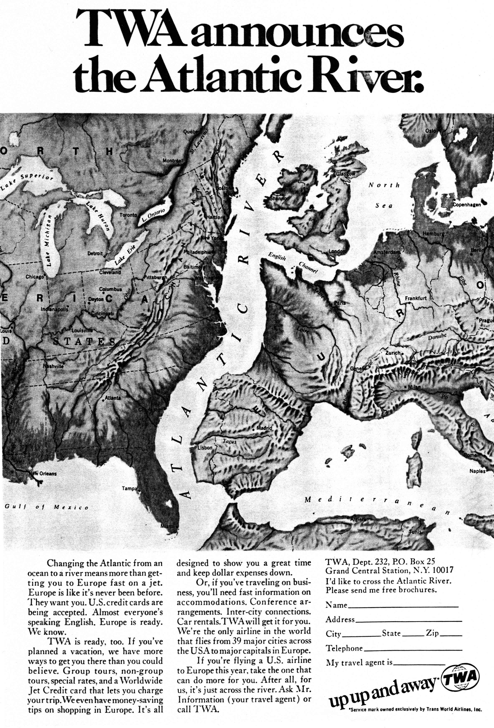
Notes:
National Geographic magazine, 1968. A good example of what happens to scale under the influence of time-space compression. Here we literally see compression on the map.

Slide 42
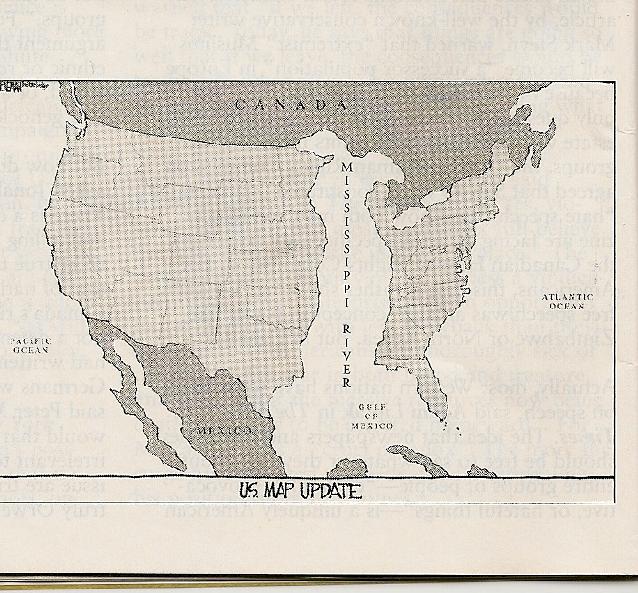
The Week Magazine, July 4-11, 2008

Slide 43
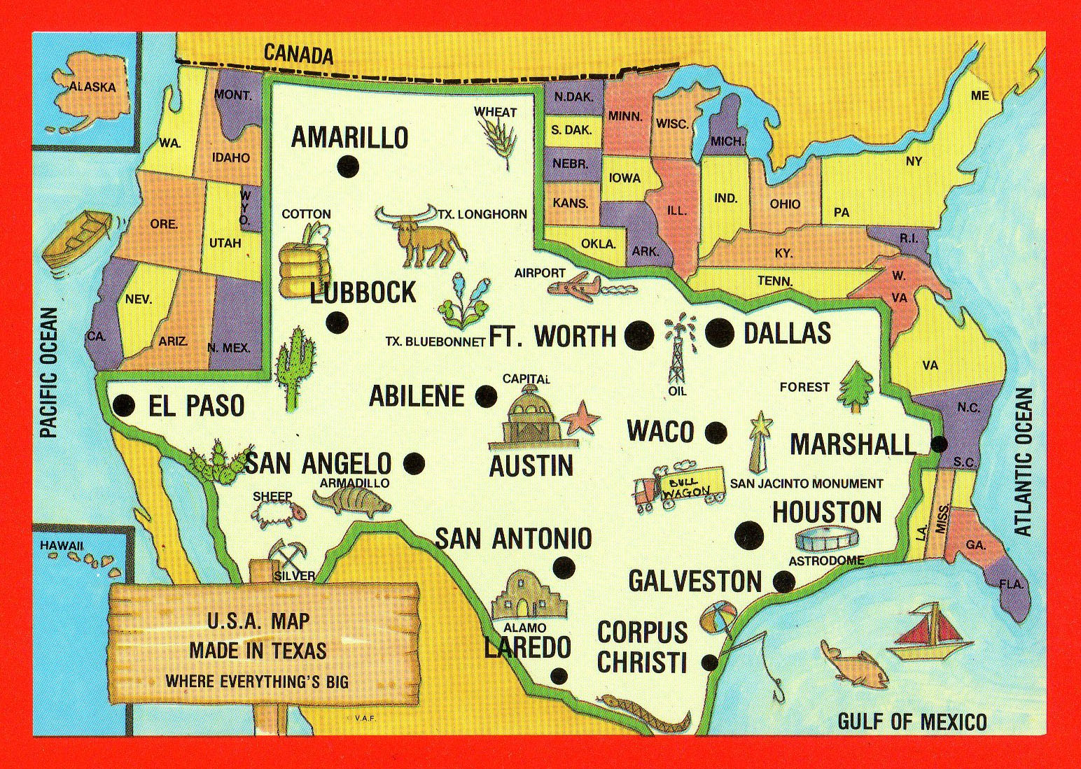
Notes:
Maps are often used to change perceptions. What is the scale of this map of the U.S.? What do we mean by perceptual scale? An entire genre of postcards is built around scale manipulations.

Slide 44
These mushroom spores are too small to see, so we put them under a MICROSCOPE.
When we can see them, we can study them.
Notes:
How do we bring things that are too small up to a size that we can see and comprehend? We enlarge them with a microscope

Slide 45
This planet is too big to see,
so we put it under a MACROSCOPE.
When we can see it, we can study it.
Notes:
What is the problem that all geographers face? We study things that are too large for us to understand, so we need to put them under a macroscope.

Slide 46
“Some things are very tiny, and we must use complex electric and optical means (e.g., a microscope) to enlarge them so as to understand their configuration and structural relationships. In contrast, geographical things are so extensive that we must somehow reduce them to bring them into view.”
- Arthur Robinson, cartographer
Notes:
Microscope vs. macroscope. Arthur Robinson was among the foremost American cartographers of his age (born in 1915 and died in 2004). In this quote, he captures the diea of scale as meta-concept.

Slide 47
We need to use our . . .
MAPS as MACROSCOPES. . .
to help us think critically about problems and “problem spots” on the world stage.
Notes:
We should put problem spots on the world stage under macroscopes that show them at various scales.

Slide 48
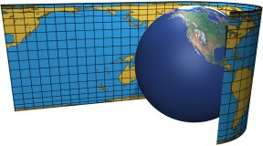
Cartographer’s 2 Big Questions Cont’
2. Projection
The Scientific method for transferring 3D locations on the Earth’s surface into a flat map (Could this be perfect?)
Creates Distortion
Shape: can appear elongated or squat in comparison to reality
Distance: may be increased or decreased
Relative Size: One area may appear larger than another even if it is usually smaller
Direction: from one place to another can be off

Slide 49
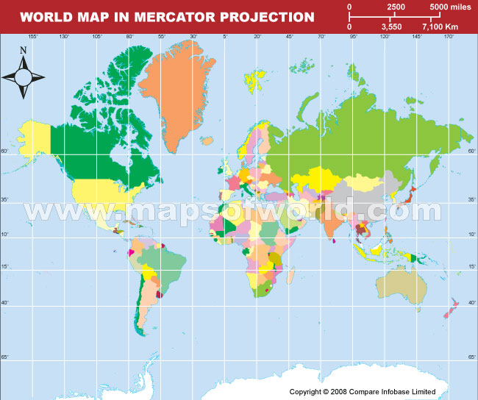
Two Types of Projection
Mercator Projection
Created during Age of Exploration
Direction was most important so often skewed or “distorted” size
Follows constant lines of a compass
What could be some problems with this?

Slide 50
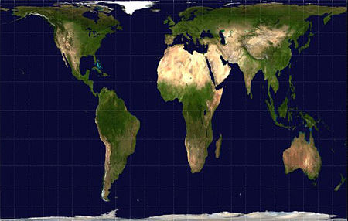
Types of Projection Cont’
Equal Area Projection: True to the shape and size of continents but distorts distance and direction

Slide 51
Warm Up
Would a large scale or a small scale map be more appropriate to view global religious patterns?
What type of distortions are found on a map with Mercator Projection? Equal Area Projection? Which is more preferred today and why?
From where does GIS gather its statistical, demographic information? What does the GIS do with this information to show relationships?
By which other high tech method we discussed, would GIS gather its “Where” information?

Slide 52
Upgrade!
Contemporary Mapping Tools

Slide 53
Geographic Information Systems
Computer system that capture, store, query, analyze, and display geographic data.
Use Geocoding: mathematically calculated the precise position of someone on the Earth and then storing that info in a computer
Creates more accurate maps (less mistakes then pen and paper)
Layering Information: outlines of countries, climates, vegetation, urbanization
Thus comparing this information in a certain location for significant or only coincidental relationships

Slide 54
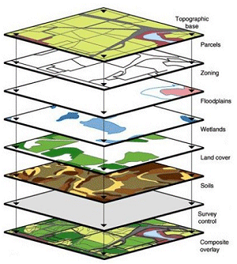

Slide 55

Remote Sensing
Acquiring information about the Earth’s surface from a satellite or other long-range method
Google Earth!
WEATHER!

Slide 56
GPS
Global Positioning System: accurately determines the precise location of something on the Earth.
24 Satellites emitting complex radio codes
Stations monitor and control the satellites
Receivers: compute position, velocity, and time from the satellites
Used for Planes, Boats, and Motor Vehicles because Satellites know these objects precise location

Slide 57
Reading
Read the article Every Step you Take, Every Move You Make
Ponder the following Questions and jot your notes on a piece of paper
We will then debate the concept
What do you believe the positives and negatives are to GPS and GIS?
What are your personal feelings regarding tagging children?
Would it depend on the age or situation?
Is there a time or instance where it may be beneficial to tag anyone?

Slide 58
Debate
Raise your hand if you think there is any instance when it is beneficial to tag anyone
Splitting sides
Each side come up with 3 arguments supporting your side (5 minutes)
Note your arguments should consider the other questions: positives and negatives of GPS/GIS, feelings towards tagging children: age, situation, etc)
Choose a spokesperson to deliver your message (in your first delivery you may not comment on the other person’s side)
After delivery, your side will have 3 minutes to create a rebuttal against the others arguments
Choose a new spokesperson of the opposite sex
Deliver your message
Sides will have 2 minutes to come up with final statements and pick a 3rd person to deliver the final word

Slide 59
Mindsets of Human Geography
Does the environment determine the success of humans or do humans manipulate the environment to suit themselves?

Slide 60
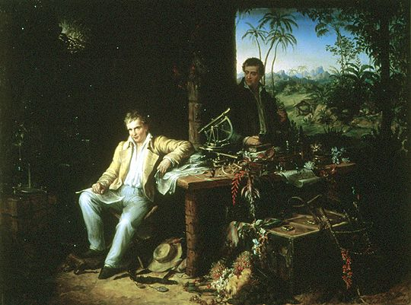
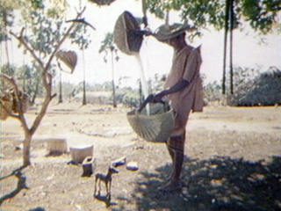
1. Environmental Determinism
Proposed in the 19th Century (Humbolt)
Ellsworth Huntington
Claims that the temperate climate of Europe lead to greater human efficiency and standards of living
Began dealing with the concept of cultural ecology:
Geographic study of human-
environmental interactions
States that physical environments shape even DICTATE culture
What could be some problems with this idea?

Slide 61

2. Possiblism
Vidal De La Blache
Environment limits human actions but people can ADJUST to their environment
Examples?
Takes into account modern technologies effects…like?
We’re Tool Makers!!! Air conditioning, tractors, plows, irrigation, etc.

Slide 62

Other examples of Possibilism
Population grows too big:
Political controls, technology, migration
Lawn maintenance:
Why do we plant grass in the front yard, mow it, and fine those that?
Well, what do you think?

Slide 63


5 Themes of geography
Movement
Regions
Location
Human-Environmental Interaction
Place
Mr. Lip

Slide 64
Thinking Geographically Activity
I will randomly pass out a picture with a short description of a site in the world from the book: 1000 Places to See Before You Die
As we look through the 5 themes of geography, on a separate sheet of paper, analyze your picture for each of the 5 themes.

Slide 65
1. Location
Where is it located?
Relative Location: Where it is located relative to other “places” or things…such as other cities, physical characteristics, etc.
Absolute Location: Its location defined by latitude and longitude

Slide 66
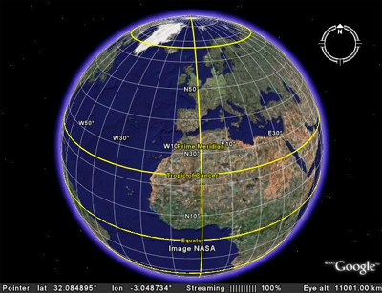
Absolute Location (in depth)
Precise Location of a place using meridians and parallels (The World’s imaginary grid system)
Parallels run: East and West AKA Latitude
0° Called: Equator

Slide 67
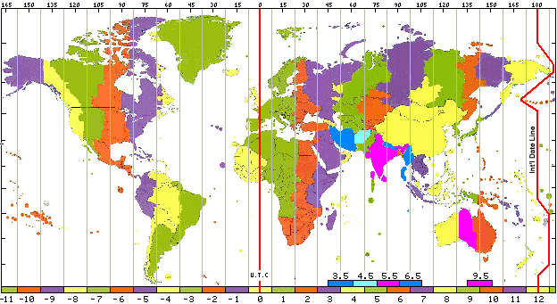
Absolute Location Cont’
Meridians run: North and South AKA Longitude
0° Called: Prime Meridian (crosses Royal Observatory in Greenwich, England
Calculates Time: Every 15° time gains or loses an hour from Greenwich Mean Time (history)
International Date Line: about 180° Longitude: heading towards the US go back a day, towards Europe go forward a day

Slide 68
On your 5 Themes of Geography Sheet…make a chart in your notes
Location: What is the absolute location of your picture? Tonight, find the absolute location of the country of your place.
Relative Location: is it S, SE, SW, N, NE, NW, E, or W of Hiram, GA

Slide 69
2. PLACE!
What makes a location unique?
What is it like in terms of physical and human characteristics?
These make people have a strong sense and bond to a specific location

Slide 70
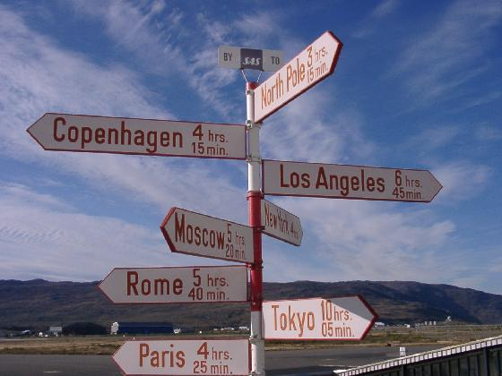

Slide 71
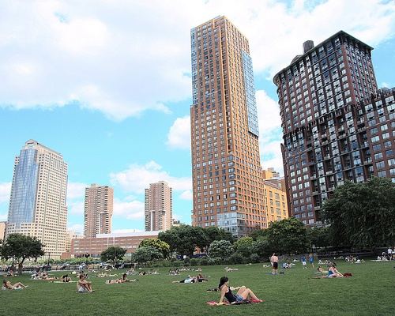
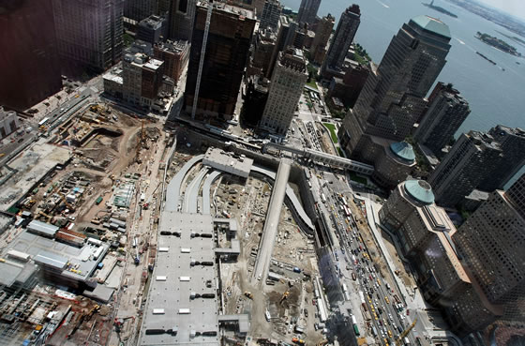
Site
Describes location by a physical character of a place
Includes
Climate, water sources, topography, soil, vegetation, latitude, and elevation
Humans manipulate site
Ex Manhattan Island, NY

Slide 72
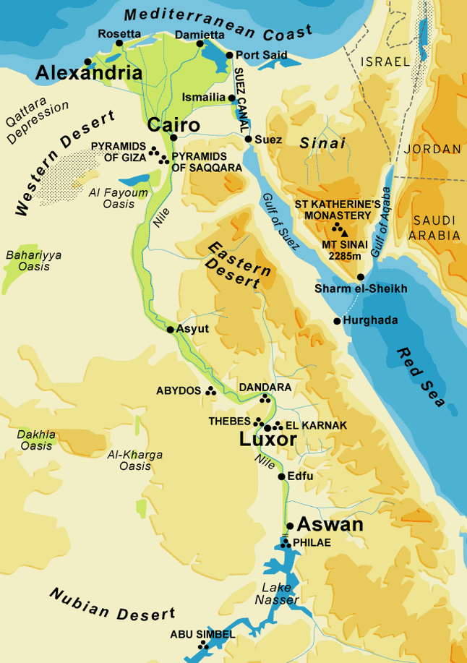
Situation
The Location of one place relative to another place
Where is the library?
Why would this be helpful?
Use what you know…
Can understand the importance of a place

Slide 73

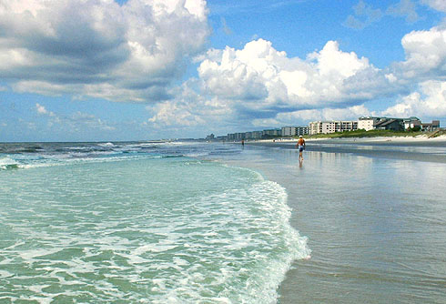
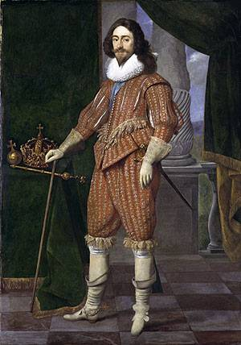
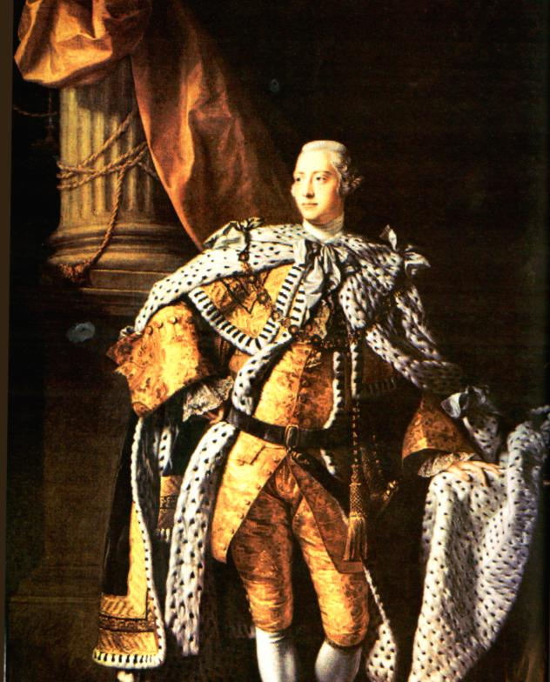
Place Names
Easiest way to describe a particular location
Toponym: name given to a place on Earth
Names reflect the thoughts, feelings, needs, experiences, physical features, or history of the town and/or its inhabitants

Slide 74
Ex: Lucky Boy Pass, Nevada (successful gold miners)
Massacre Lake (unsuccessful miners),
The Hague, Netherlands (The Prince’s Forest),
Truth and Consequence, NM (Named after a Radio and TV show),
Jenkinjones, WV (famous mine operator),
Leningrad to St. Petersburg, Russia (after communism fell)
Longest town name in the world: Llanfairpwllgwymgyllgogerychwyrndrobwllllantysiliogogogoch:
the church of St. Mary’s in the grove of he white hazelnut tree near the rapid whirlpool and the Church of St. Tisilio near the red cave
Longest name in the US: Lake Chargoggagoggmanchauggagoggchaubunagungamaugg,
Mass Fishing Place at the Boundaries -- Neutral Meeting Grounds

Slide 75
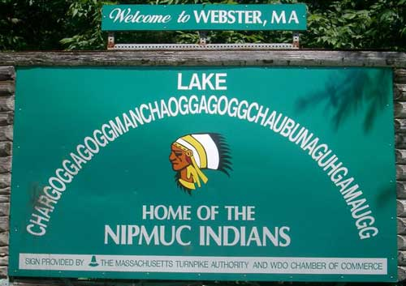





Slide 76
On your 5 Themes of Geography chart
Place: Indicate the Toponym of your location by writing Toponym next to the title (where the name of the location is on your paper)
Describe the Site in 2 sentences

Slide 77

3. Movement

Slide 78

Looks at where things are located in “space” and why and how they got there

Slide 79

Distribution
The arrangement of a feature in space
3 main properties: density, concentration, and pattern

Slide 80

Density
The frequency with which something occurs in space
Ex: people, homes, cars, volcanoes, ANYTHING
Arithmetic Density: total number of objects in an area
Physiological Density: number of people compared to arable land
Agricultural Density: number of farmers per unit of farmland

Slide 81









Slide 82

Concentration
The extent to which a feature is spread over space
Objects in an area are close together: Clustered
Far apart: Dispersed
Ex. NFL

Slide 83

Original Professional Football Teams

Slide 84

Has the Density Increased?
How has the concentration changed?

Slide 85
Critical Thinking
According to the last two maps, what has happened to the population of people in order to facilitate this growth?
Where is the population more clustered?
Where is it dispersed?
What historically would account for this?

Slide 86

Pattern
Geometric arrangement of objects in space
Ex: Linear patterns: houses along a street
Squared or Rectangular patterns: Gridded streets (Charleston, SC); Land Ordinance of 1785

Slide 87

US Land Ordinance of 1785
Divided much of the West into townships to facilitate the sale of land to settlers.
Townships were 6 sq miles
Naming and Locating Townships
Some N, S Lines separating townships
were called principal meridians
Some E,W Lines separating townships
were called base lines
These Lines are used for reference, so
Townships in the first row north of a baseline called T1N (Township 1 North)
Then the town has a second name related to its Principal Meridian, (range) so towns one row east of the Principal Meridian called R 1 E

Slide 88



Slide 89
Gender and Ethnic Diversity In Space
Patterns are affected by Gender and Ethnicity
Patterns of travel by Gender
Space allocated to “male” or “female” activities
What does this say about cultural expectations of each gender?
Patterns of housing related to ethnicity
Why do we find patterns based on ethnicity?
Reason: Cultural Identity: IMPORTANT factor in determining where we live and go

Slide 90

Sunni and Shia neighborhoods in Iraq

Slide 91
Warm Up: Critical Thinking
What is the difference between physiological and arithmetic densities?
Where is the population more clustered?
Where is it dispersed?
What historically would account for this?

Slide 92

Space-Time Compression
Distance Decay Theory:
Absence doesn’t make the heart grow fonder
Contact decreases and eventually disappears with distance
Is this as prevalent as before? Why?
Space-Time Compression: the reduction in the time it takes for something to reach another place

Slide 93


Spatial Interaction
Technology: travel quick, information instantaneous
Networks: chains of communication that connect places
Creates spatial interactions
Ex: Broadcasting Networks :ABC, CBS, NBC, FOX, etc. (hundreds of stations broadcasting the same programs simultaneously)
Transportation Networks: Hub and Spokes system (major hub airports connecting to smaller spoke airports)

Slide 94

Diffusion
Diffusion: process by which a characteristic spreads across space from one place to another over time (This is the movement)
Hearth: (node) place where an innovation originates
What is necessary to be a hearth?
May form simultaneously in 2 places (Domestication of plants and animals)
Same concept may form differently in 2 places (pyramids)
2 types of Diffusion

Slide 95

1. Relocation Diffusion
Relocation Diffusion: spread of an idea due to the people physically moving
Ex. Rapid spread of AIDS since the early 80’s
Focal points: California, New York, Florida Why these places?
Spread to all 50 States by early 90’s
Rapid decline since mid 90’s (example of the other type of Diffusion)
These goldfish are relocating to another fish bowl and are taking their culture with them.

Slide 96


2. Expansion Diffusion
Spread of a feature from one place to another in a snowballing effect (Since we are in the south this needs further explanation)
3 Processes of Expansion Diffusion:
Hierarchical
Contagious
Stimulus

Slide 97

1. Hierarchical Diffusion
Spread of an idea from a person or place of authority to other people or places
Ex: MOST POPULAR: Larger cities to smaller area, political leaders, social elites,

Slide 98


2. Contagious Diffusion
Widespread diffusion of a characteristic rapidly throughout the population
Ex: AIDS prevention methods, WEB Videos

Slide 99

3. Stimulus Diffusion
Spread of an underlying principal when a characteristic fails to diffuse
Ex:McDonald’s spread to India; however, Indian Hindus do not eat beef. Indian McDonald’s serve veggie burgers, which is culturally acceptable. The idea (McDonald’s burgers) was acceptable, but not in its original form – hence stimulus diffusion.

Slide 100

Local - Global
Local Scale: unique features represented (residential areas, religious temples, etc)
Global Scale: broad patterns (population growth, concentrations of religious groups)

Slide 101


Slide 102
Interconnectivity Activity – Warm up
By looking at the tags on your clothing, bags, purses, or the labels on your cell phones/ipods (THE ONLY TIME YOU MAY HAVE THEM OUT IN THIS CLASS!).. And those of your class mates, find 15 different countries from at least 8 different people that are represented
Locate, Label, and color those countries with a different color
Answer the other questions that accompany the sheet

Slide 103

Globalization of Economy
Globalization: a force or process that makes a local concept become a global phenomenon
Human activities occur in multiple locations
“Scale” of the world is shrinking
World more uniform, integrated and interdependent
Crop Selection dependent of demand in global markets

Slide 104


Slide 105

Globalization of Economy Cont’
Transnational Corporations (multinational corporations): research, factories, and markets found in multiple countries
Technology: easily transfer money and products
Use the economic asset of each place
(education, labor, resources)
Example: Apple iphone
Concepts developed in California (Better
education labor)
Parts processed all over world dependent on
resources
Phone assembled in China: cheap labor

Slide 106
Transnational Corporations
The U.S. is home to many multinational corporations:
Nike, Adidas
Starbucks
Wal-Mart
McDonald’s, Burger King, KFC
Hilton

Slide 107


Slide 108


Slide 109

Years and countries where McDonald’s opened.

Slide 110

Globalization of Economy Cont’
Effects
Increased Economic Difference
Regional Division of Labor: different areas specialize in different tasks depending on labor force, wages, and unionization
Leads to economic disparity (factories close in some areas, other areas grow into commercial centers)

Slide 111


Slide 112

Globalization of Culture
Corporations
Create uniform “global” landscapes
Meaning: places have similar cultural values

Slide 113


Globalization of Culture Cont’
Threatens the survival of local traditions
Religion: Africa turns away from local cultures for Islam and Christianity
Language: English dominating for business etc.

Slide 114

Opposing Effects of Globalization
2 options:
Awareness and Acceptance of Cultural Diversity
More access to diverse ways of life and products
Or Spread Intolerance and Hate
Violently holding onto traditions or forcing change...ex?

Slide 115



Diffusion of Culture and Economy Example:
3 Economic Hearth Regions: (Core Areas)North America (NY), Western Europe (London) , and Japan (Tokyo)
What do these cities have?
Advanced Technology, capital, and purchasing wealth

Slide 116

Example Cont’
What type of diffusion causes the spread of Culture and Economic Practices?
Hierarchical Diffusion:
Core areas diffused production to periphery (Africa, Asia, Latin America)
Caused Uneven Development between core and periphery as a result of globalization
Knowledge of communication systems widespread! BUT...wealth to purchase them is not

Slide 117
On your 5 Themes of Geography Sheet
Movement: In 2-4sentences explain how one or more of the following may have impacted your picture:
Distribution: Describe the population concentration of your place. In 1 sentences explain whether it seems the population is clustered (like a city) or dispersed (like a rural area).
Diffusion (Do you see any types of diffusion represented)
Globalization (Any cultural or economic influences present)

Slide 118
Warm Up Activity
Thinking of teachers, students, each groups needs, thoughts, and the layout of the school. Describe how you could break the school into the 3 types of regions: Formal, Functional, and Vernacular.

Slide 119
4. Regions
Historians break their information into periods, Geographers into Regions

Slide 120



Slide 121

Cultural Landscape
Unifying characteristic of a region: a combination of cultural features (language, religion, economy) and physical features (climate, vegetation) that make an area of land unique
Who founded the regional studies approach?
Vidal de la Blanche
People’s activities and environment have similarities that differ from other regions
Who changes the earth’s surface?

Slide 122


Functional Region
Economic regions
“Nodal Region”: organized around a “node” or focal point – serves a function
Focal point dominant at the center and less important outward
Ex: Shop/service and its trading/selling circle (newspaper)
How might technology be breaking this definition down?

Slide 123

Formal Region
Uniform region/homogenous region
Everyone shares in one or more distinctive characteristics (physically connected!)
What would be the most understood example of a formal region?
Variations in religion or level of economic development

Slide 124

Physical Processes Defining Regions
Climate: Long-term average weather condition at a particular location
Shows general agricultural production and population distributions)
Use the Köppen System: 5 major climates, sub climates based on precipitation
A Tropical
B Dry
C Warm Mid-Latitude
D Cold Mid-Latitude
E Polar

Slide 125

Name your places Formal Region from this Map

Slide 126




Another Ex. of a Formal Region
Physical Definitions of regions
Vegetation
4 Biomes (Plant Communities)
Forest
Savanna
Grassland
Desert
Unless you are insane
you will never think you
are apart of a tropical
region when you live
in the desert!

Slide 127


Slide 128

Vernacular Region
Perceptual Region
A place people believe exists because of their cultural identity
Not necessarily physically connected….Just emotionally

Slide 129
Difference? What type of regions?

Slide 130

Regional Integration of Culture
Why regions are distinct: CULTURE:
Body of customary beliefs, material traits, and social forms that together constitute the distinct tradition of a group of people
Layman’s terms: Your learned behavior
Look at: cultural characteristics, the distribution of cultures, and offer reasons why they are distributed as such

Slide 131

Non-material Culture
Customs, beliefs, values, especially LANGUAGE, RELIGION, and ETHNICITY create a particular culture in a particular place…can be graphically shown on a map

Slide 132


Slide 133


Slide 134
Mental Mapping
Activity Draw a Mental Map of the School: (draw the inside of the school as you see it in your head.)5 minutes!
Write down the name of the first room/feature you drew.
How do you think the mental map would differ if one of the following drew it: Mrs. Moneta, Mrs. Sanders the secretary, or Mr. McQueen an administrator?

Slide 135

Material culture
People’s material wealth, economic distribution of wealth, political institutions, tangible representations of culture
These leave a physical mark on the cultural landscape

Slide 136


Slide 137
5. Human Environmental Interaction
Looking at how we change and adapt to our physical environment

Slide 138
Two Categories of Geography
Physical Geography
Where and Why NATURAL forces occur
Human Geography
Where and Why HUMAN activities occur
NEITHER ARE EXCLUSIVE!!! Both impact each other

Slide 139

Example...
Hurricane Katrina

Slide 140








Slide 141








Gulf Oil Spill

Slide 142
Cultural Ecology!
What is cultural Ecology?
What 2 perspectives of geography fall into this category?
Environmental Determinism
Regionalism (Environmental Possibilism)

Slide 143





What would be some other examples of Cultural Ecology and our Human Environmental Interaction?

Slide 144

Spatial Association
Factors that are said to be related to each other because they occur at similar distributions (or in the same places)

Slide 145

Looking at the maps below, what can you say about the spatial association of Population density and poverty rate in Nicaragua?

Slide 146
On your 5 Themes of Geography Sheet
Human Environmental Interaction: In 2-3 sentences describe the cultural ecology of your picture

Slide 147
2,2, 2, AP Human Geography Quiz
Free Write: 20 minutes you may use your notes
IF YOU TALK, NO NOTES!
Discuss: What is geography and why, in your opinion, is it important to study? 2 paragraphs
In this activity I am looking for your use of the material we have covered: why geography developed as an academic discipline, including 2 real world examples, 2 themes of geography, and the 2 types of geography; as well as your ability to evaluate it for importance. Remember to explain your evaluations!

Slide 149
Yay No more Notes for Unit One...wait that means there’s a test...ehh

Slide 150
Latitude Longitude Practice
Complete the following sheet using your atlas. We will go over a few of the answers together before you begin working individually.

