Slide 1
Commodities,
Vertical Integration &
Transnational Corporations
Mr. Jenkins
AP Human Geography - 2014

Slide 2
Commodity - This refers to any product that is essentially undifferentiated. This means that there is no difference in the product regardless of which company you buy from. Milk is generally said to be a commodity. As long as the product meets the health guidelines for milk, there is really no difference between producers or sellers. Trade goods, goods -- (articles of commerce).
Oil/Petroleum Products
Coffee
Steel and Infrastructure
Gold
Wheat

Slide 3
Trade in Wheat
Wheat is the major food commodity in international trade
There are many production areas for wheat
The demand for wheat is great and because local supplies are not adequate
production areas have become specialized
Wheat is the ideal frontier crop. ie. Montana.

Slide 4
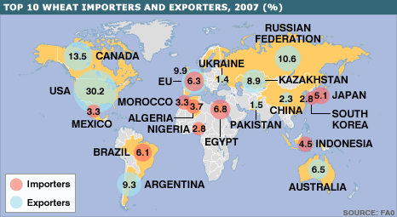

Slide 5
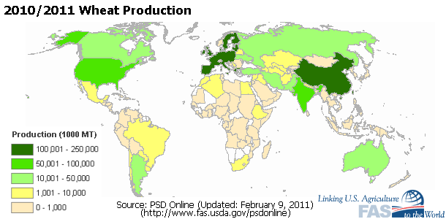

Slide 6
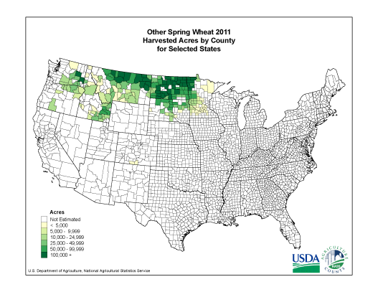

Slide 7
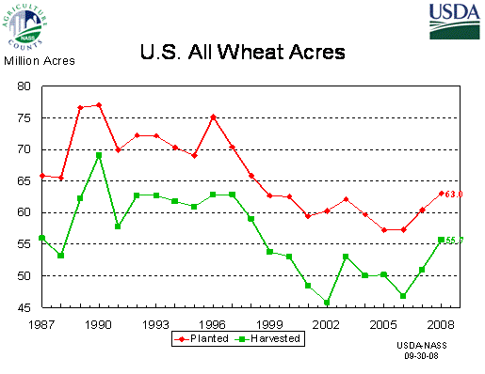

Slide 8
Maize or Corn
Like wheat, corn moves from a few production areas to a small number of consumption zones
Corn differs from wheat in that most of it is not consumed directly by humans
Many industrial uses of corn oil and sweeteners.

Slide 9
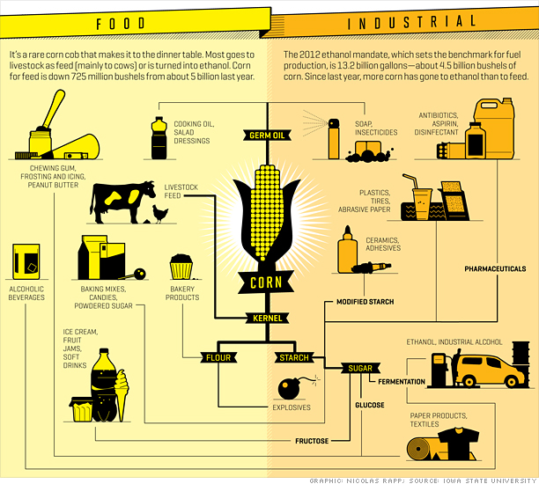

Slide 10
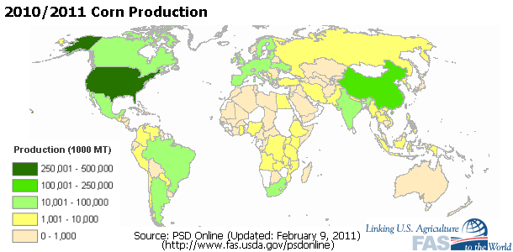

Slide 11
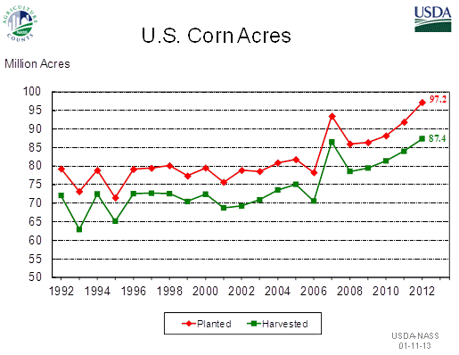

Slide 12
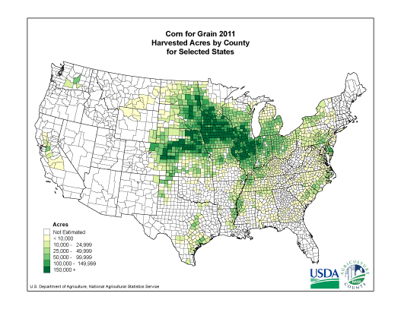

Slide 13
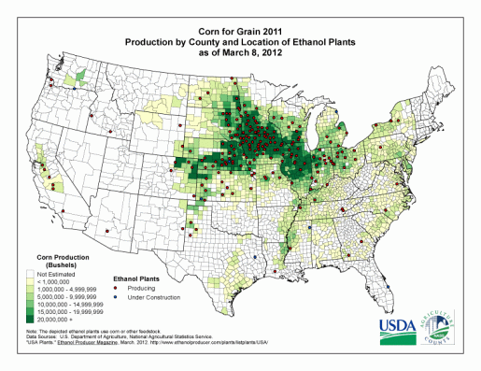

Slide 14
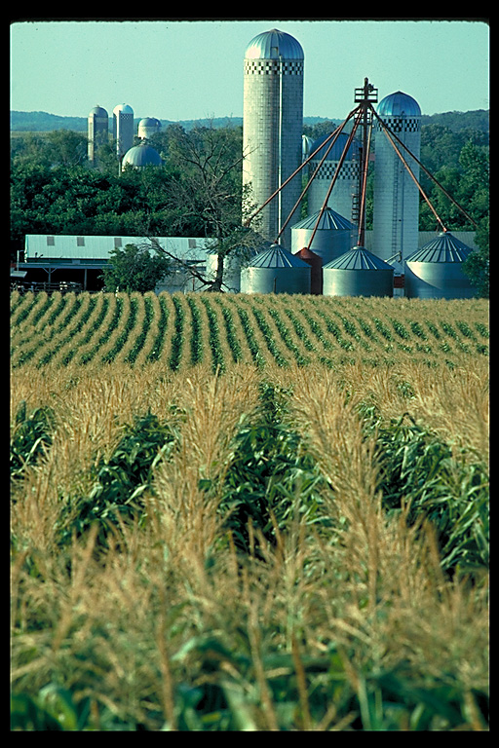

Slide 15
Rice
Third major crop in international trade
Major surpluses produced in East and Southeast Asia
Middle East a consumer of both wheat and rice.

Slide 16
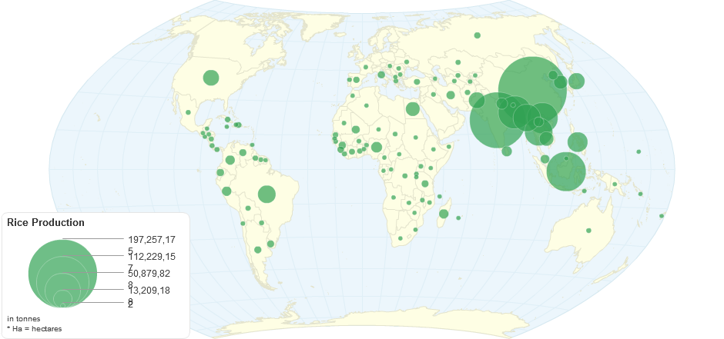
Worldwide Rice Production 2011
http://chartsbin.com/view/1009

Slide 17
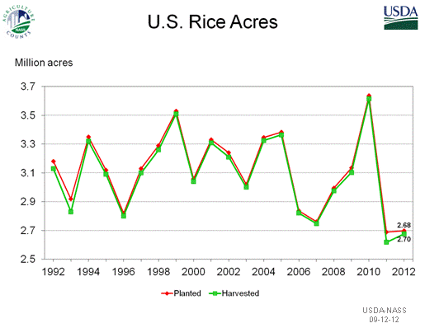

Slide 18
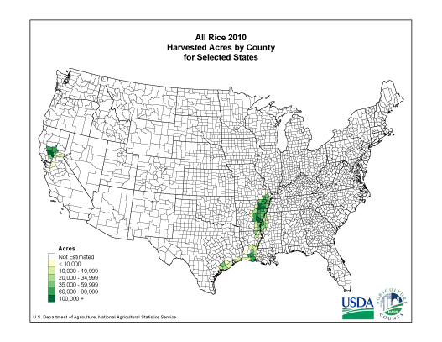

Slide 19
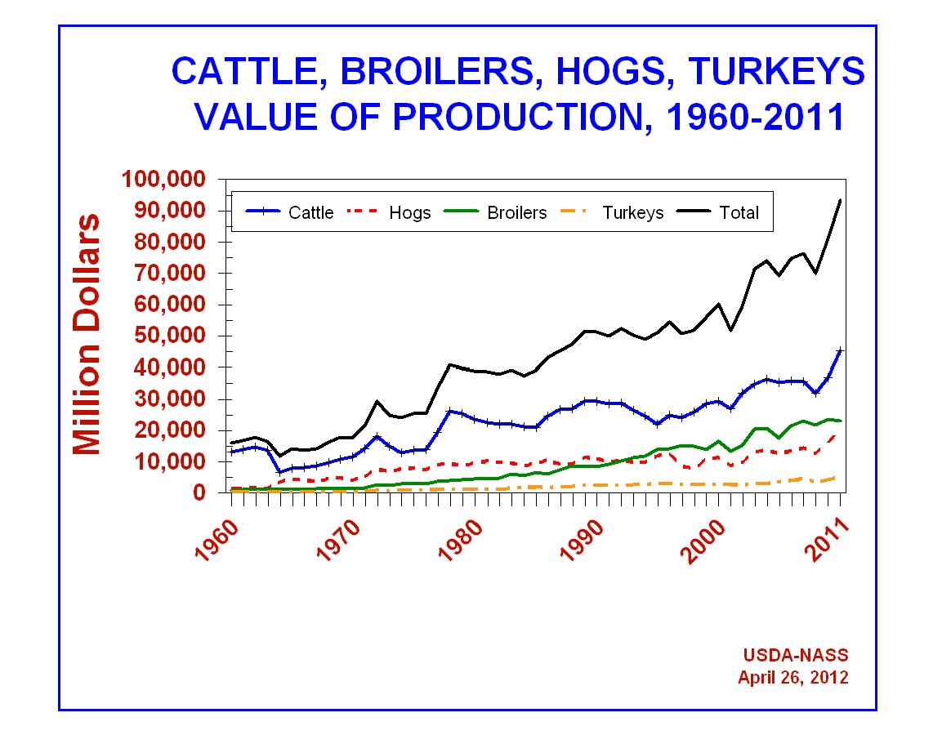

Slide 20
Geography of fowl
There are a huge number of birds raised for human consumption
Nearly all parts of the world produce poultry
The production of poultry in the United States is highly industrialized
The production in the United States is highly concentrated

Slide 21
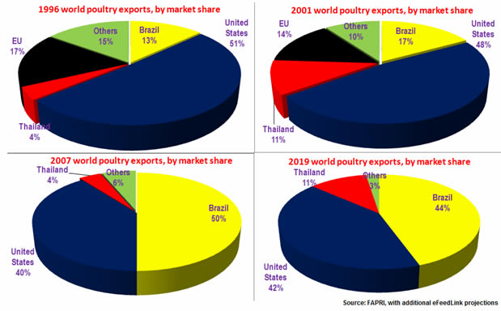
Global Poultry Exports

Slide 22
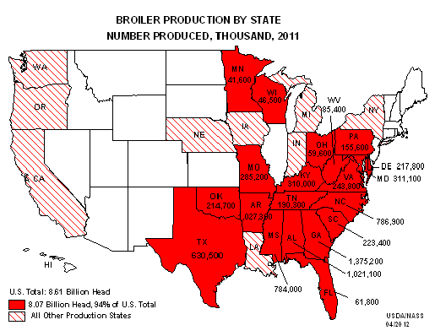

Slide 23
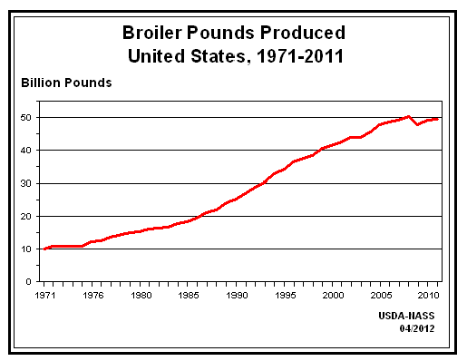

Slide 24
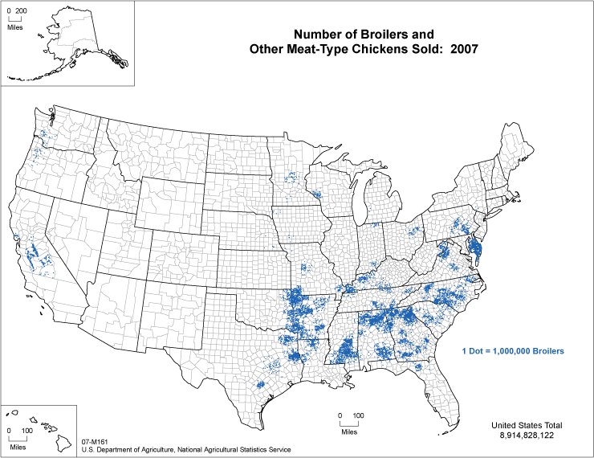

Slide 25
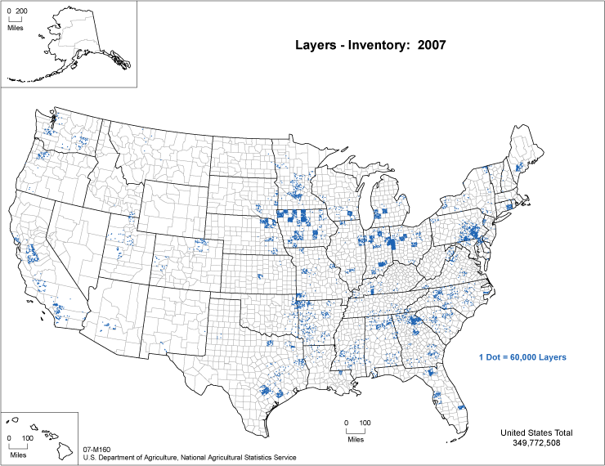

Slide 26
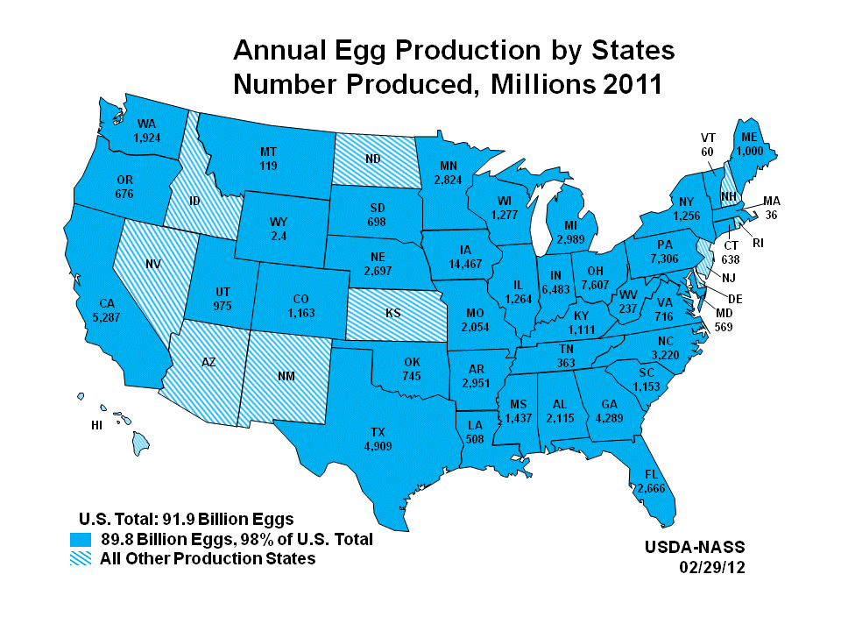

Slide 27
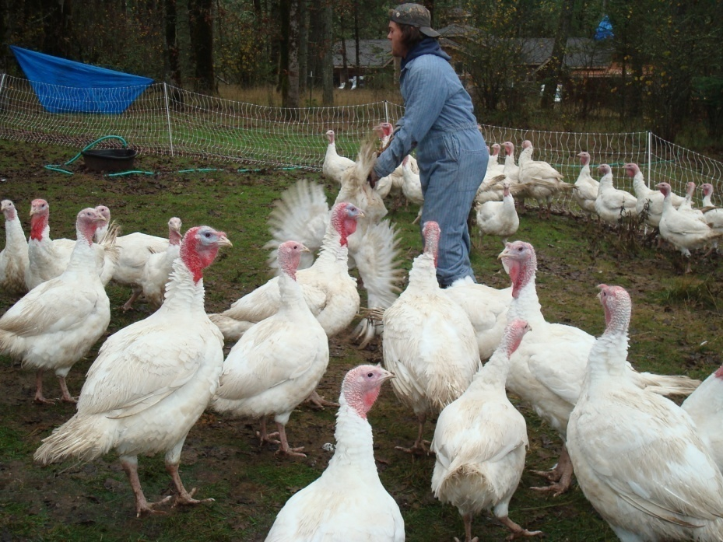
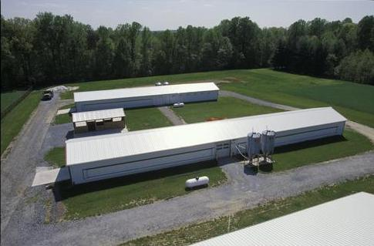
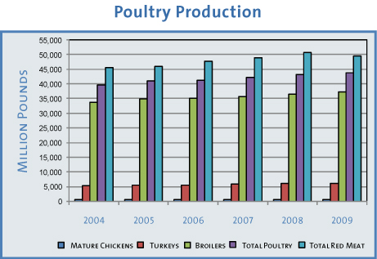

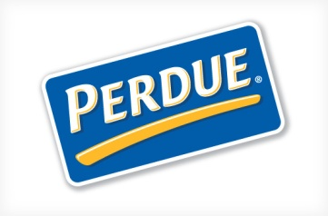
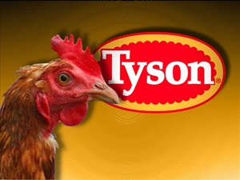
baltimoregon.com
mdchick.umd.edu
accuval.net

Slide 28
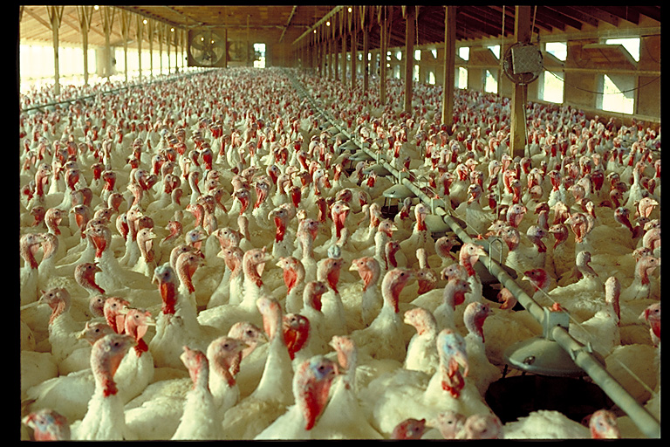

Slide 29
Geography of swine Pork Processing Hog Farm
The production of hogs is highly regionalized
There are great concentrations in Asia
Essentially no hog production in Islamic world
New centers of factory farms developing in United States in North Carolina and High Plains. Smithfield Foods.

Slide 30
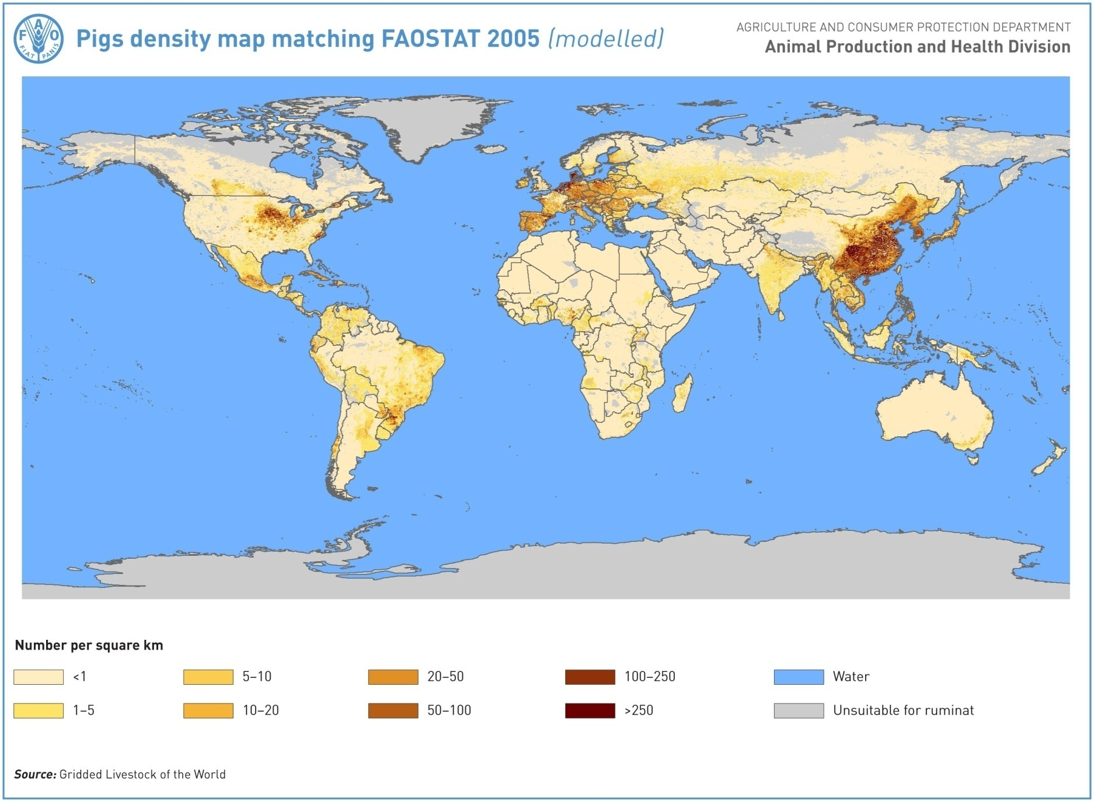

Slide 31
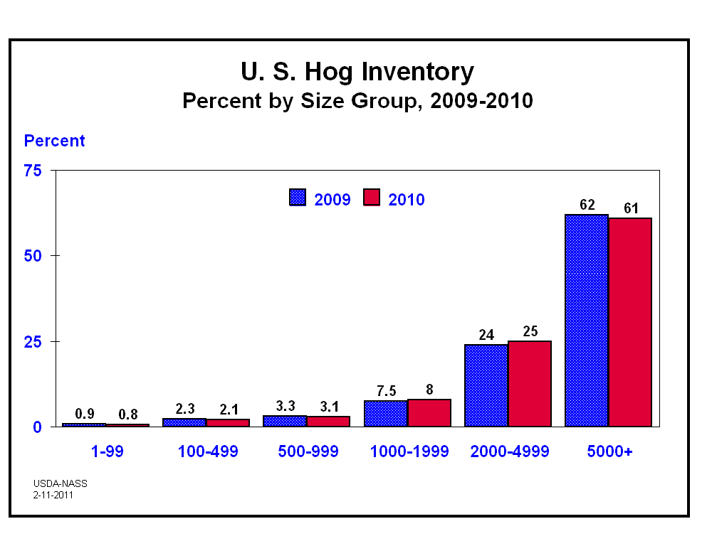

Slide 32
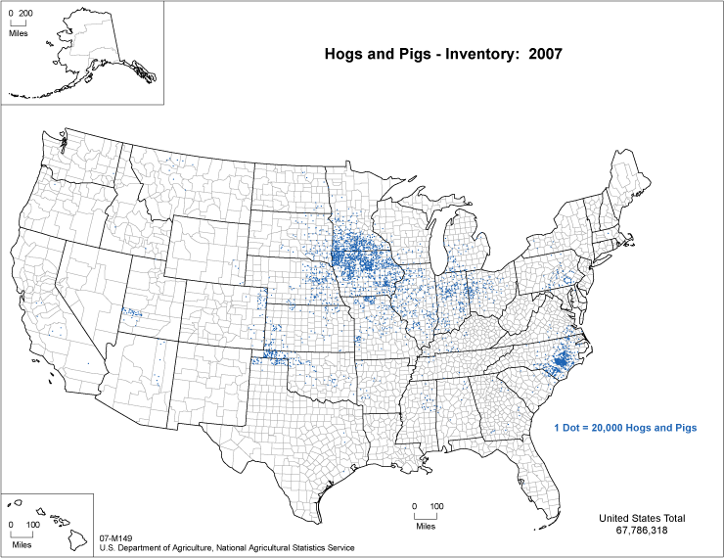

Slide 33
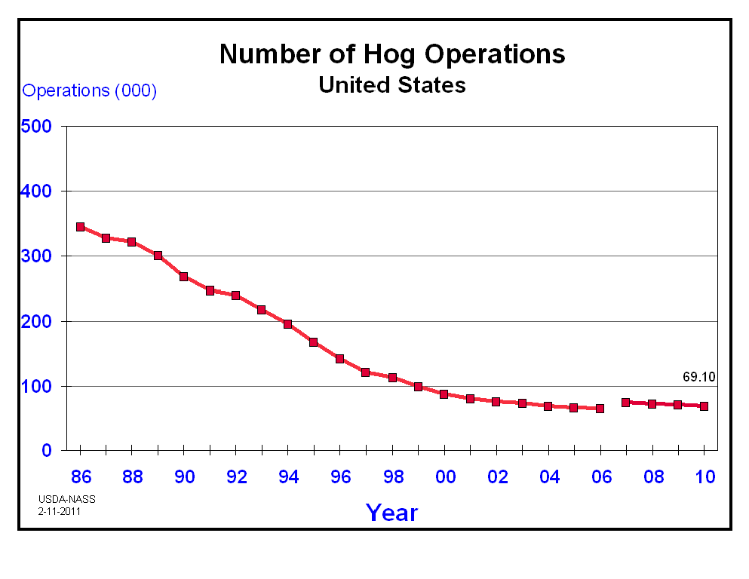

Slide 34
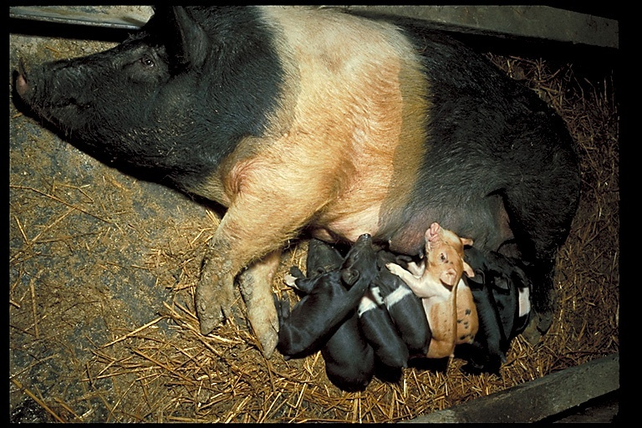

Slide 35
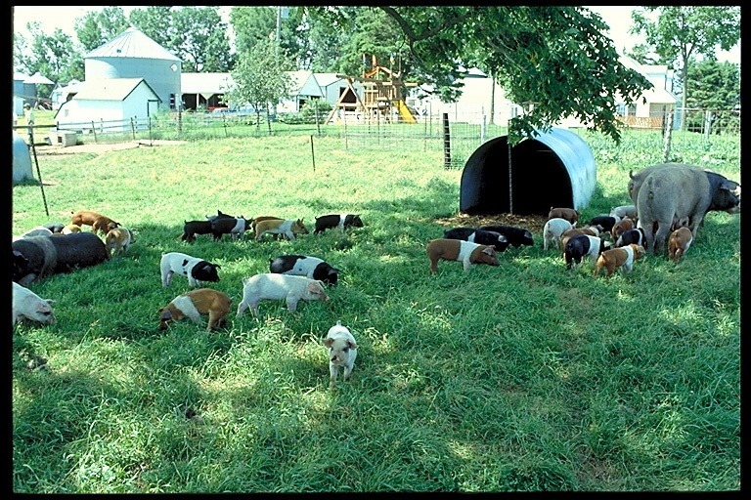

Slide 36
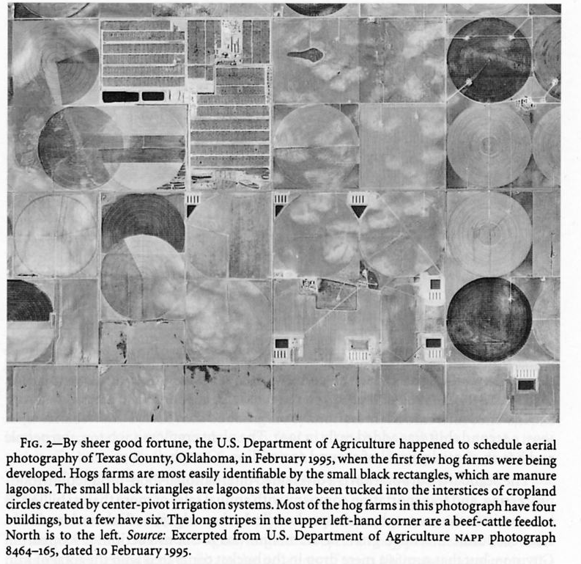

Slide 37
Geography of Cattle
Distribution of cattle highly regionalized
Concentration in India results from cultural patterns
Nomadic herding patterns still visible in the geography of cattle.
Ranching areas in colonial zones still visible

Slide 38
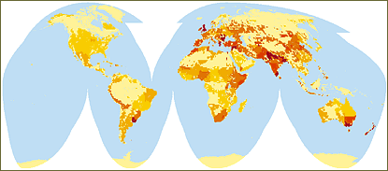

Map Description This map plots density of livestock throughout the world including cattle, sheep and goats, horses, water buffalo, and camels. Densities range from less than 50 head to over 50,000 head of livestock per square kilometer. Some of the highest densities in the world are in the Middle East, Asia, and Australia.

Slide 39
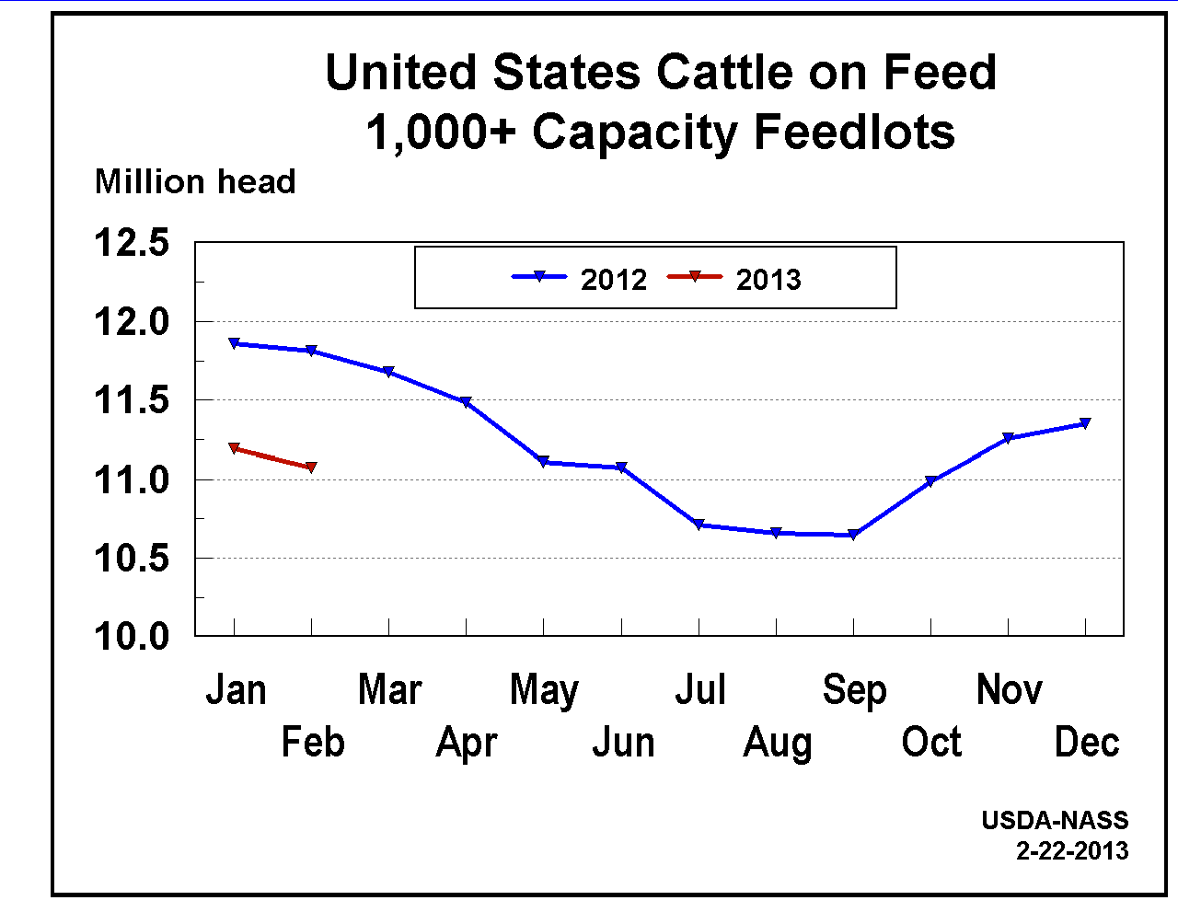

Slide 40
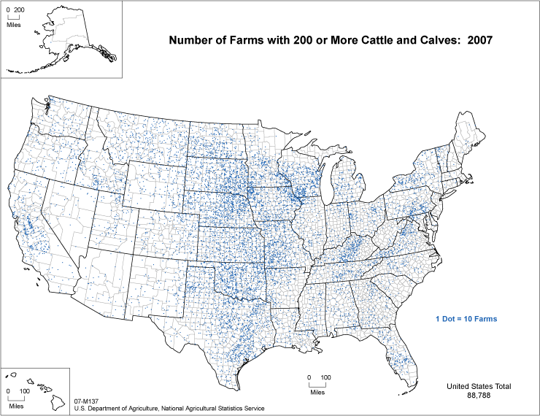

Slide 41
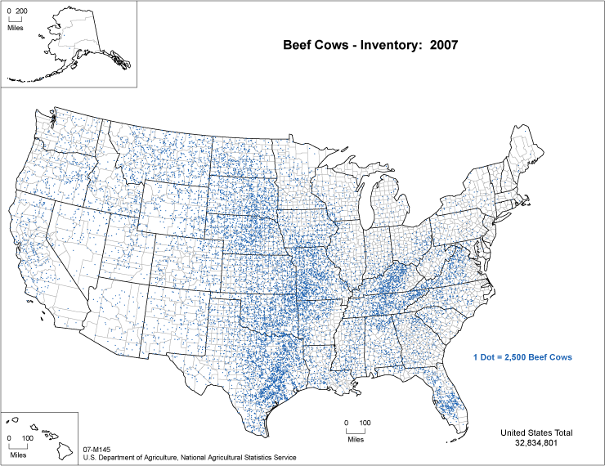

Slide 42
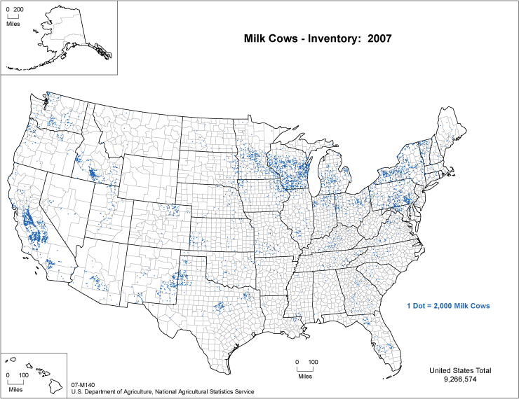

Slide 43
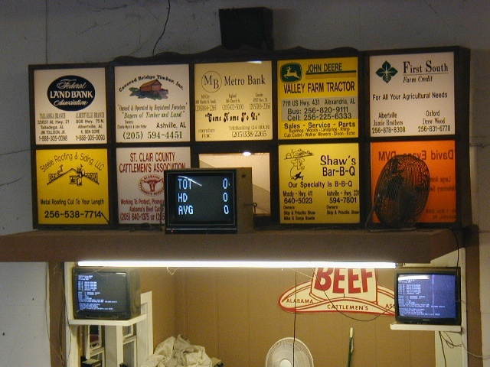

Slide 44
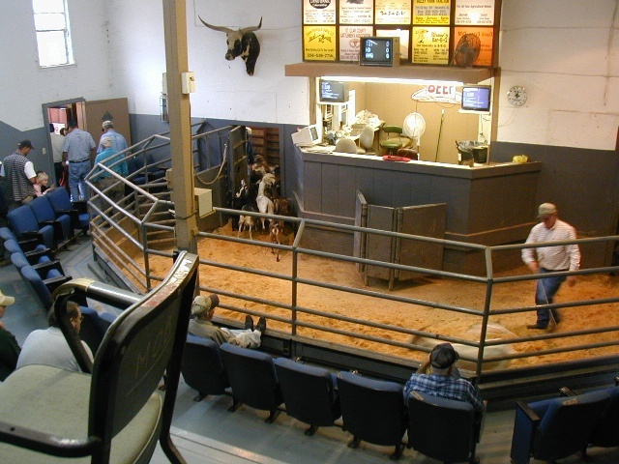

Slide 45
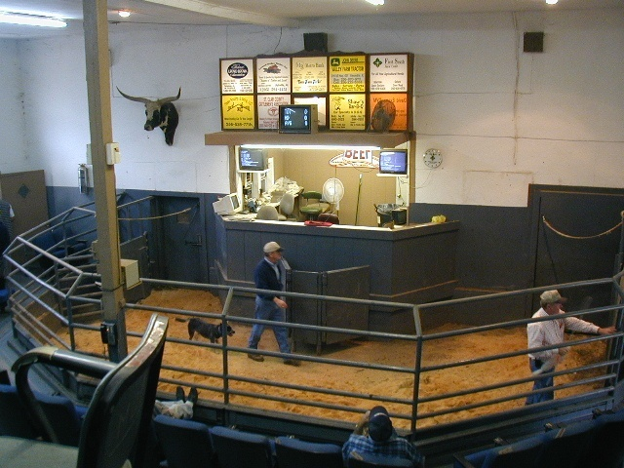

Slide 46
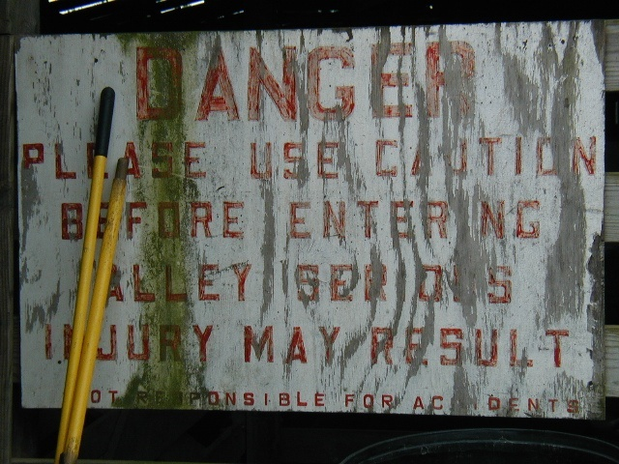

Slide 47
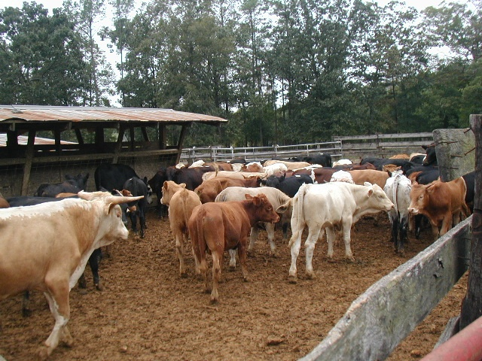

Slide 48
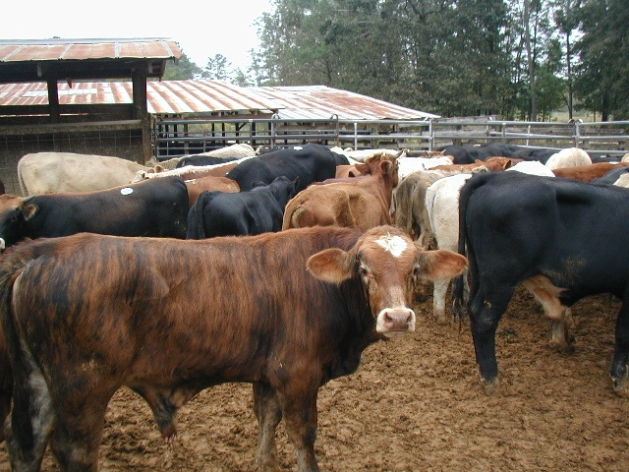

Slide 49
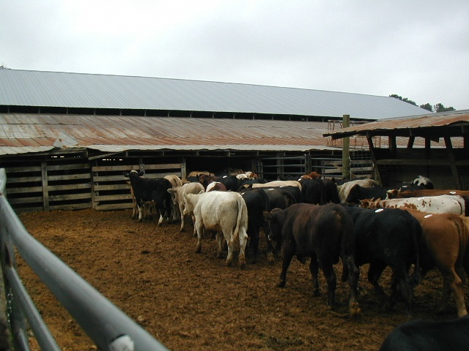

Slide 50
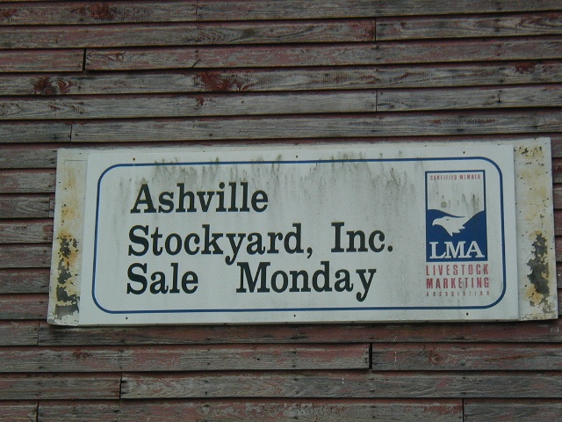

Slide 51
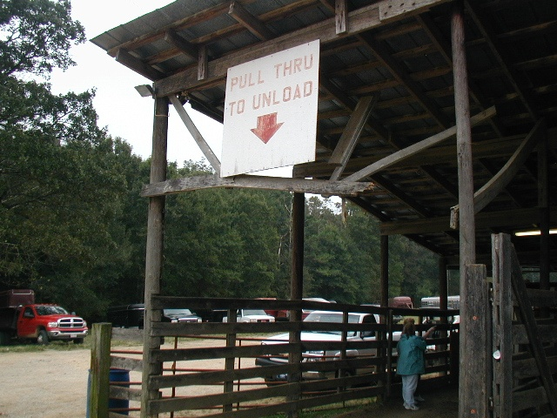

Slide 52
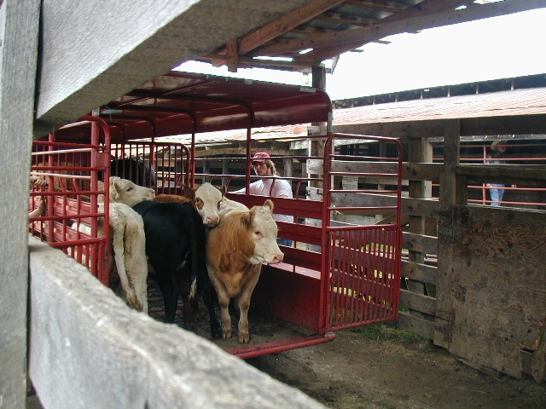

Slide 53
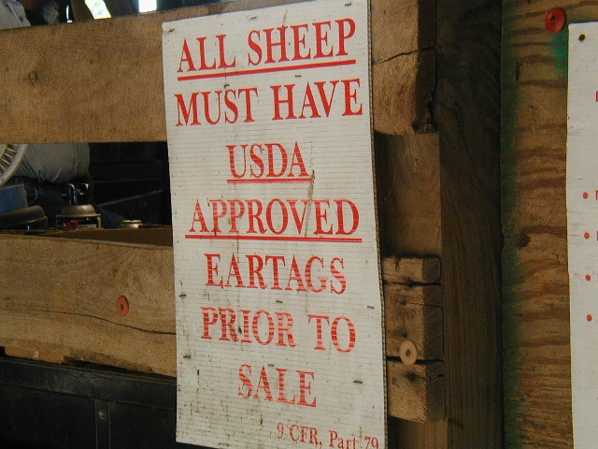

Slide 54
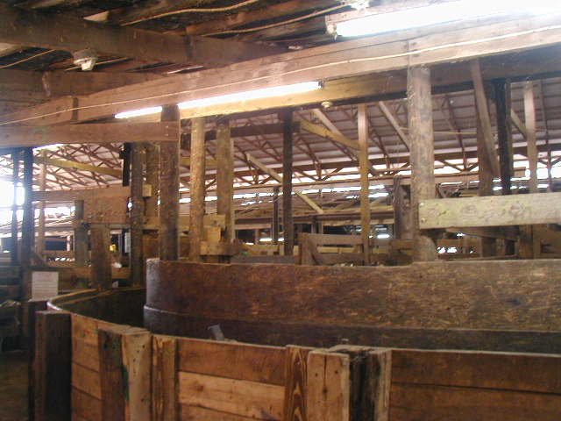

Slide 55


Slide 56


Slide 57


Slide 58


Slide 59


Slide 60
Geography of Vegetable Oil
Growing item in international trade
Increasing demand for oil in wealthy countries produced colonial trade patterns
Major shift in United States to soy bean production away from traditional crop rotation

Slide 61


Soybeans
Archer Daniels Midland
http://www.adm.com/en-US/Pages/default.aspx

Slide 62
Mixed Crop and Livestock

Slide 63


Slide 64


Slide 65
Truck Farming Crops

Slide 66


Slide 67



ORCHARDS –
Florida,
Washington (apples)
California

Slide 68


Slide 69


Slide 70


Slide 71


Slide 72


Slide 73


Slide 74


Slide 75


Slide 76


Slide 77


Slide 78


Slide 79


Slide 80

Agribusiness - Vertical Integration
Many different types of agribusinesses work together to market the products of U.S. agriculture. The marketing process starts when the producer sells grain, soybeans, cotton, livestock, dairy, eggs, poultry, fruit, nuts, vegetables or other products. From there the job is taken over by other agribusinesses that perform functions that are necessary to deliver the product to a consumer. The process ends when the consumer buys a ready-to-use product such as a steak, a loaf of bread, a pizza, a bag of apples, a can of peas, a shirt or a pound of cheese.

Slide 81
The meat and poultry industry is the largest segment of U.S. agriculture. Total meat and poultry production in 2011 reached more than 92.3 billion pounds, up 200 million pounds from 2010.
In 2010, the meat and poultry industry processed: 8.6 billion chickens 34.3 million cattle 242 million turkeys 2.5 million sheep and lambs 110.4 million hogs
In 2010, American meat companies produced: 26.4 billion pounds of beef 22.5 billion pounds of pork 5.8 billion pounds of turkey 313 million pounds of veal, lamb and mutton 37.2 billion pounds of chicken
Top Livestock and Poultry Slaughtering States Cattle - Nebraska, Kansas, Texas Hog - Iowa, North Carolina, Minnesota Chicken - Georgia, Arkansas, Alabama Turkey - Minnesota, North Carolina, Arkansas
There are 6,278 federally inspected meat and poultry slaughtering and processing plants in the U.S.

Slide 82


Slide 83
What are transnational corporations?
A transnational corporation (TNC) is a huge company that does business in several countries.
Many TNCs are much richer than entire countries in the less developed world.
Such companies can provide work and enrich a country's economy - or some say they can exploit the workers with low pay and destroy the environment. Technical definitions of TNC’s vary, but for our purposes the term "transnational corporation" means a for-profit enterprise marked by two basic characteristics: 1) it engages in enough business activities -- including sales, distribution, extraction, manufacturing, and research and development -- outside the country of origin so that it is dependent financially on operations in two or more countries; 2) and its management decisions are made based on regional or global alternatives.
Examples of TNCs include:
Nestlé
Unilever
Cadbury-Schweppes
BP-Amoco
Haliburton
Kraft

Slide 84
Corporate Agribusiness Today
Corporate agribusiness today, from seedling to supermarket, is dominated by such transnational corporate giants as ConAgra, Unilever, Nestle, Philip Morris, RJR Nabisco, Kraft, Cargill and Archer Daniels Midland.

Slide 85
Corporate Agribusiness Today
http://www.conagrafoods.com/
Conagra
http://www.cargill.com/
Cargill
http://www.adm.com/en-US/Pages/default.aspx
Archer Daniels Midland (ADM)
http://www.kraftfoodsgroup.com/About/index.aspx
Kraft
http://www.nestle.com/
Nestle

Slide 86

The top ten coffee producers are shown in yellow.

Slide 87



1000 Year World History of Coffee
Prior to 1000: native to ETHIOPIA
People discover energy boost when they eat the coffee bush berry
1000: Arab traders bring coffee to Arabia
develop plantations
exported from Yemen, especially port of Mocha
also begin to boil beans, call drink "qahwa”
Mecca
1200s: Mecca becomes a center of coffee culture
Arab rulers forbid coffee plants to be taken out of their domains
thousands of pilgrims come and coffee spreads...
1500s: Coffee houses found in all big cities of Near East
Ottoman Empire controls Middle East & coffee. Coffee becomes “Turk’s drink”; they often add spices such as clove and cinnamon
Notes:
Coffee land in Ethiopia image from:
http://www.sweetmarias.com/ethiopia.coffeeland.jpg
Ka’ba image from:
http://www.superluminal.com/cookbook/essay_coffee.html
** Good discussion of Islam and coffee at this site. **
Map of Mocha from:
http://www.na.rim.or.jp/~tatsuyo/moca_e.html

Slide 88



1600: Italian traders introduce coffee to West
some Christians call it the “devil’s beverage”
Pope Clement VIII "baptizes" coffee, making it an acceptable Christian beverage
very expensive
1616: Dutch smuggle coffee plants out of Mocha
to Ceylon and Java
Dutch East India Company becomes first to commercially cultivate and transport coffee
1668: Edward Lloyd's coffeehouse opens in England
frequented by maritime traders & insurance agents
eventually becomes Lloyds of London, the best-known insurance company in the world
Notes:
Image of Florence from:
http://web.tiscali.it/Florence/index.html
Dutch ship image from:
http://www.blarg.net/~kachmor/collierwork.html
Lloyds of London building photo from:
http://www.origin360.com/travel/london_17.html

Slide 89


1714: Mayor of Amsterdam presents Louis XIV a coffee bush
descendants will produce virtually entire coffee industry in the Americas (90% spreads from this plant)
Seedlings from this plant brought to Martinique (1725), and spread from there to S. America
1700s: Dutch and French cultivate coffee in S. America
jealously guard their treasure
Brazilian official who mediates a French-Dutch dispute in S. America romances French Guiana governor’s wife and receives coffee seedlings in a farewell bouquet...
these seedlings spawn Brazil’s coffee industry; today Brazil is world’s largest coffee producer (33%).
Notes:
Martinique map from:
http://www.martinique.cci.fr/ccim/aeroport/sommaire/principal.htm
Brazil - tractor and drying field - image from:
http://www.virtualcoffee.com/october_2000/6.html

Slide 90




1886: Former wholesale grocer names his popular coffee blend “Maxwell House”
after hotel in Nashville, TN where it's served
1900: Hills Bros. begins packing roast coffee in vacuum tins
spells end of local roasting shops & coffee mills
1901: first soluble "instant" coffee invented
invented by Japanese-American chemist
1903: German researchers remove caffeine from beans without destroying flavor
marketed under brand name "Sanka”; a contraction of French phrase “sans caféine.”
Notes:
Kraft logo and product line image from:
http://www.kraft.com/
Hill Bros. tin image from:
http://countryjoe.bizland.com/Xhills.jpg
Sanka images from:
http://164.109.16.145/100/founders/LRoselius.html

Slide 91



1946: Italian (Achilles Gaggia) perfects espresso machine & Italians first to manufacture it
cappuccino is named for resemblance of its color to robes of monks of the Capuchin order
1971: Starbucks opens its first store in Seattle
1983: a director travels to Italy; is impressed with their "coffee bar culture"; opens 1 bar
1987: 17 locations
2006: 8000+ locations
1988: Fair Trade Certification
an alternative trade organization
promotes organic farming and equity for farmers
Global Exchange
Notes:
Expresso Machine photo from:
http://www.aabreecoffee.com/gaggia.html
Starbucks logo from:
http://www.starbucks.com
Fair Trade logo from:
http://www.globalexchange.org/campaigns/fairtrade/coffee/

Slide 92

1000 Year World History of Coffee
Today: 2nd largest commodity in world after oil
US is largest consumer in world; consumes 1/5 of world's coffee
Notes:
World coffee map from:
http://www.gardfoods.com/coffee/coffee.gograph.htm

Slide 93


Slide 94

STARBUCKS
Coffee is a huge business. In fact, coffee is the second most valuable commodity after oil. Starbucks combs the world for the perfect combination of climate, soil, elevation, and agricultural practices that come together to produce a great coffee. When searching for coffees, the only question for Starbucks is this: Which coffees from a given location best represent the perfect intersection of climate and skilled horticulture?

Slide 95

Oil Producing Countries and U.S. States

Slide 96

Oil Consumption countries

Slide 97


Their business is about finding, producing and marketing the natural energy resources on which the modern world depends
Their main activities are the exploration and production of crude oil and natural gas; refining, marketing, supply and transportation; and the manufacture and marketing of petrochemicals
They operate in 100 countries with well-established businesses in Europe, North and South America, Australasia and Africa.

Slide 98


Slide 99
World’s Largest Companies
Wal-Mart Stores Royal Dutch Shell Exxon Mobil BP Toyota Motor | Japan Post Holdings Sinopec State Grid AXA China National Petroleum

Slide 100
Top companies: Most profitable
Rank | Company | Global 500 Rank | 2009 Profits ($ millions) | Profits % change from 2008
1 | Gazprom | 50 | 24,555.7 | -17.8
2 | Exxon Mobil | 3 | 19,280.0 | -57.4
3 | Industrial &Commercial Bank of China | 87 | 18,832.2 | 18.1
4 | BP | 4 | 16,578.0 | -21.6
5 | China Construction Bank | 116 | 15,627.9 | 17.3
6 | Petrobras | 54 | 15,504.0 | -17.9
7 | Barclays | 96 | 14,648.3 | 82.3
8 | Microsoft | 115 | 14,569.0 | -17.6
9 | Wal-Mart Stores | 1 | 14,335.0 | 7
10 | Vodafone | 80 | 13,782.3 | 165.6

Slide 101


