Slide 1
Development indicators
And what they tell us?
APHG – Jenkins

Slide 2
What does development look like?

Slide 3
What does development look like?

Slide 4
What does development look like?

Slide 5
Concepts of Development
Developed vs Underdeveloped
Developing?
LDC vs MDC (LEDC vs. MEDC)
NICs (Newly Industrialized Countries)
BRIC – Brazil, India, and China

Slide 6
UNHDP – United Nations Human Development Program
Problem: GDP is to general and does not tell you enough about the people.
While things like life expectancy is a little too specific – although as all sorts of other indicators influence this one, it is a very important one.
But if you know how much education people get, together with how long they are likely to live and thrown in the GDP as well, you have a reasonable measure of development.
This is exactly what the UN did in 1990

Slide 7
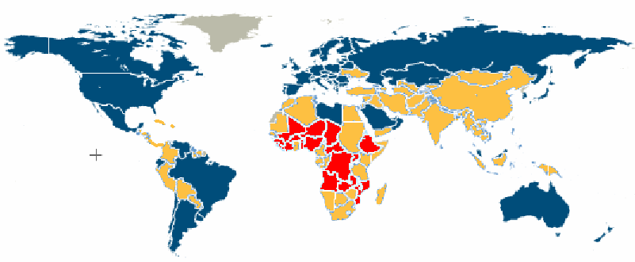
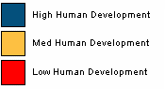
HDI and the UN - 2008
Each year, the countries are ranked.
High human development cut-off point is 0.8
Middle is above 0.5 to 0.8
Low is 0.1 – 0.5
Notes:
Note that Brazil and several places in South America and Libya have made it to the High developed group

Slide 8
How does the Human Development Index (HDI) work?
The UN looks at GDP per capita, Life expectancy and an educational index –
It assessed what it thought is the best each can aspire to
It finds the difference between each countries value and the maximum, which is then divided by the maximum – so no value can be more than 1
Then averages them
So a perfect country will have an HDI of 1 - A less developed country will have much lower value.

Slide 9
HDI - Issues
While this is much more effective way of measuring change across the world the group at the top are very close together
The difference of a year in life expectancy can cause a change of several places on the list.
Also, when it started the maximum value GDP was $40,000 – several countries near the top have overtaken this and so are given a rating of 1
In other words once you reach a GDP of $40,000 dollars you don’t get any more points – so a country with a lower GDP and only slightly better other indicators will go higher up the index

Slide 10
A definition of development
Development is the improvements in standard of living and quality of life that follow on from a country becoming richer.
In other words, the country needs the money, but how it is shared and spent affects the level of development a lot.
We are going to look at:
Different development indicators
How a realistic measure of economic development has been created by the UN
The development in 3 particular countries

Slide 11
Development indicators
Beginning in 1990, The UN has annually produced over 30 tables containing more than 200 indicators.
These are grouped together by topic, e.g. poverty, trade, gender issues
This is far too many! So we will look at a few representative ones under the headings of
Economic
Population
Social

Slide 12
Core Periphery Model (Wallerstein)
Scholars argued for this new approach
Sensitive to geographical differences and the relationships among development processes occurring in different places
Focuses on economic relationships.
Core
Periphery
Semi periphery

Slide 13
Core Periphery Model
Core Regions
High levels of socioeconomic prosperity
Dominant players in global economic game
Anglo America HDI .94
Japan and the South Pacific HDI .93
Western Europe HDI .92
Eastern Europe HDI .78

Slide 14
Core Periphery Model
Periphery
Poor regions
Dependent on the core
Do not have much control over their own affairs

Slide 15
Periphery Regions
Latin America HDI .78
East Asia HDI .72
Southeast Asia HDI .71
Middle East HDI .66
South Asia HDI .58
Sub Saharan Africa HDI .47

Slide 16
Core Periphery Model
Semi Periphery
Regions that exert more power than periphery regions
Dominated to some degree by core

Slide 17
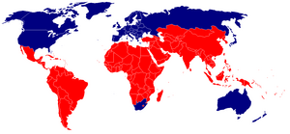
The North South Divide
http://en.wikipedia.org/wiki/Image:Northsouth.png
Based on the 1980’s Brandt Report. Suggested a simplified world contrast of development and undevelopment based on degree of industrialization and per capita wealth.

Slide 18
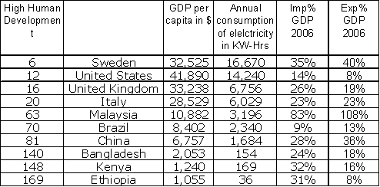
Economic Indicators
These are 2007 figures
Which do you think these countries are:
MEDCs, NICs, LEDCs, LLEDCs?
As we will see, your text, other sources and me have slightly different ideas on this! And as the world economy and general situation changes, so do individual countries – so don’t worry about finding THE right answer – there isn’t one!
Notes:
The figures are different from the book which are 2003
MEDCs = top 4
NIC = next 3 – although the textbook insists Brazil is an LEDC
LEDC = next 2 – probably!
LLEDC = Ethiopia altho’ with an GDP of $1055 (> $1000) some might say no – for those who say Ethiopia is then some might include Kenya
Also added little factoid – the $ has lost 25% of its value relative to the rest of the world this last year – but we still use this as the standard – so maybe GDPs will be up this year in a lot of places despite the credit crunch!!!

Slide 19
The GDP is the best known but as we have seen it has its limitations even though it does tell of something
Qu1: Why is electricity consumption used as an economic indicator – it is not just about electric lights in the home!
Qu 2: If the GDP=$100, Sweden buys imports for $35 and sells exports for $40 – so it gets richer – what is happening to each country?
Notes:
Qu1: it is partly how good a quality of life people have, which is social, but it also tells you about how good it is at turning material into products - So if there is not much used– not highly developed
Qu2 : Sweden, Malaysia, Brazil China all get richer
BUT there are things called INVISABLE exports which countries like the US and UK have lots of – this is money made by banking and insurance – you can’t send a plane load of it! – and this fills the gap for us and the US
Those who are definitely poorer are Bangladesh, Kenya, Ethiopia.

Slide 20
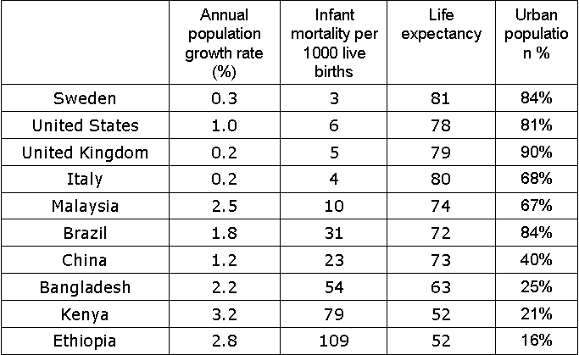
Population indicators
Growth rate = Death rate – birth rate
1. What do you expect the birth rate to be like in different economic groups?
2.The death rate?
3. Life expectancy is a major indicator of development because it has links with all sorts of other things. What?
4. What can you say about urban populations ?
Notes:
In MEDCs birth rate is quite low, while in LEDCs it is high but coming down – why? (Look at infant mortality)
poor health care means they tend to have more children so some will survive – but as a country develops and gets better healthcare, fewer dies and so they have fewer children as children cost a lot to bring up
The death rate is low in MEDCs and higher in LEDCs – but as the birth rate is still high it LEDCs – then the growth rate is high as well
But we have a problem – if Kenya for instance carries on at the current rate – it will have doubled its population in 22 years!
Life expectancy – indicates levels of water/sanitation, health care, food: quantity and quality
Urban population is highest in the MEDCs , getting higher in NIC due to more people working in industry and services and less in primary industry, and still lower in countries very dependant on agriculture where there is little mechanisation

Slide 21
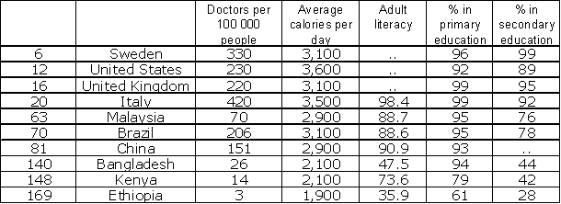
Social Indicators
The gaps are left because:
Either it would cost lots to find out what we know – an answer of about 99%
Or in the case of China’s secondary education – they don’t divide it up that way

Slide 22
Social Indicators
The doctors per 100,00 does not say much – work out how many one doctor serves in each country – what does that tell you?
Remember: 2,200 – 3,000 calories is about the range for quite active people – less and you are hungry – more are you are likely to be obese – what do the figures tell you?
What is adult literacy like: in MEDCs & NICs? In LEDCs & lower?
Primary education is one of the Millennium Goals – they are not doing too bad? Not the same in secondary education??
Notes:
The doctors per 100,000 is not helpful – so how many people does one doctor serve? Sweden about 300, US – 435; UK – 455; Italy 240;
Malaysia – 1400; Brazil – 485; China – 660; Bangladesh – 3800; Kenya – 7150; Ethiopia – 33,300
Brazil, UK, US, Sweden and possibly China and Malaysia could have an obesity problem – Bangladesh, Kenya and Ethiopia have at least some of the people who will be short of food
A large majority of adults can read in MEDCs/NICs as well as Bangladesh – Kenya is getting there but Ethiopia has a ling way to go
Apart from Kenya and Ethiopia, primary education is doing well – Millennium goal
Near universal secondary education is only for MEDCs – defined as % under 18 still in education – hence the leaving age AT THE MOMENT in the UK is 16 – going up soon – so this is why their % is lower – about ¾ for NICs and less than ½ for LEDC/LLEDC

Slide 23
Individual country case studies
We have 2 to look at:
They are Italy and Brazil
For a number of reasons, you will not be expected to remember numbers, but be able to take data from tables/graphs and comment on them.
But you will be expected to know something about what the countries are like, and how the data you are given reflects that
E.g. birth rates: from Brazil you would be expected to see that they were higher than MEDCs but that they were coming down – not on the table!!
Notes:
Namely – they are different from different places, change over years etc

Slide 24
Case study –Italy
Indicators (mostly 2008 estimate)
Area: 301,230 sq km
Population: 58,145,320
GDP - per capita :$31,000
Birth rate: 8.36 births/1,000 population
Death rate: 10.61 deaths/1,000 population
Life expectancy at birth: 80.07 years
Infant mortality rate: 5.61 deaths/1,000 live births
People per doctor: 238
% working in farming: 4%

Slide 25
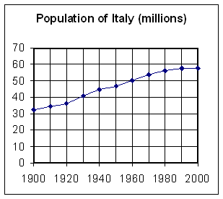
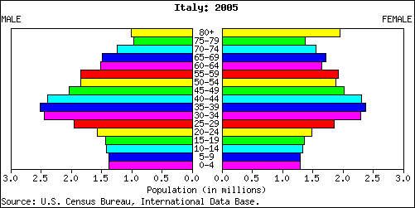
Case study –Italy
Aging pop.
Slow growth
High life expectancy
Low birth/death rates
Low infant mortality
Notes:
This is typical of an MEDC – a lot of people over 65 – fewer being born than are alive at 60-64 – slow growth rate – expected to go negative in 2008 ( -0.019% (2008 est.) CIA World fact book )–one BIG problem heading their way – soon there will not be enough workers to look after the old people
this is typical of MEDC – people do not need lots of children to ensure the survival of 1 or 2.

Slide 26
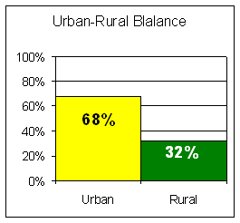
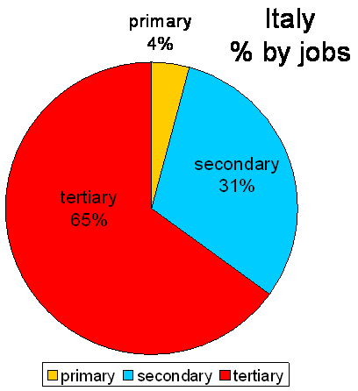
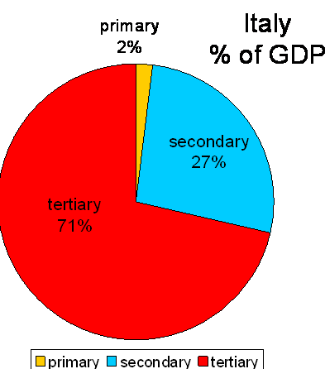
Case study –Italy
This one shows where the money comes from
What do you think the bar chart shows?
Primary is what?
2% of the money but 4% of the jobs – what does that say?
This one shows where the jobs come from
Notes:
The bar chart shows that most people live in towns and cities – a sign of an MEDC. Primary is farming/fishing/mining etc if 2% of the money comes from 4% of the jobs – these are low paid jobs. What is secondary? (manufacturing) What is tertiary? (services) what can you say about jobs and money for secondary ? Tertiary? Tertiary is the only one where less people make more – so this is where the money is – not much difference in secondary so manufacturing gives about the average wage – this points to most of the money in the towns and cities – common in MEDCs

Slide 27
Some other things that may influence development
Large areas of fertile land used intensively for vines, arable crops and vegetables
The mountainous regions of the Southern Alps and the Apennines, the mountains ridge down the middle of Italy, are very suitable for HEP (hydro-electric power).
There is a long history of manufacturing for export – machinery, textiles, clothing, vehicles.
Energy use: 22 barrels of oil equivalent per person per year
Notes:
recall (Unit 1B Hazards – why live near Volcanoes?) very fertile volcanic soils around Vesuvius is where most of the tomatoes in Italy are produced

Slide 28
Some other things that may influence development
Problems:
summer droughts,
Volcanoes/ earthquakes
recession has had an impact
Congestion and pollution in the cities – Milan, Venice, Rome
Biggest problem is underdevelopment in the south – but more of that another day!

Slide 29
Case study –Brazil
Indicators (mostly 2008 estimate)
Area: 8,511,965 sq km
Population: 196,342,592
GDP - per capita $10,300
Birth rate: 18.72 births/1,000 population
Death rate: 6.35 deaths /1,000 population
Life expectancy at birth: 71.71 years
Infant mortality rate: 23.33 deaths/1,000 live births
People per doctor: 485
% working in farming: 20%

Slide 30
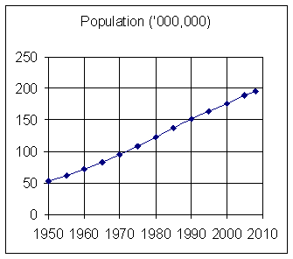
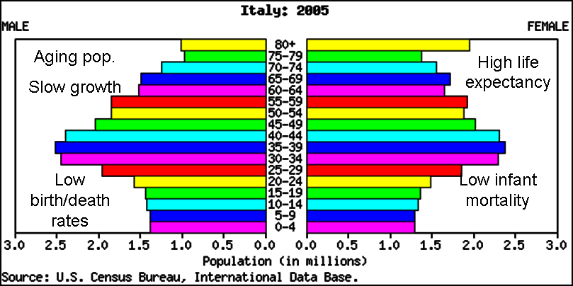
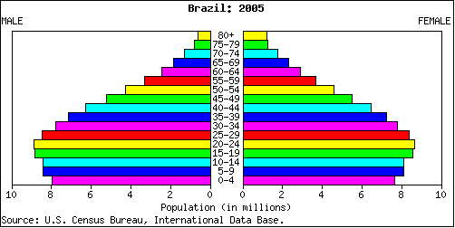
Case study –Brazil
Little one of Italy to compare with
Not many reaching retiring age
Large numbers of children but falling
Notes:
How many year did it take to roughly quadruple the population? 1950 – 2010 = 60 years – notice that while Brazils birth-rate is falling – it is not in the same state as Italy – What else do you notice about the 2 of them? Less people are reaching retirement age in Brazil – so life expectancy is lower

Slide 31
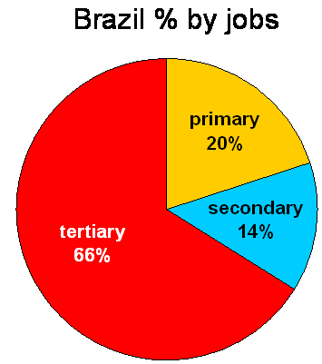
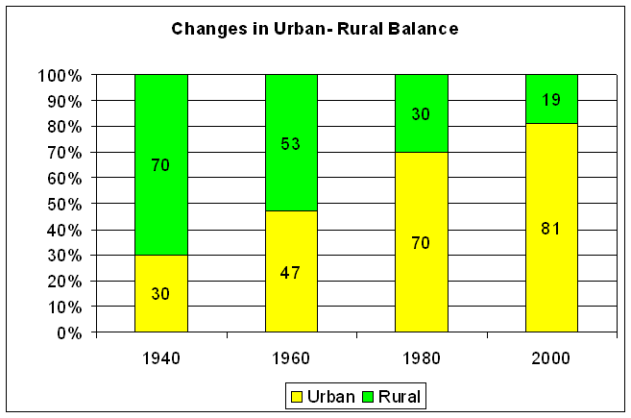
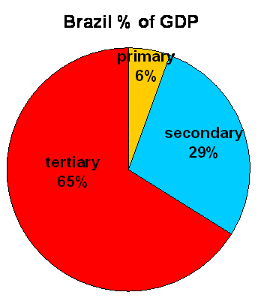
Case study –Brazil
Notice any differences?
What has happened to the Brazilian population in the last 60 years?
Notes:
The big difference between primary workers /%GDP might be down in part to subsistence farming?
Industry is the best performing as you would expect in an NIC (GDP = x 2 no of workers)
Tertiary: same % of people as % GDP – so average wage overall. BUT quite a lot of tertiary activity – lawyers, bankers etc are very well paid so there must be a number of tertiary workers who are not – people like hotel/restaurant staff and rubbish clearance and small shop keepers – many people who live in the slums – favelas – do these kind of tasks are poorly paid

Slide 32
Case study -Brazil
The book says Brazil is an LEDC, but according to UN’s HDI it has just reached ‘the top table’ as it is listed as one of the countries with High Human development
It still has some distance to go in terms of life expectancy and literacy but it is well on the way.
It is certainly newly industrialised – it is in the forefront of ethanol production (made from bagasse – waste sugarcane stubble) – and has numerous projects to improve its environmental track record in farming.
Of course there are still issues over the Amazon rainforests.
But there are also improvements being made to the favelas (squatter settlements) on the edges of the big cities – more about that another day
Notes:
Tomato farmers – drip irrigation – works by hose pipes with holes in just by the roots of the plant.
So
Saves water
Spraying means water vapour in air → moisture means mildew and other diseases – no moisture few diseases
Few diseases → less chemicals
Fertilizer added to piped water → delivered straight to the plant – none wasted – less used

Slide 33
Some other things that may influence development
Problems:
There is a wide gap between the very rich and the very poor
Business is allowed to get away with environmentally unfriendly activity, because they have the money to pay their way – quite often possibly through bribery and corruption.
The human rights need a lot of work, especially if you are poor.

Slide 34
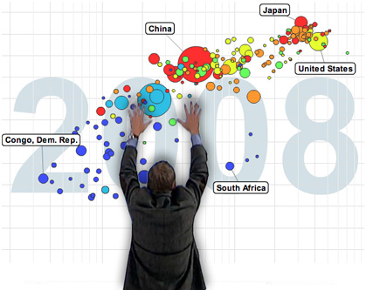
Gapminder.org

Slide 35
Models of Development
Liberal Models
All countries are capable of development
Economic disparities are a result of short term inefficiencies in local or regional market forces

Slide 36
Models of Development
Structuralist Models
Regional disparities are a structural feature of the global economy
Things have come to be organized or structured in a way and cannot be changed easily

Slide 37
Modernization Model
Walt Rostow, 1950’s
Liberal model
Development through international trade
Suggests that all countries follow a similar path through economic development
Traditional
Preconditions to takeoff
Takeoff
Drive to maturity
High mass consumption

Slide 38
Traditional
Not yet started development
High % of people engaged in subsistence agriculture
High % of wealth allocated to ‘nonproductive activities’ such as religion and military
Rigid and unchanging social structure
Resistance to change to technological change

Slide 39
Preconditions of Takeoff
An elite group initiates innovative economic activity
Country begins investing in new technology and infrastructure
Stimulate increase in productivity
Progressive leadership

Slide 40
Takeoff
Rapid growth facilitated by a limited number of economic activities
Some sectors of the economic structure remain dominated by traditional practices
Industrialization, urbanization, mass production

Slide 41
Drive to Maturity
Modern technology diffuses to wide variety of industries
Industries experience rapid growth similar to the early takeoff industries
Workers become more skilled and specialized
Modernization in the core
Population growth declines

Slide 42
High Mass Consumption
Economy shifts from production of heavy industry such as steel and energy to consumer goods like refrigerators and motor vehicles
High incomes
Widespread production of a variety of goods and services
Majority of workers in service sector of economy

Slide 43
Dependency Theory
Structuralist alternative to Rostow’s model
Political and economic relationships between countries and regions control and limit the economic development of less well off regions
Dependency helps sustain the prosperity of the dominant regions and the poverty of the lesser regions

Slide 44
Dependency Theory
Little hope for economic prosperity in regions and countries that have traditionally been dominated by external power
Based on generalizations that pay little attention to regional differences in culture, politics, and society

Slide 45
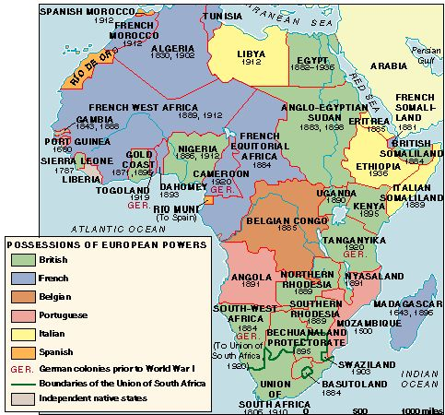
Colonization of Africa

Slide 46
Why do LDC’s face obstacles to development?
Self-sufficiency
International trade
Financing development

