Slide 1
Weber’s Least Cost Theory of Industrial Location Model
AP Human Geography

Slide 2
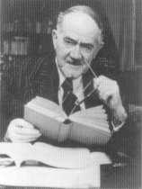
Who?
Alfred Weber (1868-1958)
German Economic Geographer
Published Theory of Location of Industries in 1909.
“What is the best (most profitable) location for manufacturing plants?”
“Just because I’m old doesn’t mean I don’t know what I’m talking about!”

Slide 3
3 major factors that determine location of manufacturing
1. Transportation (most important)
Raw materials (inputs) to factory
Finished goods (outputs) to market
Distance and weight most important factors.
2. Labor
High labor costs reduce profit
May locate farther from inputs/ market if cheap labor can make up for added transport costs.
3. Agglomeration
Similar businesses cluster in the same area.
Businesses support each other, reduce costs

Slide 4
Assumptions
People are economically rational
Producers and sellers want to make profit
Best econ decisions result from market mechanisms
Price of land, labor, raw materials, energy, transportation
Supply and demand

Slide 5
Bulk Reducing Industry (Weight-losing) “Material Orientation”
Inputs weight more than final product.
Weight is lost during the production process
Cost of shipping inputs to factory > cost of shipping outputs to market.
Therefore, factory is located near raw materials/ inputs.
Examples: copper, steel, lumber

Slide 6
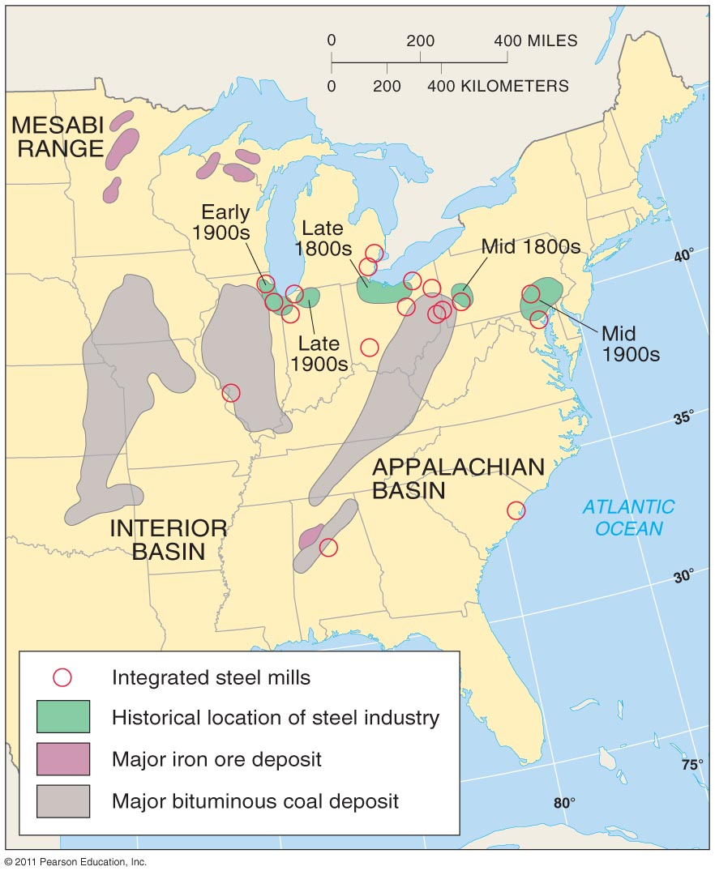
Bulk-Reducing Industry

Slide 7
Bulk Gaining Industry (Weight-gaining) “Market Orientation”
Finished product weighs more than the inputs.
Weight is gained during the production process.
Cost of shipping outputs to market > cost of shipping inputs to factory.
Therefore, factory is located near the market.
Examples: Automobiles, beverages

Slide 8
Bulk Reducing
Heavier input, shorter distance to plant
Input Factory Market
Input Factory Market
Lighter output, longer distance to market
Lighter input, longer distance to plant.
Bulk Gaining
Heavier output,
shorter distance to market

Slide 9
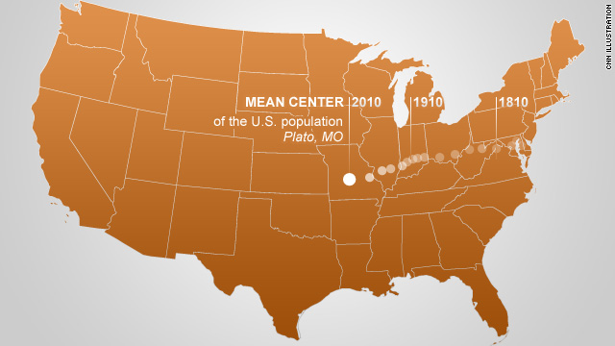
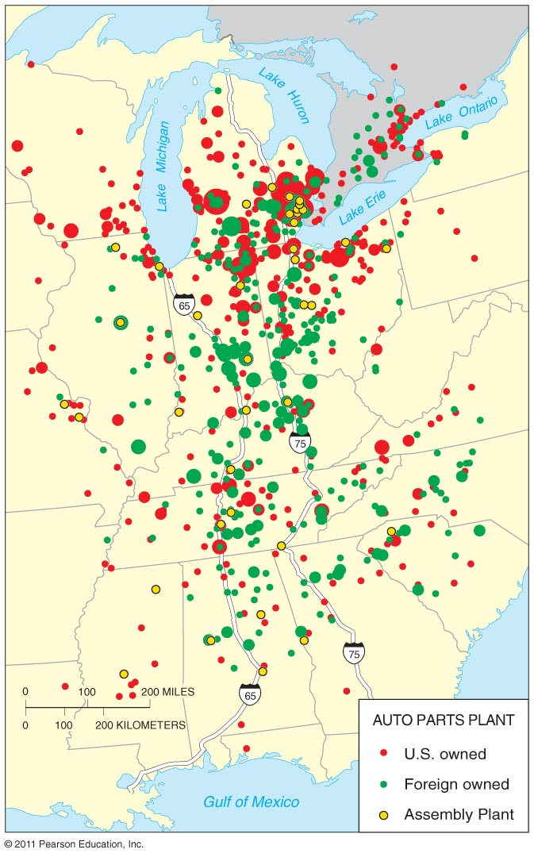
The Connection?
Bulk gaining or reducing?
Agglomeration

Slide 10
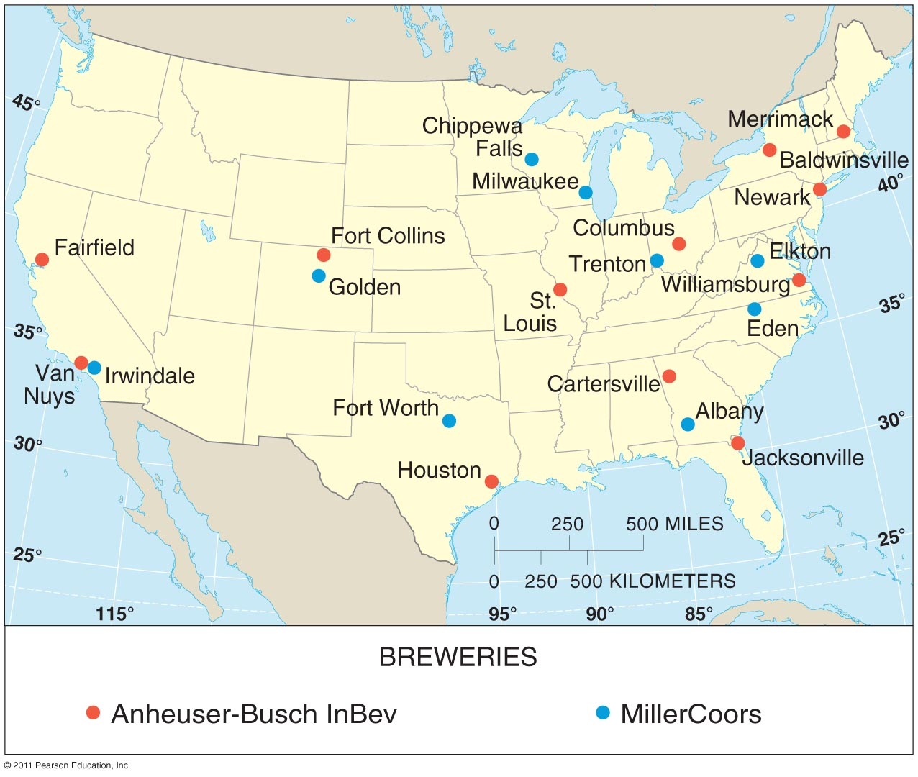
Bulk Gaining Industry

Slide 11
Single Market Manufacturers
Factories that produce products for 1 or 2 customers.
Ex. “We build the seats for Ford cars”
Finished seats are shipped to assembly plant.
Agglomerate near the larger plant.
This allows for “Just In Time” delivery.
Parts are sent to factory right as they are needed…reduces need for warehouse space.

Slide 12
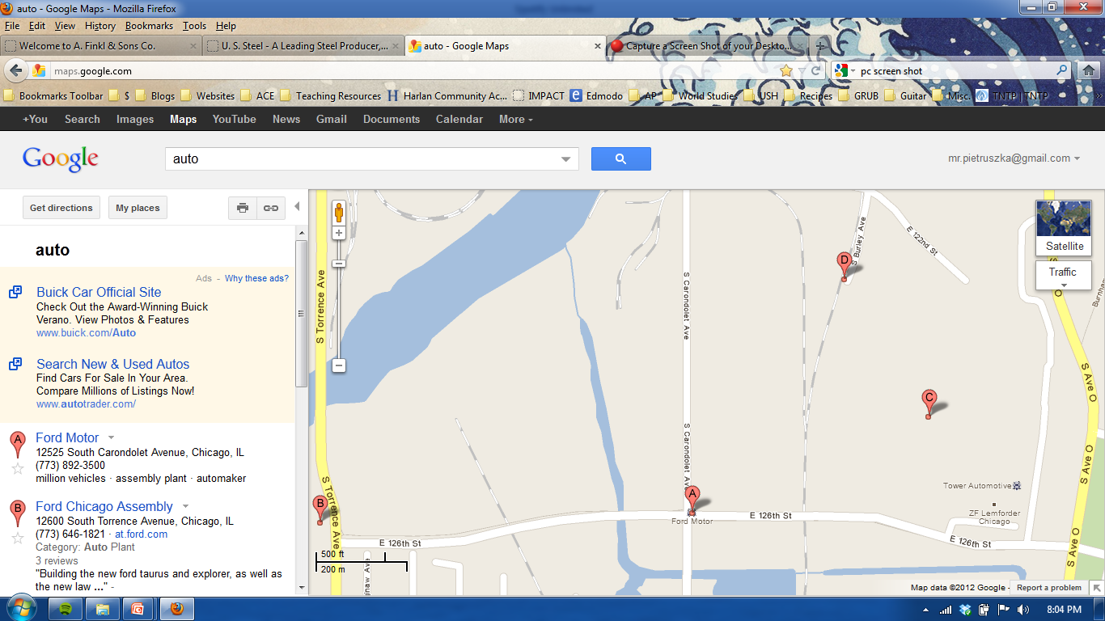
Agglomeration, Chicago East Side
Warehouses
Ford Offices
Auto Parts Manufacturers
Assembly Plant

Slide 13
Perishable Products
Must be located near market
Short shelf live/ fast expiration
Bread
Goes bad within the week
Newspaper
Good only for 24 hrs.
“Yesterday’s News!”

Slide 14
Other important vocabulary
Footloose industry
Produces a lightweight produce that is very valuable….location not much of an issue!
Computer chips
Technopole
A region of many high tech businesses (agglomeration)
Silicon Valley, CA
Deglomeration
The “unclumping” of similar businesses due to over crowding.
Break-in-bulk Point
Point where products is broken up to be diffused to various markets

Slide 15
Today
Is the model still applicable today?
Transportation costs are lower
Cost of specialization has increased (brain replaced brawn)
Most production is conducted transnational
Governments play a role with tax incentives and other policies
Production processes have changed – nimble, specialized, and flexable

