Slide 1
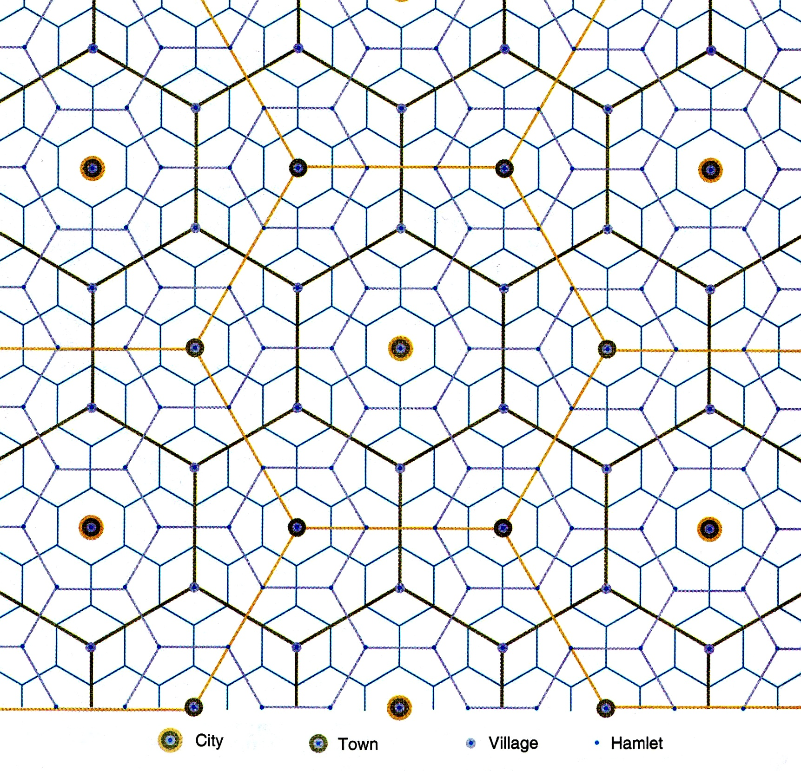
Notes:
A central place network. Whatever you do, don’t start teaching CPT with this diagram! But,by the end of your coverage of CPT, students should be able to look at this diagram, explain it, and critique it. Source: Rubenstein, 9th ed, p410

Slide 2

Review?
  Who told us where to place factories? Theory?
  Who told us where to place agriculture? Theory?
  Who told us where to place services? Or at least how services are dispersed? Theory?

Slide 3



Types of Services
3 Main types:
  Consumer Services
  Business Services
  Public Services
All exist is what sector?

Slide 4

1. Consumer Services
Consumer Services: provide services for those that want them and can afford them
  4 Examples
    Retail
    Education (Private schools)
    Health
    Leisure and Hospitality (entertainment restaurants)

Slide 5

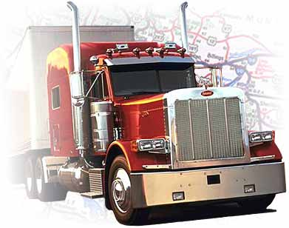

2. Business Services
Facilitate (aid) other businesses
  3 Examples
    Financial: FIRE (Finance, Insurance, and Real Estate)
    Professional: (management, law, design, engineering, clerical)
    Transportation and Similar Services: (trucking and transporting goods, publishing, broadcasting, utilities)

Slide 6

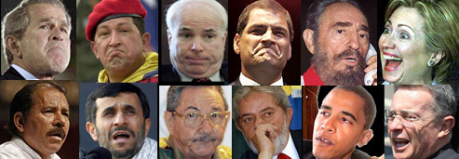

3. Public Services
Services offered by governments to provide security and protection for citizens and businesses
  Examples: Public education, Military, Politicians, and anyone else paid by the government

Slide 7
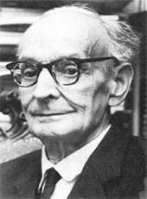
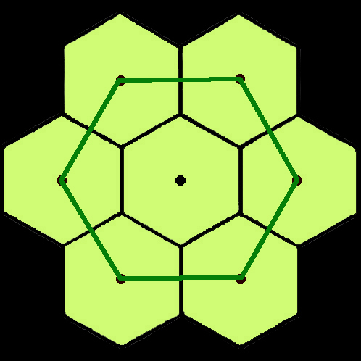
Central Places Theory and Applications
Walter Christaller,
1939
Not as hard as it looks
Notes:
Presented as part of the AP Human Geography strand

Slide 8
Notes:
A central place network. Whatever you do, don’t start teaching CPT with this diagram! But,by the end of your coverage of CPT, students should be able to look at this diagram, explain it, and critique it. Source: Rubenstein, 9th ed, p410

Slide 9
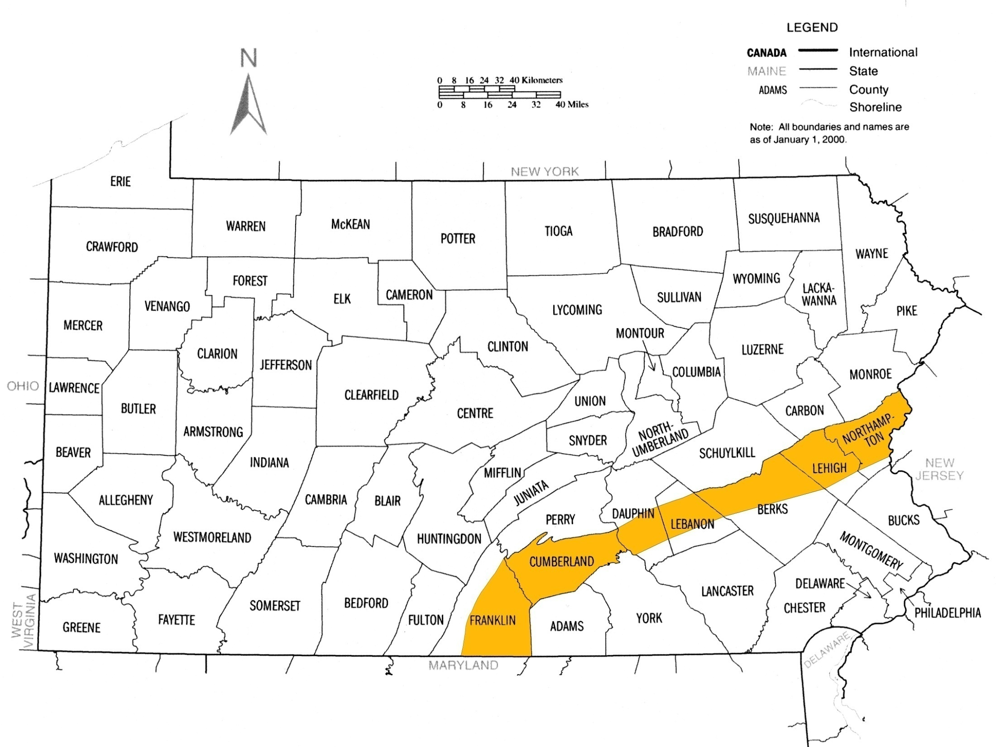
Notes:
Like Christaller we should begin in the real world, not in theory. Pennsylvania’s section of the Great Valley of the Appalachians. Follow it south to the Coosa Valley of Alabama and north to the Hudson Valley.

Slide 10
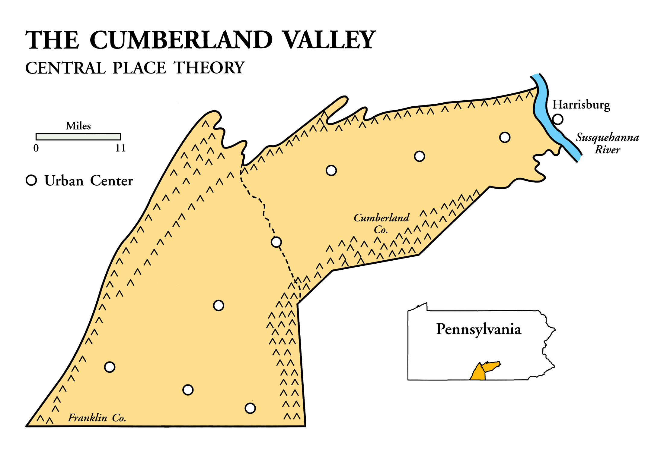
Notes:
The Cumberland Valley of Pennsylvania is a portion of the Great Valley of the Appalachians. Broad valley floor, agricultural, settled in the early-to-mid 1700s. Note the regularity of spacing between urban centers -- towns. Local lore has it that the distances between towns evolved because it was the distance someone could travel in a day.

Slide 11
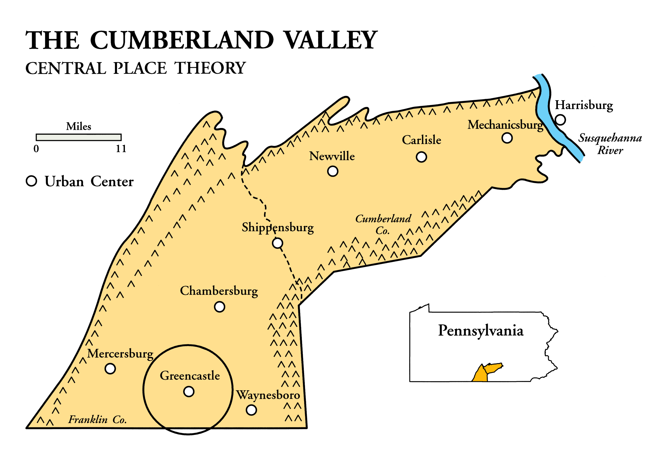
Notes:
Swing a circle 5.5 miles around Greencastle; that’s the area that serves the farmers surrounding the town. Why 5.5 mi? Farmers could travel that far into town, have time to do their business, and return home before nightfall.

Slide 12
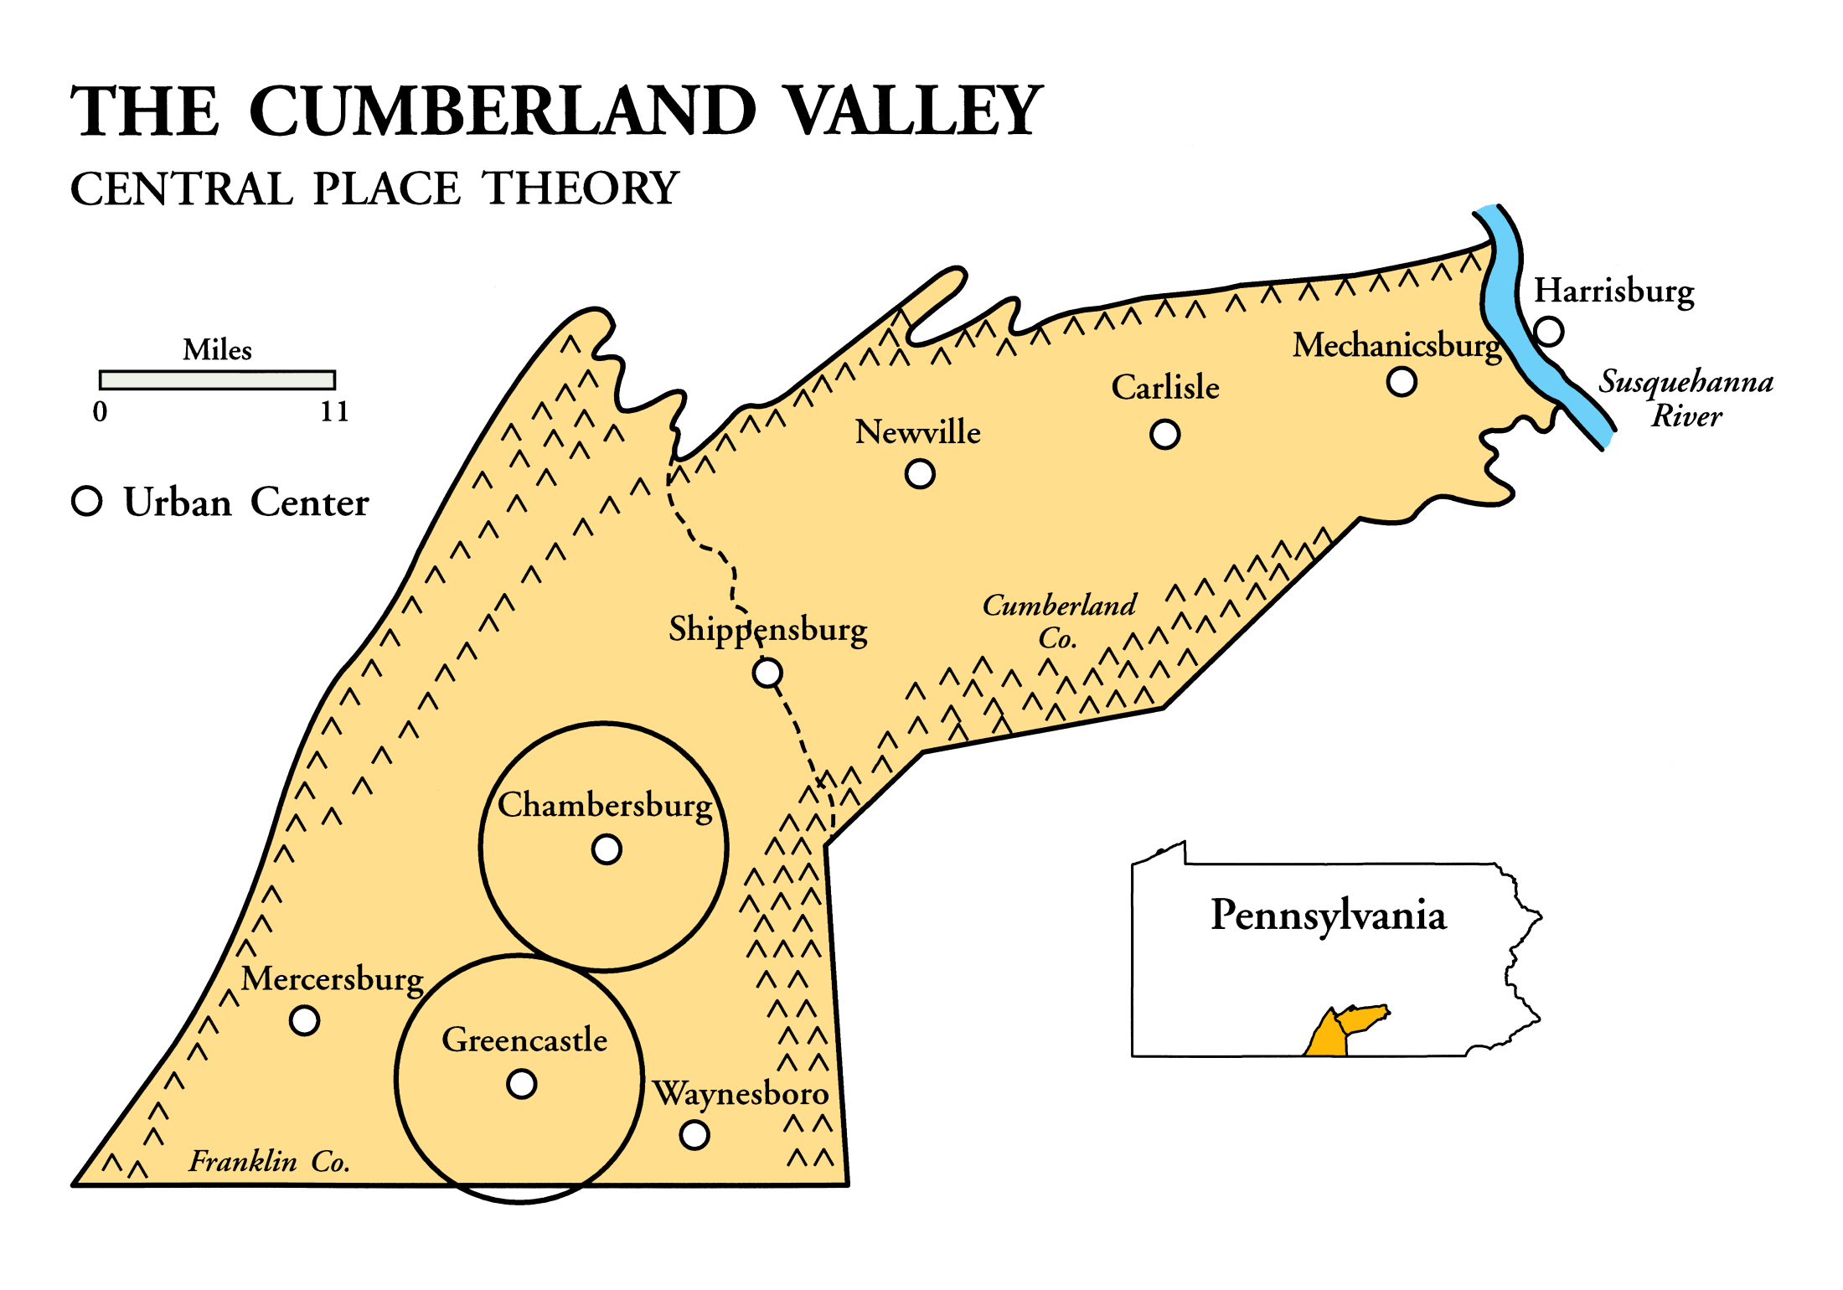
Notes:
It’s about 11 miles between Greencastle and Chambersburg. Chambersburg is the county seat of Franklin Co.

Slide 13
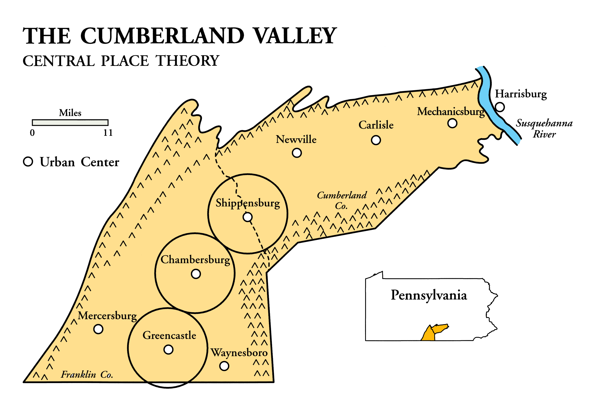
Notes:
It’s 11 miles between Chambersburg and Shippensburg.

Slide 14

Notes:
It’s 11 miles between Shippensburg and Newville.

Slide 15

Notes:
It’s 11 miles between Newville and Carlisle. Carlisle is the county seat of Cumberland Co.

Slide 16

Notes:
It’s 11 miles between Carlisle and Mechanicsburg. But look how close Harrisburg is to Mechanicsburg. Then consider the impact of the river on travel time. Harrisburg grew up around a ferry-crossing of the Susquehanna. And, 11 miles south of Mechanicsburg is another central place town: Dillsburg (not on this map). Try following the pattern into Maryland, West Virginia, and Virginia.

Slide 17
CENTRAL
More small places than big places
Ratio of big places to small places relatively constant
PLACE
Big places farther apart than small places
THEORY
Notes:
What did Christaller observe? How did he explain it? These are some of Christaller’s observations. Empiricism usually culminates in a set of generalizations. Christaller noted these patterns on the landscape. But why? We need a theoretical framework for the purpose of explanation. From these observations a theory evolved to explain them.

Slide 18
CENTRAL
PLACE
A settlement whose livelihood depends on the sale of goods and services to people in the surrounding area
Notes:
What is a central place? Central places offer goods and services to customers in the surrounding area. This is a symbiotic relationship. People need or want particular goods and services; businesses need or want the business.

Slide 19

Notes:
Geography as geometry. We begin with circles. This is where we start to built a central place network. What does each circle represent? A trade area, market area, complementary region, tributary area. Some might call it a hinterland, although that term should properly be used for the area “behind” a port.

Slide 20
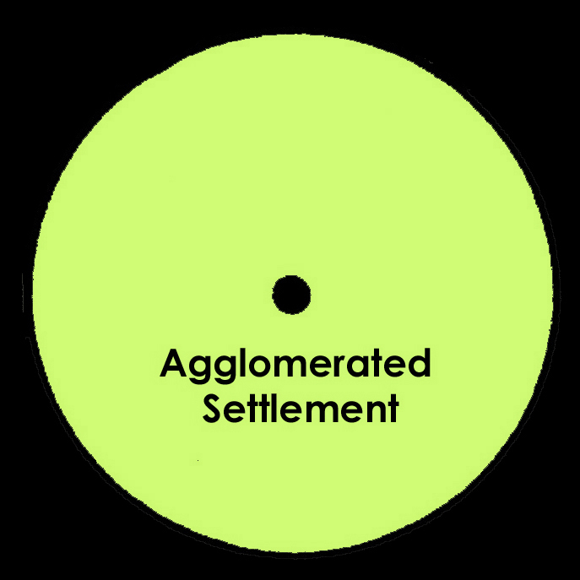
Notes:
Agglomerated settlements are geographically clustered, as opposed to dispersed settlement (as an area where people live on farms). They constitute one category of places. The place is in the center of the area it serves: a central place. Some settlements exist primarily to serve the surrounding population; other cities have a different reason-for-being, e.g., a tourist center, a manufacturing center, a port. Christaller limited himself to explaining the distribution of settlements as service centers, such as you would find in an agricultural region. These agglomerated settlements are sometimes called distribution centers.

Slide 21
Settlement Sizes
Hamlet – a hamlet has a tiny population (<100) and very few (if any) services, and few buildings
Village – a village generally does not have many services, possibly only a small corner shop or post office. A village has a population of 100 to 1,000.
Notes:
Hamlets and villages are considered rural settlement forms. They exist to provide goods and services to farmers in the nearby trade area. Cities and Metropolises are fully urban. The town is the transitional settlement from rural to urban, though usually considered urban. Using the term village suggests that it is firmly tied to the soil.

Slide 22
Settlement Sizes
Town -a town has a population of 1,000 to 20,000. (Think – Hiram)
City - a city would have abundant services, The population of a city is over 100,000 people up to 300,000.
Metropolis - a large city and its suburbs consisting of multiple cities and towns. The population is usually one to three million.
Notes:
Hamlets and villages are considered rural settlement forms. They exist to provide goods and services to farmers in the nearby trade area. Cities and Metropolises are fully urban. The town is the transitional settlement from rural to urban, though usually considered urban. Using the term village suggests that it is firmly tied to the soil.

Slide 23
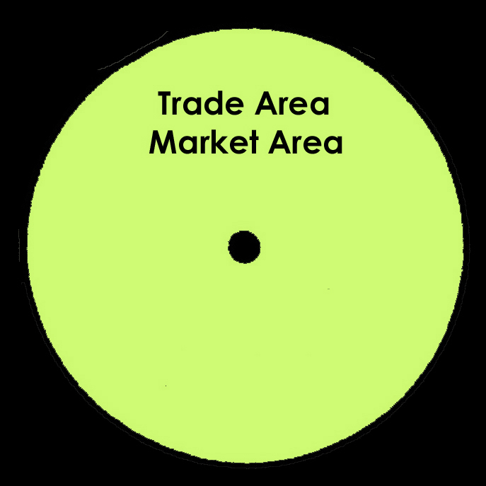
Notes:
The trade area is green because the primary economic activity is farming: at the level of the hamlet, only farming. Let’s put a trade area around the surrounding settlements, too. Farmers were not self-sufficient; they would need to purchase such things as gunpowder, salt, iron implements, and glass.

Slide 24
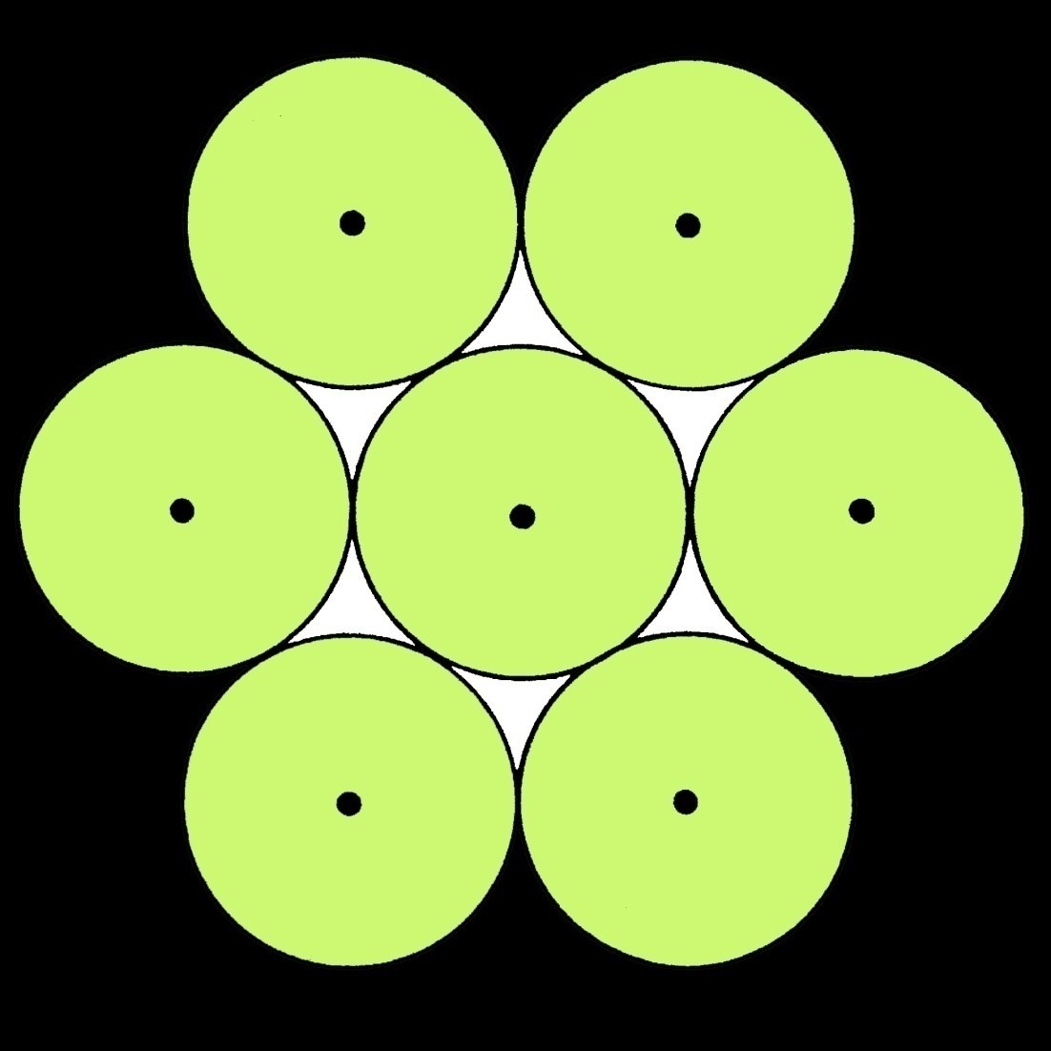
Notes:
What happens when you use a circle to define trade areas? Unserved consumers living in the white areas. You can’t have unserved areas.

Slide 25
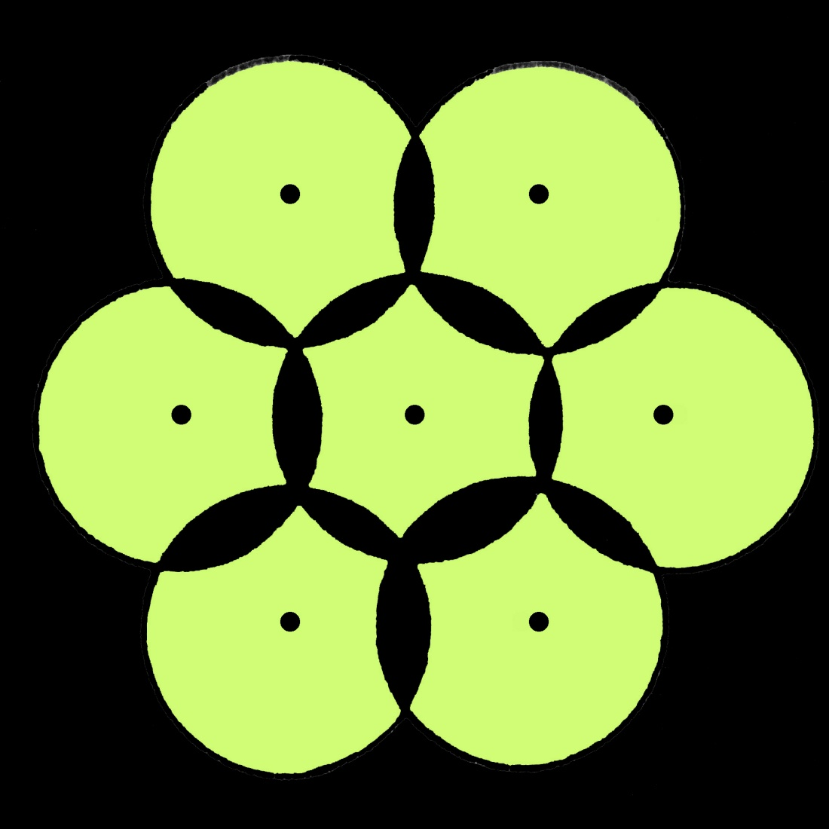
Notes:
Push the circle together. But, you can’t have market areas (circles) overlapping either: black lenses between circles. If we bisect each lens we resolve the conflict. These bisections give us the only geometric shape that resolves the conflict: a hexagon. With a hexagon, all areas are served and there is no overlap,

Slide 26
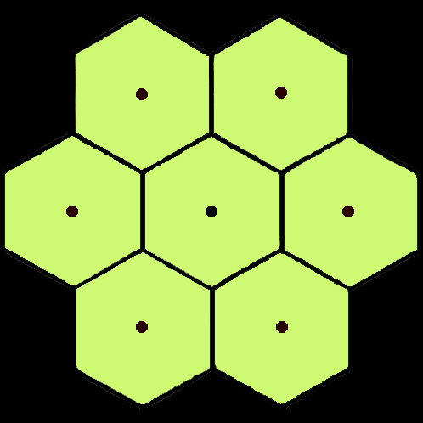
Notes:
The only geometric shape that resolves this conflict is the hexagon. Think about why a square or a triangle would not be better. (Hint: distant corners)

Slide 27
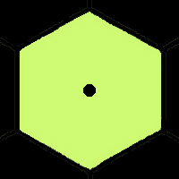
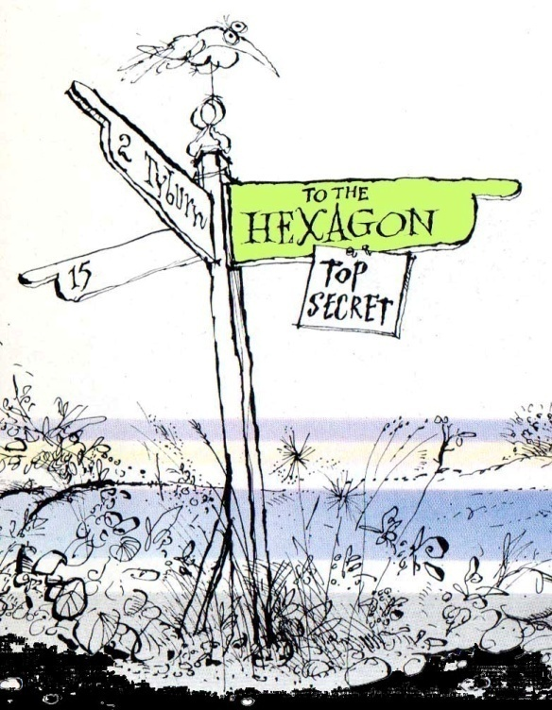
Notes:
Trade areas that began as circles are now regular hexagons.

Slide 28
Notes:
We now have the first layer of a central place network. We have 7 trade areas served by 7 villages.

Slide 29
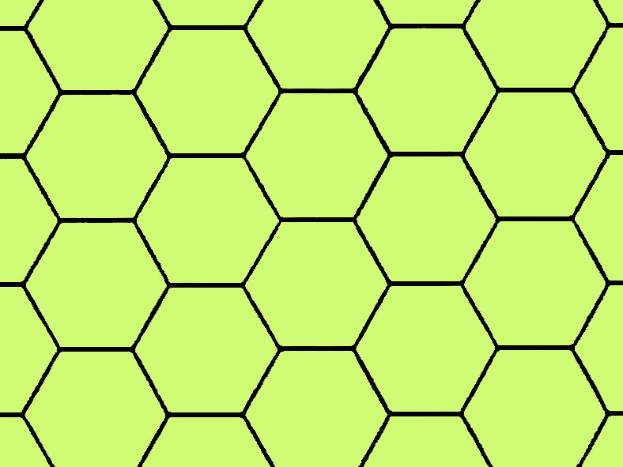
Notes:
Here is what we have if we expand the area: a network of market areas consisting of regular hexagons continuously covering an isotropic surface.

Slide 30
CENTRAL
PLACE
THEORY
Notes:
How do all those hexagons fit together? A theory requires laboratory conditions.

Slide 31
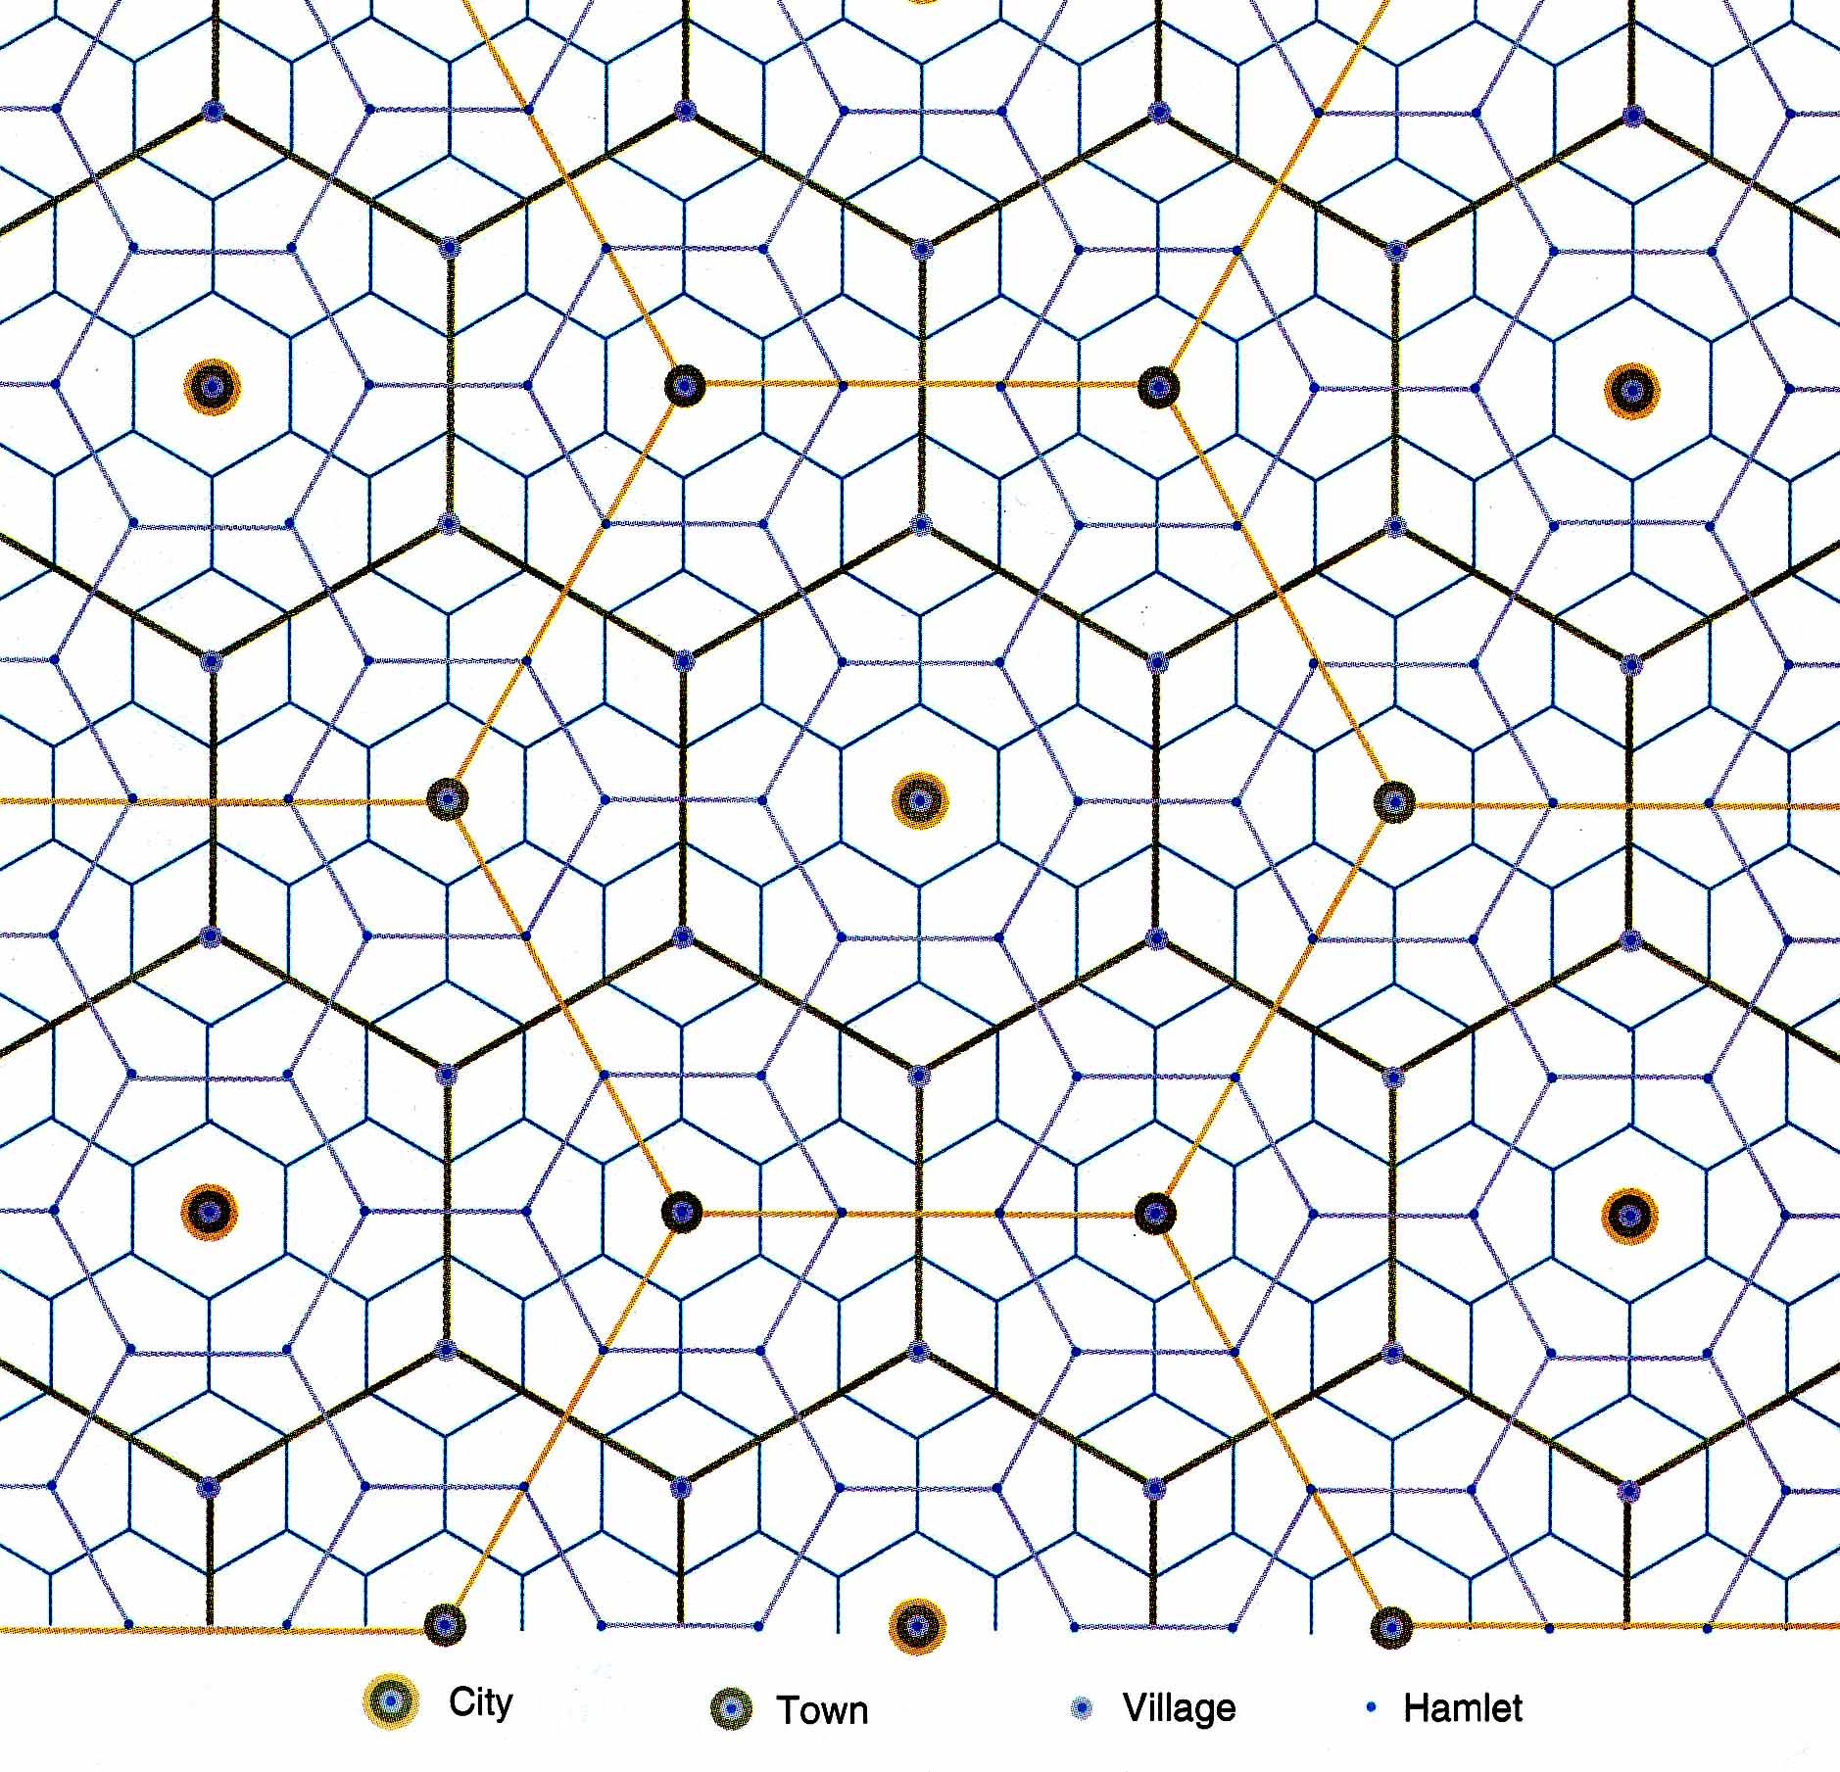
POSTULATES or OUTCOMES
“Then . . . “
Notes:
Then, you should expect a central place network to evolve over time to serve the demands of a rural population. Imagine them as farmers, but that assumption is not necessary for theory-building. Vocabulary: Pre vs. Post; Premises vs. Postulates.

Slide 32
PREMISES or ASSUMPTIONS
“If . . . “
Isotropic Surface
  “featureless plain” with no barriers to movement
Even Population Distribution
  similar in purchasing power and behavior
Homo Economicus
  “economic man” with purely economic motives
Integrity of the Law of Supply and Demand
  customers needed for a business to stay open
Notes:
Physical geography = there is none. Population geography = dispersed population. Behavioral geography = people economize. Retail geography = service providers must make a profit or close down. Homo economicus gives us a case of economic determinism.

Slide 33
POSTULATES or OUTCOMES
“Then . . . “
There will be a regular spatial order in the number of central places of different population sizes.
  Few large places
  Many small places
There will be a regular spatial order in the spacing of central places of different population sizes.
  Large places relatively farther apart
  Small places relatively closer together
Notes:
Or we could explain it in words…like these.

Slide 34
Central Place Functions
Categories of like services found in a central place
Grocery Stores
Gas Stations
Jewelry Stores
Book Stores
Hair Stylists
Auto Dealerships
Houses of Worship
Schools
Doctors
Dentists
Museums
Concert Halls
Notes:
To find out how the layers of central places evolve, we need to look at the settlements and what they are providing. Examples of the types of goods and services provided in a central place.

Slide 35
Higher-Order Functions
Higher-Order Central Places
Provision of higher-order goods and services
Trade in goods and services that are more valuable and infrequently demanded
Because the goods and services are more valuable, people are willing to travel farther to shop.
Higher-order goods and services are available in higher-order central places.
Notes:
Some characteristics of higher-order goods and services.

Slide 36
Lower-Order Functions
Lower-Order Central Places
Provision of lower-order goods and services
Trade in goods and services that are less valuable and frequently demanded.
Because the goods and services are less valuable, people are willing to travel only short distances to shop.
Lower-order goods and services are available in lower-order central places.
Notes:
Some characteristics of lower-order goods and services.

Slide 37
Would you travel farther to buy a new car or the week’s groceries?
To buy a new car
Would you travel farther to see your family physician or a heart specialist?
To see a heart specialist
Would you travel farther to go to elementary school or to go to high school?
To go to high school
Notes:
Become aware of how far you are willing to travel to make a purchase. Private sector and public sector goods and services are both accounted for in CPT.

Slide 38
A Hierarchy of Educational Services
City:
College
Town:
High School
Village:
Elementary
School
Hamlet:
No Schools
Notes:
You have more elementary schools than high schools, more high schools than colleges. Elementary schools are closer to each other; colleges are farther apart from each other.

Slide 39
Stock Exchange
Sports Stadium
Regional Shopping Mall
Major Department Store
Income Tax Service
Convenience Store
Gas Station
Notes:
Hierarchical arrangement of a sampling of central place services. This is a 7-order hierarchy. Christaller found 7 levels to the hierarchy of central places in southern Germany.

Slide 40
How big is the trade area of a service center?
It depends on . . .
- How far a consumer is willing to travel for the service
- How many customers a service needs
Notes:
We’ve established the geometry. Now, let’s establish the geography; let’s put the hexagons on the landscape. The higher the value of the good or service, the longer people are willing to travel to purchase it.

Slide 41
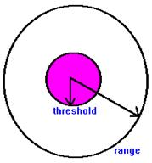
Central Place Theory: Size of Markets
Marketing services often use zip codes to map the type of people living in certain areas.
  What could they determine from this information?
Determining the size of markets (or the hexagon a service is a part of )
  2 pieces of Information:
    Range and Threshold

Slide 42
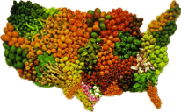
Central Place Theory: Range
Range: maximum distance people will travel for a service
  Only a short distance for everyday goods (groceries, video rentals etc.)
    In which Hexagon would you find the nodes for these items?

Slide 43
Central Place Theory: Range
  Longer distance for specialty items (major league sports games, concerts, )
    In which Hexagon would you find the nodes for these items?
Example: Restaurants
  Rank these 3 restaurants in terms of the lowest to highest range: McDonald’s, Logan’s Steakhouse, Rioz Brazilian Steak House

Slide 44
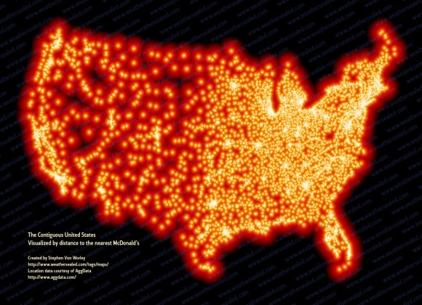
Distance Between McDonald’s

Slide 45

Central Place Theory: Threshold
Threshold: minimum number of people, and type of people needed to support a service
  Use Census data to determine specific hexagons needed to support a service
    Consider: population, age, and wealth of consumers to determine where to place business

Slide 46
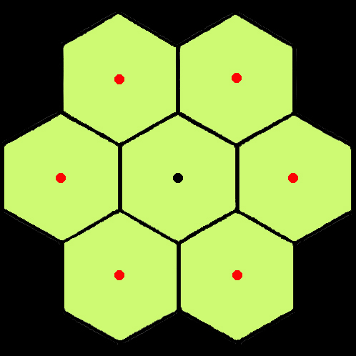
Notes:
Let’s start looking at how the orders in the central place hierarchy overlap. Imagine the black dot a the center as a town and the red dots as villages. The town is a higher-order central place; villages are lower-order central places.

Slide 47

Notes:
But remember that the town also provides village-level (lower-order) goods and services. So, it has been given a red center to equate it with a village. Central place functions are additive: you can find all village-level services in towns, and all town-level services in cities.

Slide 48
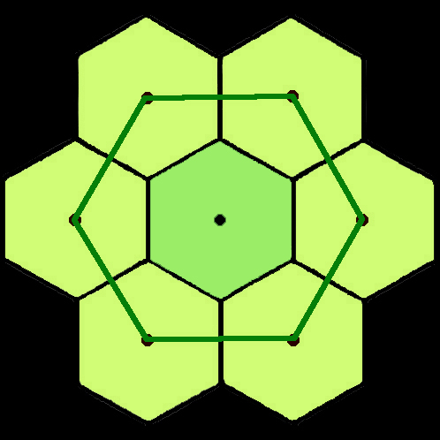
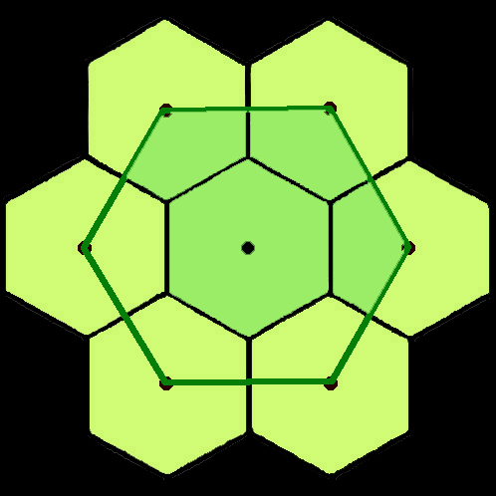
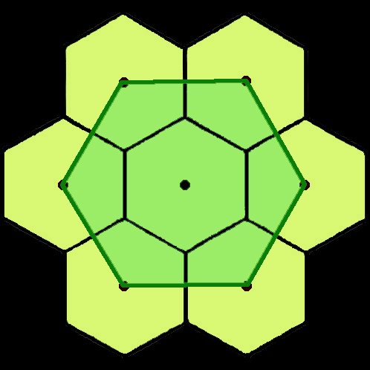
Notes:
Trade areas overlap. Settlements are organized in a nested hierarchy (in this case, in nests of 3). This is a 2-order hierarchy of central places (e.g., town and surrounding villages). People would go to the village center to pick up a loaf of bread at the convenience store; they would go to the town to shop for a week’s worth of groceries.

Slide 49
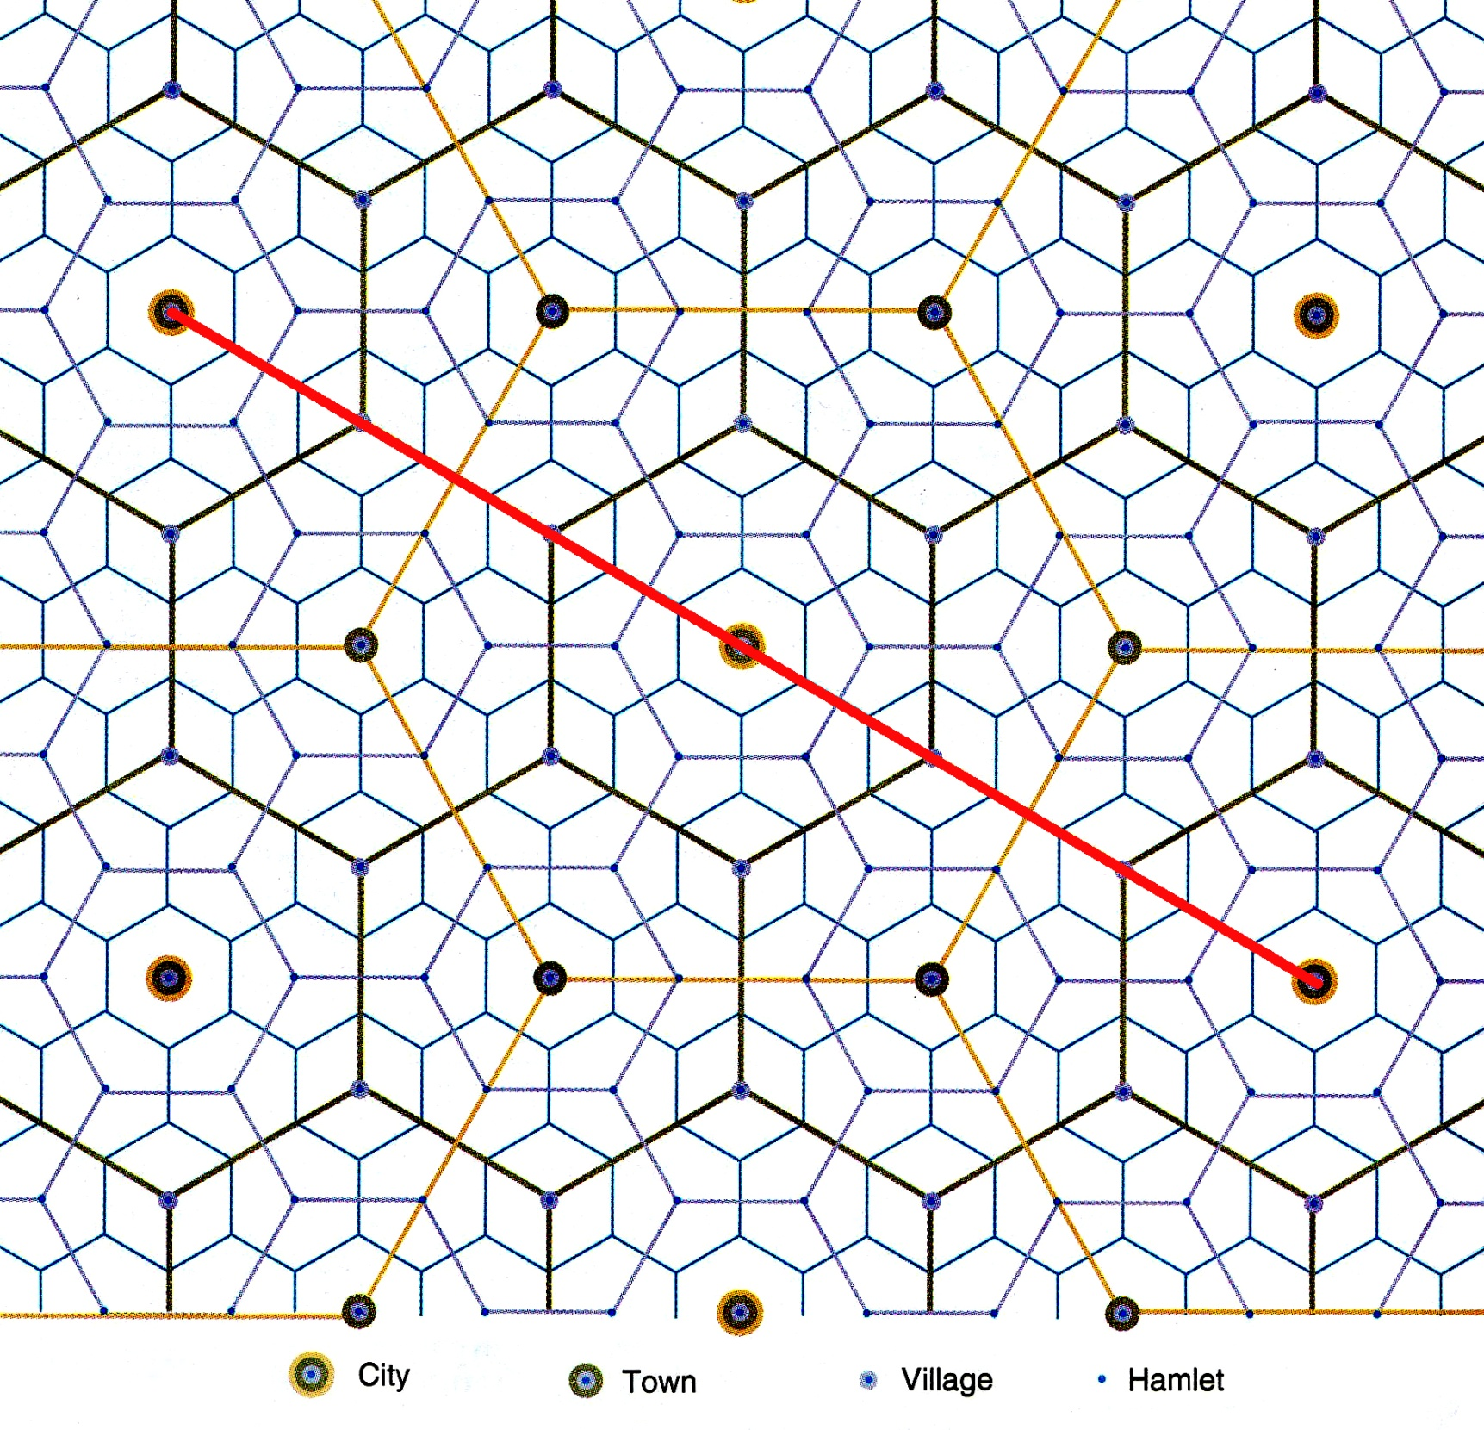
Notes:
Here is a 4-order hierarchy of central places. Imagine the red line as a highway that connects three of the biggest cities in the area. There is a problem: the highway misses the towns. If movement is possible in any all directions on our featureless plain, then central place theory makes sense. If we start adding transportation arteries, we reveal a weakness. That is why Christaller, came up with some modifications.

Slide 50
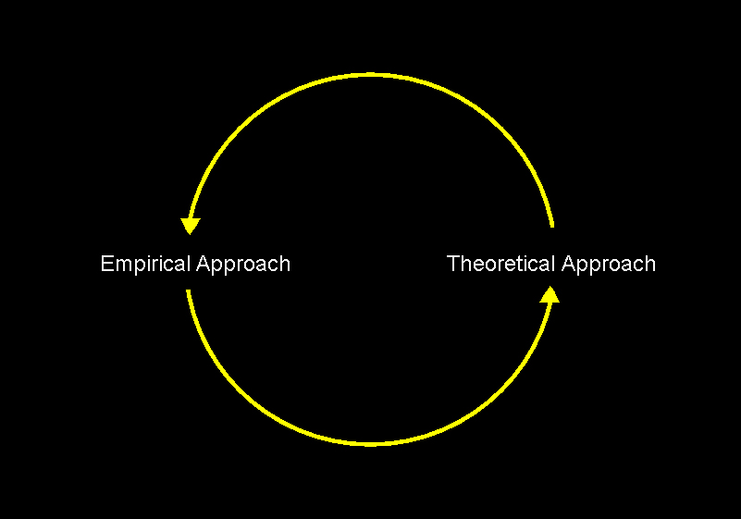
THE CIRCLE OF INQUIRY
Deduction
Induction
What is? vs. What should be?
Notes:
Go back to the real world to test the theory. What does the theory enable us to predict?

Slide 51
A WALK ACROSS FRANCE by Miles Morland
“We never knew whether or not a village would have a shop or a restaurant, but we were developing a system. We used to look up the population on the map. The IGN puts this in tiny figures next to the village name. Our system went like this:
Notes:
Sometimes people don’t even know they are using central place theory. A theory helps us predict. Here is an example. Miles Morland, A Walk Across France (New York: Fawcett, 1992)

Slide 52
Village Population | What to Expect
300+ | One all-purpose shop
500+ | Shop and café Occasional pharmacy
700+ | 2 shops, 2 restaurants, garage, pharmacy, maison de la presse
200 | Forget it.
Notes:
A village of 200 (maybe properly called a hamlet) = no services. Morland had probably never studied central place theory, but he recognized patterns on the landscape which conformed with central place theory.

Slide 53
Tests of Central Place Theory
J. E. Brush: The Hierarchy of Central Places in Southwestern Wisconsin
B. J. L. Berry, Trading Centers in Haakon County, South Dakota
R. C. Mayfield, A Central Place Hierarchy in Northern India
Y. Watanabe, The Service Pattern in the Shinjo Basin, Yamagata Prefecture
P. Woroby, Functional Ranks and Locational Patterns of Service Centers in Saskatchewan
Notes:
These were early tests of Christallerian Theory. The list was drawn from Brian J. L.Berry and Allen Pred, Central Place Studies; A Bibliography of Theory and Applications, 1961. Notice the world-wide distribution of these tests.

Slide 54
Villages become towns, and towns become cities.
The ‘Tween Places
Notes:
‘tween = between. Little places located in between larger places have grown in population and economic diversity because they are centrally located “in between” and there able to soak up growth in the transport corridor linking the two larger places.

Slide 55
Central Places of
Intermetropolitan Corridors
Half-way between Washington and Richmond?
Fredericksburg
Half-way between Richmond and Norfolk?
Williamsburg
Half-way between Washington and Baltimore?
Columbia

Slide 56
Why do we not ever see a perfect central place hierarchy?
Physical geography is important! Topography and hydrography interfere.
Consumer behavior is determined by more than economic considerations.
The automobile has made long-distance travel popular (cheap and easy).
People make multiple-purpose shopping trips, often bypassing the smallest places.
The Internet has made it unnecessary to have customers nearby.
Notes:
We need to bring the theory back to reality. There are lots of others, too.

Slide 57
The Practical Value of
Central Place Theory
Where would you go for ideas, if . . . .
Notes:
We need to bring the theory back to reality.

Slide 58
You were Dutch and needed to settle the newly drained polders of the Zuider Zee?
Central Place Theory
You were Brazilian and needed to settle people on the Amazon frontier?
Central Place Theory
You were an archaeologist and wanted to know where to dig next?
Central Place Theory
Notes:
Become aware of how far you are willing to travel to make a purchase. Private sector and public sector goods and services are both accounted for in CPT.

Slide 59
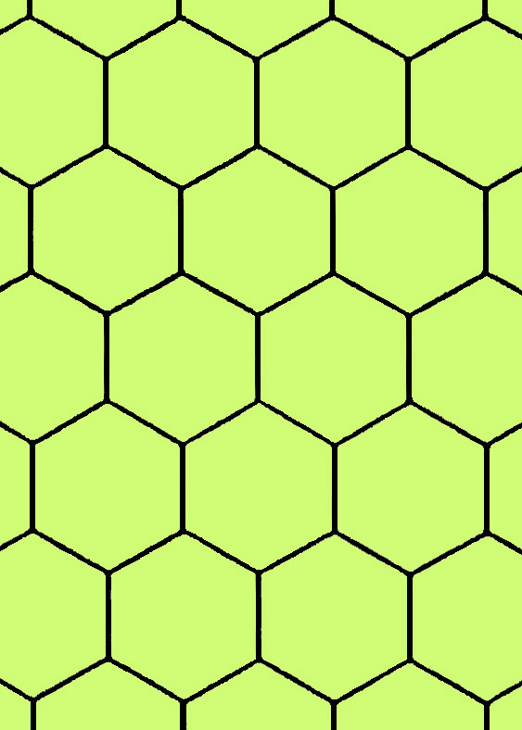
How could central place theory help you to choose a location for:
A new hospital?
A new high school?
A new mall?
A new café?
A new grocery store?
A new Starbucks?
A new McDonalds?
A new baseball team?
Notes:
Each of these needs a big enough customer base in order to operate profitably. Are there unserved areas of the metropolitan region?

Slide 60
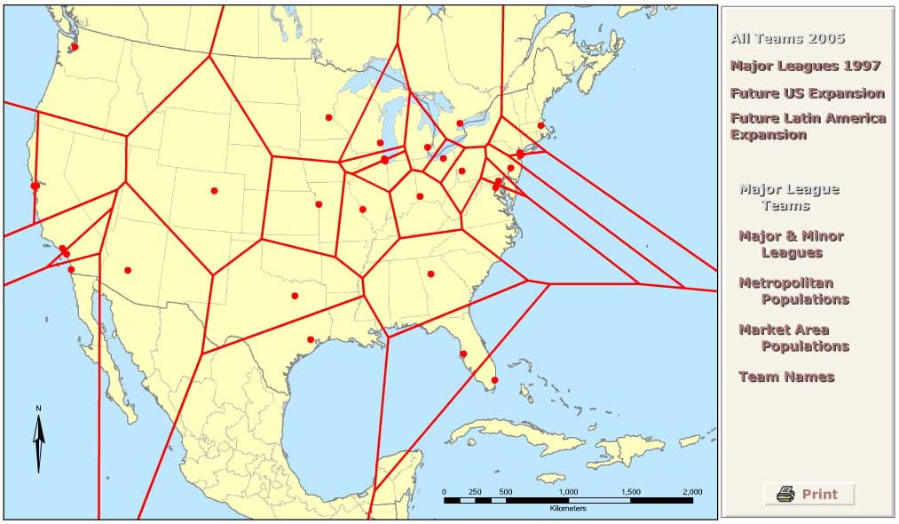
HGIA Kuby Chapter 9
Online Activity

Slide 61
Basic CPT with my students…

Slide 62
Choose three close-together (within 150 miles) towns: the one your school is located in (Danbury) and two others (Hartford) (Providence) so that the relative sizes are at least 1:5:25 (each town is at least or close to five times the size of the next). Then ask the question (next slide) Which towns would be likely to have a…
The examples should lead you to the "obvious" answer that the more specialized services will be located in the larger city, while the basic services will be found in every town. How do the concepts of threshold and range relate to these examples?

Slide 63
Bethel, Population: 18,000
Danbury, Population: 75,000
Boston, Population: 600,000
Which towns would be likely to have a...
gas station?
fast-food restaurant?
general practitioner?
shopping center?
Pizzeria
shopping mall?
movie theater?
theater for plays or performances?
professional piano tuner?
lawyer for traffic court?
neurosurgeon?
thrift store?
lawyer for international litigation?
luxury fashion shop (e.g., Fendi, Prada, Versace)?
Professional sports stadium, arena, etc…
Etc…

Slide 64
So to Summarize…

Slide 65
In order to determine level of a central place, you must rank all goods and services according to their thresholds and ranges.
Threshold – minimum level of demand needed that will allow a firm to stay in business (minimum level of sales, minimum population.
Range – average maximum distance people are willing to travel to purchase a good.
Threshold and range vary for each good and service.
Central places of a given level provide not only goods and services that are specific to its level, but also all other goods and services that lower order centers provide.

Slide 66
Threshold influences the number and relative location of producers.
High-order goods are available only at a few locations. They are expensive and purchased infrequently.
They have a high threshold and wide ranges.
Low order goods provided by a large number of locations. They are relatively cheap and purchased frequently.
For any market, the most effective system of marketing region will be a hexagonal lattice.
Completely covers an area without overlaps or unserved areas.

