Slide 1
Squatter Settlements and Mega Cities
Keller – APHG

Slide 2
Traditional Islamic City Form
Heart of city dominated by mosque and market
Associated with these features are schools, baths, government centers
Radiating patterns of hierarchy
Residential areas segmented into quarters
Segregated by communities
Also displaying radiating pattern
Within quarter a maze of alleys, lanes and cul-de-sacs
Major avenues ran from quarter to mosque/market

Slide 3
Changes to Modern Middle Eastern Cites
Rural to urban migration creates ‘squatter settlements,’ some lasting generations
The increase in car usage has changed transportation patterns and infrastructure
Suburbs are springing up, and the wealthy are moving into them
Many more young people in need of services and employment

Slide 4
Pre-Industrial Cities LDC World Cities
These are cities that have not been influenced by industrialization.
The social structure is usually based on a hierarchical class system.
There is a three level differentiation.
The elite or the ruling class occupies the center of the city; the lower class and the outcastes occupy the intermediate and the outer peripheral areas respectively.
Transportation modes are quite primitive (usually walking, bullock carts, and so on).
Since these cities depend on small agricultural retail, they are usually small in size.

Slide 5
Industrial & Post-Industrial LDC Cities
Industrial Cities
Cities with a significant manufacturing component.
Factories are located in central areas, which are accessible by mass transportation (buses, trains).
These cities survive as long as they maintain a comparative advantage over other cities in the manufacturing sector.
Post-Industrial Cities
These are cities that have "graduated from industrialization" into service (business, leisure) industries.
Most LDC cities are yet to reach this stage.

Slide 6
Colonial Cities
The pattern of colonial cities depends on the colonies of which they were a part of.
Spanish conquistadores completely erased indigenous settlements and mingled with the local culture to become a part of it.
Thus, Spanish colonial cities are more unitary in nature and follow Spanish elements.
Most of the cities in Latin America to the west of Andes, for example, follow the Laws of Indies that were promulgated by the Spain's King during late sixteenth century.
Their administrative system is also more centralized than that of the Portuguese in Brazil.

Slide 7
Colonial Cities
On the other hand, the French and the British never mingled with the local population and created separate quarters for themselves.
Thus, French and British colonies usually have a "White Town" consisting of spacious houses, well laid out streets and a "Native Town" which were usually quite dense and housed the indigenous population.
In apartheid countries of Africa, the division is very well defined.
Most colonial cities were either coastal (to allow maritime trade with the colonies) or administrative.

Slide 8
Post-Colonial Cities
Colonialism has strong impact on the form of post-colonial cities, and reflect some of their earlier characteristics.
The elite and the upper class usually buy properties from the previous colonial owners, thus transforming such areas into rich enclaves.
Africa is facing a more turbulent situation with the transfer of property as many properties owned by the White are being forcibly taken over by native blacks (e.g. South Africa, Zimbabwe).

Slide 9
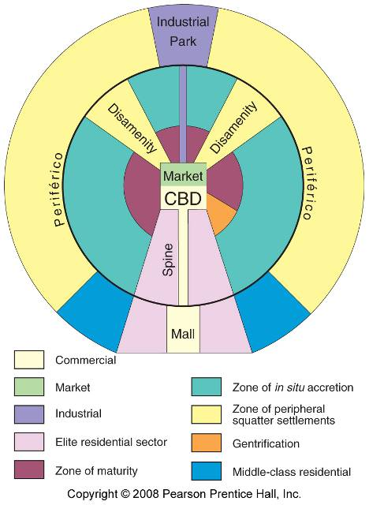
Latin American City Model
Fig. 13-15: In many Latin American cities, the wealthy live in the inner city and in a sector extending along a commercial spine.

Slide 10
Squatter Settlements
Unlike North American cities, the inner core of South American cities has, until recently, remained vital and of greater social standing, the periphery relegated to poverty, decay and crime.
Sprawl, facilitated by buses, has extended the limits of cities.

Slide 11
Latin America - Inner City Trends
Adjacent to the CBD, in areas that were formerly elite residential zones but which have not yet attracted the developers bulldozers, a flight of the rich to the spines and to the gated greenfield suburbs has left mansion homes vacant of their former owners.
Frequently, these have been converted into rented tenements – multi-family apartment buildings in which several whole dwellings will be carved out of a single room, resulting in twenty or even forty families living in a building once housing a single family and their servants.
These then become the shanty-towns of the inner-urban poor, those working as street vendors or in low-paying service jobs in and around the towering commercial buildings of the next door CBD.
These types of changes create zones of disamenity which are neglected by the city authorities and exploited by the landlords.

Slide 12
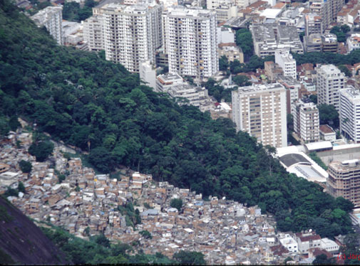
Squatter/Shanty Towns
Every South American city has them – usually on the edge of town outside the ring road, often on steep slopes or along river corridors subject to periodic flooding.
So common are the squatter areas that almost every country in South America has its own term for them – favelas, villas miserias, pueblos jóvenes, cerros and quebradas, and so forth.
Depending on the country and city, shanties may contain more than half of the urban population, although 20-30% is a more common figure.
In some situations, rapid growth of cities has led to shanties filling in underutilized space (for example steep unstable slopes) inside the sprawling metropolises, creating stark juxtapositions.

Slide 13
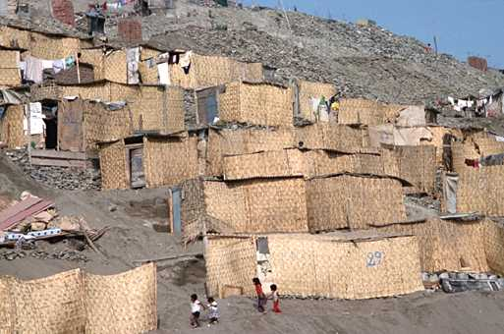
Squatter settlements – Highly Variable Zones
They are characterized more by the fact that the land they occupy has no title – the communities are squatting on (usually) public or ejidal lands – than the nature of the dwellings.
Depending on age, they can range from sprawling collections of hastily constructed shacks of scavenged materials to more orderly, multi-room brick or cement panel buildings, often with rebar or wood scaffolding sticking out of a flat roof - evidence of permanency, or at least ambitions of such.

Slide 14
Characteristics of Shantytowns
Population densities are high, families living in close proximity to each other on small parcels of land.
Privacy is very limited, with minimal separation between households in both a geographical and physical sense.
Basic services are usually absent especially garbage collection, sanitary sewer service, telephone and piped potable water supply, although basic electricity service might be provided (often with many illegal connections).
Roads are usually unpaved, with no formal surface drainage to conduct surface runoff safely off the roads and down hillsides, leading to extensive erosion.
Garbage is usually burned in oil drums or pits and open-air defecation is common, thus development projects frequently promote pit-latrine projects in shanty towns.

Slide 15
To summarize: Squatter settlements are most likely located:
On the edge of the metro area on either public or private land which was unoccupied prior to the establishment of the squatter settlement.
On steep hillside areas either at the edge of the city or in the center, which were thought to be un-buildable or unoccupied before the squatters established themselves.
On dump sites in the city
On areas that are prone to flooding
Lands that have unclear title

Slide 16
Factors that have resulted in the high proportion of squatter settlements
Large scale and rapid rural to urban migration resulting from push
factors. For ex: changing nature of agriculture, rural population
growth and violence.
Lack of employment opportunities in urban areas.
Inability of government to provide enough public or subsidized housing to meet the demand.
Undeveloped housing sector of the economy to provide financing, labor, property and development expertise to build large areas of low cost housing in the private sector.
Rapid population growth within the squatter population in the large cities.

Slide 17
Consequences of Rapid Growth
Large numbers of people working in informal sector of the economy.
Unhealthy living conditions and high sickness and mortality rate in squatter settlement.
Development of strong anti-gov’t or authority political parties or branches of political parties.
Development of gangs, mafias, or other non-legal authority systems in the squatter settlements that use violence to enforce their rule.
Increased police corruption.

Slide 18
Consequences of Rapid Growth (cont.)
Increased soil erosion on hillsides as existing vegetation is removed for housing.
Increased water pollution resulting from lack of sanitary facilities in squatter settlements.
Decreased air quality resulting from fires used for cooking and heating in settlements.
Social, health issues, such as increased drug use, limited access to fresh water, children not attending school.
Strain on infrastructure, illegal access to electricity out of necessity.

Slide 19
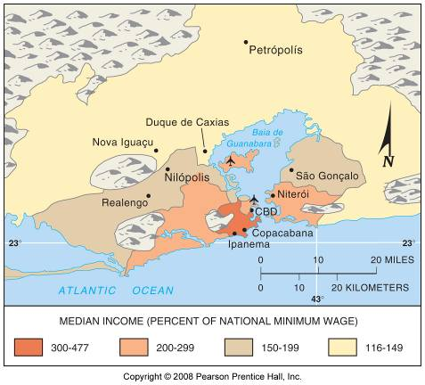
Rio de Janeiro, Brazil High & Low Income Regions
Fig. 13-16a: High income households in Rio de Janeiro live in the CBD and in a spine along the ocean. Low-income households often live in peripheral areas.

Slide 20
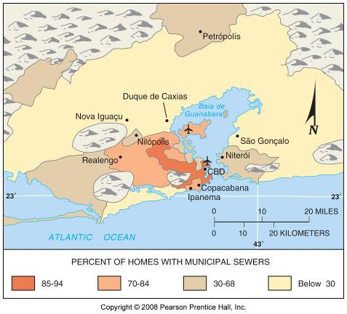
Rio de Janeiro Areas with Sewers
Fig. 13-16b: High income households are attracted to central areas of Rio partly because these areas have access to services such as sewers.

Slide 21
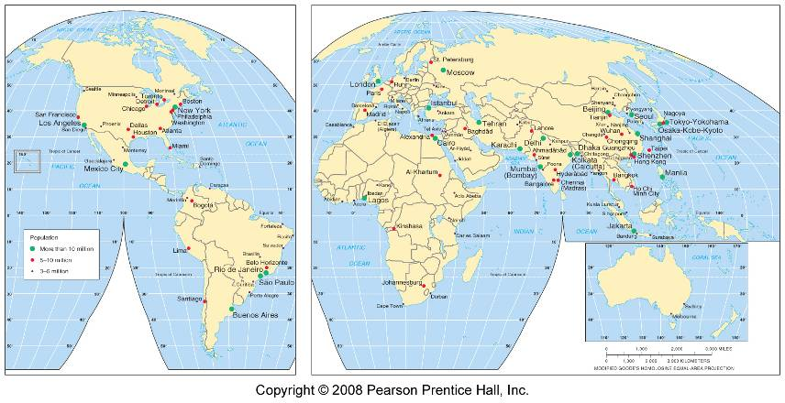
Large Cities
Fig. 13-2: Cities with 3 million or more people. Most of the largest cities are now in LDCs.

Slide 22
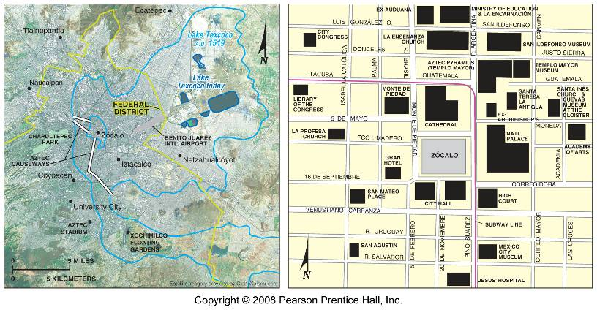
Mexico City
Fig. 13-12: The Aztec city of Tenochtitlán was built on an island in Lake Texcoco. Today poorer people live on a landfill in the former lakebed, and the elite live to the west.

Slide 23
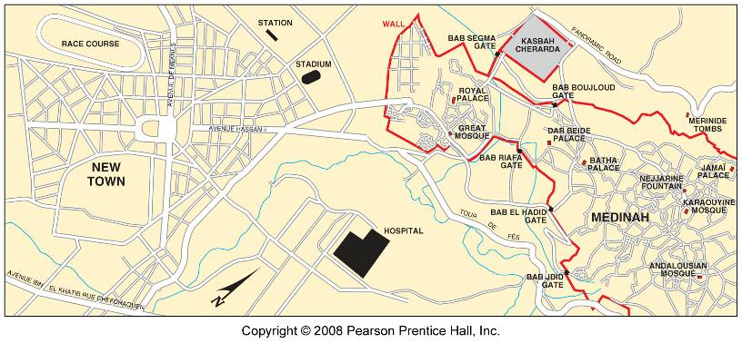
Fès (Fez), Morocco
Fig. 13-13: The old city in the east has narrow winding streets and dense population. The French laid out a new district to the west with a geometric street pattern.

Slide 24
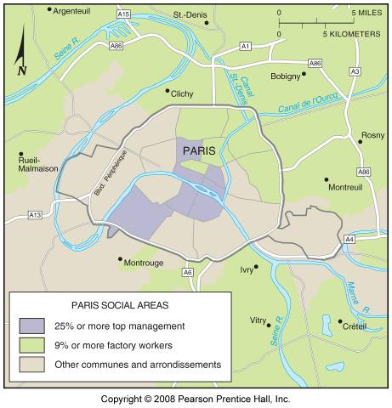
Social Areas in Paris
Fig. 13-11: Higher income professionals are likely to live in the center of Paris, while factory workers tend to live in the suburbs, in contrast to the pattern of many American cities.

Slide 25
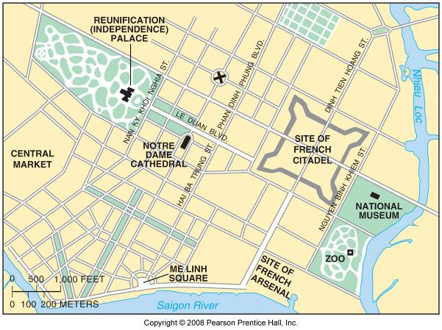
Ho Chi Minh City, Vietnam
Fig. 13-14: In Ho Chi Minh City (formerly Saigon), the French demolished the previous city and replaced it with a colonial design with boulevards and public squares.

Slide 26
World Megacities

Slide 27
Largest World Cities
Ten Most Populous in A.D. 1975
1. Tokyo 19.8 million
2. New York 15.9 million
3. Shanghai 11.4 million
4. México 11.2 million
5. São Paulo 9.9 million
6. Osaka 9.8 million
7. Buenos Aires 9.1 million
8. Los Angeles 8.9 million
9. Paris 8.9 million
10. Beijing 8.5 million
Source: U.N., 2001
* Note that five of these cities are in the Core or more developed world.

Slide 28
Largest World Cities
Ten Most Populous by A.D. 2015
1. Tokyo 28.7 million
2. Bombay 27.4 million
3. Lagos 24.4 million
4. Shanghai 23.4 million
5. Jakarta 21.2 million
6. São Paulo 20.8 million
7. Karachi 20.6 million
8. Beijing 19.4 million
9. Dhaka, Bangladesh 19.0 million
10. México City 18.8 million
Source: U.N., 2001
* Note that only one of these cities is in the Core of the more developed world!

