Slide 1
Urban Ecological Models of the internal structure of North American Cities
APHG
Keller 2011

Slide 2
Earliest ideas for models
Ecology developed in biology
Shift from thinking about individual species to plant and animal communities
Plant species compete for water and energy
Communities evolve in response to competition

Slide 3
Fundamental concepts
Communities evolve to climax. The Community of plants and animals that is best suited to the water and energy balance of locales.
When disturbed an environment experiences the process of invasion and succession as the landscape evolves once again toward a climax.

Slide 4
Concepts from biology brought into new Social Science
Harlan Barrows Geographer at U of Chicago uses term Human Ecology
Park and Burgess found school of Urban Ecology in Sociology Department of University of Chicago
Both scholars had been journalists and were careful observers of cities
Wanted to go beyond previous writing on cities

Slide 5
The Growth of the City: An Introduction to a Research Project by Earnest Burgess U of Chicago Press 1926
Robert Park and Earnest Burgess work together. Park provides a frame in the introduction Burgess provides the analysis

Slide 6
The problem
One of the most important and striking developments in the growth of the urban population of the more advanced peoples of the world during the last few decades has been the appearance of a number of vast urban aggregates or conurbations, far large and more numerous that the great cities of any preceding Age

Slide 7
Observation
“In the United States the transition from a rural to an urban civilization though beginning later that in Europe, has taken place, if not more rapidly and completely at any rate more logically in its most characteristic form”

Slide 8
Opportunity
Cities merge as a result of expansion
Process can be seen in New York and Chicago where growth crosses county and state boundaries
No study of urban expansion as a process had been completed

Slide 9
The basic conclusion
“the typical processes of the expansion of the city can best be illustrated, perhaps, by a series of concentric circles which may be numbered to designate both the successive zones of urban extension and the types of areas differentiated in the process of expansion”
It is a model of urban growth

Slide 10
“An ideal construction of the tendencies of any town or city is to expand Radially from its central Business district”
“It hardly needs to be added that neither Chicago nor any cities perfectly fit into this ideal scheme”

Slide 11
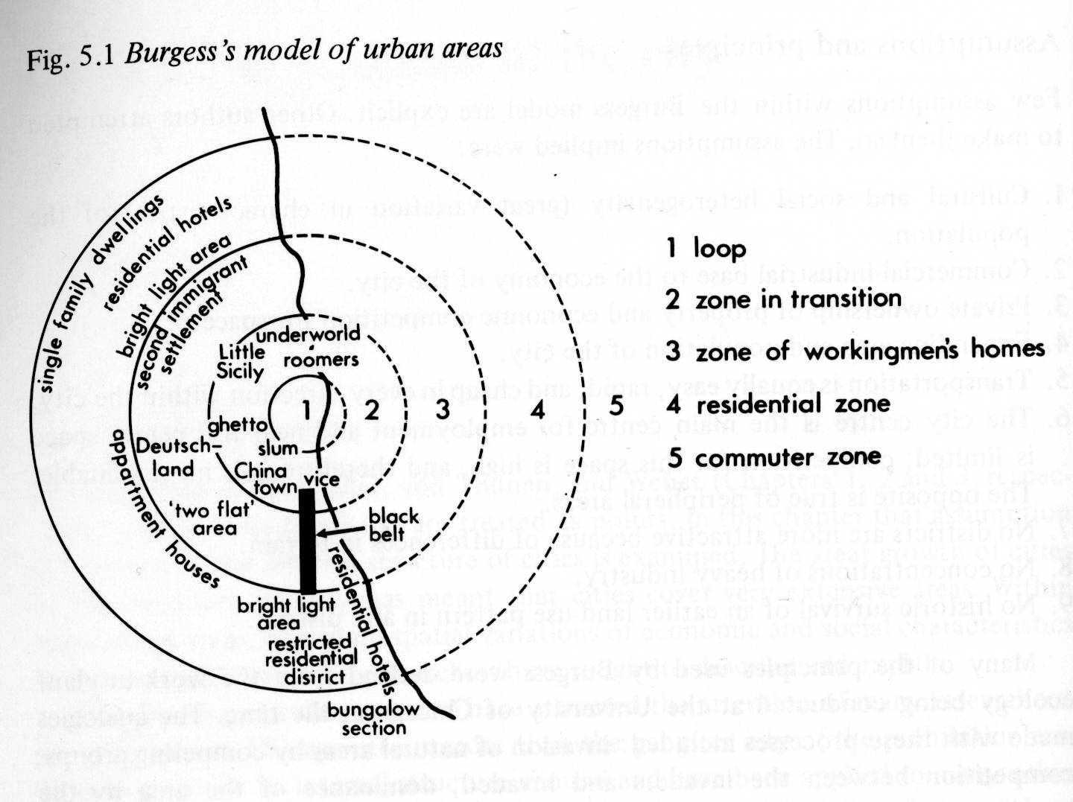

Slide 12
The Zones
1. The “Loop”
Center of Economic, cultural and political life
Main Stem of hobohemia

Slide 13
Zone 2 The Zone of Transition
Encircling the downtown area, there is normally an area of transition, which is being invaded by businesses and light manufacturing
first drawing has factory zone.
Slum and badlands of city
Zone of poverty degradation and disease
Underworld
immigrants

Slide 14
Zone 3 Zone of Workingmen’s homes
Inhabited by the workers in industries who have escaped from areas of deterioration but who want to have easy access to their work

Slide 15
Zone 4 Residential area
Beyond zone of workingmen’s homes
High class apartment buildings
Exclusive districts of single family homes

Slide 16
Zone 5
Still farther, out beyond the city limits is the commuter’s zone – suburban areas or satellite cities – within a thirty to sixty minute ride of the central business district

Slide 17
Factors influencing patterns
Physical landscape
Transportation routes
Historical factors of the location of industry
Relative degree of the resistance of communities to invasion.

Slide 18
Critical ideas
The main fact of expansion is the tendency of each inner zone to extend its area by the invasion of the next outer zone
The concept of land use competition for accessibility and amenity
Invasion and succession goes in one direction only

Slide 19
A model of Segregation
“This differentiation into natural economic and cultural groupings gives form and character to the city
Segregated areas tend to accentuate certain traits, to attract and develop their kind of individuals and to become further differentiated

Slide 20
Conditions which initiate invasion
Changes in forms and routes of transportation
Obsolete – deterioration or change in function
New type of industry
Real estate promotion
Erection of buildings that may repel or attract
Bridges, schools

Slide 21
Stages of Invasion
Initial resistance or inducement
Secondary or developmental land values increase and building values decline
climax

Slide 22
Importance of model’s acceptance
Middle class neighborhoods must be protected from the invasion process
Real estate agents must not do anything to destroy neighborhoods
Zoning laws developed to protect neighborhoods from invasion by commercial or high density residential uses

Slide 23
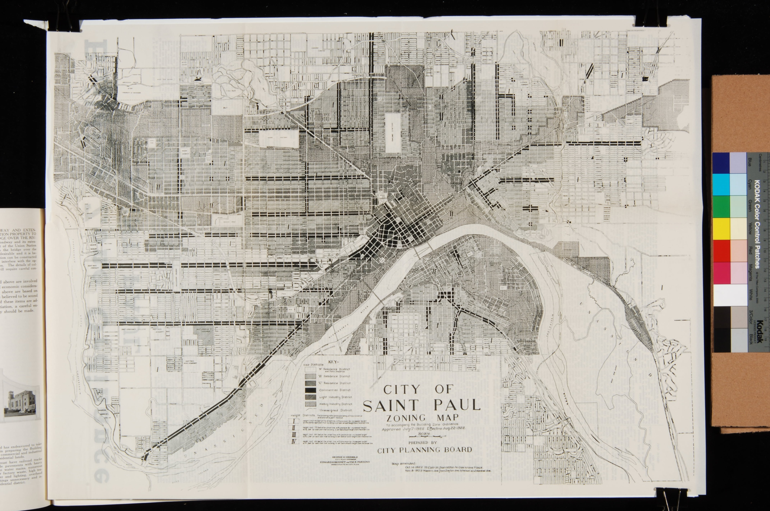

Slide 24
Importance of model’s acceptance
Gave scientific underpinning to ethnocentricism and racial discrimination
Promoted homogeneous residential communities

Slide 25
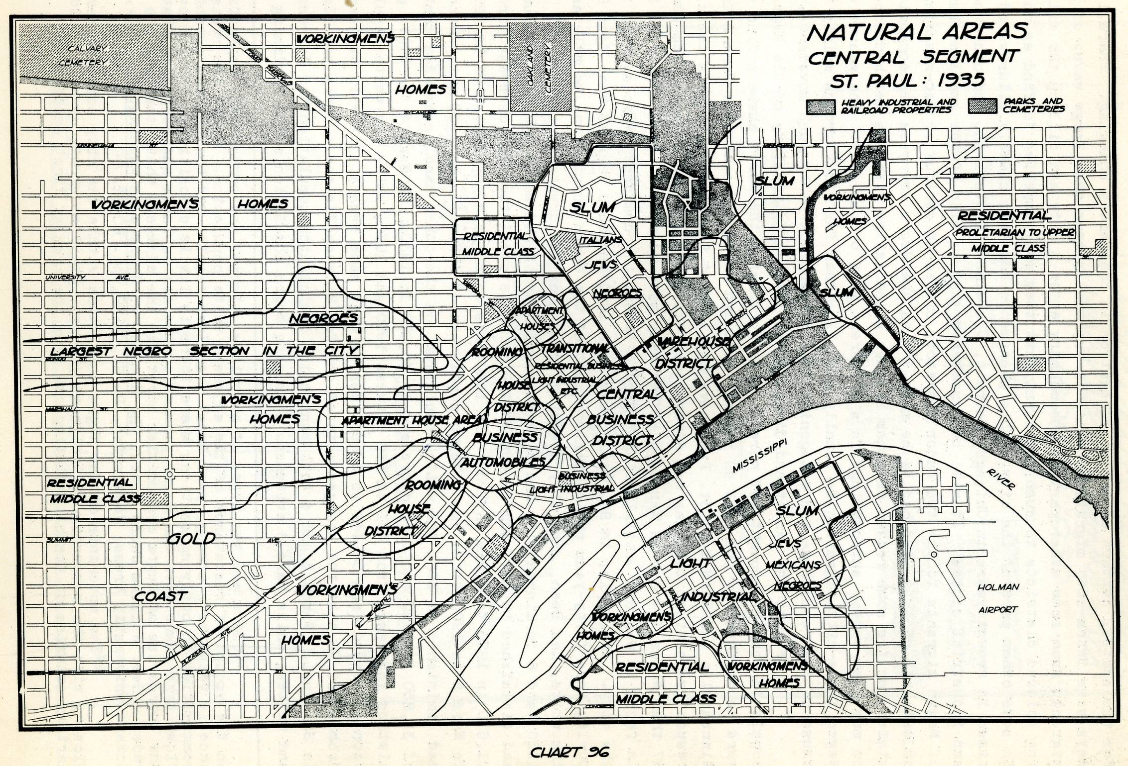

Slide 26
Importance of model’s acceptance
Used by real estate industry to turn over middle class neighborhoods via block busting tactics
Justified redlining by financial and insurance industry - do not invest in poor or minority areas because they will continually deteriorate due to invasion and succession
Increased the importance of distance (NIMBY)

Slide 27
Importance of model’s acceptance
This model is the base for all other models of the internal spatial structure of cities
Later models of US cities
Model of Latin American City
Models of Southeast Asian
Models of African Cities
Models of South Asian Cities
Soviet model was developed in opposition to it.

Slide 28
Homer Hoyt
Student of Park and Burgess
One Hundred Years of Land Values in Chicago
Makes two major changes to the thinking of the Burgess model
High income wedge pulls the city
Low income can invade high income
Change surface to network The STREET CAR MODEL

Slide 29
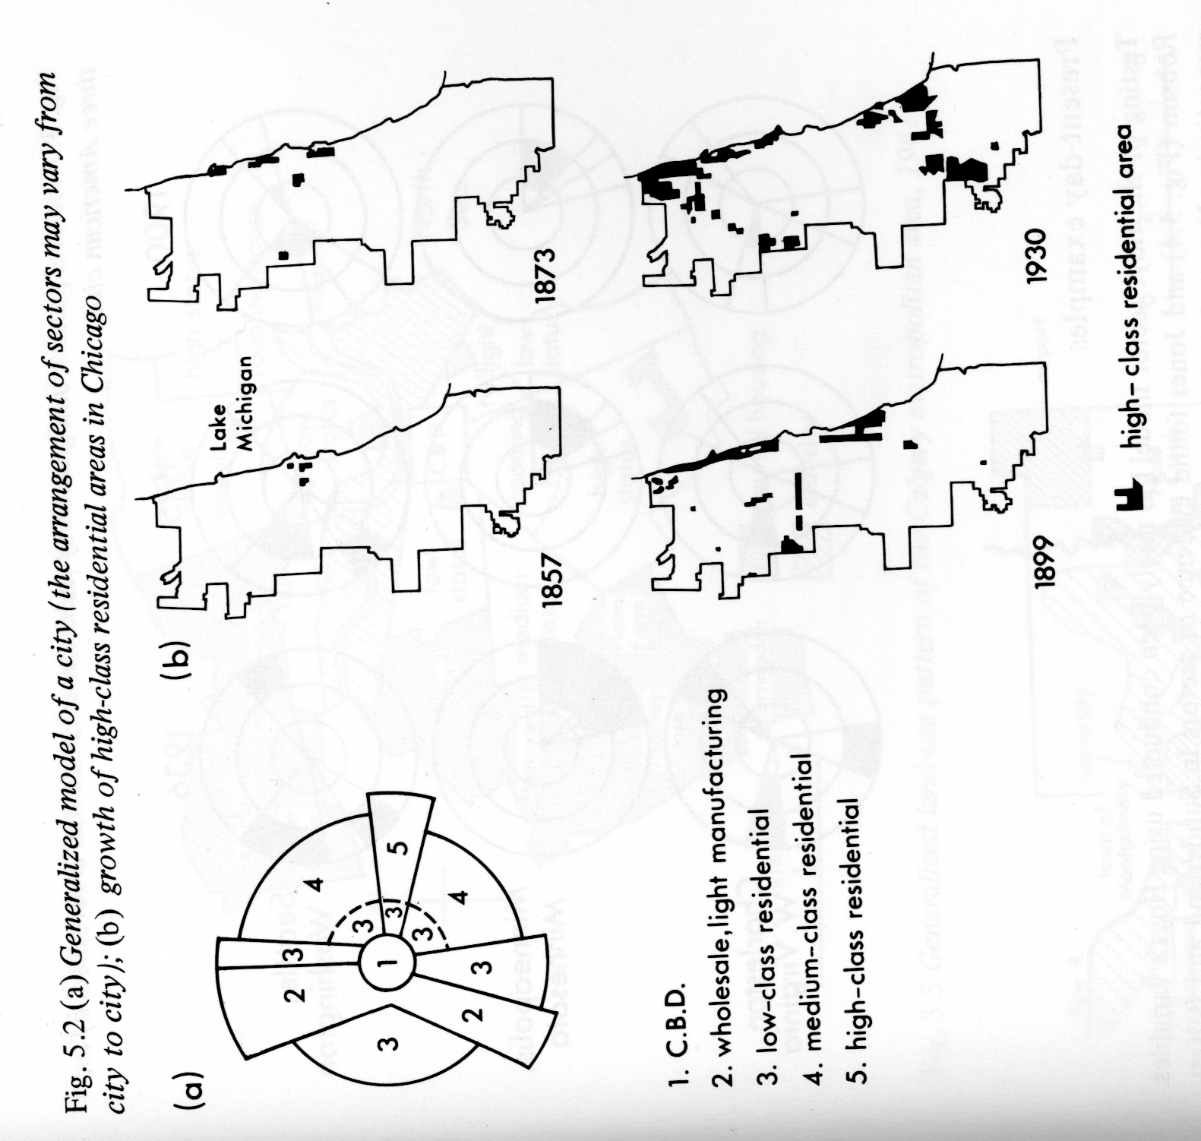

Slide 30
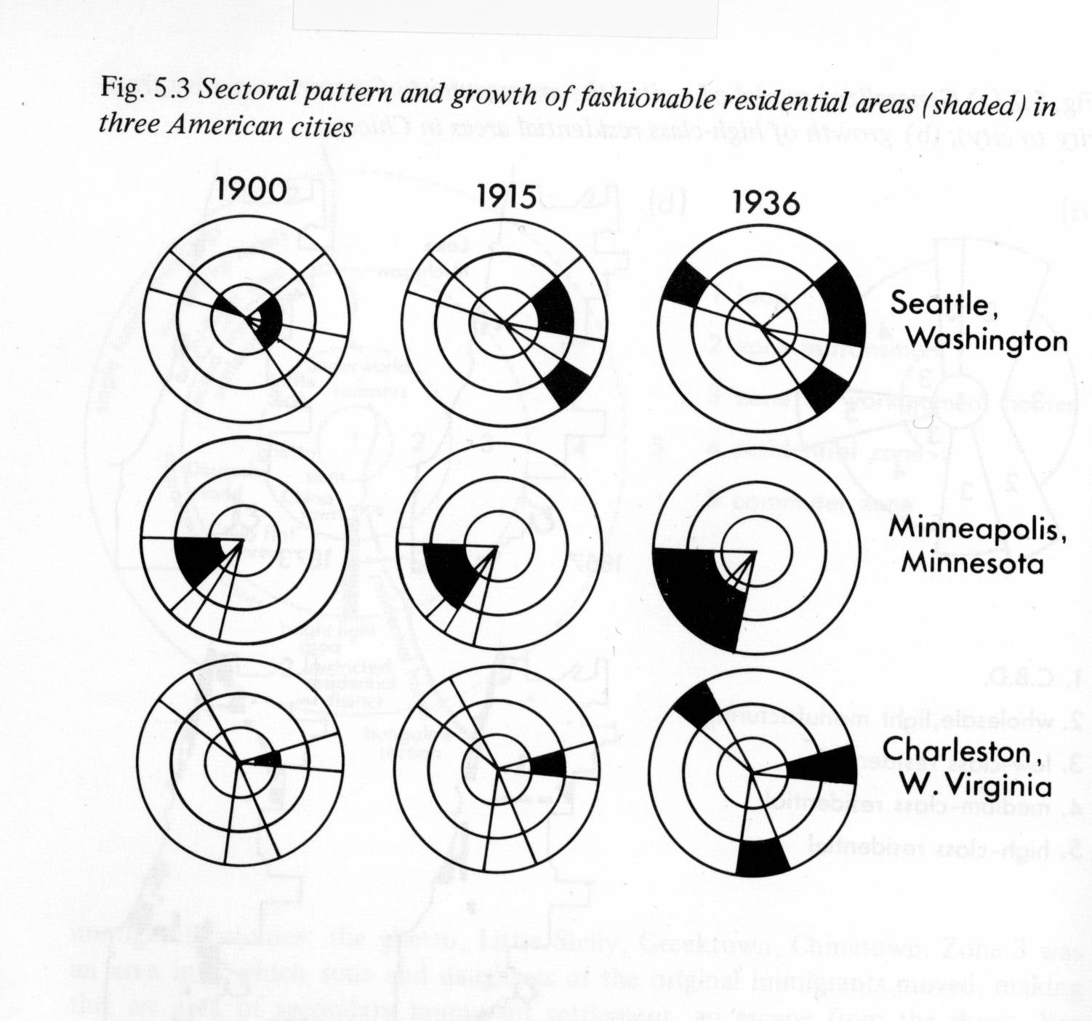

Slide 31
Critical change ONE Growth at edges pulls city
Real estate developers control the expanding city
Manipulate building designs
Develop amenities
Promote exclusivity
Encourage the development of large lot communities
Promote the status of place

Slide 32
Critical changes
Calls for low income suburbs
Acknowledges the across the tracks syndrome
Predicts the movement of high status shops toward the high income residential areas
Calls for a zone of expansion and abandonment in the Central Business District

Slide 33
Basic idea not different
Land use competition for locational advantage
Invasion and succession from high density to low
Natural process of expansion

Slide 34
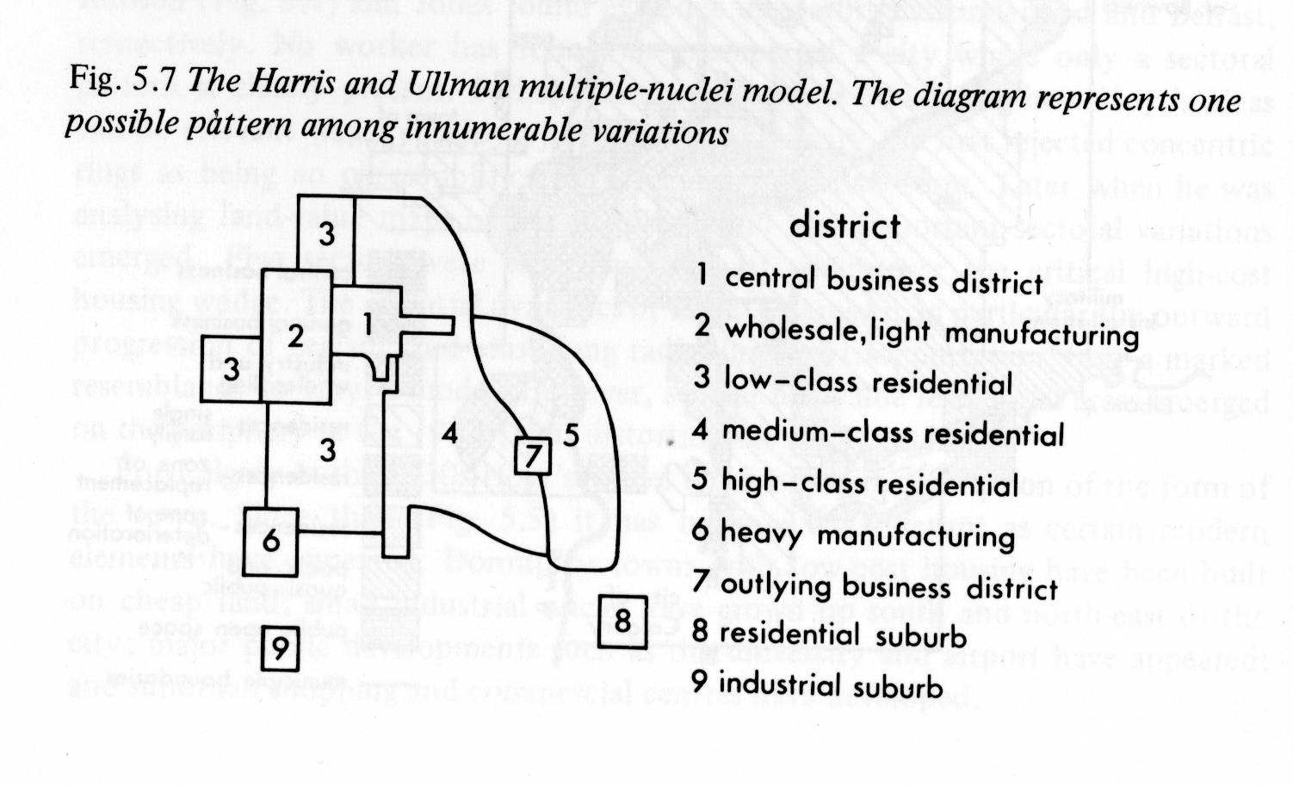
Auto Era Model – Multiple Nuclei

Slide 35
Critical difference
Allows for more forms of transportation – particularly the automobile
Allows for more variation in landscape
Allows for industrial suburbs

Slide 36
Critical flaws in these models
The assumption of free competition of land use is unwarranted because as soon as Burgess model was made public its concept of invasion and succession was not tested but rather became the base for zoning regulations. Therefore it became a self-fulfilling prophecy

Slide 37
Critical flaws in these models
Its assumption that invasion and succession was one directional – from rich and low density to poor and high density was proven false by gentrification.

Slide 38
Critical flaws in these models
White flight created space for African Americans to occupy. Not really an invasion but a retreat caused by a belief in the assertion of the model

Slide 39
Generalizations for having students learn about these models
Do not Concentrate on geometry of the diagrams rather than their application.
Show how Models can provide preliminary understandings or generalizations
Role of distance decay
High income sector and other groupings
Segregation
Role of amenities and disamenties
Role of transportation
Role of various actors –planners, organizers, real estate professionals, bankers etc.

