Slide 1
The Four Kinds of Fragments
Mrs. Hurd
English 9
John S. Battle High School

Slide 2
Fragments
Fragments are word groups that lack a subject or a verb and does not express a complete thought.
Fragments include:
Dependent word fragments
-ing and to fragments
Added detail fragments
Missing subject fragments

Slide 3
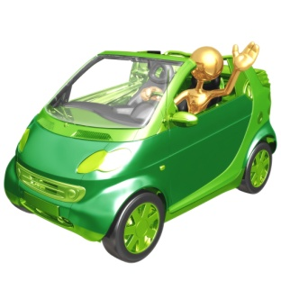

Dependent word fragments
After I closed the door or Before I could answer her email.
These statements CANNOT stand alone. They must depend on an independent clause. Usually this results from one not finishing a thought.
(incorrect) After I learned the price of the new car. I decided to keep my current one.
(correct) After I learned the price of the new car, I decided to keep my current one.

Slide 4
-ing and to fragments
I spent almost two hours on the phone yesterday. Trying to find a garage to repair my car.
I plan on working overtime. To get this job finished.
To fix this, simply delete the period and connect the two phrases together.
I spent almost two hours on the phone yesterday trying to find a garage to repair my car.
I plan on working overtime to get this job finished.

Slide 5
Added-Detail Fragments
These fragments occur when you place a period at the end of a sentence, but wish to continue giving more description. If this is the case, you need to restate your subject in a new sentence or eliminate the period.
I love to cook and eat Italian food. Especially spaghetti and lasagna.
I love reality shows. Like Survivor or American Idol.
I love to cook and eat Italian food, especially spaghetti and lasagna.
I love reality shows like Survivor or American Idol.

Slide 6
Missing Subject Fragments
Missing subject fragments try to add information, but do not restate the subject again, causing confusion.
Michelle tried each of the appetizers on the table. And then found that, when the dinner arrived, her appetite had gone.
Michelle tried each of the appetizers on the table. She then found that, when the dinner arrived, her appetite had gone.

Slide 7
Determine if it is a sentence or a fragment.
I went to the store yesterday.
To buy a gallon of milk.
I called Lisa this morning.
Because she said that she was not feeling well.
To get a better look at the car.
I drove up on the dealership lot.

