Slide 1
Pronouns
Mrs. Hurd
John s. Battle High School

Slide 2
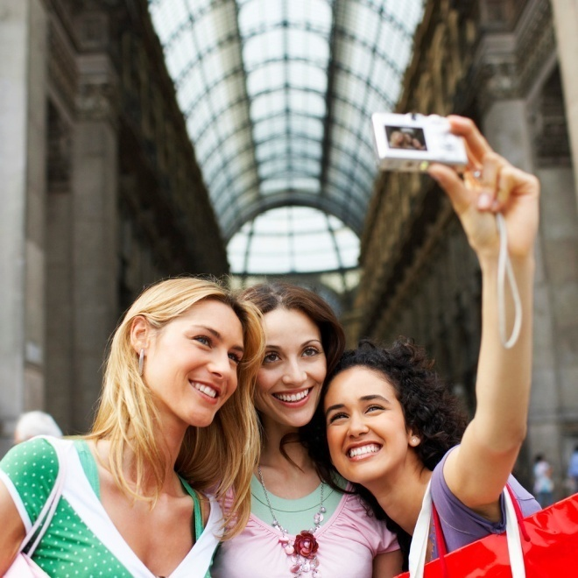
Personal Pronouns
Personal pronouns refer to the one speaking (first person), the one spoken to (second person), or the one spoken about (third person).
First person: I, me, my, mine, we, us, our, ours
Second person: You, your, yours
Third person: he, him, his, she, her, hers, it its, they, them their, theirs

Slide 3
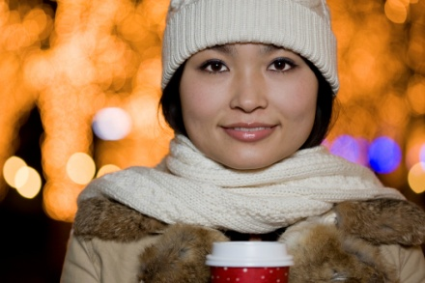
Reflexive and Intensive Pronouns
A reflexive pronoun refers to the subject of a sentence and functions as a complement or as an object of a preposition
Intensive pronouns emphasize an antecedent and have no grammatical function.
Reflexive and intensive pronouns:
Myself, ourselves, yourself, yourselves, himself, herself, itself, themselves.
They went to the store themselves.
She made the scarf by herself.

Slide 4

Demonstrative Pronouns
Demonstrative pronouns are used to point out a specific person, place, thing, or idea.
THIS, THAT, THESE, and THOSE
This is the dress I was telling you about.
These are the notes from yesterday.

Slide 5
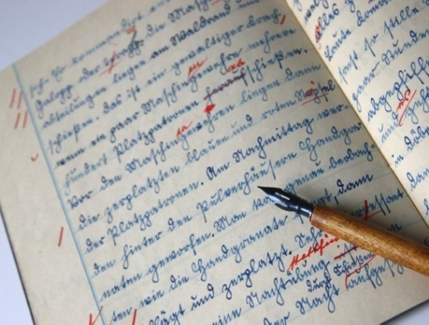
Interrogative Pronouns
Interrogative pronouns introduce a question.
Who, Whom, Whose, Which, What
What is the capital of Virginia?
Which book was our assignment from?

Slide 6
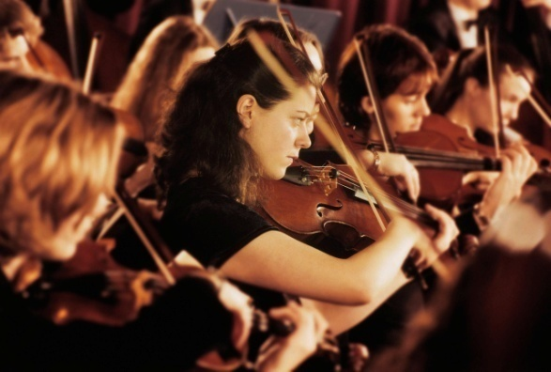
Relative Pronouns
A relative pronoun introduces a subordinate clause.
Who, Whom, Whose, Which, That
My brother works at the animal shelter that is located on Sycamore Street.
This was the night which the school orchestra has been preparing.

Slide 7

Indefinite Pronouns
An indefinite pronoun refers to one or more person(s), places, things, or ideas that may or may not be specifically named. Some common indefinite pronouns are all, another, anybody, both, either, each, everyone, many, nothing, several, and some.
Everyone who went to the space camp had a wonderful experience.
Someone told me that the bald eagle is no longer on the list of endangered species.

Slide 8
Identify the types of pronouns used in the following sentences:
That is my favorite coffee shop. =
Who is answering the phone?
I am applying for the scholarship that pays for full tuition.
My mother is a librarian.
Many of my friends have a class in the Mason building.
I fixed the faucet leak myself.

Slide 9
Answers!
That is my favorite coffee shop. = Demonstrative
Who is answering the phone? = Interrogative
I am applying for the scholarship that pays for full tuition. = Relative
My mother is a librarian. = Personal
Many of my friends have a class in the Mason building. = Indefinite
I fixed the faucet leak myself. = Reflexive

