Slide 1
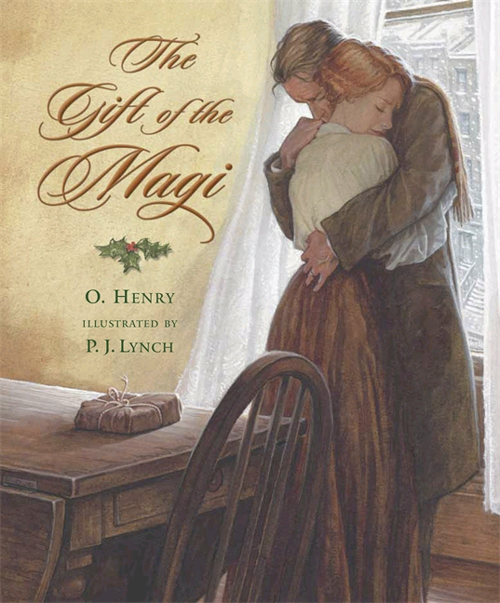
The Gift of the Magi
By: O. Henry
(1862-1910)

Slide 2
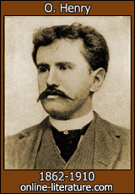
Some facts About O. Henry
He lived in New York City
Wrote stories for magazines and newspapers
O. Henry is a pseudonym: A "false name" or alias used by a writer desiring not to use his or her real name. Sometimes called a nom de plume or "pen name.”
Embezzled money; was in jail for three years
Wife died of tuberculosis
Famous for stories with a twist at the end

Slide 3
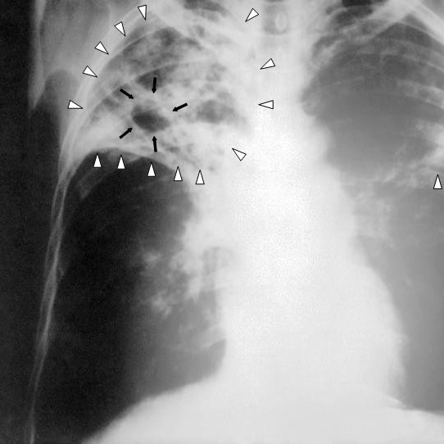
Tuberculosis (TB)
Tuberculosis (abbreviated TB for tubercle bacillus or Tuberculosis) is a common and often deadly infectious disease caused by mycobacteria, in humans mainly ^{[1]}. Tuberculosis usually attacks the lungs but can also affect the central nervous system, and other areas of the body.

Slide 4
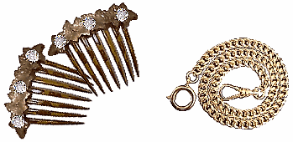
Rewards and Sacrifices
Big Idea: As you read the story, ask yourself, What are the characters willing to sacrifice and what do they expect as rewards?

Slide 5
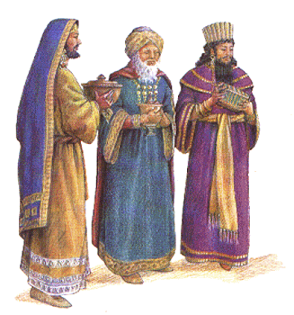
Who Were the MaGI?
According to the New Testament of the Bible, the Magi were the three wise men who came from the East to give gifts to the newborn baby Jesus. Over time, the Magi have come to be associated with the practice of giving gifts.

Slide 6
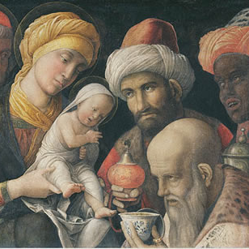
allusion
A reference in one work of literature to a historical event, person, or another work of literature, often used to deepen the meaning of the story.

Slide 7
Allusion
According to Christian tradition, the Magi were three wise men or kings that presented gifts to the infant Jesus.
  Sometimes thought of as the first Christmas presents.
  Why is this an appropriate allusion for this story?

Slide 8
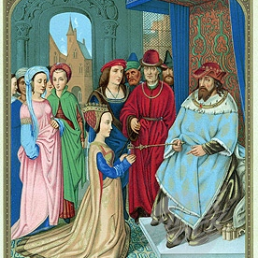
Allusion
Queen of Sheba: The Hebrew Bible devotes some thirteen verses to the Queen of Sheba. 1 Kings 10.1-13 (copied in 2 Chronicles 9.1-12) relates that the Queen of Sheba journeyed to King Solomon's Jerusalem with an impressive and numerous entourage, eager to "prove him with hard questions." Solomon's wisdom and the greatness of his court impressed the queen, she gave him rich gifts, and she returned home, never to be heard from again.

Slide 9
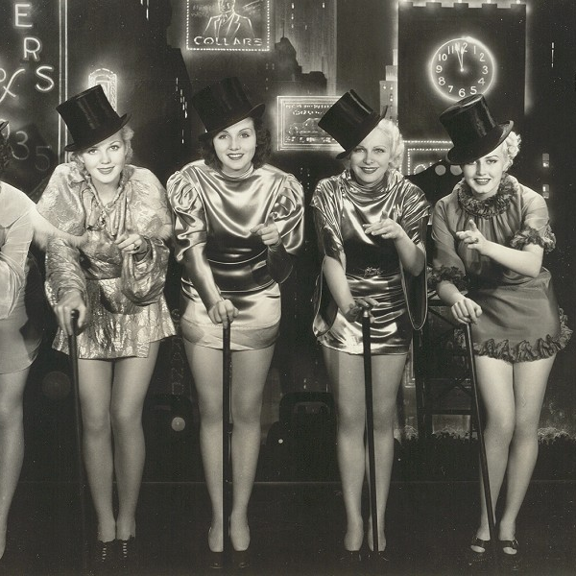
Coney Island Chorus Girl
A woman who dances in a chorus line as part of a stage production or play.

Slide 10
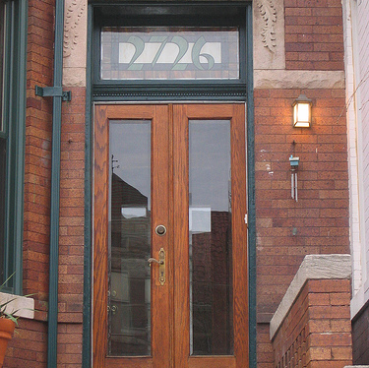
Vestibule
A vestibule is a lobby, entrance hall, or passage between the entrance and the interior of a building.

Slide 11
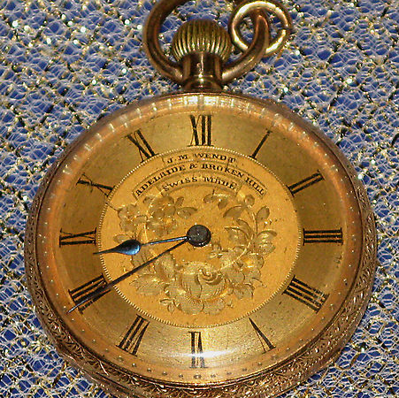
Pocket watch

Slide 12

Pier Glass
Tall, narrow glass designed to be hung between two windows.

Slide 13
Characterization
The method a writer uses to reveal the personality traits of a character.
Direct Characterization: The writer makes statements about the character
Indirect Characterization: The writer reveals a character through his words, actions, thoughts, and through what other characters think and say about that character

Slide 14
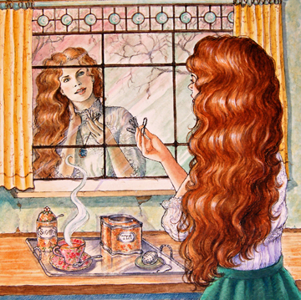
Della
Characterization: What can you tell about Della from the narrator’s commentary?

Slide 15
Della
Characterization: She feels love and esteem for Jim. She wants to give him a present that is worth of him.

Slide 16
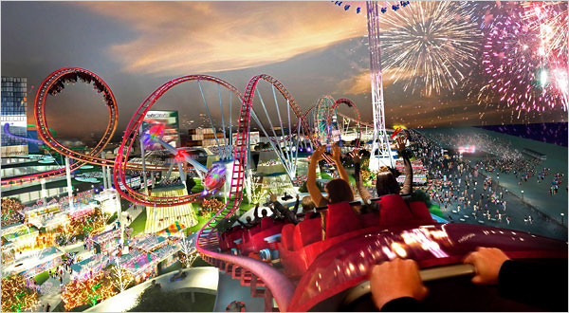
Analyze Description
Examine the language the writer uses to portray a person, place or experience.
Good descriptive writing appeals to the senses through word choice, concrete details, figurative language like similes, and metaphors.
How does description help me visualize people, places and events?

Slide 17
Analyze Description
Identify details in the story that describe what Della and Jim Look like. Cite examples from the text.
How do the details the narrator uses to describe the watch reflect Jim’s character? Cite examples from the text.

Slide 18
Irony: Difference between appearance and reality
Situational Irony: An event occurs that directly contradicts the expectations of the reader, as in the ending of the “Gift of the Magi.”
Verbal Irony: Words that are used to describe the opposite of their usual meaning: “We do our best to preserve civilization here.” (Ironic b/c they are killing people for sport.)

Slide 19
How does description help me visualize people, places, and events?
Coney Island Chorus Girl
Immovable as a setter at the scent of a quail
Della
Jim
Descriptive Details

Slide 20
Do you think the story’s message is Valuable to today’s Readers? Why or why not?

